Slide 1
FGAI4H-I-036-A01
E-meeting, 7-8 May 2020
Source: | Editors
Title: | Updated DEL02.2: Guidelines for AI based medical device: Regulatory requirements (Draft: April 2020) - Att.1: Presentation
Purpose: | Discussion
Contact: | Luis Oala HHI Fraunhofer, Germany | Email: luis.oala@hhi.fraunhofer.de
Contact: | Christian Johner Johner Institute for Healthcare IT, Germany | Email: christian.johner@johner-institut.de
Contact: | Pradeep Balachandran E-health expert, India | Email: pbn.tvm@gmail.com
Abstract: | This PPT contains a presentation of I-036, Updated DEL02.2: Guidelines for AI based medical device: Regulatory requirements.
NOTE – This presentation has been recreated from screenshots of the original presentation online, hence the reduced resolution in some slides.

Slide 2
AI4H Guideline
From Regulations to Application
By Pradeep Balachandran, Luis Oala, Sven Piechottka, and Christian Johner

Slide 3
Target Audience
Developers, Data Scientists
Requlatory Affairs
Quality Managers
(Medical Professionals)
Notified Bodies
Authorities

Slide 4
Proposed Scope of AI4H
Scope of IEC 82304
Software as Medical Device
Scope of AI4H Guideline
Software is product
==
Software is part of product
Scope of IEC 62304
No medical device (but application in healthcare)
Medical Device no enforcement
Medical Device with enforcement

Slide 5
Target
Regulatory Requirements (mostly AI unspecific)
Requirements specific for Medical Applications
Checklist for Verification of Compliance with Requirements

Slide 6
Target Structure
Requirement | Checklist Item | Example, Comment | Reference | Priority

Slide 7
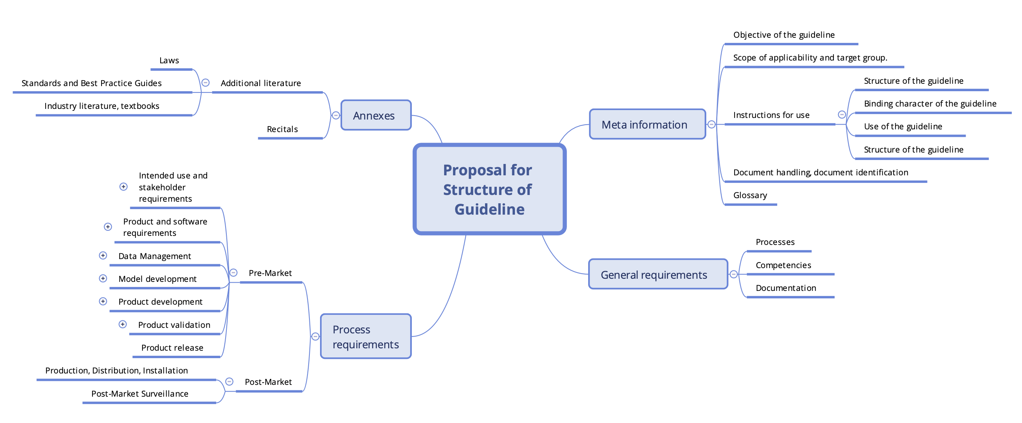
Structure

Slide 8
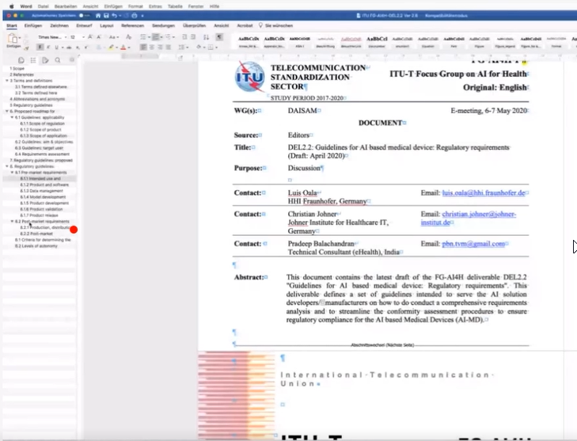

Slide 9
