Slide 1
FGAI4H-I-034-A01
E-meeting, 7-8 May 2020
Source: | Editors
Title: | Updated DEL05.4: Training and test data specification - Att.1: Presentation
Purpose: | Discussion
Contact: | Pradeep Balachandran | E-mail: pbn.tvm@gmail.com
Abstract: | This document contains the draft version 2.0 of the project deliverableFG-AI4H DEL5.4 on "Training and test data specification". This belongs to a set of four deliverables under the umbrella of the deliverable FG-AI4H-DEL05.1"Data specification"

Slide 2
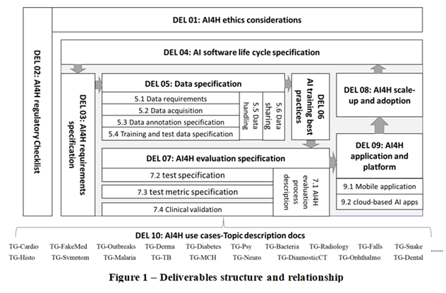
Relationship of TTDS with other AI4H deliverables
Courtesy of Shan Xu Fig. Ref- FG-AI4H-I-029 “ Deliverables structure and summary “

Slide 3
Scope of TTDS document
This document is intended to guide the target audience with a systematic way of preparing technical requirements specification for datasets used in training and testing of machine ML models
This document explains the best practices of data quality assurance during the training and test data preparation phase of machine learning process lifecycle
The training and test data requirement specifications follow the data integrity, data security and data safety norms of the AI data governance lifecycle process

Slide 4
TTDS: Requirements modeling criteria
Objective: To minimize the noise and variance of the input data in order to maximize the performance accuracy of ML model
Verification of data quality aspects related to
reproducibility
completeness
correctness
representation
volume
variety
annotation
labeling consistency
transformation
feature selection
partitioning datasets ( 1.train, 2. validation and 3.test data sets)

Slide 5
TTDS organization
Data acquisition requirements
Data management requirements
Data quality requirements
Data loading & pre-processing requirements
Data visualization requirements
Data transformation requirements
Data feature selection requirements
Train & test data configuration requirements

Slide 6
Next Steps
Before integration of TTDS with its parent deliverable i.e DEL 05 Data Specification
To check for consistency and coverage of requirements in comparison with its sister deliverables ( Data Requirements, Data Acquisition, Data Annotation Specification, Data Handling and Data Sharing)
To validate TTDS with topic groups

Slide 7
Thank you for your time

