Slide 1
FGAI4H-I-030-A01
E-meeting, 7-8 May 2020
Source: | Editors
Title: | Updated DEL10 - Att.1: Presentation
Purpose: | Discussion
Contact: | Eva Weicken | E-mail: eva.weicken@hhi.fraunhofer.de
Abstract: | This presentation contains an overview about the topic groups of the focus group (FGAI4H-I-030 = DEL10).

Slide 2
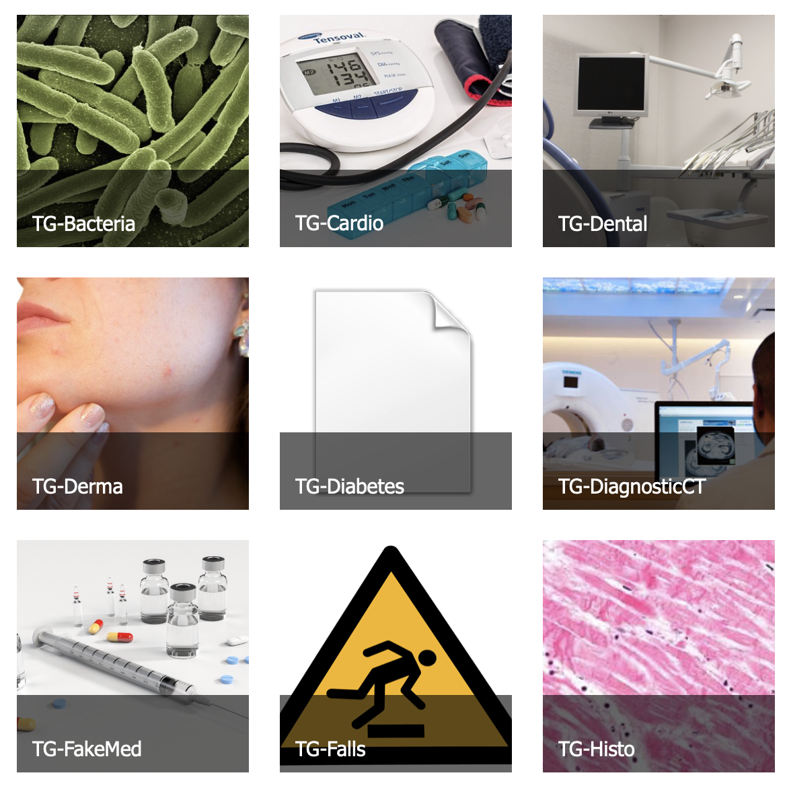
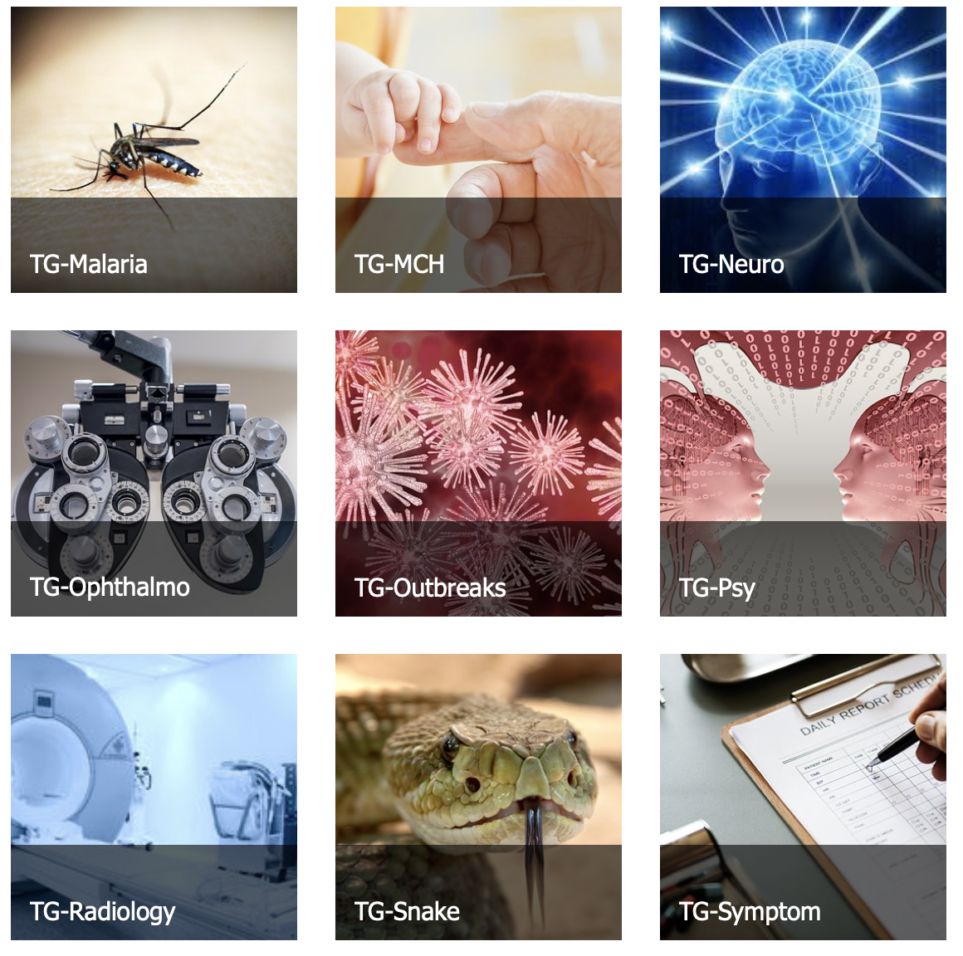
Topic groups by May 2020

Slide 3
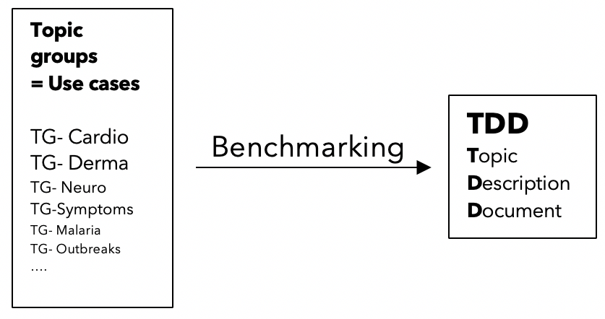
Standardized benchmarking within topic groups
Topic Description Document (TDD) = central document of each topic group
Specific health topic in the context of AI
TDD:
structure
operations
features
considerations of the TG

Slide 4
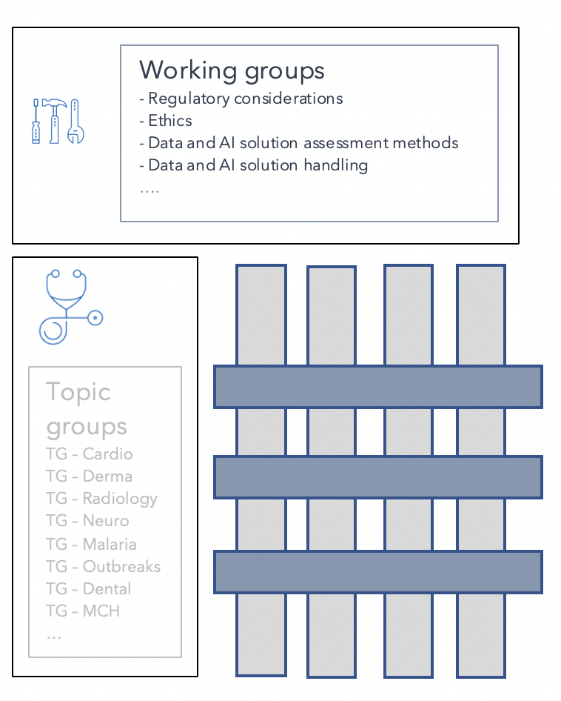
Relation of topic groups / working groups
Working groups: horizontal
overarching themes
Regulatory considerations
Ethical considerations
Data and AI solution assessment method (DAISAM)
Data and AI solution handling (DASH)
Operations
Topic groups: vertical
use cases – special health topics
19 by May 2020

Slide 5
Preparation of the Topic Description Documents (TDDs)
Topic Group10.5 | Status of TDD | Comment
TG-Cardio | DEL 10.1 - Ongoing work | Needs content for subtopic on cardiac image analysis
TG-Derma | DEL 10.2 - Ongoing work
TG-Bacteria | DEL 10.3 - Forthcoming | Starting topic group
TG-Falls | DEL 10.4 - Ongoing work
TG-Histo | DEL 10.5 - Ongoing work
TG-Malaria | DEL 10.6 - Ongoing work | Needs update for subtopic Malaria surveillance
TG-MCH | DEL 10.7 - Ongoing work
TG-Neuro | DEL 10.8 - Ongoing work | Needs update for subtopic Parkinson’s disease
TG-Ophthalmo | DEL 10.9 - Ongoing work
Topic Group | Status of TDD | Comment
TG-Outbreaks | DEL 10.10 - Ongoing work | Needs update for subtopic Dengue surveillance
TG-Psy | DEL 10.11 - Ongoing work
TG-Radiology | DEL 10.12 - Ongoing work | Starting topic group
TG-Snake | DEL 10.13 - Ongoing work
TG-Symptom | DEL 10.14 - Ongoing work
TG-TB | DEL 10.15 - Ongoing work
TG-DiagnosticCT | DEL 10.16 - Ongoing work
TG-Dental | DEL 10.17 - Ongoing work
TG-FakeMed | DEL 10.18 - Forthcoming | Starting topic group
TG-Diabetes | DEL 10.19 - Forthcoming | Starting topic group

Slide 6
Thank you for your attention! Thanks to all contributors: Markus Wenzel, Monique Kuglitsch, Henry Hoffmann, Joachim Krois
If you want to contribute to DEL10, please contact:
eva.weicken@hhi.fraunhofer.de

