Slide 1
FGAI4H-I-026-A01
E-meeting, 7-8 May 2020
Source: | CAICT, PAHO
Title: | Proposal to set up an ad-hoc working group on AI and other digital technologies for COVID-19 health emergency (WG-WE) - Att.1: Presentation
Purpose: | Discussion
Contact: | Ana Rivière Cinnamond (PAHO/WHO) | Email: rivierea@paho.org
 | Shan Xu (CAITC) | Email: xushan@caict.ac.cn
Abstract: | This PPT contains a proposal to set up an ad-hoc working group on AI for COVID-19.

Slide 2
Proposal to set up an ad-hoc working group on AI for COVID-19
Ana Rivière Cinnamond (PAHO/WHO)
Shan Xu (CAITC)

Slide 3
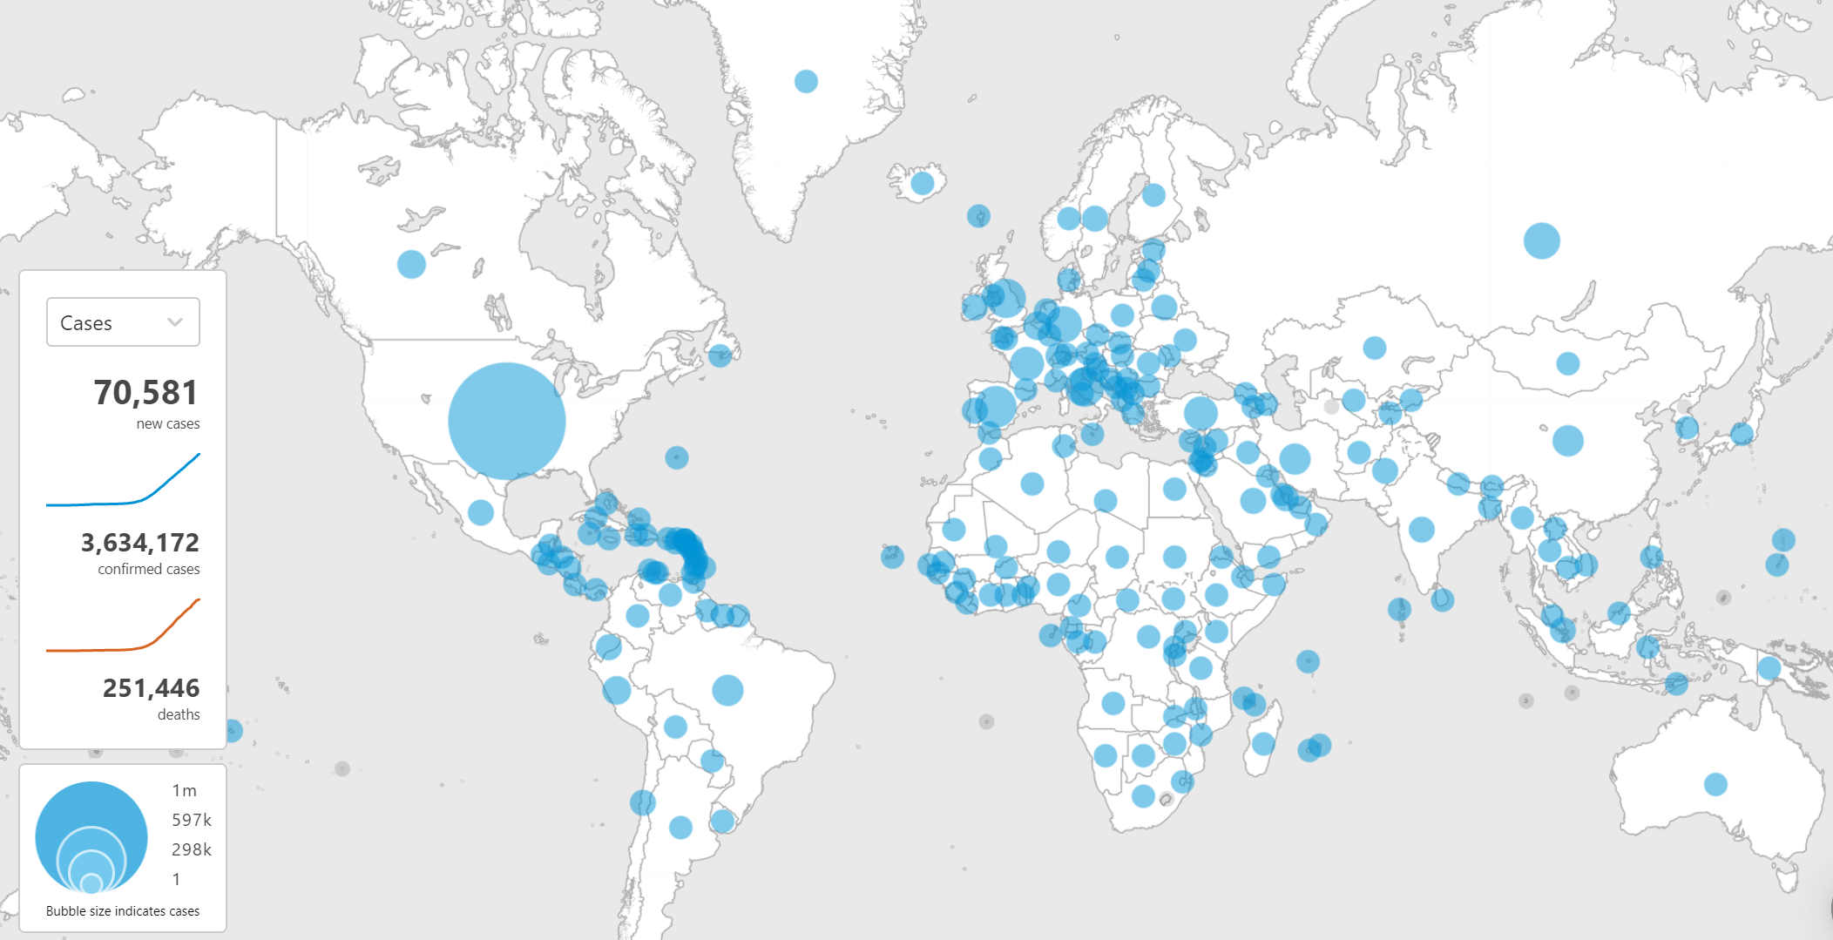
Introduction

Slide 4
Rationale
WHO proposed a collection on anonymized COVID-19 clinical data and built a data platform for COVID-19 clinical data
ITU-WHO released a Joint Statement on unleashing information technology to defeat COVID-19
The World Bank, the International Telecommunication Union (ITU), GSMA and the World Economic Forum launched COVID-19 Crisis Response: Digital Development Joint Action Plan and Call for Action
Extraordinary G20 Digital Economy Ministerial Meeting: COVID-19 Response Statement (Apr 30)

Slide 5
Scope
This ad-hoc working group on COVID-19 health emergency (WG-HE) is aimed at covering the entire cycle of an epidemic emergency, encompassing the following: prevention and preparedness, outbreak early detection, surveillance and response, recovery, rehabilitation, mitigation, etc.
In the short-term, this group will collect effective ways and cases on AI and other digital technologies to combat COVID-19 at the above stages.
In the future, this work could contribute to a general experience on the analytics and scenario setting as a continuous exercise during the emergency cycle feeding each stage and evolve towards a more generalizable mechanism on the health emergency continuum, eventually applicable to other pandemics.

Slide 6
Specific issues
Targeted to COVID-19: With the urgency on fighting against COVID-19 worldwide, this ad-hoc WG focuses on the COVID-19 pandemic.
No conflicts with TG-Outbreak nor with TG-Symptom: The TG-Outbreak focuses on AI solutions on early detection of outbreaks, and this group plans to cover the many stages of epidemic emergency. TG-Symptom focuses on AI solutions to identify possible pathologies based on syndromic description by patients. This ad-hoc WG will collaborate, reuse and share mid or final outputs with the applicable FG-AI4H TGs.
Further research in the future: Collection and collaboration on COVID-19 digital cases are not the only activities of this ad-hoc WG. Further research such as risk assessment, monitoring and evaluation, analytics and scenario setting as a continuous exercise during the above emergency cycle will be conducted. We expect a generalized experience extracted from this COVID-19 work, eventually applicable to other health emergencies.

Slide 7

Facilitating movement restrictions: food and medication delivery, medical follow up, teleworking, home schooling etc.
Lessons learned to inform change: systematizing findings, feeding to policy changes
Prevention
Preparedness
Mitigation
Recovery and rehabilitation
Surveillance
Early detection
Response
Containment
New ways of living: technologies that will facilitate social distancing while allowing to continue with work and personal life
Movement restrictions/ control/ lifting of measures: Contact tracing, facial recognition, PEPP-PT etc.
ethics
TG Symptoms: global syndromic surveillance data availability
Laboratory: improving testing bottlenecks (capacity, timeliness)
AI
at each stage
TG Outbreaks: global monitoring of epi data, media monitoring
Early detection of cases: geolocation, movement, facial recognition etc.
ethics
Clinical diagnostics: speeding triag, diagnostic and treatment techniques (imaging, clinical algorithms)
Analytics: capacity to assess the risk at local, national and international levels (data needs on mobility to quantify possible spread )

Slide 8
Existing work
CAICT (China) best practice reports on digital health cases in the prevention and control of COVID-19 in China: with more 200 digital cases were collected (AI, 5G, Internet, IoT, Virtual hospital, etc.), and the series of reports(V1, V2, V3, V4, EN) started in Jan 2020 is regularly updated.
CAICT’s digital health demand and supply platform: Over 500 companies and enterprises are engaged and published their digital products and solutions on epidemic prevention and control. This platform is now supporting NHC on international supplies supporting for countries.
Technologies for digital contact tracing are being used to monitor how efficiently social distancing measures are being applied across cities/countries. Different techniques have been explored and tools (such as apps) developed, e.g. Google or Waze metadata, Fitbit, Bluetooth and different social media platforms metada, covidApp etc. General concerns include privacy and confidentiality of data, which can be a factor in adoption. Some estimates indicate that digital contact tracing, to be effective, would require adoptions of 60% or more within a monitored population.

Slide 9
Deliverables
Nurture the creation of a network of experts that can be a reference group for addressing the use of AI and other digital technologies for tackling health emergencies such as the COVID-19 pandemic.
Develop a collection of best practice or case collection that can be referenced globally that leverage AI and other digital technologies in combating COVID-19, build suitable mechanisms on sharing these experiences.
Reports on risk assessment, monitoring & evaluation of different digital interventions on COVID-19.
Develop a framework to cover the entire cycle of an epidemic emergency and provide guidance on digital interventions feeding each stage.
Provide, as appropriate and upon request, input to WHO development processes for guidelines on the use of AI and other digital technologies for tacking health emergencies.
Providing guidance for public health considerations on the use of AI and other digital technologies for tackling health emergencies.
Other possible collaboration output within the network (e.g. With Ethics, with Outbreak, with Symptoms, with Xray solutions etc.)

Slide 10
Representations and interactions
Chairs and experts of FG-AI4H
WG and TG members with relevant expertise and interest
ITU and WHO experts
G20 and other international mechanisms
Workshops to include participants from government agencies, academic institutions, NGOs and National Health Committees
Participants in this ad-hoc WG will follow the procedure in Document FG-AI4H-F-105.
FG-AI4H F-105 (Zanzibar, September 2019)), ToRs for the WG-Experts and call for experts and Annex A, Application form; Conflict of interest form

Slide 11
Thank you!
Any question or suggestion?

