Slide 1
FGAI4H-I-023-A03
E-meeting, 7-8 May 2020
Source: | TG-Radiology Topic Driver
Title: | Att.3 – Presentation (TG-Radiology)
Purpose: | Discussion
Contact: | Darlington Ahiale Akogo Founder, Director of AI minoHealth AI Labs | E-mail: darlington@gudra-studio.com
Abstract: | This PPT contains a presentation of I-023-A01.

Slide 2
Topic Group on AI for Radiology
Darlington Ahiale Akogo Topic Driver
Founder, Director of AI
minoHealth AI Labs
darlington@gudra-studio.com

Slide 3
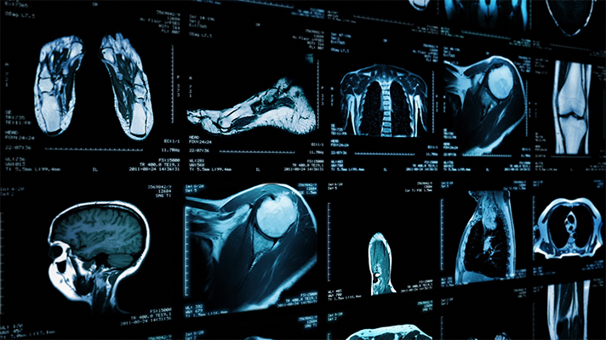
AI in Radiology - Overview
AI systems in radiology have achieved impressive results. They outperformed radiologists in some cases.
Challenge in properly testing AI radiological systems and ensuring they work in all edge and diverse cases radiologists encounter.
Study analysed 31,587 AI healthcare studies, only 69 studies provided enough data enabling calculation of test accuracy. Only 25 studies further did out-of-sample external validations. And further, only 14 of such studies compared the models’ performances to that of radiologists. (Liu et al., 2019)
Standardisation and benchmarking is required.

Slide 4
Objectives
TG-Radiology is dedicated to the development of global standards for the evaluation and benchmarking of AI radiological systems.
We are also collecting diverse data towards the assessment of AI radiological applications.

Slide 5
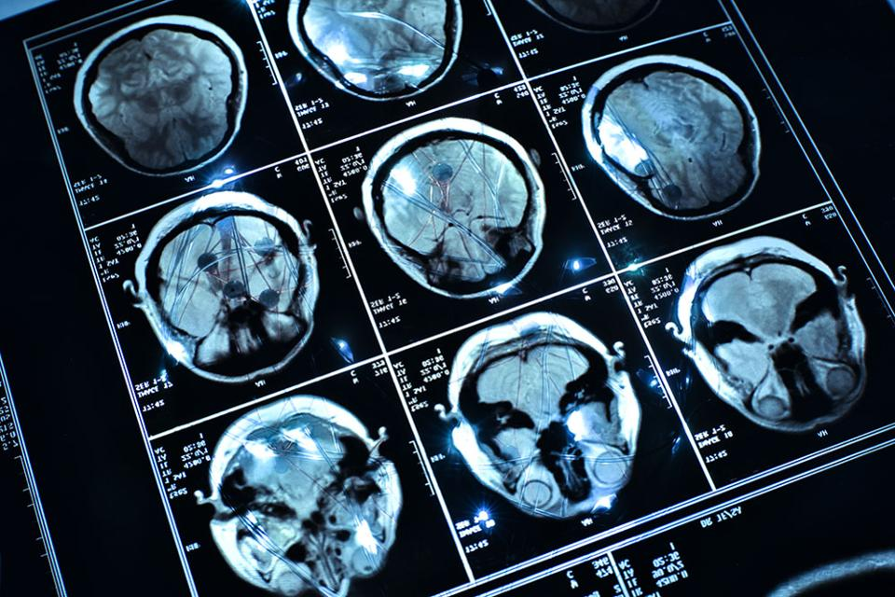
Timeline
21-24​ Jan 2020 - TG-Radiology was officially created at Meeting H, Brasilia
30 Jan - Call for Participants published
25 Feb - First Zoom meeting
Use Case Collection
26 Mar - First TDD submission
Further work on TDD
Updated TDD for ​​9th Meeting

Slide 6
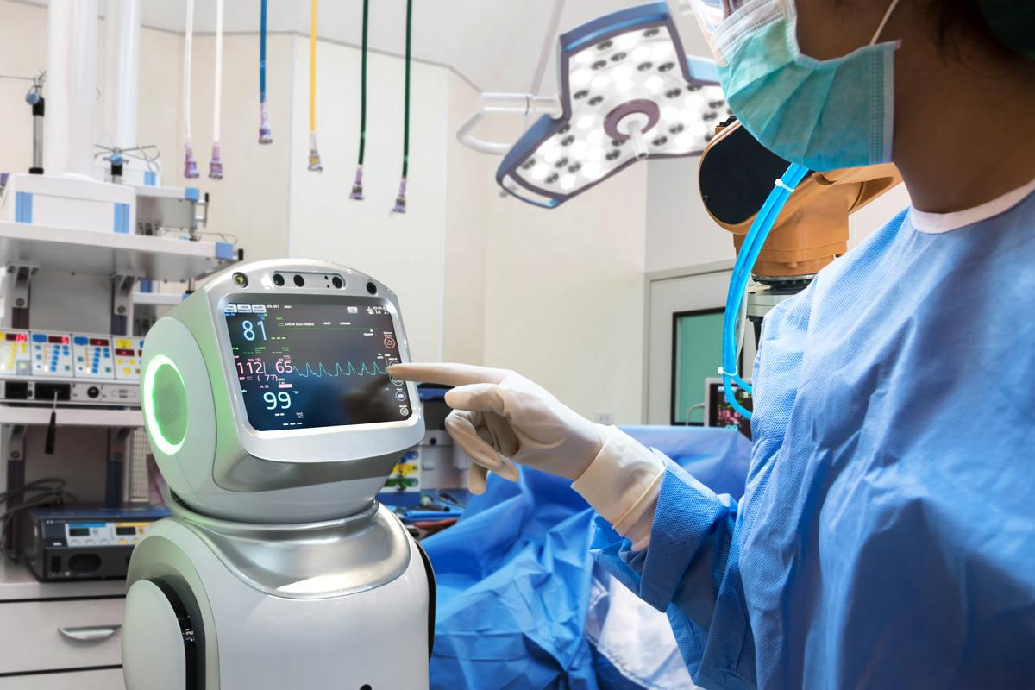
Participants
17 participants currently
From 5 continents; Africa (6), North America (5), South America (2), Europe (1), Asia (3)
11 organisations; AI providers (3), other digital health providers (2), health centers (2), universities (4)

Slide 7
Current Contributors to TDD (10 participants)
Vincent Appiah, minoHealth AI Labs, GUDRA Xavier Lewis-Palmer, minoHealth AI Labs, GUDRA Issah Abubakari Samori, minoHealth AI Labs, GUDRA Benjamin Dabo Sarkodie, Euracare Advanced Diagnostic Center Andrew Murchison, Oxford University Hospitals NHS Foundation Trust Alessandro Sabatelli, Braid.Health Daniel Hasegan, Braid.Health Pierre Padilla-Huamantinco, Universidad Peruana Cayetano Heredia Judy Wawira Gichoya, Emory University School of Medicine Saul Calderon Ramirez, De Montfort University (Metrics deliverable)

Slide 8
Topic Description Document
Topic Description Overview of Radiology, Challenges facing Radiology, Overview of AI in Radiology, Challenges Facing Overview AI in Radiology, Impact of Benchmarking
Existing AI Solutions Use Case Descriptors (9): Condition, Medical imaging modality, AI task/problem description (eg. Image Classification, Image Segmentation), General algorithm description (if shareable), Project goal and current stage (if shareable), Input structure and format, Output structure and format, Evaluation metrics, Explainability and Interpretability framework

Slide 9
Topic Description Document
Existing AI Solutions Use Cases from minoHealth AI Labs and Braid.Health
29 conditions: incl, breast cancer, pneumonia, hernia, arthritis
X-Ray/body part classification: 56 parts: incl, cervix, wrist, lumbar, spine
3+ modalities: Chest X-Ray (22), Foot X-Ray (6), Mammography (1), other X-Ray (56)

Slide 10
Topic Description Document
Existing AI Solutions Algorithms used: Convolutional Neural Networks, Transfer Learning, Bayesian Optimization Input structure and format: 2D image, PNG/JPEG (converted from DICOM) Evaluation metrics: Accuracy Score, ROC curve & Area Under Curve ROC Score, Specificity and Sensitivity

Slide 11
Topic Description Document
AI Input Data Structure Image Conversion Considerations: Table with 3 approaches and their Advantages and Disadvantages Approaches: Integrating an automated conversion programme into AI Software, Using a separate software, Using an online tool
Scores & Metrics Overview on 3: ROC curve and AUC score, F1 Score, Patient Level Accuracy & Image Level Accuracy (Metrics deliverable - Saul Calderon Ramirez)

Slide 12
Topic Description Document
Benchmarking Methodology and Architecture Precision Evaluation framework and platform A radiograph-agnostic benchmarking platform and framework
Assess how well an AI system performs across different demographics (Location, Gender, Age and more)

Slide 14
Next Steps
Collecting additional metrics & scores, developing guidelines
AI Input Data Structure: Overview/Guidelines of various ideal input & modalities (based on use cases)
AI output Data Structure: Overview/Guidelines of various outputs (based on use cases)
Meeting on Guidelines for AI4Radiology COVID-19 Solutions (27th May - TBD)

