Slide 1
FGAI4H-I-022-A03
E-meeting, 7-8 May 2020
Source: | TG-TB Topic Driver
Title: | Att.3 – Presentation (TG-TB)
Purpose: | Discussion
Contact: | Dr. Manjula Singh, ICMR, Under Department of health research, MOHFW, GOI, India | Email: drmanjulasb@gmail.com
Abstract: | This PPT contains the presentation of FGAI4H-I-022-A01.

Slide 2
Topic Group-Tuberculosis
Use of AI for radiographic detection of Tuberculosis
Meeting of ITU-WHO FG4H
May 7, 2020
Dr. Manjula Singh
Scientist E/Deputy Director General,
Indian Council of Medical Research
New Delhi, India

Slide 3
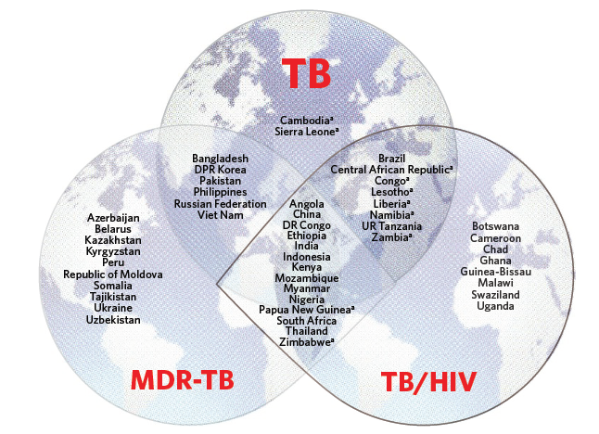
Countries in the three TB high-burden lists
TB is biggest infectious killer in the world
India has the highest burden of TB in the world
WHO/HTM/TB/2016.13

Slide 4
Background
Artificial intelligence technologies, including deep learning (DL) and natural language processing (NLP), draw attention of public health professionals because of its potential to ease the shortfall of health workers.
In India, the quality of TB care varies widely depending on the geographical location and the socioeconomic status of a patient, resulting in delayed or missed diagnosis of active TB cases.
India: approximately one radiologist for every 100,000 population.
Zambia, also one of the high-TB/HIV-burden countries, there are only two radiologists in the country of over 11 million population.
India: To eliminate TB by 2025 and around the world by 2030 can be facilitated by early adoption of AI in TB control program, and successful use of AI in ending TB will help the world achieve goals.
Various AI tools in development in India and there is need to have a robust AI tool with a high sensitivity and specificity which can be used as a screening tool.
This document is intended to propose a benchmark for AI in radiographic detection of Tuberculosis which include data format, desired data for AI training and testing as well as AI performance evaluation methodologies.

Slide 5
Relevance
AI technologies, including deep learning (DL) can be used in places where there is shortage of healthcare professionals.
India has a well-established infrastructure for integration of AI into the Indian health technology infrastructure.
AI has gained a platform in India to enable the scientific community to deal with challenges related to cognitive disorders and social issues through the use of psychological tools & batteries, early diagnosis and better therapies, intervention technologies and rehabilitation programs.
India has conducted mobile TB diagnostic van intervention using X-ray diagnostic vans and sputum microscopy for diagnosis of TB in tribal population which has resulted in increase in detection and reduction in out of pocket expenditure of patients . The AI technique can help in diagnosis of TB cases in difficult o reach areas in India and other low income countries.
Also National TB prevalence survey is being conducted covering 500000 population in entire country using mobile X-rays in field. The AI x-ray diagnosis would be of immense use in field diagnosis of TB and can be used across the globe specially with limited resources and expertise.

Slide 6
Current approaches and Gold Standard for detection
Gold standard for diagnosis of TB is the microbiological confirmation either by culture or CBNAAT.
Sensitivity of the smear microscopy is low and it tends to miss many cases of TB and the availability of the CBNAAT is not there in peripheral areas because of the infrastructure that it requires and lack of expert manpower to run it and of course the high cost.
X-rays are done to further confirm the findings. Therefore role of X-ray becomes more important specially as the triage test to detect the TB cases and moreover, the availability of the X-ray machines in the periphery make is more feasible.
Currently the X-rays are read by the radiologists and co-related clinically. However in resource poor countries use of AI can help in radiographic detection of TB at a very low cost thus making a huge impact in saving lives.

Slide 7
Possible impact of AI on this Topic
Pulmonary TB being an infectious disease has the threat to spread in absence of its timely detection which is a major challenge.
Current diagnostics make it more challenging as many millions across the world are missed by the conventional method.
Use of AI for radiographic detection of TB would have greater public health impact around the world in view of its potential to be used in remote areas for detection
Expected Impact of the benchmarking
Benchmark dataset for the X-ray detection of TB should be representative of not only of one region but the entire world to be robust enough to have >95% sensitivity and preferably 100% specificity.
The benchmarking for the AI tool would help in generating such a dataset which could help in validation of AI tool across the world.

Slide 8
Ethical considerations
Ethical consideration in benchmarking including its data acquisition
Ethical considerations on collection of data and thereafter usage of AI for public health is important.
Major concern is data anonymization. Identifiers must be removed and data used for learning should be confirmed via gold standard tests.
Data acquisition should be voluntary from the cases and their contacts.
Consent of patients for use of the data for development of AI tool must be taken.
Ethical consideration for use of AI tool for public health use:
Radiographic detection of TB using AI to be almost 100% specific and >95% sensitive.
Primary use for screening purposes in remote settings followed by the final diagnosis by other methods.
Patients must be informed of the use of such tools for screening and detection of their disease and their implications.

Slide 9
AI4H Topic group: Current topic group and its mandate
Objectives
to provide a forum for open communication among various stakeholders,
to agree upon the benchmarking tasks of this topic and scoring metrics,
to facilitate the collection of high quality labelled test data from different sources,
to clarify the input and output format of the test data,
to define and set-up the technical benchmarking infrastructure, and
to coordinate the benchmarking process in collaboration with the Focus Group management and working groups.
Output
Primary output of a topic group is one document that describes all aspects of how to perform the benchmarking for this topic.
This Topic Group is for building AI based solution for radiographic detection of Tuberculosis.

Slide 10
Method
AI benchmarking includes input data format requirement and output data, testing data, labelling and testing matrixes
AI Input data
Chest X-Ray images from culture confirmed (Gold standard) cases for AI benchmarking, normal X-rays from various geographic locations, and confirmed Non-TB cases like pneumonia, Bronchitis etc
AI output data structure
AI output of AI tool detecting TB lesion position, area, classification and differentiating from Normal X-rays and Non-TB cases.
Test data labels
For clinical evaluation of AI algorithm, images from confirmed cases of TB to be labelled by Expert panel.
Panel would have at least two experts with more than 10 years of practice in chest radiology. In case of any discrepancy among the two radiologists, the image would be referred to the third radiologist for final decision
All experts would receive prior specialized training regarding how to annotate TB lesions (including cavitary)
For clinical evaluation of cases for AI for radiographic detection of TB, gold standard is the microbiological confirmation of cases i.e either by sputum culture confirmation, CBNAAT confirmation or confirmation by FU
The data set would also include cases from non-TB conditions which would include pneumonia, asthma etc.
Confidentiality of gold standard testing data results would be maintained.

Slide 11
Model development
The model will be developed in following stages -
Stage 1: Building an algorithm that interprets chest plain radiography and detects signs of pulmonary tuberculosis
Stage 2: Building a more comprehensive algorithm that combines imaging and other clinical information to provide more reliable prediction for diagnosis of tuberculosis
Stage 3: Expanding the model to be used in detection of other pulmonary diseases
Each stage will consist of three sub-phases;
Phase 1: Retrospective data collection and model building
Phase 2: Prospective validation and user feedback
Phase 3: Full deployment of the system and continuous improvement

Slide 12
Scores and Metrices
Testing
Dataset comprising of a mix of each confounding variable case test data would be taken and tested against performance of AI.
Initially tool would differentiate normal with an abnormal ones and then TB and Non-TB.
Further differentiation of types of TB like cavitary, military, and lobes affected etc. would be done subsequently
Primary Benchmarking:
Include X-rays from confirmed cases of Pulm. TB, normal X-rays and also X-rays from other non-TB cases. TB lesions detected by AI tool, would be compared with pre-labelled lesions to determine the true positive and false positive.
Benchmarking metrics would include sensitivity of the tool to detect TB cases based on TB lesions and false positives. Specificity would be calculated based on ability of the AI tool to detect identify non-TB cases as Non-TB.
Secondary Benchmarking:
Involves marking the lesion size, area, cavity, classification etc. Early cases of TB can be easily missed if not seen by experienced radiologists.
Therefore, confirmed cases with early lesions in X-rays marked by radiologists from confirmed TB cases would be included to train and test the performances.

Slide 13
Available data sets and undisclosed test data sets
To assess algorithm robustness, sufficient and diversified data from multiple heterogeneous sources (e.g., various types of digital images like, digital and Biochemical films converted to digital, patient demographics like age, sex, socioeconomic status, geographical areas, smokers and other clinical conditions, etc.) needed for testing AI.
Public and real-world undisclosed data would be collected.
Database includes 69000 X-Ray images from a community base TB prevalence survey done in.
Images Collected from various TB studies. (Public and private).
Also include X-ray images from the ongoing National TB Prevalence survey wherein 500,000 x-ray images to be collected from 625 clusters from all the states of the country over a period of one year.
This would cover the geographic differences (rural and urban, plain and plateau etc.), gender, socioeconomic status.
Training data set would be 80% of entire data set and undisclosed test data would be 20 percent of set.
Data set would be from confirmed cases of TB by Gold standard test (microbiological or clinical).
AI tool would be further validated in a prospective manner by the community based and hospital based study wherein the initial diagnosis of a new TB suspect would be given by the AI tool based on X-ray findings which would be further confirmed by radiologists, microbiological tests and clinical follow-up.
A panel of Radiological and Pulmonary experts will examine labelled undisclosed test data to confirm data variance, quantity, heterogeneity, labelling and conformity to ethical and legal requirements.

Slide 14
AI tool development and status
ICMR, under DHR, Govt. of India, currently has large amount of data clinical and Pictorial generated through its 33 permanent Institutes and regional Research centers and also through ICMR funded studies.
ICMR also has extensive clinical expertise in developing AI tool for diagnosis or screening of various communicable and non communicable diseases and is in a position be to lead the study.
We are currently collaborating with Institute of Plasma Research (IPR), Under Govt. of India for the development of the AI tool for radiographic detection of TB. The IPR has vast infrastructure and expertise in developing the tool for the Public health use. They have already developed the tool which can differentiate between TB and normal cases.
Features of AI tool:
The automated tool can automatically detect foot print of Pulmonary Tuberculosis in Chest X ray at a rate of 10 images per minute, can identify different form of tuberculosis; can differentiate normal X ray from abnormal X ray using images of both biofilms as well as dicom version of digital X ray to some extent.
The software also had an added advantage of being cloud independent and can be used in common desktops and laptops.
The process of training of the tool for detection of TB is in process. The tool would further be tested in a prospective study.

Slide 15
Salient features of the strategy to develop AI would be:-
Tool to be trained to identify all possible variant of pulmonary tuberculosis.
Have high sensitivity as well as specificity. Maximum tuberculosis cases should get screened out and no non tuberculosis case be identified as tuberculosis.
Must be able to screen tuberculosis considering all possible variation in subject/chest X ray film as per geography, age, sex, occupation, stage of tuberculosis, quality of image, type of image.
Tool can be used in remote areas with minimal manpower.
Chest X ray films closely resembling tuberculosis but are non-tubercular in nature should ideally be screened as negative.

Slide 16
Reporting Methodology: two staged;
First stage the AI tool would differentiate between Normal and abnormal. Normal cases would be true normal cases and the accurate detection would define specificity.
Second stage: Differentiate between abnormal but TB or Non-TB. This would define the sensitivity of the tool.
Third stage Later on the tool can be trained to detect other non-TB chest lesions like pneumonia, Bronchitis etc.

Slide 17
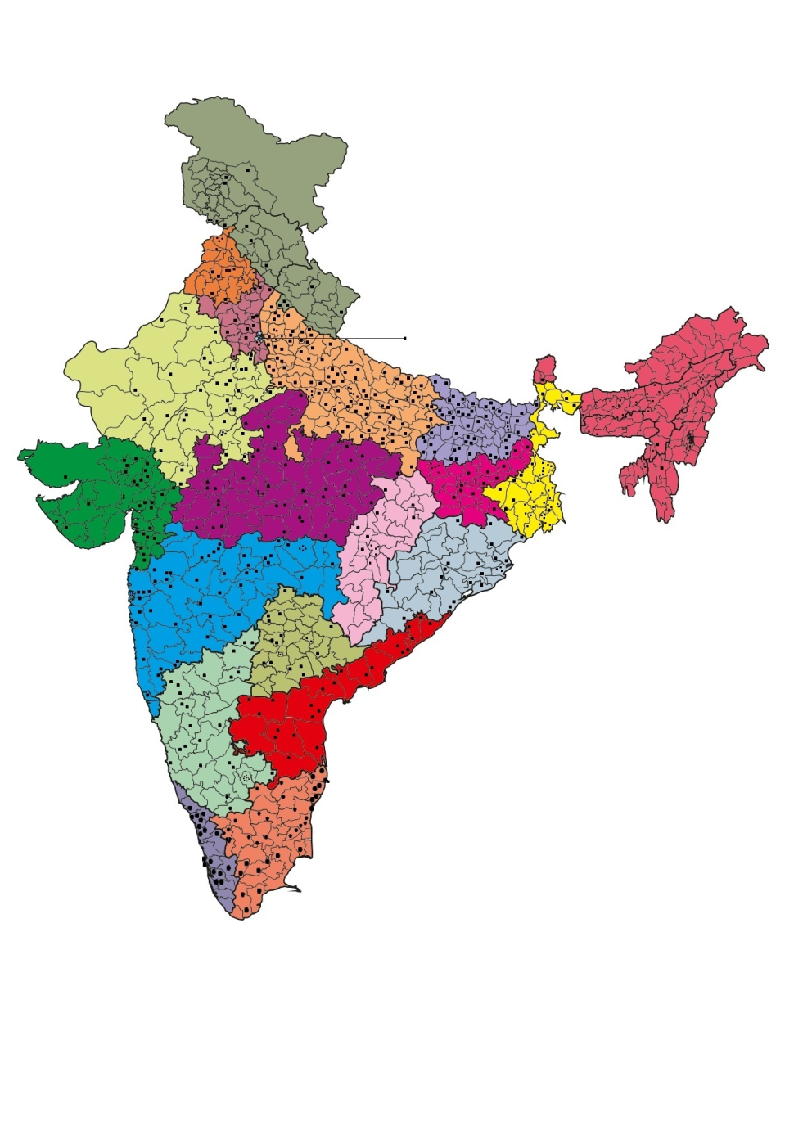
Progress
Figure 1: Map of India depicting survey clusters for National TB prevalence Survey, India
Each dot represents a survey site

Slide 18
Progress cont---
25 state of art buses fitted with Digital X-ray machines and CBNAAT for sputum examinations to collect data from 625 clusters for the survey.
The X-rays being collected are dicom images.
The reading would be done by 2 radiologists for each X-ray. IN case of discrepancy the image would be sent to 3rd radiologists.
The final diagnosis would be confirmed with results from culture, CBNAAT, and clinical examination and subsequent follow up by local health authorities.
Till March 3rd week, about 110 clusters have been completed with about 88000 population being surveyed and X-ray done along with sputum examination for symptomatic cases and for whom the X-ray are abnormal. After that the survey was put on hold due to Covid-19 pandemic

Slide 19
Expected outcome
Development of a Cost-effective AI tool for radiographic diagnosis for early detection of TB
Declaration of Conflict of Interest
None between the developers and collaborators
Progress in terms of collaboration for development of AI tool
Institute of Plasma Research, DoAE, Govt. of India developed the AI tool for radiographic detection of the TB using Chest X-ray.
MOU has been signed and the training of the tool has been initiated on the data of culture confirmed X-rays from previous survey.
Following which the tool would be placed in the survey vans/data from survey vans would be used for the training. However due to Covid-19 pandemic the survey has been put on hold
Collaboration with South Africa, (Under BRICS collaboration):
ICMR and WITS-CAD had MOU for the validation of the AI tool in National TB Prevalence Survey
Tool is well trained and is ready for use. It can work offline to give a diagnosis right in the survey buses.
Tool was to be installed in Buses in last week of March 2020 for testing /validation in first phase. However due to Covid-19 Pandemic the team from South Africa could not visit India and also the survey is put on hold due to Covid-19 pandemic.

Slide 20
Existing AI solutions
There are few AI tools available for radiographic detection or screening of TB. But they have been trained on a limited data set and the entire range of variables have not been covered.
Some of the systems have very low specificity and thus more false negative cases would be detected. These tools tend to fail on the undisclosed data sets.
Therefore there is a need for a standard benchmarking for the training and testing the data sets.
Other AI tools for detection of TB
Tool using cough sounds
Three developers have been working on this and have developed the tool, however are working on training of the tool using more data.
Some are even working on training to diagnose Covid using cough sounds
Still in progress

