Slide 1
FGAI4H-I-021-A03
E-meeting, 7-8 May 2020
Source: | TG-Symptom topic driver
Title: | Att.3 – Presentation (TG-Symptom)
Purpose: | Discussion
Contact: | Henry Hoffmann | E-mail: henry.hoffmann@ada.com
Abstract: | This PPT summarizes the progress made by the topic group on AI-based symptom assessment since meeting H.

Slide 2
Meeting I Update for the
Topic Group “Symptom Assessment”
E-meeting, 7-8 May 2020
Notes:
Hallo,
My name is Henry Hoffmann and it is now my pleasure to present you the update on AI-based symptom assessment benchmarkign on behalf of our Topic Group.

Slide 3
AI-based Symptom Assessment
What is the AI task this TG deals with?
Mobile/Web Applications – sometimes called ”Symptom Checkers” that
Allow users to enter current
Presenting Complaints (coded symptoms, free texts ) (INPUT)
To then engage in a dialog similar to a doctor collecting
Additional symptoms, findings, factors, attributes, (lab, imaging, genetics, …) (INPUT)
To finally provide the user with first advice (OUTPUT)
Pre-Clinical Triage (emergency, see doctor today, self-care … )
Differential Diagnosis (disease A 93%, B 73% - e.g. in ICD10, SnomedCT)
Additional diagnostic tests to perform, treatment advice, explanations
Notes:
Symptom assessment – is about applications, sometimes called „symptom checkers“ that,
Allow users to enter some current symptom they want to get advice for, for instance some sharp abominal pain
To then engage in an AI based diagog, mimicing the doctor-patient conversation to collect further symptoms, factors, attributes …
To finally provide the user with some advice that might be
A pre-clinical triage saying if it is ok to stay at home or if it is important to see a doctor at the same day
Some systems also list some differential diagnoses that might be the underlying causes for the patients symptoms
And the systems might also give further advice for instance on further tests, treatment or just some general explanations

Slide 4
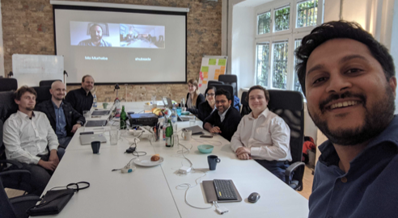
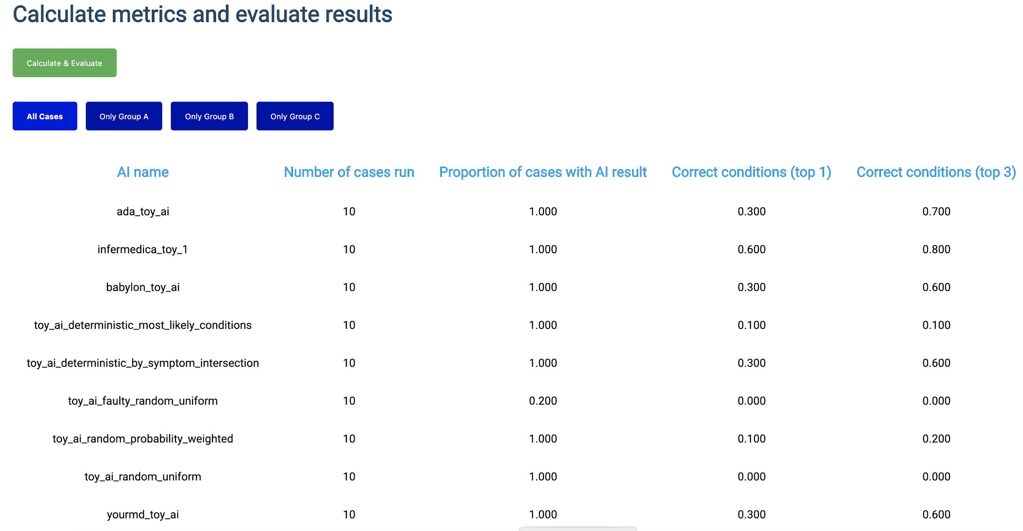
Journey & Approach
What happened so far?
Meeting A – Geneva, 25-27 September 2018
A-020: Towards a potential AI4H use case "diagnostic self-assessment apps"
Meeting C – Lausanne, 22-25 January 2019
Topic Group created
Approach:
MMVB 1.0 … MMVB N.0 → MVB
Meeting F – Zanzibar 2-5 September 2019
First benchmarking with toy AI & toy Data
Minimal Minimal viable Benchmarking
MMVB 1.0
Meeting G, H, I
Gradual increase of complexity
Notes:
Such applications are use by millions of users worldwide
And if done right they can as some kind digital frontdoor to the health systems make the systems more efficient by navigating patients to the right solution at the right time
But, as most AI systems in the focus group there was no standardized benchmarking for such systems yet
An so, right from the beginning in Meeting A we worked on creating such benchmarking
In Meeting C then the current Topic Group was officially created and start its work
We following here a stepwise approach.
As you know there are many companies involved already having internal benchmarking, an so here it is more about agreeing on system that can benchmark all system
For this we need to create a whole new benchmarking system which is much easiert to do if everyone can see and work on all parts of the benchmarking software which is obviously not possible with the real production Ais
Also for debugging it is better to start with small toy model with only a few conditions and symptoms
The idea is then to increase the complexiy step by step, usually in workshops where we agree on the next level of complexity, until we are then ready for prime-time, benchmarking the real Ais with real data
So, we presented a first toy benchmarking at meeting F
And since then are in the phase of stepwise increasing the complexity

Slide 5
Status of the Topic Group
Overview
Topic Group Members:
Companies (14+1):
1DOC3, Ada, Babylon, Baidu, Buoy, Deepcare, Infermedica, Inspired Ideas, Isabel Healthcare, mfine, MyDoctor, Symptify, Visiba Care, xund.ai, Your.MD
Independent contributors (2+4):
Thomas Neumark, Muhammad Murhaba, Pritesh Mistry, Alejandro Osornio, Salman Razzaki, Yura Perov
Sub-Topic Groups
Self-assessment
Clinical symptom assessment
fgai4htgsymptom@lists.itu.int 83 (27 more)
10 Online meetings since meeting H (All with minutes/protocols in SharePoint)
Notes:
The Topic group has now 15 companies, with xund.ai recently joining thats one more than last time
Since last meeting Pritesh Mistry, Alejandro Osornio, Salman Razzaki and Yura Perov joined as individual contributors supporting the group, making it a total 6
We have 2 sub-topic groups
One on Self-assessment
and one on clinical symptom assesment
Currently both sub-topics work together on the first benchmarking
Once this is done we will split the workstreams to take care of the sub-topic details

Slide 6
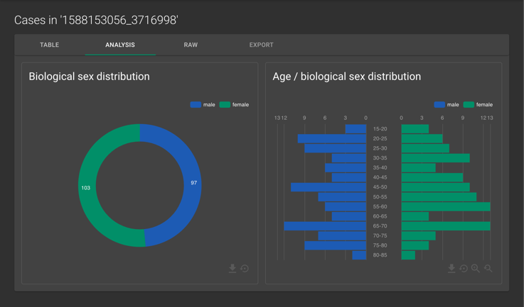
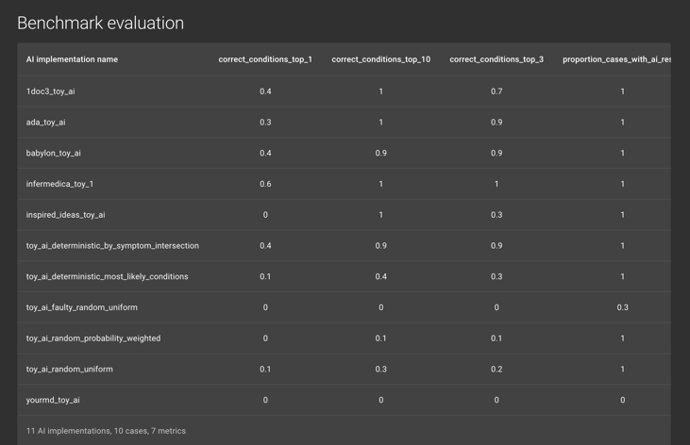
Status of the Technical Work
What we implemented since meeting H
Continued MMVB 2.0 (Berlin Model) Implementation
New dedicated separate frontend application (JS/TS, react, redux, saga, material, …)
New more robust and scalable backend (Python, Django, MySQL, Celery, Redis, …)
First dedicated case creation and annotation tool
All in github
Work on Ontologies
Mapping of Berlin Model to SnomedCT
Integration into the MMVB 2.0 work
Notes:
- On the technical side it was nice to see that we had a little bit more development capacity since last meeting
So we could implement most of the things we wanted to implement
First, the introduction a dedicated new state of the art frontent application fro executing and analyzing the benchmarking
This was important to allow to then add the upcoming more complex analysis and reporting features
Mostly the Babylon team also redesign the benchmarking backend architecture so that is now much more robst and scalable, and thereby coser to the real benchmarking
Now that with the latest model iteration spreadsheets clearly reached their limits, we also create a first dedicated tool for creating and annotating benchmarking data
For both understanding there requirements there better and to test this with the doctors in the group
With Alejandro joining the group after the last meeting, we also could do some more work on ontology mapping than expected.
We found a promissing way of how to use SnomedCT for encoding the benchmarking data and already integrated this in the current interation,
Which is an important step for then scaling it to a larger condition and symptom ontology needed for the real benchmarking

Slide 7
Status of the Non-Technical Work
The non-technical things we did
TDD work
Description of the technical developments
Integration of Baidu‘s details
Meeting I Status Update
Refinement of literature analysis (R01)
Summary of the ontology work (R01)
Clinical Group
Doctors formed a clinical group to work on scores & metrics
Outreach & FG Interaction
Contribution to the revised C105 TDD document template (FG-AI4H-I-004)
Worked with the clinical working group
Refined the FG wide annotation tool idea
Supported with Onboarding
Notes:
On the non-technical side we of couse also contined to work on the TDD
We documented there the latest work in the current benchmarking iteration,
We also integrated recent feedback from Baidu,
There was also some work done on the literature analysis and the ontology mapping, even though it was not in the TDD version from last week yet.
Noteworthy is that inside the group our doctors create some kind of clinical break-out group to work on the scores & metrics systems.
They have their own meeting stream and work on a corresponding document that will then feed into one of the next TDD version
The group was also incolved in some other focus group activities
So we contributed to the update of the TDD template
Worked with the clinical work group
Refined the ideas on focus group wide annotationt tool
And also supported with some focus group onboarding activities

Slide 8
Next Steps
What to focus on until meeting J
Continue MMVB 2.0 (Berlin Model)
Finalization of the new backend, frontend and annotation tool
Implementation of a Berlin model Toy-AI by each TG member
Berlin model case synthesizer
Test of case creation with the annotation tool by the TG doctors
Conduction of the benchmarking on the Berlin model
Reporting tool refinement
MMVB 3.0
Workshop
Ontologies, Authentication
TDD & Outreach
Clinical group works in scores & metrics
Adoption for refined template structure
Notes:
The next steps will involve the
Finalization of current version of the benchmarking frontend, backend and annotation tool in the next two weeks hopefully
Based on this the topic group members can then update their ToyAIs
After building then a new case synthesiser and letting doctors create some benchmarking data
We can then do the benchmarking for the current Berlin model iteration
And then work on reporting tool refinements
Once this is done we will have some kind of workshop where we will then decide on the next iteration – maybe even the last iteration before the real benchmarking
It will probably focus a full scale condition/symptom space with then thousands of symptoms & conditions and the necessary ontology mapping for this
We will of course also continue the work on the TDD, for instance integrating the input from the scores & metrics breakout-group – and also probably adapting the new TDD document structure.

Slide 9
Thank you!
WHO/ITU FG AI4H TG Symptom Assessment
Meeting I
E-meeting, 7-8 May 2020

