Slide 1
FGAI4H-I-018-A03
E-meeting, 7-8 May 2020
Source: | TG-Outbreaks Topic Driver
Title: | Att.3 – Presentation (TG-Outbreaks)
Purpose: | Discussion
Contact: | Stéphane Ghozzi, & Auss Abbood, Robert Koch Institute, Berlin, Germany | E-mail: ghozzis@rki.de abbooda@rki.de
Abstract: | This PPT contains a brief timeline until now, our first survey, and review results.

Slide 2
Topic Group: Disease Outbreak Detection
Stéphane Ghozzi and Auss Abbood
Robert Koch-Institute, Berlin, Germany
E-meeting 7th – 8th May 2020

Slide 3
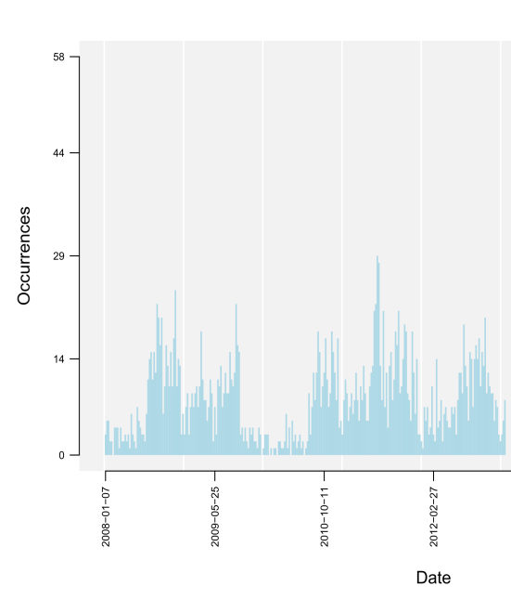
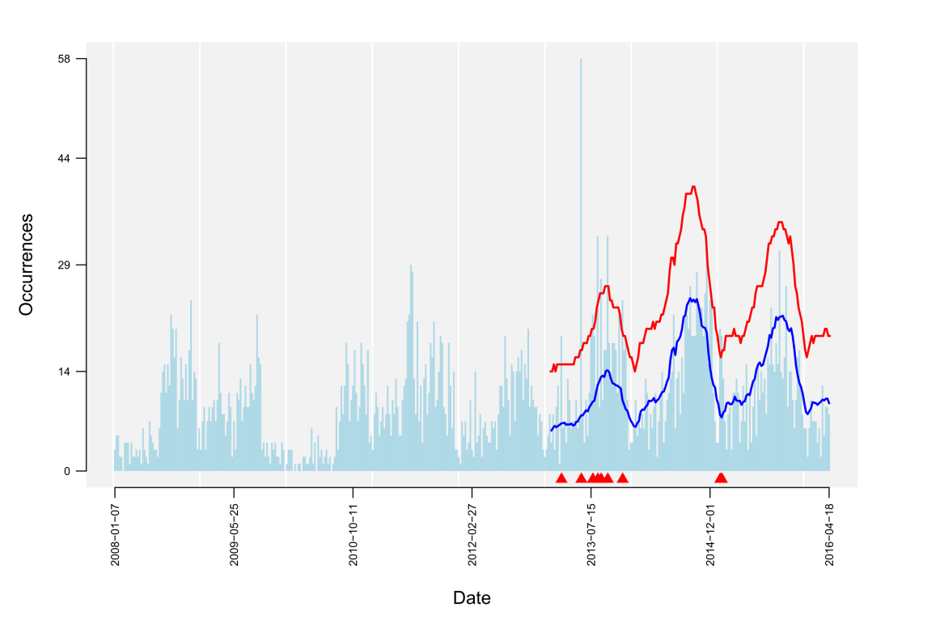
Objective
Data
AI task
warning signal
(spatio-)temporal data (reported cases of infection, symptom counts, etc.)
Detection of aberrant case numbers ( )
hint on potential outbreak event
TG Outbreaks- FG-AI4H
Notes:
Data: time series data (x-axis is the date, y-axis the occurence e.g. counts of reported cases of infection, or also counts of ocurring symptoms)
The blue line corresponds to the expected count numbers according to the previous pattern/ the baseline which includes seasonality, trends etc
The red line gives the upper bound up to which count numbers are still considered to be in the normal range of cases
The AI detects the peaks which show extreme unexpected counts of cases – for which it produces a warning signal

Slide 4
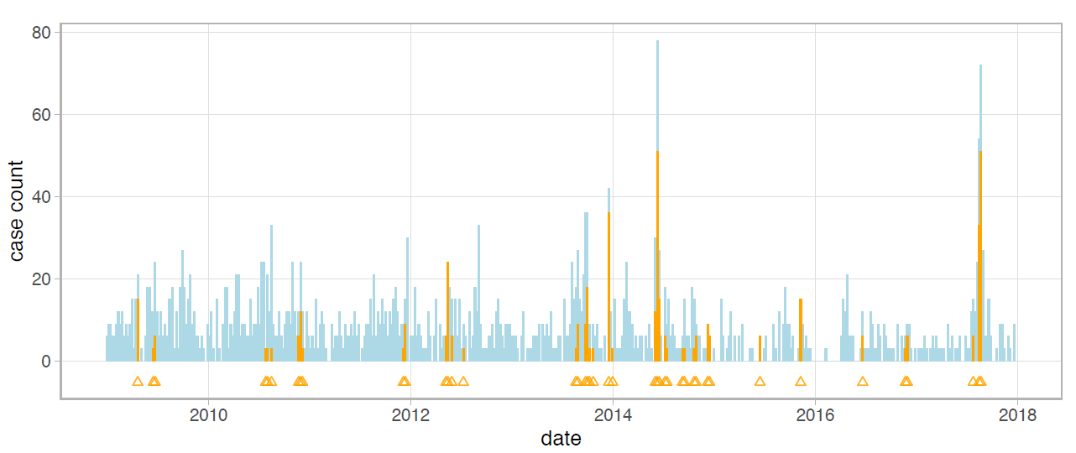
Objective
AI task
warning signal
Detection of aberrant numbers ( )
hint on potential outbreak event
Benchmarking
Test Data: confirmed outbreak labels

Slide 5
Timeline (December)
Conference call held
15 participants joined
Unresolved questions emerged
Simulated vs real data
Data types (temporal and/or spatial and/or molecular information)
Disease types
We identified that there are no participants from the Middle East and Australia (not exhaustive)
TG Outbreaks- FG-AI4H

Slide 6
Timeline (December-February)
Contacted
Almost 90 people
Interested
50 people are interested as of now from almost over 20 organizations and over 15 countries
TG Outbreaks - FG-AI4H

Slide 7
Review
Review on benchmarking of disease outbreak detection
Contains collection of common input data formats
Discusses common algorithms and trends in disease outbreak detection
How to perform benchmarking despite diverging conditions (labeled/not labeled, temporal/spatial resolution…)
Lists outbreak detection specific metrics (scoring timeliness, spatial precision, and outbreak size)
TG Outbreaks- FG-AI4H

Slide 8
Review
Review on benchmarking of disease outbreak detection
Read the review https://extranet.itu.int/sites/itu-t/focusgroups/ai4h/tg/outbreaks/review_benchmark_outbreaks.pdf
Find the literature at https://extranet.itu.int/sites/itu-t/focusgroups/ai4h/tg/SitePages/TG-Outbreaks.aspx
TG Outbreaks- FG-AI4H

Slide 9
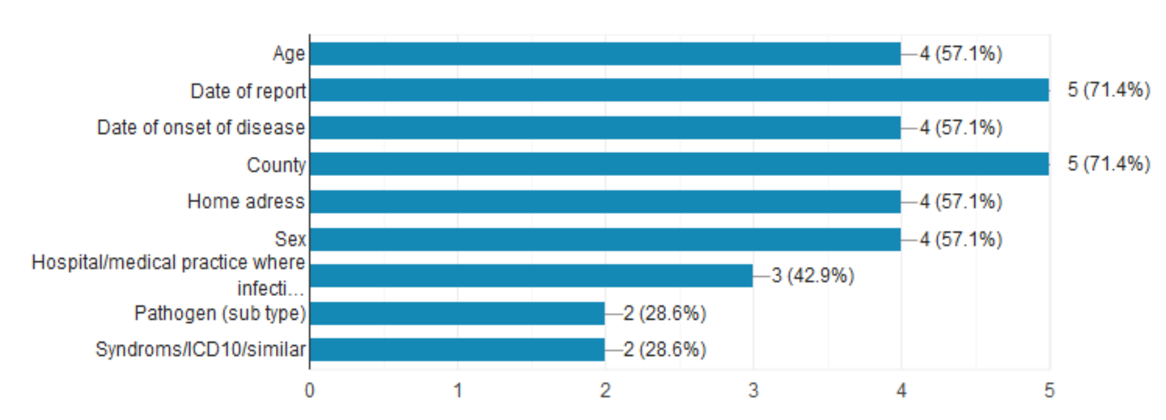
Survey
Data
We held a survey during March 2020 to answer unresolved questions
Seven participants contributed (due to/despite of the pandemic)
TG Outbreaks- FG-AI4H

Slide 10
Survey
Algorithms
Most algorithms reported are described in the scientific literature, and are implemented in open source repositories
Mostly statistical approaches, less so “AI” driven algorithms (which can be facilitated by benchmarking)
TG Outbreaks- FG-AI4H

Slide 11
Survey
Evaluation
Standard model comparisons performance evaluation are done for : Competition-like benchmarking is missing
Good, topic-specific metrics exists that are trusted and tested by practitioners
TG Outbreaks- FG-AI4H

