Slide 1
FGAI4H-I-014-A03
E-meeting, 7-8 May 2020
Source: | TG-Malaria Topic Driver
Title: | Att.3 - Overview of the topic area (TG-Malaria)
Purpose: | Discussion
Contact: | Rose Nakasi Makerere University Uganda | E-mail: g.nakasirose@gmail.com
Abstract: | This PPT summarizes activities and an update to TG-Malaria.

Slide 2
Topic Group-Malaria: AI based detection of Malaria-an update
Rose Nakasi
Makerere University, Uganda
E-Meeting 7th-8th May 2020

Slide 3
Background
Malaria burden in endemic Countries
Accounts for over 3.4 billion cases globally
Lack of enough trained lab technicians
1.72 microscopes per 100,000 population, but only 0.85 Microscopists per 100,000
Gold standard diagnosis(microscopy) challenge
SOP requires not to view more than 30 slides a day
Less diagnosis throughput
Variations in individual expert judgment
AI solution
Supports image analysis and has potential to improve the timeliness and accuracy
There is need to;
Standardise benchmarking AI solutions for the detection of Malaria
Notes:
Why this Topic Group? Context, WHO/ITU necessity
The Global Problem
The opportunity (and the challenge) | What is Symptom Assessment? How might it help?
The case for benchmarking? Why needed?
How the Topic Group can help, what outcomes might feed into

Slide 4
TG-Malaria activities
Quality datasets needed
Have more datasets for training and testing
Well labelled datasets
Solution
AI models and approaches related to malaria detection.
Suggestions on scoring metrics.
Improvements on the benchmarking framework.
Support to the group on different aspects (data, methods, benchmarking, etc.) of this topic
Extension of the solution to improve disease surveillance and prediction.
Heterogeneous Data needed

Slide 5
TG-Malaria Online meetings
Skype meeting with FIND
A need to acquire TG-Mailing list
Getting more members on board
Pave way for collaboration with FIND
Skype meetings with University of France
Discuss benchmarking requirements (data, AI models, Interface)
Discuss technical implementation details
Develop simple models for testing the benchmarking platform
Agree on scoring metrics

Slide 6
Updates since meeting H
Overview
Creation of a TG mailing list at fgai4htgmalaria@lists.itu.int
First Minimal Benchmarking platform developed
Topic Group Members added
Updates in TDD

Slide 7
Interested in Topic Group:
Name | Affiliation
Philippe Verstraete | Co-founder of Milan and Associates, Italy
Laura Moro, | Researcher, science & medical writer. Co-founder of AI Scope, Spain
Dr. Helmi Zakariah. | Cofounder of AIME company, Malaysia
Martha Shaka | Researcher at University of Dodoma, Tanzania
Ana Rivière Cinnamond | Advisor and Pubic Health Expert under Health Emergency Information & Risk Assessment Department with PAHO/WHO.
Rigveda Kadam | Senior Access Officer, FIND, Switetzerland
Seda Yerlikaya | Scientific Officer, FIND, Switetzerland
Herilalaina RAKOTOARISON | PhD student in Machine learning from the Université Paris-Saclay)

Slide 8
Benchmarking
What do we need?
Our first benchmarking attempt required the following;
Inputs
A well annotated dataset of thick blood smear images
AI models to be submitted to the benchmarking platform
Outputs
Performance of AI
Scores & Metrics
ROC AUC
Precision
recall
Average precision
Report
Performance of AI models

Slide 9
Benchmarking malaria system Link
Benchmarking Malaria system-v1:
https://codalab.lri.fr/competitions/748#learn_the_details

Slide 10
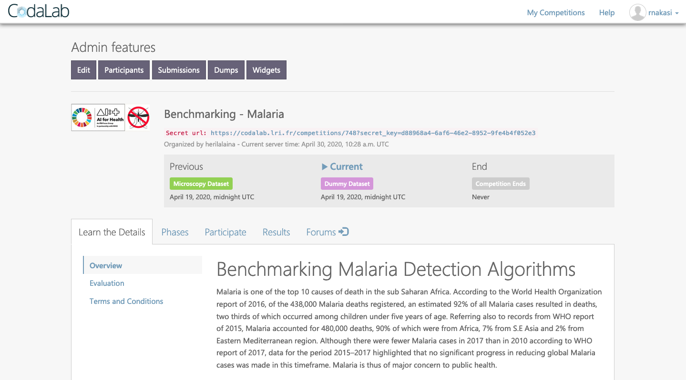
Benchmarking system
Benchmarking-Malaria platform with codalab

Slide 11
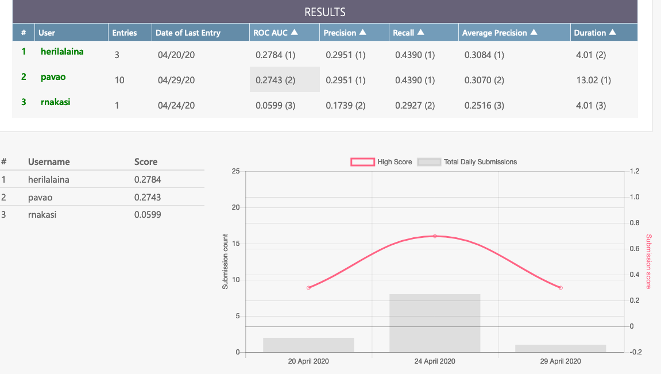
Preliminary Results
Preliminary results from the first TG benchmark platform

Slide 12
Next benchmarking
iterations
We have achieved a first attempt on the benchmarking platform,
Our next set of activities include;
Finding a way to allow participants contribute data through the system.
Allowing for multiple algorithms to be used.
Adding more evaluation metrics that are acceptable for different AI models used.
Need to standardise different datasets to a unified format
A need to acquire secret test data
Different development environments for their developing and executing AI.

Slide 13
Call for participation
Participation can be in form of:
Provision of quality labelled data
AI models and algorithms for benchmarking task on malaria
General support on different aspects of this topic (data, methods, benchmarking, etc.)

