Slide 1
FGAI4H-I-010-A03-R01
E-meeting, 7-8 May 2020
Source: | TG-Dental Topic Driver
Title: | Att.3 – Presentation (TG-Dental)
Purpose: | Information
Contact: | Joachim Krois Falk Schwendicke Tarry Singh | E-mail: joachim.krois@charite.de E-mail: falk.schwendicke@charite.de E-mail: tarry.singh@deepkapha.ai
Abstract: | This presentation is given at the FG-AI4H e-meeting on 07-08 May 2020 and contains background and overview of the TG-Dental activities and outputs since meeting H Introduction of Tarry Singh and deepkapha.ai

Slide 2
Meeting I TG-Dental Update
May 07-08, 2020
Falk Schwendicke, Joachim Krois, Tarry Singh

Slide 3
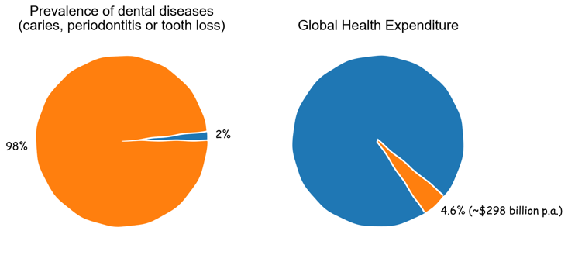
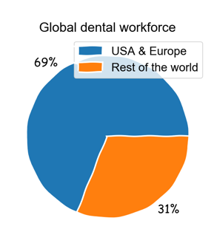
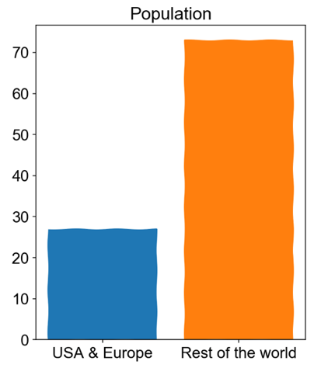
Background and Overview
Relevance and impact
Unequal access to dental services

Slide 4
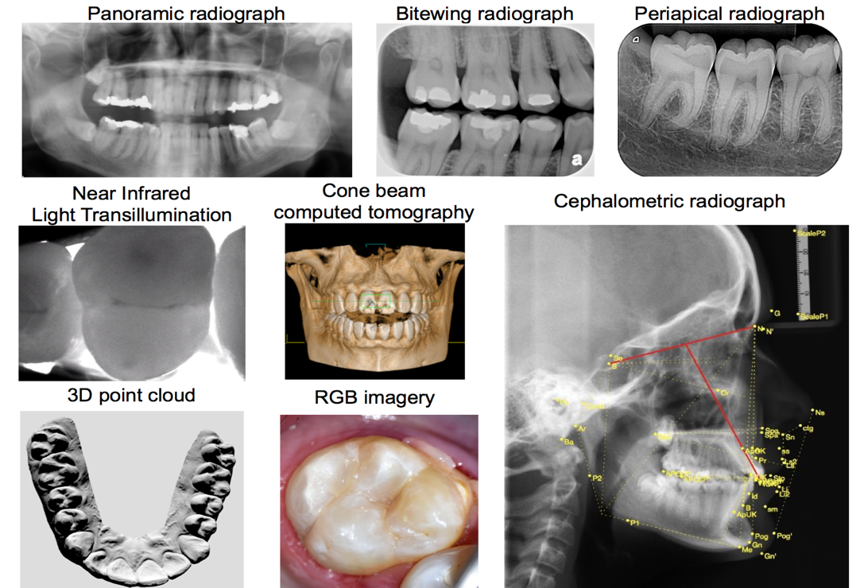
Background and Overview
Data modalities
Imaging
Dental history
Clinical investigation
further physical or (bio)chemical or microbiological assessments

Slide 5
TG-Dental - Topic group history
Meeting G (New Delhi, India)
Applied for new TG
Meeting H (Brasilia, Brazil)
First presentation and outline of AI-based systems in dentistry
Draft of TDD
Introduction (relevance, impact, existing work)
Methods (anatomical structures, pathologies, datasets and AI output data structures, metrics)
Draft of CfTGP

Slide 6
Activities since Meeting H
New contributors joined the TG-Dental
Tarry Singh (deepkapha)
Prof Jae-Hong Lee (Wonkwang University, Korea)
Consultations with key opinion leader from SPIRIT/CONSORT-AI; preparation of dissemination in key dental journals
Article series on dental AI methods and chances in leading journals
Updates on TDD, in particular on section 2, AI4H Topic group
Review and gap analysis, set up of biweekly video calls, defined tools of communications
Updates on CfTGP
Feedback on the TG onboarding experience (tbc)

Slide 7
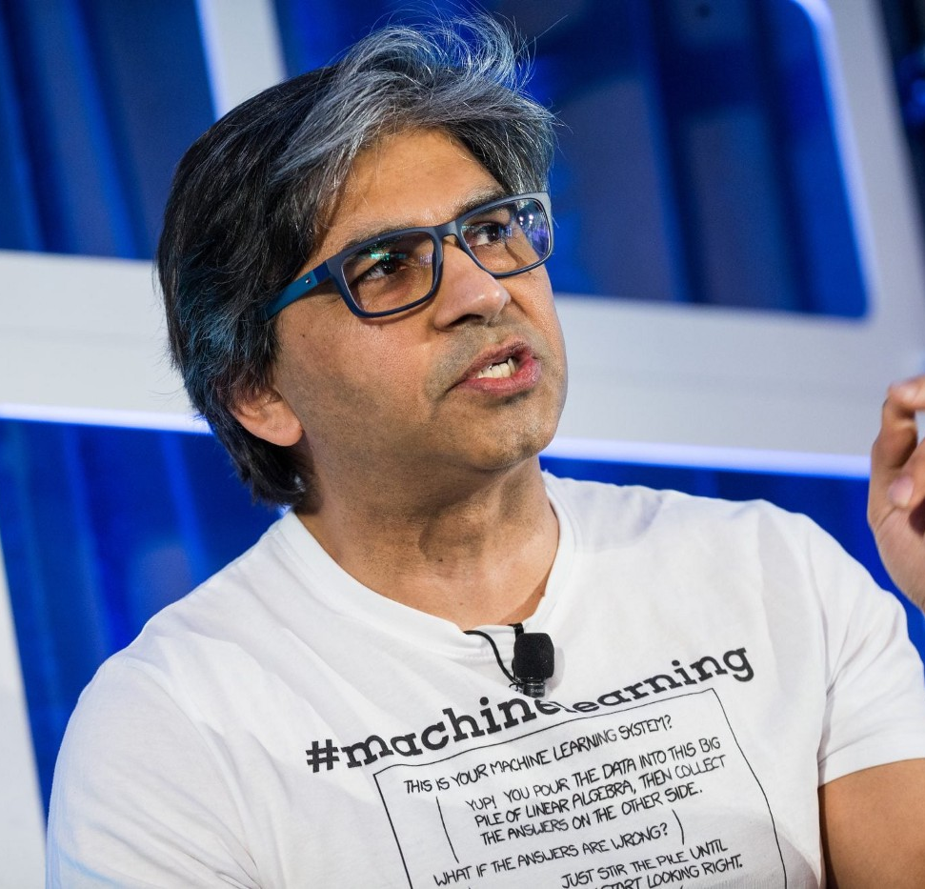
Introduction Tarry Singh
CEO and AI Researcher, deepkapha.ai, curae.ai & Real AI B.V.
Adf Prof & Board Advisor, UTD Dallas, Texas
Recognized Industry leader and AI Pioneer 2020 (link)
AI research related to Dental (2019-)
Development of advanced models and techniques together with Charite Medical College such as training deep learning models with teeth masks/bounding boxes helped with regularization while decreasing false positives. We wish to improve and foresee additional opportunities for improvement with Mask R-CNN models with robust backbones, data augmentation and potential feature engineering.
For more research please visit: link: https://deepkapha.ai/ai-research/
Advanced AI Research in Healthcare (neuroscience, Covid19)
Feasibility Assessment of Artificial Intelligence in Breast Cancer Diagnostics, A SNN/EFRO European Commission Project ,
- Intra-Thalamic and Thalamocortical Connectivity: Potential Implication for Deep Learning (https://www.semanticscholar.org/paper/Intra-Thalamic-and-Thalamocortical-Connectivity%3A-Mei-Singh/772c100d15635c430f0588da95206682c75e1b8a)
Upcoming Covid19 research: Preliminary review of COVID 19 interventions across countries and tool development for Herd/ Group immunity (intended journals: BMJ, Elsevier AI in Medicine, Emerg. Infect. Dis. J., Lancet)

Slide 8
Introduction Prof Jae-Hong Lee
DDS, MSD, PhD, Board certified Periodontist
Associate Professor, Department of Periodontology, Wonkwang University, College of Dentistry, Korea
Dental AI related research project (2019-)
Development and computerized clinical decision support system (CDSS) application of optimization technique of deep learning algorithm for detection and classification of dental implant system. Supported by the National Research Foundation of Korea (NRF) grant funded by the Korea government (MSIT).
Dental AI related papers
Lee JH, Kim DH, Jeong SN, Choi SH. Diagnosis and prediction of periodontally compromised teeth using a deep learning-based convolutional neural network algorithm. Journal of Periodontal & Implant Science. 2018;48(2):114-123.
Lee JH, Kim DH, Jeong SN, Choi SH. Detection and diagnosis of dental caries using a deep learning-based convolutional neural network algorithm. Journal of Dentistry. 2018;77:106-111.
Lee JH, Kim DH, Jeong SN. Diagnosis of cystic lesions using panoramic and cone beam computed tomographic images based on deep learning neural network. Oral Diseases. 2020;26(1):152-158.

Slide 9
Outputs
TDD – Topic description document (FGAI4H-I-010-A01)
Call for Topic Group Participation “Dental Diagnostics and Digital Dentistry” (FGAI4H-I-010-A02)

Slide 10
Next steps
Further advance and discuss the TDD
Preparation of article series on SPIRIT/CONSORT AI (Reporting)
Preparation of checklist/narrative review (Conducting)
Interinstitutional experiment series on AI for dental image analysis

Slide 11
Thank you!

