Slide 1
FGAI4H-I-004-A01
E-meeting, 7-8 May 2020
Source: | Editors
Title: | Updated TDD template - Att.1: Presentation
Purpose: | Discussion
Contact: | Eva Weicken | E-mail: eva.weicken@hhi.fraunhofer.de
Abstract: | This presentation complements FGAI4H-I-004 that contains an updated template for the topic description documents.

Slide 2
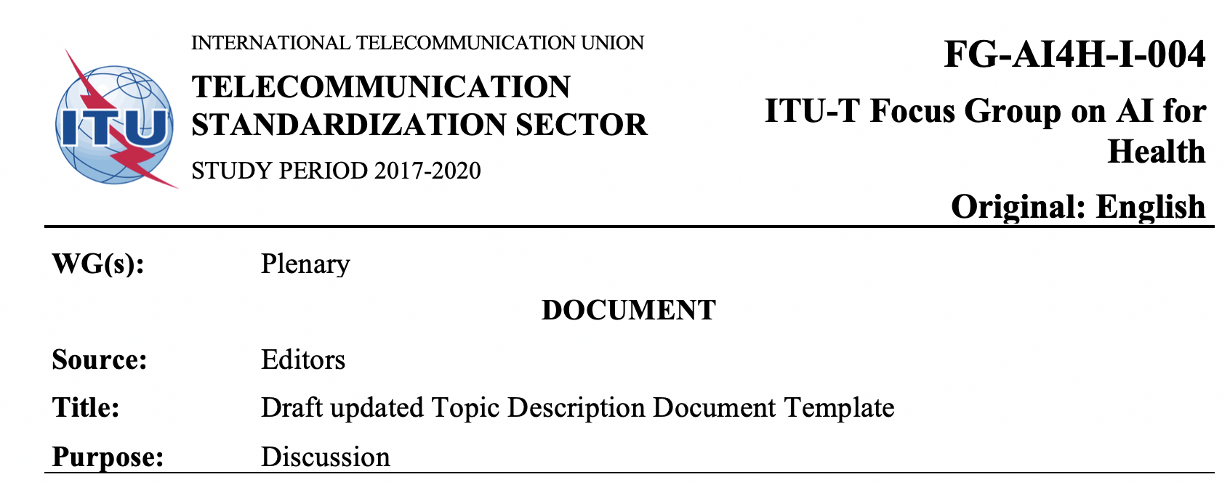
Update: Topic Description Document (TDD) template
Updates first version of TDD template
FG-AI4H-C-105, Lausanne, January 2019
Updates include
Sub-topics in TDD structure
Change notes, mentioning contributors
Restructuring of some sections
Health economics and regulatory section
Lists of figures and tables, glossary

Slide 3
Thank you for your attention! Thanks to all contributors: Markus Wenzel, Monique Kuglitsch, Henry Hoffmann, Joachim Krois
If you want to contribute to DEL10, please contact:
eva.weicken@hhi.fraunhofer.de

