Slide 1
FGAI4H-H-016-A03
Brasilia, 21-22 January 2020
Source: | TG-Neuro Topic Driver
Title: | TDD update: TG-Neuro (Neurological disorders)
Purpose: | Discussion
Contact: | Marc Lecoultre ML Lab, Switzerland | E-mail: ml@mllab.ai
Abstract: | This PPT summarizes the content of H-016-A01 with the TDD for the TG on neuro-cognitive diseases, for presentation and discussion during the meeting.

Slide 2
Meeting H - Topic Group Update Neurocognitive disorders (TG-Neuro)
Marc Lecoultre ml@mllab.ai
Ferath Kherif CHUV/LREN

Slide 3
Overview
This topic group is dedicated to AI against neuro-cognitive diseases.
Co-editor Kherif Ferah
Laboratory for Research in Neuroimaging, Department of Clinical Neurosciences, Faculty of Biology and Medicine, UNIL Centre Hospitalier Universitaire Vaudois (CHUV) (Switzerland)

Slide 4
Received proposals
Provide an empirical basis for testing the clinical validity of machine learning-based diagnostics for Alzheimer’s disease (AD) and related dementia syndromes (defined by DSM V as ‘Neurocognitive disorders’) using real world brain imaging and genetic data
Rename TG-Cogni (Neuro-cognitive diseases) as TG-Neuro "Neurological disorders". The neuro-cognitive diseases use case becomes a sub-topic group within TG-Neuro.
Cover the AI based Parkinson's disease screening and management use case as a sub-topic group within the TG-Neuro (ex TG-Cogni). The sub-topic is led by Khondaker Abdullah Al Mamun (mamun@cse.uiu.ac.bd), AIMS Lab, United International University, (Bangladesh).

Slide 5
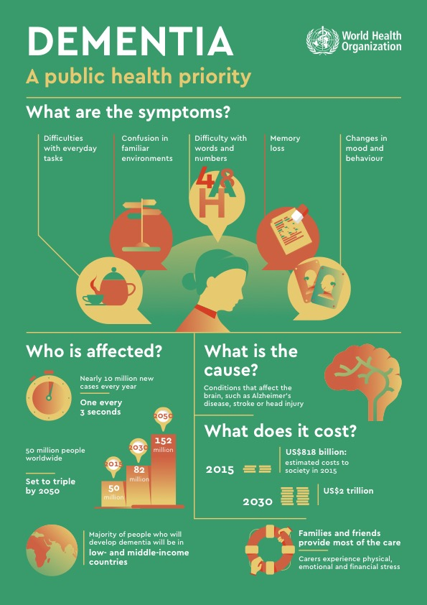
Problem we want to solve

Slide 6
Problem we want to solve
Early-stage detection and classification of neurological diseases using clinical scores, diagnostic, cognitive measures and biological measures (PET, MRI, fMRI, lab results)

Slide 7
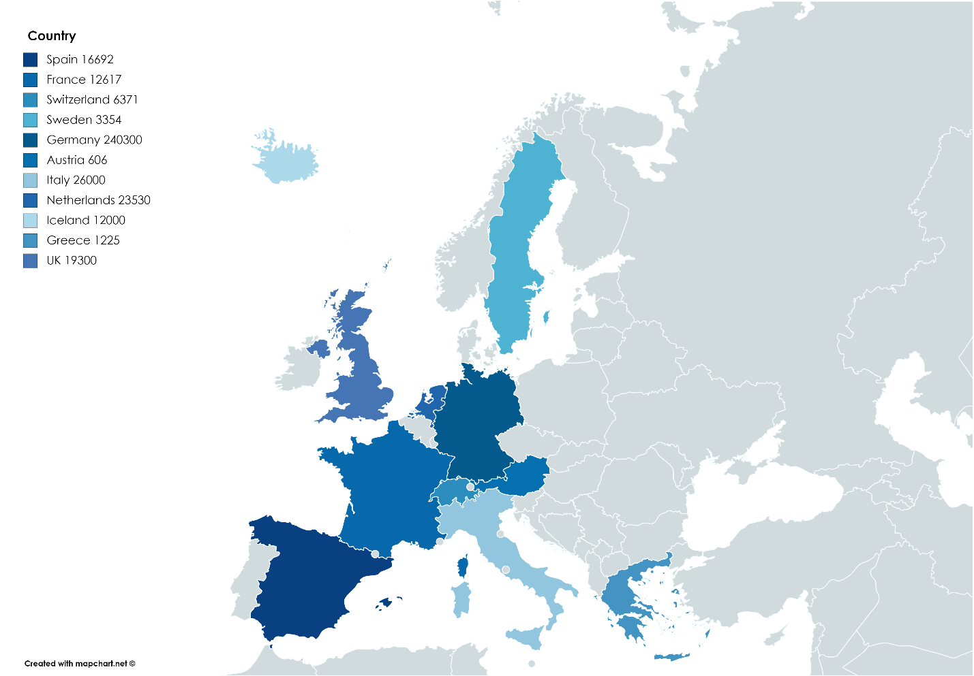
TG Progress : Data catalogue
Identification of new cohorts to be included
Create a catalogue of potential studies that can be included in the future.
++ Protential large datasets
challenges : Harmonization
-- Only in Europe

Slide 8
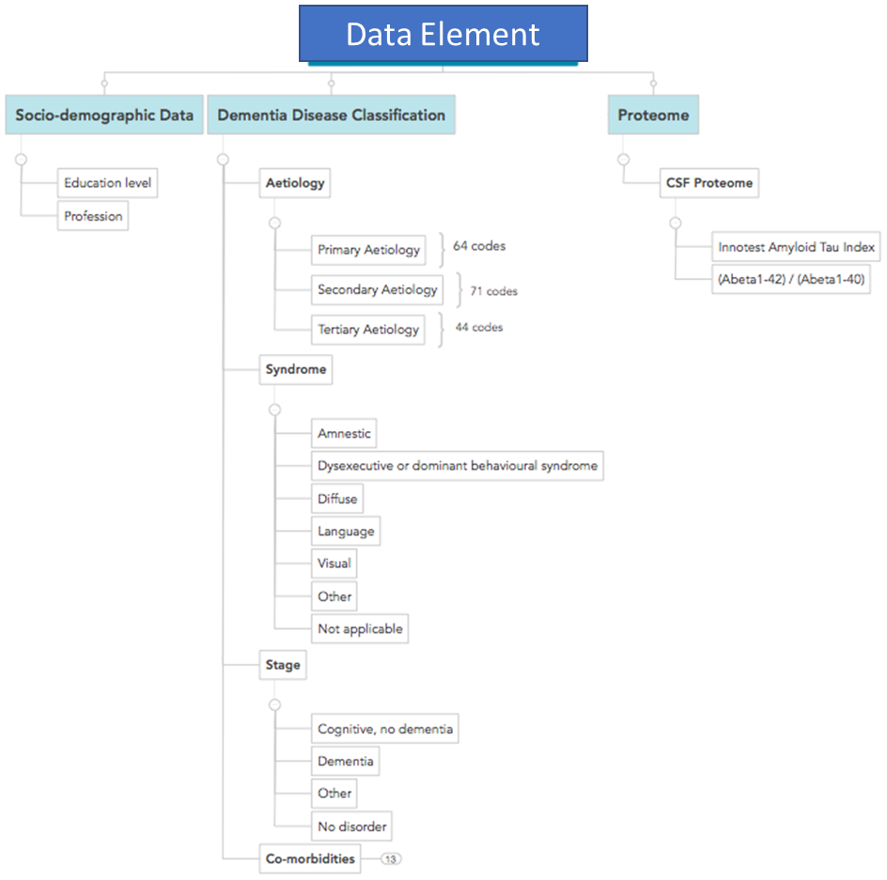
TG Progress

Slide 9
TG Progress
Identification of new cohorts to be included
Create a catalogue of potential studies that can be included in the future.
++ Protential large datasets
challenges : Harmonization
-- Only in Europe
Criteria |  | SUBJECTS NUMEROSITY (baseline)
Type of data Collected | Bio-Bank | 95782
 | Biological | 296963
 | Clinical | 332045
 | Cognitive abilities | 320743
 | EEG | 4000
 | Epidemiological | 360564
 | Genetic | 315910
 | Imaging | 349394

Slide 10
TG Progress
Identification of new cohorts to be included
Create a catalogue of potential studies that can be included in the future.
++ Protential Comorbidities

Slide 11
TG Progress
Members
Requests
From few startups (3).
Data
Improved feature extraction from .data and quality measures.
Meta-data registry
Develop generic tools for data curation, quality control and provenance. Develop, implement and deploy tools to extract brain morphology, genomic, proteomic behavioural and cognitive features from clinical and research databases

Slide 12
TG Progress
Contribution DASH
Data capture:
Distributed sites
data quality
Curation
Standards
formats …
Algorithm:
de-centralized, locally hosted data sets federated platform

Slide 13
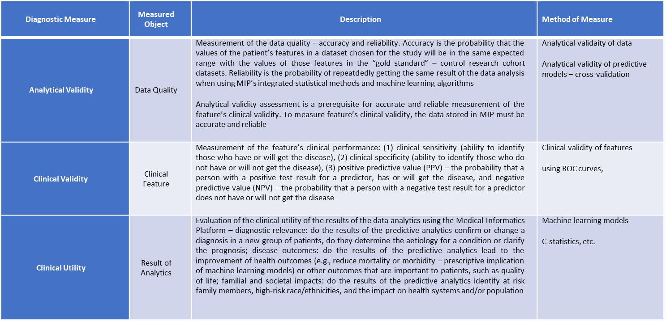
TG Progress Diagnostic Measure

Slide 14
Next steps
Onboard new proposals in the TG

