Slide 1
FGAI4H-H-014-A03
Brasilia, 22-24 January 2020
Source: | TG Malaria Topic Driver
Title: | Overview of the topic “AI-based detection of malaria”
Purpose: | Information
Contact: | Rose Nakasi | E-mail: g.nakasirose@gmail.com
Abstract: | This PPT provides background information that led to the creation of the TG-Malaria and is provided as information to the FG-AI4H participants at the Brasilia meeting.

Slide 2
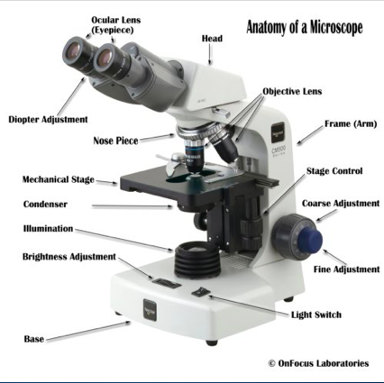
Microscopy Diagnosis
Gold standard for diagnosis of malaria is a microscope

Slide 3
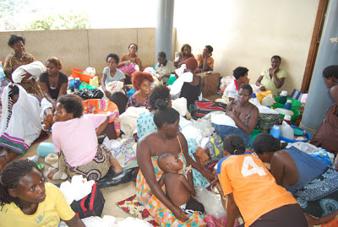
Malaria burden
Currently in Uganda, and many developing countries
Malaria has been reported as one of the leading cause of death accounting for over 27\% of lives of Ugandans
Patient in big numbers wait to be diagnosed

Slide 4
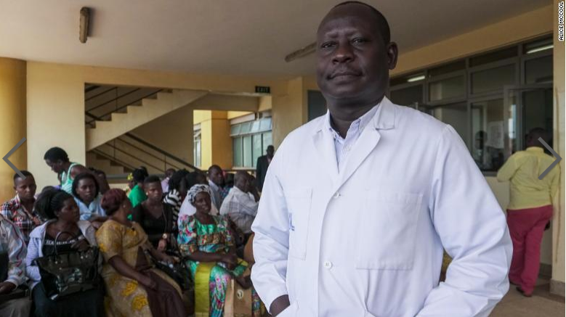
Microscopy challenge
In highly malaria endemic countries;
There is lack of enough trained lab technicians
In Ghana, 1.72 microscopes per 100,000 population, but only 0.85 trained laboratory staff per 100,000 population

Slide 5
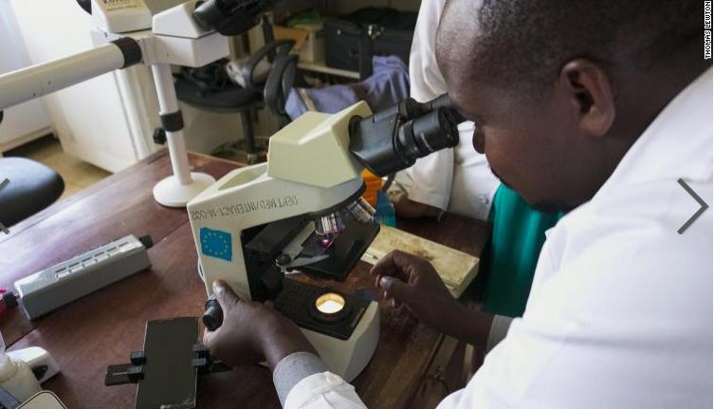
Microscopy challenge
Standard Operating Procedure requires not to view more than 20 slides a day
Microscopy is eye straining
Less diagnosis throughput
Variations in individual expert judgment

Slide 6
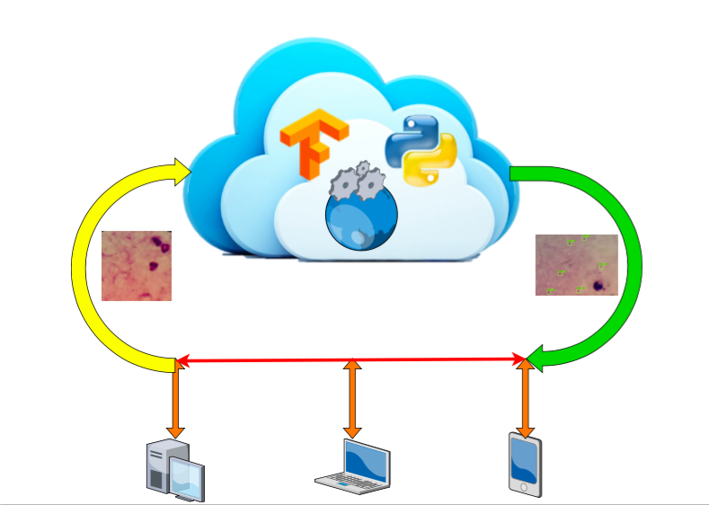
Use case detail

Slide 7
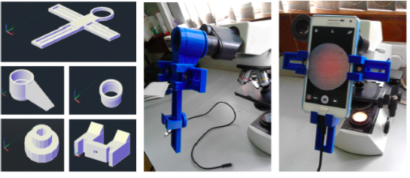
Image capture detail

Slide 8
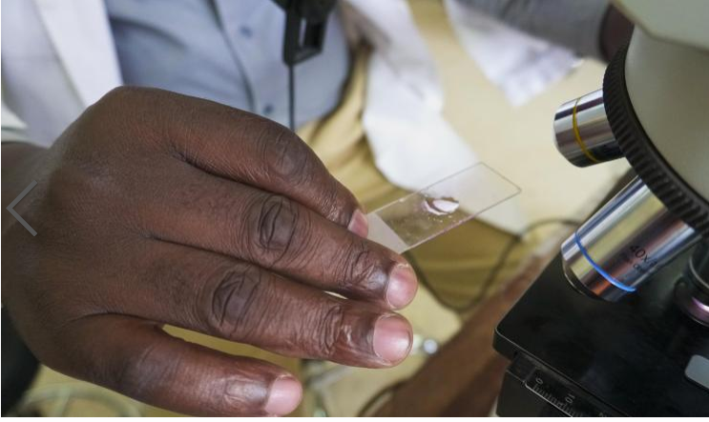
Image capture

Slide 9
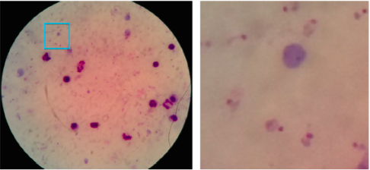
Captured image
1182 images captured by smart phone and 2703 captured by Motic camera.
The blue bounding box drawn around a pathogen
Thick blood smear microscopic image captured with a smartphone

Slide 10
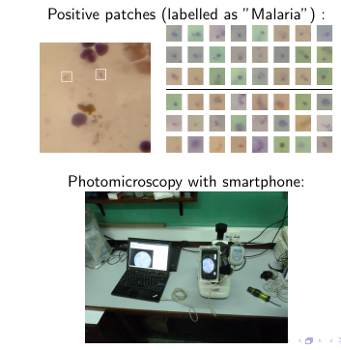
Captured image
Image Annotation by experts-Binary classification task
Expert annotation process

Slide 11
Binary classification
Malaria Positive patches are annotated by drawing bounding boxes around the pathogens in (1182 images captured by smart phone and 2703 captured by motic camera)
Positive patches labelled as "malaria"--TP
Negative patches: anything in the image not labelled as malaria--TN
Used PASCAL VOC format here for annotation as a benchmark

Slide 12
AI APPROACH-Supervised Machine Learning
Approaches for benchmark;
Traditional machine learning(with feature engineering)-Extra Random Tree
Deep learning approach-Convolutional Neural Network

Slide 13
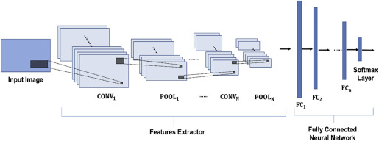
Bench mark deep learning architecture-CNN
AI approach using CNN architecture
https://www.sciencedirect.com/topics/engineering/convolutional-neural-networks

Slide 14
Plasmodium patch detection accuracies
Positive and negative pathogen CNN accuracies
Patch detection accuracies

Slide 15
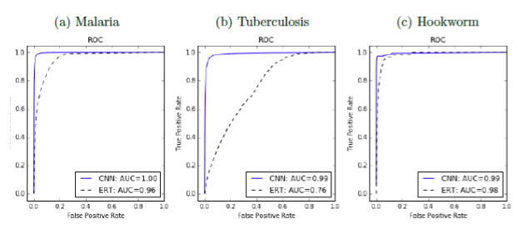
ROC AUC for malaria, TB and intestinal parasites detection
Deep learning accuracies (CNN) VS traditional machine learning (Extra Random Tree(ERT))
CNN VS ERT ROC accuracies for malaria(a), TB(b) and Hookworm

Slide 16
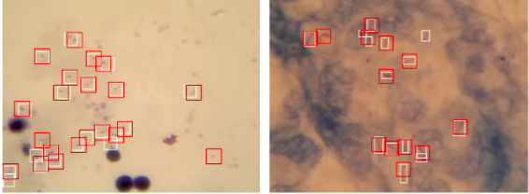
Detected Objects for plasmodium (left) and bacilli(right).
CNN Algorithm performance (red boxes) Vs expert annotation(white)

Slide 17
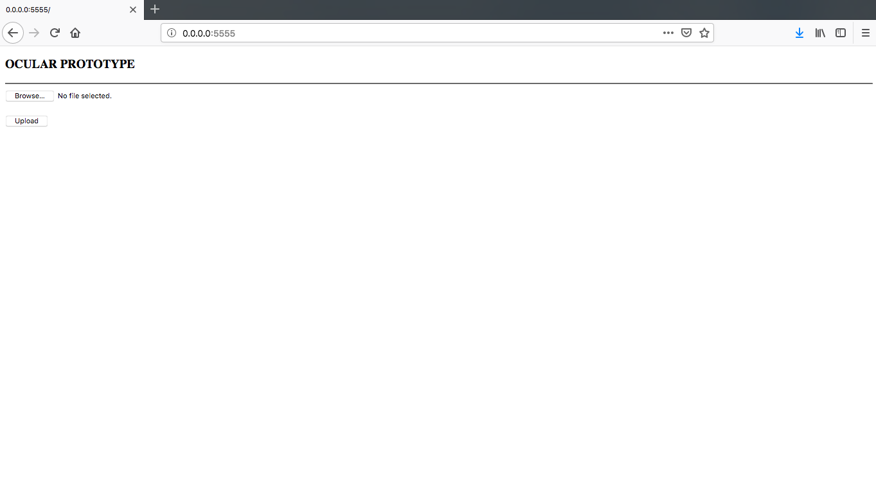
Web based testing prototype
User Interface

Slide 18
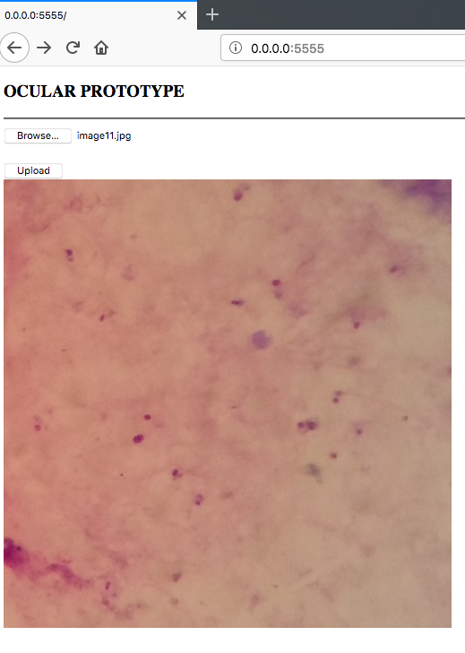
Test image upload
Before detection

Slide 19
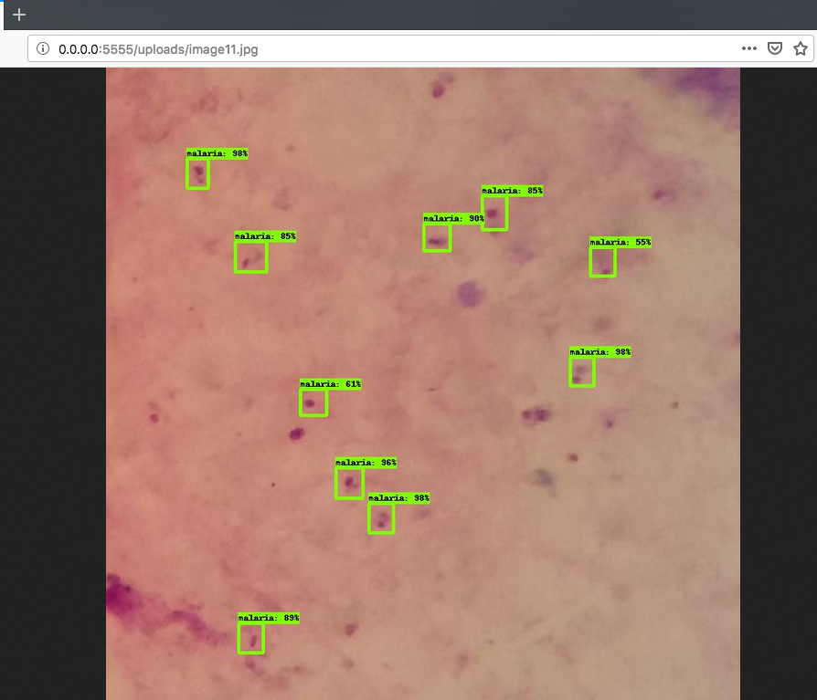
Test image upload
After detection

Slide 20
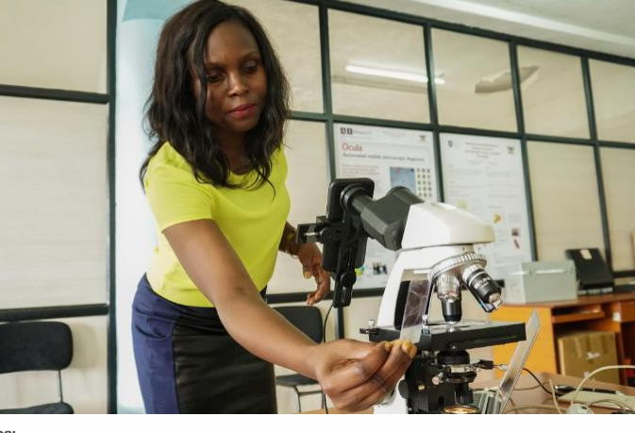
END
Thank You
Rose Nakasi
g.nakasirose@gmail.com

