Slide 1
FGAI4H-H-012-A03
Brasilia, 22-24 January 2020
Source: | TG-Falls Topic Driver
Title: | Att.3 – Presentation (TG-Falls)
Purpose: | Discussion
Contact: | Inês Sousa Associação Fraunhofer Portugal Research – Fraunhofer AICOS Portugal | E-mail: ines.sousa@fraunhofer.pt
Abstract: | This PPT contains an update of TG-Falls presented at the FG-AI4H meeting in Brasilia, 22-24 January 2020.

Slide 2
ITU-T Focus Group on AI for Health
TG-Falls (Falls among the elderly)

Slide 3
Falls Topic Description
Problem
Falls have a multifactorial origin and most factors are amendable
Multifactorial assessment of fall risk factors is recommended but still not widespread in the clinical practice.
Difficulty in combining the multiple parameters in order to differentiate in high risk of falling.
Fall Risk Screening
Prevention

Slide 4
Falls Topic Description
Relevance
30% of 65+ and 50% of 80+ community-dwelling people fall each year.
Falls are one of the most common health related problems in the elderly population, representing more than 50% of the hospitalizations due to injuries.
Direct costs of falls are 25 billion EUR1 in EU and $31 billion2 in USA per year.
Falls are also considered one of the main causes for institutionalization and loss of independence.
¹Hartholt, K, Falls and drugs in older population: medical and societal consequences, Erasmus University Rotterdam, 2011.
²Burns EB, Stevens JA, Lee RL. The direct costs of fatal and non-fatal falls among older adults—United States. J Safety Res 2016:58.

Slide 5
Falls Topic Description
Impact
Artificial Intelligence (AI) techniques can be of great value in generating models that combine multiple sources of data.
Standardize multifactorial fall risk assessment.
Create AI-based tools to easily implement multifactorial fall risk assessment in the clinical practice.

Slide 6
AI4H Topic Group Falls
Participants
Pierpaolo Palumbo, biomedical engineer, post-doctoral fellow at the Personal Health Systems Laboratory, University of Bologna, Italy
Stefania Bandinelli, SOC Geriatria -USLToscana Centro, Firenze, Italy
Barry Greene, Chief Technology Officer, Kinesis Health Technologies, Ireland
Salman Khan, Assistant Professor in the department of electrical engineering, University of Engineering and Technology Peshawar, Pakistan
Rakesh L., Professor Computer Science & Engineering, JITD, India
Ann Hever, R&D Programme Manager, The Irish Longitudinal Study on Ageing (TILDA), Ireland
Kim van Schooten, Human Frontier Science Program Postdoctoral Fellow, Conjoint Senior Lecturer, UNSW Medicine, UNSW Ageing Futures Institute, Australia

Slide 7
AI4H Topic Group Falls
Data Availability
FallSensing: 403 data samples from community-dwelling Portuguese older adults. One year prospective falls, medical data, questionnaires and instrumented functional tests.
Undisclosed data. Data acquisition protocol is published in an open access journal, so it can be easily replicated by peers.
InCHIANTI: Data on prospective falls and instrumented functional tests are available for the last two waves (FU4 and FU5).
The data are generally shared with other research groups on the basis of formal agreements with a non-disclosure clause.
TILDA: dataset could become available in 2021.

Slide 8
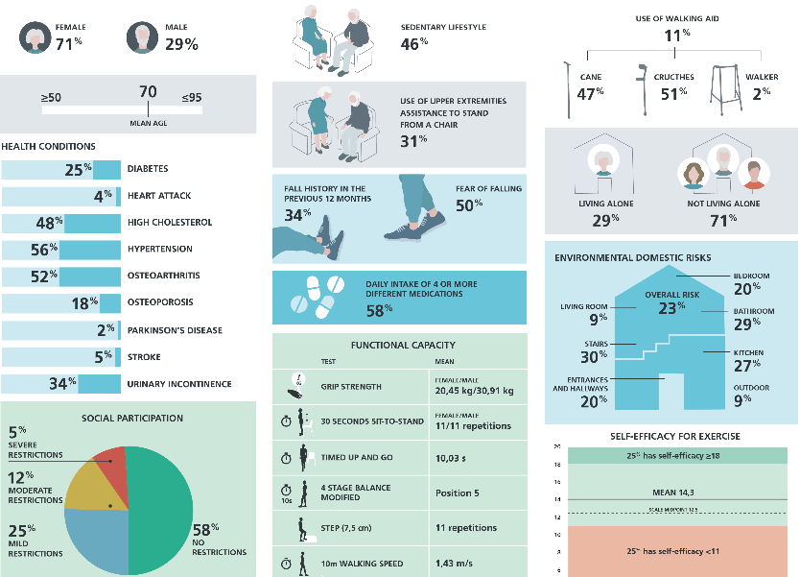

Slide 9
AI4H Topic Group Falls
Questions
The InCHIANTI dataset is generally shared with interested researchers under formal agreements with a non-disclosure clause. The InCHIANTI board keep track of the researchers that have accessed the different versions of their dataset. Furthermore, the waves that could be available for the benchmarking activities of the Focus Group have been shared with a relatively small number of persons. Could the benchmarking framework accept these data (excluding from the benchmark the models coming from researchers that have accessed the data)?
The different datasets are mostly similar but slightly different in terms of available variables. Should we keep all useful variables from both datasets or should we restrict the datasets to the variables that are present in both datasets?
Because of their design, neither FallSensing nor InCHIANTI can be considered rigorously representative of the Portuguese or Italian older population. How do we take this into account?
What is the approximate time schedule of our activities?

Slide 10
AI4H Topic Group Falls
Benchmarking Methodology and Architecture
AI problem formulation - outcomes:
binary classification problem (occurrence of at least one fall in subsequent year vs. non-occurrence of falls in that period)
multiclass classification (first-time fallers after the assessment, recurrent fallers and non-fallers, …)
predicted time until the first fall (in months)
probability of suffering a fall in a given period during the year after the assessment
Possible metrics:
Sensitivity/Recall, Specificity, Precision
Area under the receiver operating characteristic curve (ROC AUC)
Youden's J statistic - Informedness

Slide 11
Next Steps
A systematic assessment of all solutions and studies regarding fall risk assessment is missing;
Quality levels and standards for algorithm evaluation should be defined;
Most datasets available are heterogenous and consider different variables and functional tests, may include data from sensors or not.
Action Points:
Systematize information regarding available solutions for fall risk assessment;
Continue the discussion of the variables to be considered, and methods/best practices for algorithm evaluation;
Discuss with the Working Group how should the Benchmarking Framework deal with heterogenous datasets.

Slide 12
Thank you

