Slide 1
FGAI4H-H-010-A03
Brasilia, 22-24 January 2020
Source: | TG-Dental Topic Driver
Title: | TG-Dental - Att.3 – Presentation
Purpose: | Discussion
Contact: | Joachim Krois Falk Schwendicke | E-mail: joachim.krois@charite.de E-mail: falk.schwendicke@charite.de
Abstract: | This presentation is given at the FG-AI4H meeting in Brasilia, 22-24 January 2020 and contains background and overview of the TG-Dental activities and outputs since meeting G

Slide 2
Meeting H TG-Dental Update
Brasilia, January 22-24, 2020
Falk Schwendicke, Joachim Krois

Slide 3
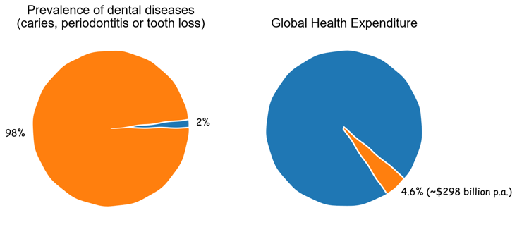
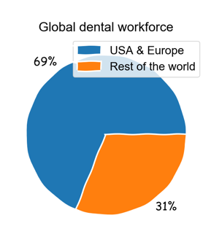
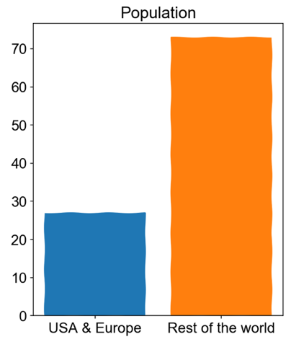
Background and Overview
Relevance and impact
Unequal access to dental services

Slide 4
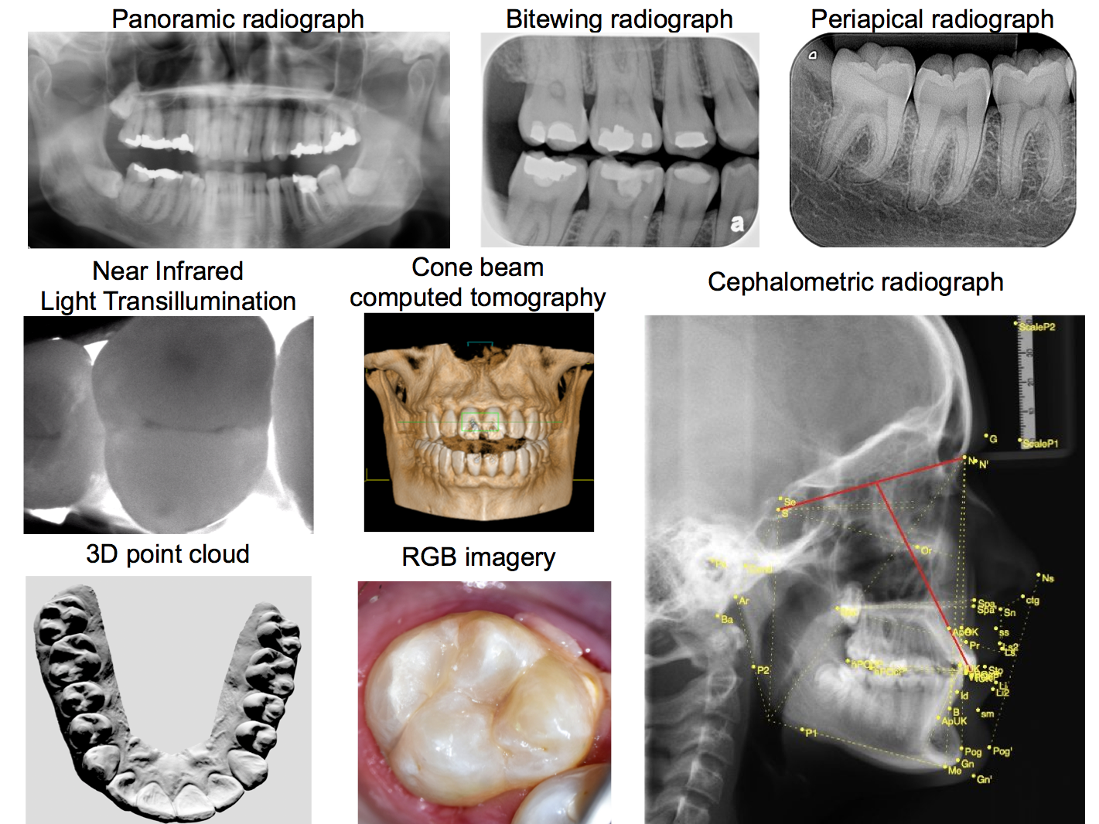
Background and Overview
Data modalities
Imaging
Dental history
Clinical investigation
further physical or (bio)chemical or microbiological assessments

Slide 5
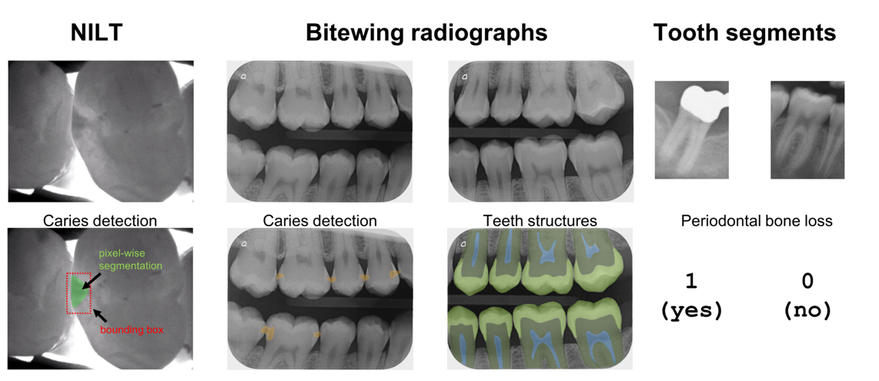
Background and Overview
AI based diagnostics

Slide 6
Publications
Ekert, T., Krois, J., Meinhold, L., Elhennawy, K., Emara, R., Golla, T., & Schwendicke, F. (2019). Deep Learning for the Radiographic Detection of Apical Lesions. Journal of endodontics, 45(7): 917-922.
Krois, J., Ekert, T., Meinhold, L., Golla, T., Kharbot, B., Wittemeier, A., & Schwendicke, F. (2019). Deep Learning for the Radiographic Detection of periodontal Bone Loss. Scientific reports, 9(1), 8495.
Schwendicke, F., Golla, T., Dreher, M. & Krois, J. (2019). Convolutional neural networks for dental image diagnostics: A scoping review. Journal of dentistry, 91, 103226.
Schwendicke, F., Elhennawy, K., Paris, S., Friebertshäuser, P., & Krois, J. (2019) Deep Learning for Caries Lesion Detection in Near-Infrared Light Transillumination Images: A Pilot Study. Journal of dentistry, https://doi.org/10.1016/j.jdent.2019.103260.
Schwendicke, F., Samek, W. & Krois, J. (submitted) Artificial Intelligence in Dentistry: Chances and Challenges. Journal of Dental Research.

Slide 7
Networking and communication
Conferences with focus on Dentistry 2019 10 talks, poster presentations or symposia
IADR Washington, March 17-22, 2020 Symposium: Artificial Intelligence (AI) in Dentistry: From Caries Diagnostic to Beyond
DZT, November 13-14, 2020 Keynote: (working title) AI in Dentistry: The future is ahead of us - Let’s give it a try!
AIDM - Artificial Intelligence in Dental Medicine Established since November 08, 2019 1st elected president: Prof. Dr. Falk Schwendicke

Slide 8
Activities since Meeting G
Newly established TG-Dental
Experienced the onboarding process
Drafting CfTGP
Drafting TDD

Slide 9
TDD – Topic description document
We focused on the following document sections…
1 Introduction
1.2.2 Relevance
1.2.3 Impact
1.4.1 Existing work
3. Method
3.1.1 Anatomical structures
3.1.2 Pathologies
3.2.2 Data sets and format
3.3 AI Output Data Structure
3.5.1 Metrics
… tbc

Slide 10
Outputs
TDD – Topic description document (FG-AI4H-H-010-A01) https://extranet.itu.int/sites/itu-t/focusgroups/ai4h/docs/FGAI4H-H-010-A01.docx
Call for Topic Group Participation “Dental Diagnostics and Digital Dentistry” (FG-AI4H-H-010-A02) https://extranet.itu.int/sites/itu-t/focusgroups/ai4h/docs/FGAI4H-H-010-A02.docx

Slide 11
Next steps
Contact other academic groups in dentistry to join the TG
ML/DL focused
Ethics
Public Health
Economics
Further advance and discuss the TDD draft

Slide 12
Thank you!

