Slide 1
FGAI4H-G-041
New Delhi, 13-15 November 2019
Source: | WG-DAISAM Chair
Title: | WG-DAISAM update
Purpose: | Discussion
Contact: | Pat Baird (Philips) Luis Oala (Fraunhofer) Pradeep Balachandran | E-mail: luis.oala@hhi.fraunhofer.de pat.baird@philips.com pbn.tvm@gmail.com
Abstract: | This document contains an update of the work in WG-DAISAM presented at the FG-AI4H meeting in New Delhi, 13-15 November 2019.

Slide 2

Meeting G Working Group Update DAISAM: Data and AI Solution Assessment Methods
New Delhi, November 13, 2019
Pat Baird, Pradeep Balachandran, Luis Oala

Slide 3
Background and Overview
Assignment From Meeting E
“To establish a WG that comes up with documentation and software tools that can be used to assess the quality of data [and AI solutions]”
Activities
Regulatory review
International Medical Device Regulators Forum (IMDRF) Essential Principles (EPs)
Deliverables
Outputs
Six quality criteria (FGAI4H-G-037)
EPs to AI concepts mapping (FGAI4H-G-038)
Deliverables document (FGAI4H-G-031-R02)
In Other News: Intra-FG Cooperation
DASH/DAISAM Workshop, January 8 & 9, 2019 (FGAI4H-G-025)
What’s Next

Slide 4
Outputs
Six quality criteria (FGAI4H-G-037)
https://extranet.itu.int/sites/itu-t/focusgroups/ai4h/docs/FGAI4H-G-037.docx
EPs to AI concepts mapping (FGAI4H-G-038)
https://extranet.itu.int/sites/itu-t/focusgroups/ai4h/docs/FGAI4H-G-038.docx
https://extranet.itu.int/sites/itu-t/focusgroups/ai4h/docs/FGAI4H-G-038-A01.xlsx
Deliverables document (FGAI4H-G-031-R02)
see our previous discussion

Slide 5

In Other News: Intra-FG Cooperation
DASH/DAISAM Workshop
Invitation: https://extranet.itu.int/sites/itu-t/focusgroups/ai4h/docs/FGAI4H-G-025.docx
Registration: https://forms.gle/JtDtUMWxaMakkSXBA

Slide 6
What’s Next
Workshop
Grow FG wo/manpower and expertise
Feed results into deliverables
Produce first drafts for the deliverables
#4 “AI software life cycle specification”
#5.a “Training and test data specification”
#7.b “AI technical test specification”
#7.c AI “technical test metric specification”
Intensify cooperation with TGs
Loose ends and moonshots
AI4H educational material @Pat and Pradeep
Regulatory delta @Pat and Luis
Assessment platform sandbox @Marc and Luis
Guidance/standards document repository @ Luis and Pat
*
*1st TG-Symptom/DAISAM meeting, October 15, 2019

Slide 7
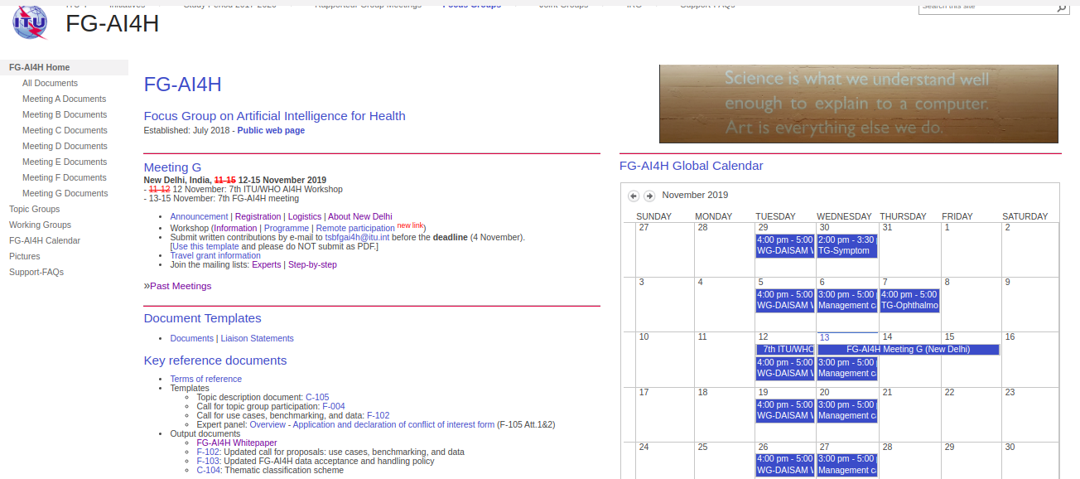
Still awake? Interested?
Join us!
Weekly online meeting 16.00 hrs on Zoom, Geneva time Meeting room: https://itu.zoom.us/j/480325627 (as can be seen in our shiny FG SharePoint, thanks to Markus and Al for setting it up!)
Contacts
Pat Baird | pat.baird@philips.com
Pradeep Balachandran | pbn.tvm@gmail.com
Luis Oala | luis.oala@hhi.fraunhofer.de

Slide 8
Thank you and Namaste!

