Slide 1
FGAI4H-G-040-A01
New Delhi, 13-15 November 2019
Source: | United International University (Bangladesh)
Title: | Proposal for new topic group: AI based Parkinson's disease (PD) screening and management – Att.1: Presentation
Purpose: | Discussion
Contact: | Khondaker Abdullah Al Mamun AIMS Lab, United International University, Bangladesh | E-mail: mamun@cse.uiu.ac.bd
Abstract: | This PPT summarizes the content of G-040 with a proposal for a new topic group on AI based Parkinson's disease (PD) screening and management for presentation and discussion during the meeting.

Slide 2


PVDoctor
Cloud based Virtual Doctor for Parkinson’s Disease Screening and Monitoring
Khondaker A. Mamun, PhD
Founder and Director, Advanced Intelligent Multidisciplinary Systems Lab (AIMS Lab)
Associate Professor, Dept. of CSE, United International University, Dhaka, Bangladesh
General Chair, International Conference on Medical Engineering, Health Informatics and Technology, 2016
Ex. Research Fellow, Holland Bloorview Kids Rehabilitation Hospital & IBBME, University of Toronto, Canada
Email: mamun@cse.uiu.ac.bd, k.mamun@ieee.org, Web: www.cse.uiu.ac.bd/faculty/kmamun

Slide 3

Problem: Parkinson’s Disease
Notes:
A communication device is piece of equipment or hardware designed to move information or data from one place to another, in other words, allowing one computer device to communicate with another. There are many examples of communication devices and we will look at a few below

Slide 4
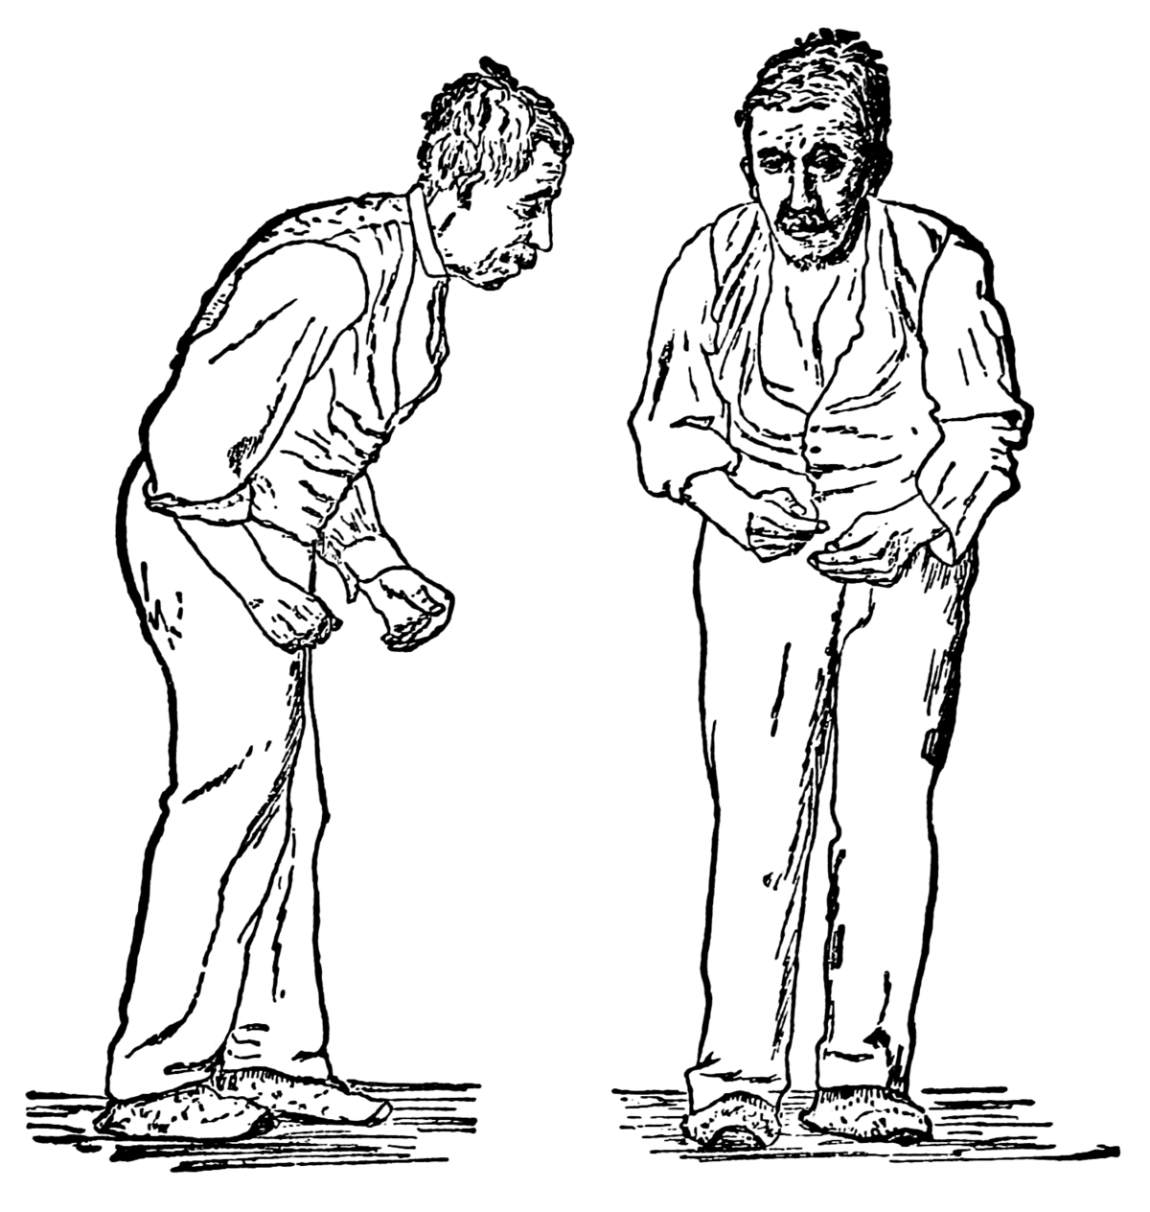
Problem: Parkinson’s Disease
Lacking of awareness on PD in Bangladesh
Mostly effects people over 50 years
  Affects 1% over 50
  10% over 60
  Death in 10 to 15 years
Second most severe neurodegenerative disease
No exact statistics is available
Notes:
A communication device is piece of equipment or hardware designed to move information or data from one place to another, in other words, allowing one computer device to communicate with another. There are many examples of communication devices and we will look at a few below

Slide 5
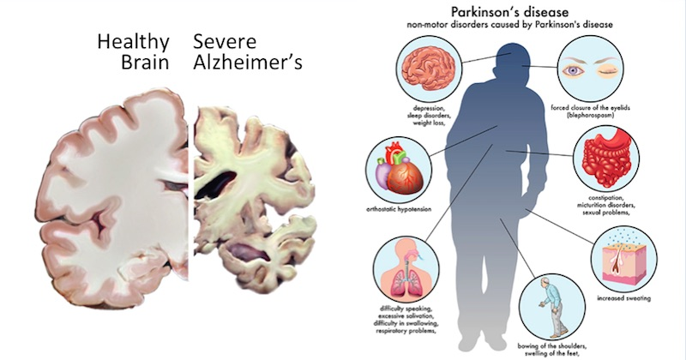
Parkinson’s Disease
Notes:
A communication device is piece of equipment or hardware designed to move information or data from one place to another, in other words, allowing one computer device to communicate with another. There are many examples of communication devices and we will look at a few below

Slide 6
Our Solution:
PVDoctor
Notes:
A communication device is piece of equipment or hardware designed to move information or data from one place to another, in other words, allowing one computer device to communicate with another. There are many examples of communication devices and we will look at a few below

Slide 7
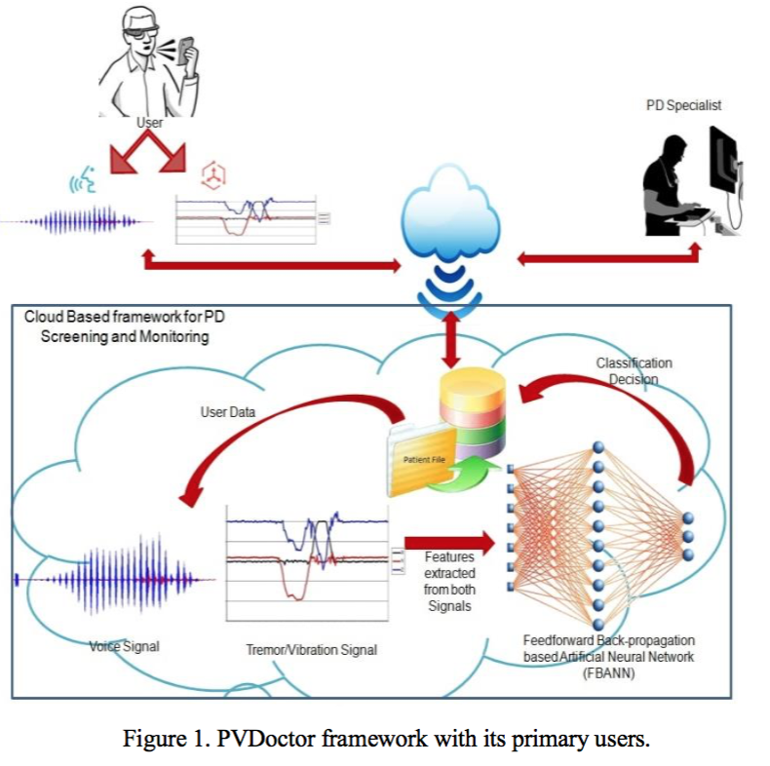
PVDoctor
Figure 1. PVDoctor framework with its primary users.
Notes:
A communication device is piece of equipment or hardware designed to move information or data from one place to another, in other words, allowing one computer device to communicate with another. There are many examples of communication devices and we will look at a few below

Slide 8
PVDoctor
Figure 2. Flow diagram of the cloud based automated PD Screening and Monitoring application.
Notes:
A communication device is piece of equipment or hardware designed to move information or data from one place to another, in other words, allowing one computer device to communicate with another. There are many examples of communication devices and we will look at a few below

Slide 9
PVDoctor: Features
Features
From a recorded voice of user, one of the common symptoms ‘voice disorder’ of Parkinson’s Disease can identified.
User can get to know about their condition by getting a message from the system.
This system also send a list of PD healthcare centers and doctors with their location maps.
In case of absence of nearest help centers our application provides a list of remotely referable doctors.
Notes:
A communication device is piece of equipment or hardware designed to move information or data from one place to another, in other words, allowing one computer device to communicate with another. There are many examples of communication devices and we will look at a few below

Slide 10
PVDoctor: Future Work
Another common symptoms of PD ‘tremor’ will try to identify in future.
Launching a pilot project to assess our application in developing countries like Bangladesh.
Including some more PD tests like spiral test and different image tests to filter the patients with different level of PD.
Notes:
A communication device is piece of equipment or hardware designed to move information or data from one place to another, in other words, allowing one computer device to communicate with another. There are many examples of communication devices and we will look at a few below

Slide 11

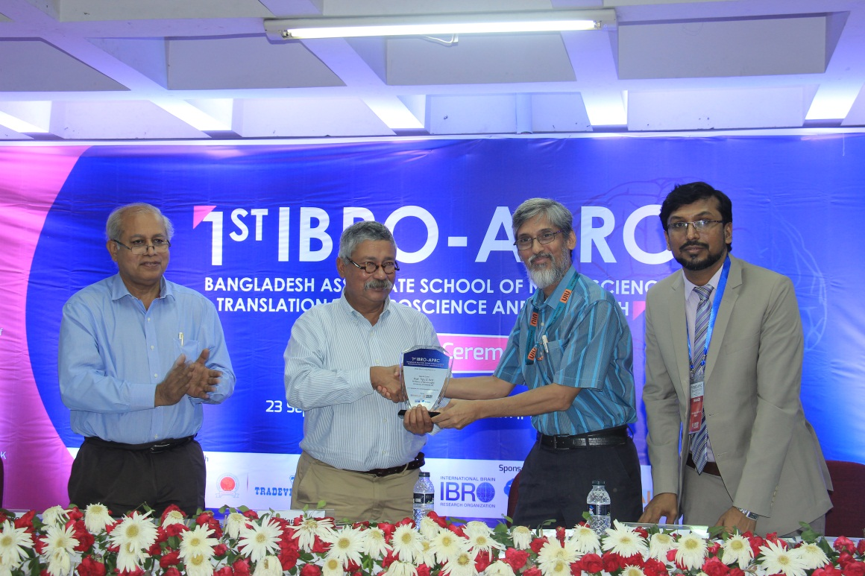
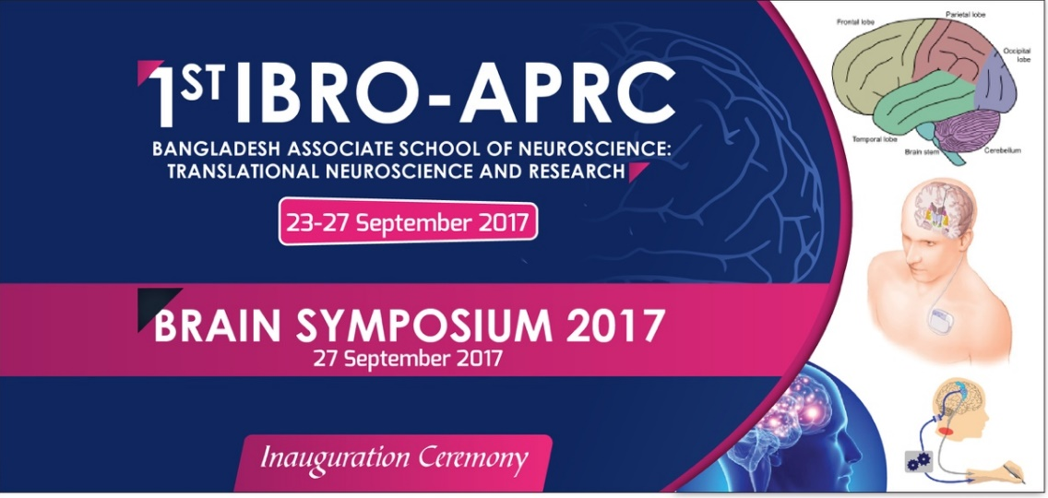
IBRO APRC 2017
First International Neuroscience Conference where neurologist, Neurosurgeon and Biomedical Engineers are joining together to work on neurological disorder, neuromodulator and neural interventions.

Slide 12

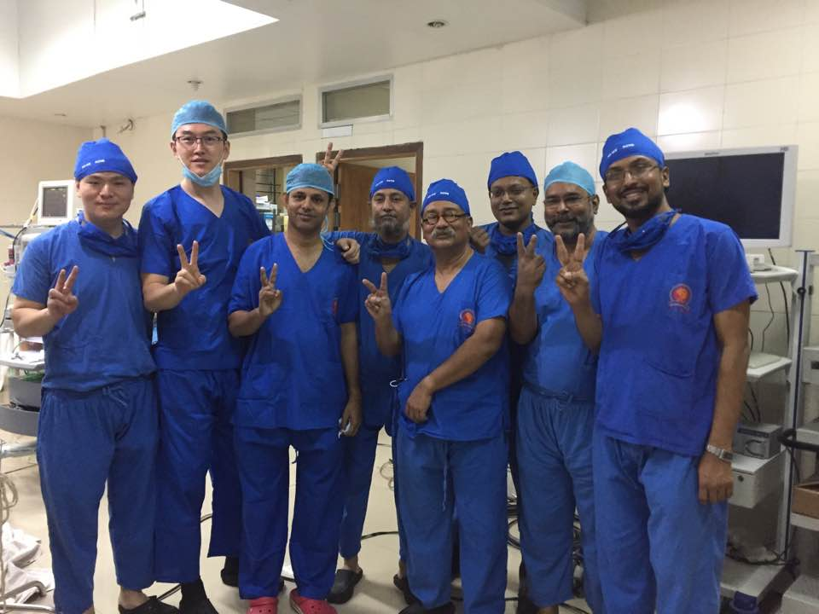
First DBS Surgery in Bangladesh
Deep Brain Stimulations (DBS)
Prof. Tipu Z. Aziz
PROFESSOR OF NEUROSURGERY,
University of Oxford, UK
After success DBS Surgery

Slide 13
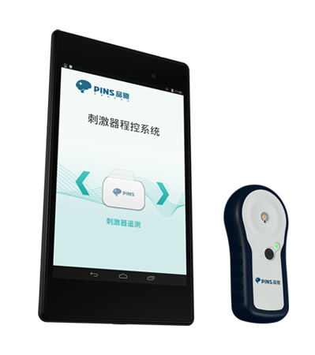
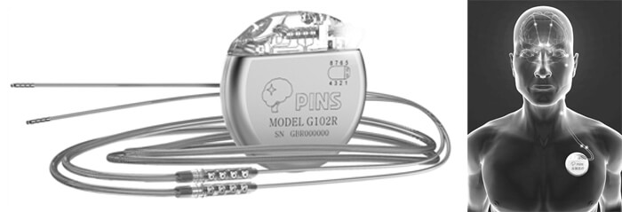
First DBS Surgery in Bangladesh
Deep Brain Stimulations (DBS)

Slide 14

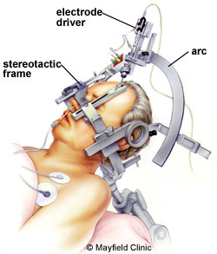
First DBS Surgery in Bangladesh
Deep Brain Stimulations (DBS)
DBS Electrodes
DBS Surgeon
CT Scan
MRI 1.5T

Slide 15
Two Procedures
Patient 1 : Parkinson’s
Patient 2: Dystonia

Slide 16
PVDoctor: Parkinson’s Visual Doctor
Cloud based AI Driven Screening and Monitoring System for Parkinson’s Diseases
Original Squeeze Machine (Left) and newly developed e-Squeeze Machine (Middle) and its Features

Slide 17
Publication
Al Mamun, Khondaker Abdullah, et al. "Cloud based framework for Parkinson’s disease diagnosis and monitoring system for remote healthcare applications." Future Generation Computer Systems 66 (2017): 36-47.
Al Mamun, Khondaker Abdullah, et al. “PVDoctor : Cloud Based Virtual Doctor for Parkinson's Disease Screening and Monitoring” 38th Annual International Conference of the IEEE Engineering in Medicine and Biology Society. March 14, 2016.
Original Squeeze Machine (Left) and newly developed e-Squeeze Machine (Middle) and its Features

Slide 18















Acknowledgement
University of Toronto, Canada
Holland Bloorview Kids Rehabilitation Hospital
Chinese Academy of Sciences, China
University of Southampton, UK
Imperial College London, UK
University of Oxford, UK
Florida International University, USA
King Saud University, Saudi Arabia
United International University, Bangladesh
Professor Tom Chau, Dr. Catriona Steele
Dr. Evdokia Anagnostou, Dr. Jessica Brian
Professor Shouyan Wang
Professor Mark E Lutman
Dr. Ravi Vaidyanathan, Dr. Michael Mace
Professor Tipu Aziz, Professor John Stein
Dr. Hai Deng
Dr. Ghulam Muhammad
Professor Mohammad Nurul Huda

Slide 19


Thank you for your attention!

Slide 20

Q&A

