Slide 1
FGAI4H-G-013-A02
New Delhi, 13-15 November 2019
Source: | TG-Outbreaks topic driver
Title: | TDD (new): TG-Outbreaks (Outbreak detection) - Att.2 - Data & Benchmarking challenges
Purpose: | Discussion
Contact: | Dr. Stéphane Ghozzi Dr. Martina Fischer Auss Abbood Robert Koch-Institute, Germany | E-mail: GhozziS@rki.de
Abstract: | This PPT complements the content of G-013 with challenges on the use of AI for outbreak detection. This is an updated version of the presentation in document FG-AI4H-013-A01 (Zanzibar).

Slide 2
Topic Group: Disease Outbreak Detection Data & Benchmarking challenges
Dr. Stéphane Ghozzi, Dr. Martina Fischer, and Auss Abbood
Robert Koch-Institute, Berlin, Germany
New Delhi 14th Nov 2019

Slide 3
Background
Infectious disease outbreaks pose a major risk to public health
Early detection of outbreaks can prompt fast interventions
Case data are collected by diverse surveillance systems
AI algorithms can be applied to detect aberrant case numbers based on these data collections
AI algorithms have the potential to increase the timeliness and accuracy of outbreak detection
AI for Outbreak Detection - FG-AI4H

Slide 4
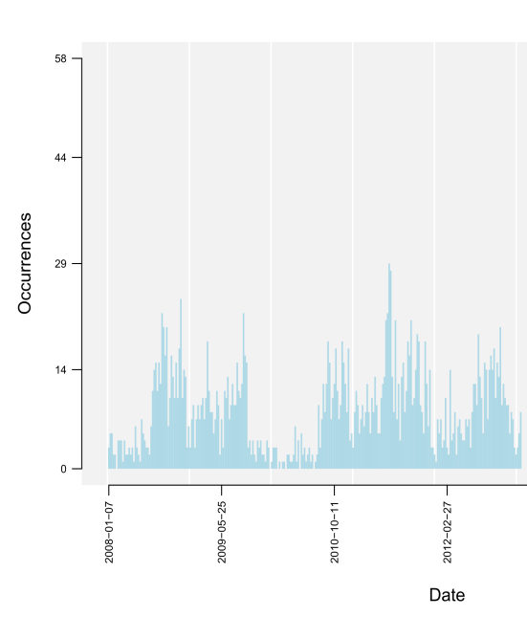
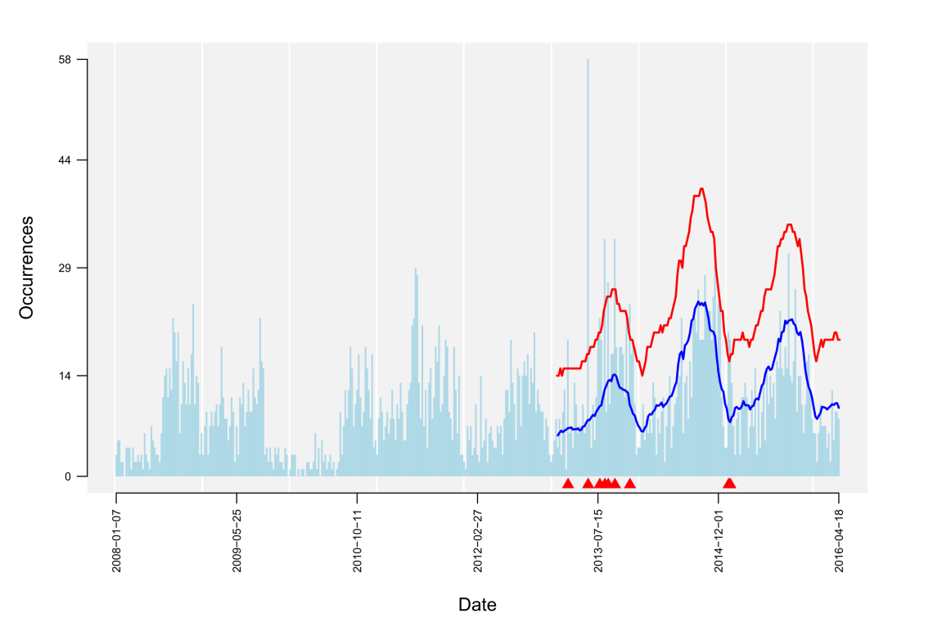
Objective
Data
AI task
warning signal
(spatio-)temporal data (reported cases of infection, symptom counts, etc.)
Detection of aberrant case numbers ( )
hint on potential outbreak event
AI for Outbreak Detection - FG-AI4H
Notes:
Data: time series data (x-axis is the date, y-axis the occurence e.g. counts of reported cases of infection, or also counts of ocurring symptoms)
The blue line corresponds to the expected count numbers according to the previous pattern/ the baseline which includes seasonality, trends etc
The red line gives the upper bound up to which count numbers are still considered to be in the normal range of cases
The AI detects the peaks which show extreme unexpected counts of cases – for which it produces a warning signal

Slide 5
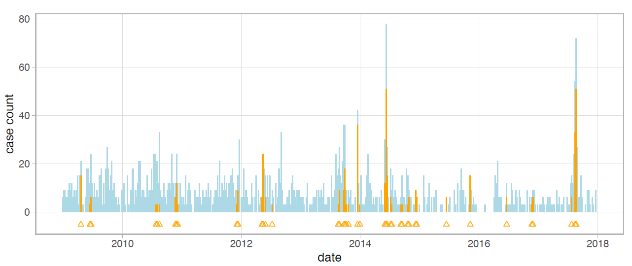
Objective
AI task
warning signal
Detection of aberrant numbers ( )
hint on potential outbreak event
Benchmarking
Test Data: confirmed outbreak labels

Slide 6
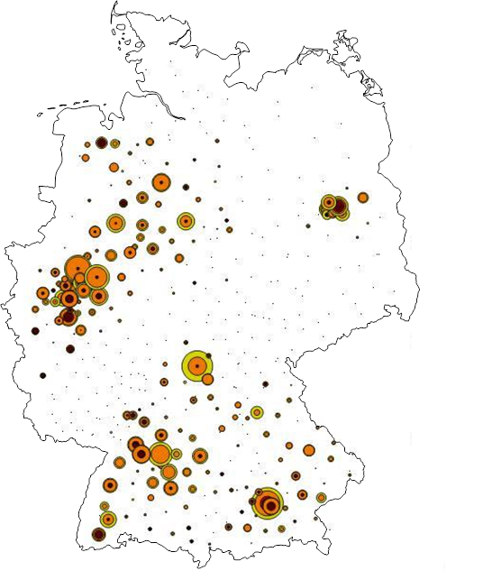
Example: German reporting system
German Reporting System
Notifiable pathogens (Infection Protection Act)
ECDC / WHO
IfSG §7.1
Robert Koch Institute
Adenoviren | Ebolavirus | Lassavirus | Rickettsia prowazekii
Bacillus anthracis | EHEC | Legionella spp. | Rubellavirus
Bordetella parapertussis | Francisella tularensis | Leptospira interrogans | Salmonella Paratyphi
Bordetella pertussis | FSME-Virus | Listeria monocytogenes | Salmonella Typhi
Borrelia recurrentis | Gelbfiebervirus | Marburgvirus | Salmonella, sonstige
Brucella sp. | Giardia lamblia | Masernvirus | Shigella sp.
Campylobacter sp. | Haemophilus influenzae | Mumpsvirus | Trichinella spiralis
Chlamydophila psittaci | Hantaviren | Mycobacterium leprae | Varizella-Zoster-Virus
Clostridium botulinum | Hepatitis-B-Virus | Mycobacterium tuberculosis | Vibrio cholerae O 1 und O 139
Corynebacterium diphtheriae | Hepatitis-C-Virus | Neisseria meningitidis | Yersinia enterocolitica
Coxiella burnetii | Hepatitis-D-Virus | Norovirus; Stuhl | Yersinia pestis
Cryptosporidium sp. | Hepatitis-E-Virus | Poliovirus
E. coli | Influenzaviren | Rabiesvirus
state health agencies
local health agencies
laboratories
doctors
Aim:
Early outbreak detection for fast intervention
patient
Surveillance of > 80 pathogens and > 400 counties recording ~ 500.000 cases/year
detection ~ 20.000 outbreaks/year
Notes:
- In Germany, we have a national infection protection law (the IfSG).
It defines a list of notifiable pathogens. And it regulates the recording of these infectious disease cases.
Existing German mandatory reporting system from patient via local and state health agaencies to the national public health institute of Germany, the RKI, up to the WHO. This electronic reporting system exists since 2001.
The data arrives pseudonymized at the RKI from about 400 local health agencies.
-> The available data set comprises over 8 million reported infectious disease cases, based on the collection since 2001!
-> The data holds expert labels which relate cases to specific disease outbreaks! <outbreak labels>
For each case, information is given on the pathogen, demographics (age, sex), location (NUTS-3 level, county) and on additional features such as hospitalization, fatality, and affiliation with care facilities and others
It enables us currently to surveil >80 pathogens in more than 400 German counties. Approx. 500.000 cases are reported per year and ~20.000 outbreaks are detected (oubreaks are defined as epidemiologically connected cases >2)
(Note: 80 pathogens are collected, for 30 pathogens we are currently able to do automated outbreak detection)
Note: Our outbreak data set (case collections since 2001) serves as perfect training set for AI application, as it is a reliable data source and cases are confirmed (by lab tests!).

Slide 7
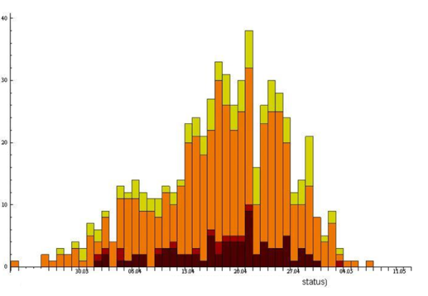
Example: German reporting system
German Reporting System
Notifiable pathogens (Infection Protection Act)
ECDC / WHO
IfSG §7.1
Robert Koch Institute
Adenoviren | Ebolavirus | Lassavirus | Rickettsia prowazekii
Bacillus anthracis | EHEC | Legionella spp. | Rubellavirus
Bordetella parapertussis | Francisella tularensis | Leptospira interrogans | Salmonella Paratyphi
Bordetella pertussis | FSME-Virus | Listeria monocytogenes | Salmonella Typhi
Borrelia recurrentis | Gelbfiebervirus | Marburgvirus | Salmonella, sonstige
Brucella sp. | Giardia lamblia | Masernvirus | Shigella sp.
Campylobacter sp. | Haemophilus influenzae | Mumpsvirus | Trichinella spiralis
Chlamydophila psittaci | Hantaviren | Mycobacterium leprae | Varizella-Zoster-Virus
Clostridium botulinum | Hepatitis-B-Virus | Mycobacterium tuberculosis | Vibrio cholerae O 1 und O 139
Corynebacterium diphtheriae | Hepatitis-C-Virus | Neisseria meningitidis | Yersinia enterocolitica
Coxiella burnetii | Hepatitis-D-Virus | Norovirus; Stuhl | Yersinia pestis
Cryptosporidium sp. | Hepatitis-E-Virus | Poliovirus
E. coli | Influenzaviren | Rabiesvirus
state health agencies
local health agencies
laboratories
doctors
patient
Aggregate case data into timeseries:
Surveillance of > 80 pathogens and > 400 counties recording ~ 500.000 cases/year
detection ~ 20.000 outbreaks/year
number of cases
Time (calender week)
Notes:
1) The reported cases are aggregated by time, e.g. per calender week, into time series.
2) Our outbreak detection algorithm is trained on the past reported/confirmed outbreak cases, and predicts the outbreak status of the current week

Slide 8
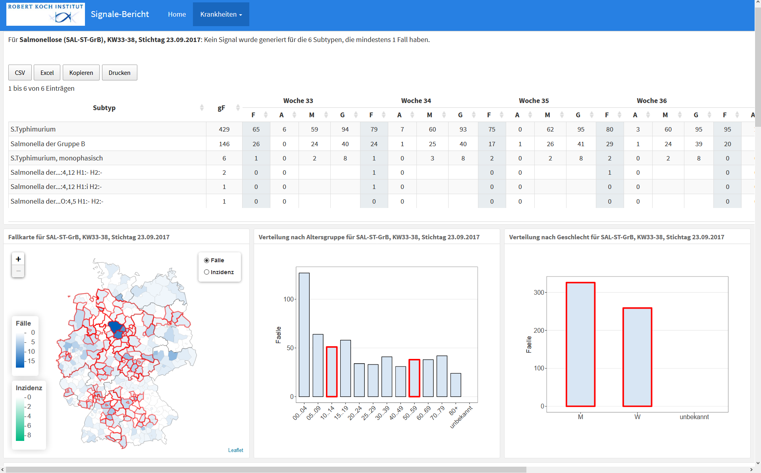
Example: weekly case data of Salmonella
Notes:
Example what this presented data source looks like – here shown by weekly case data …
F= case number, A= cases as part of an outbreak (reported by local/state health agencies), M= mean value (expected value by AI) , G= calculated threshold by AI
incidences of cases within German counties
incidence of the disease shown for the different age groups
incidence within gender

Slide 9
Data sources for outbreak detection algorithms
Different surveillance systems:
national/ mandatory reporting systems
(syndromic) surveillance systems:
Near-real-time syndromic surveillance: e.g. routine data from emergency departments and hospitals (e.g. ESEG-project in Germany)
Antibiotic Resistance Surveillance (ARS project in Germany)
…
potential other data sources:
publicly available sources (e.g. meterological data,..)
online data sources (wikipedia, google clicks, HealthTweets, Twitter, etc.)
near real-time symptom data by self-assessment health apps
…
AI for Outbreak Detection - FG-AI4H
Notes:
There are different potential data sources which can be used for outbreak detection and serve as input for the detection algorithms

Slide 10
Benchmarking challenges: (1) Data
Definition label ‚Outbreak‘
Exact start/end-time point → size of outbreaks often unknown
Number of epidemiologically connected cases?
Confirmation by simple lab test or molecular analysis
Label uncertainties
How to deal with unlabelled outbreak cases for benchmarking?
Minor peaks (with no confirmation): outbreak or random variation?
Data diversity
Highly diverse outbreak data patterns of the different pathogens
Detection necessary per pathogen and per feature combinations (regions, risk groups,..)
Test data
Needs to reflect national/international outbreak realities
Each country relies on individual national disease surveillance systems.
→ How do we optimally define a test set (undisclosed) to serve as a gold standard for benchmarking?
AI for Outbreak Detection - FG-AI4H
Notes:
Benchmarking challenges, we have to adress in order to clearly define a gold standard test set for this topic group
-- Agree on Definition of label „outbreak“
concerning start + end point of an outbreak – at which time point does an outbreak start and end – Problem: size often unknown
-- Label uncertainties: -Not all outbreaks are found or investigated by the local health agencies.
→ !!!!! for (1-2) methods are most likely to disagree and be separable – difficult how to evaluate performance (Method: A better B)??
-- Diversity (seasonal patterns, trends , artifacts and other variation (e.g. some characterized with flat course but individual spikes, other with periodic waves etc.),
-- Test Data
- At present: outbreak detection algorithms commonly parametrized + benchmarked on small sets of data or simulations. - These simulations are very simplistic outbreak representations, which capture only few aspects. By using real outbreak data, algorithms can be benchmarked on the actual task of detecting real world outbreak events.
- The topic of outbreak detection is of national and international concern.
The development of most detection algorithms is, however, naturally executed on national level. Thereby, each country relies on individual national disease surveillance systems.
→ For a TEST SET, we NEED DATA sets REPRESENTATIVE of EACH COUNTRY and their OUTBREAK PATHOGEN PATTERN

Slide 11
Benchmarking challenges: (2) Metrics
Definition of epidemiologically relevant metrics for AI-algorithm evaluation:
Sensitivity & Specificity → How to strike the balance?
precise + early detection of outbreaks
minimize number of false alarms
accounting for case numbers: missed large outbreaks penalized more than missed small ones
precise outbreak size detection
Timeliness
by time (days/weeks) passed
by number of occurred cases
before outbreak detection
Pathogen-specific
specific metrics according to pattern diversity?
Metrics & test data need to be usable for evaluation comparison of AI and established statistical models for outbreak detection
AI for Outbreak Detection - FG-AI4H
Notes:
-- Sensitivity & Specificity: → Q: how to strike the balance?? → combined measure necessary: specificity can always be improved at cost for poorer sensitivity + accounting for the number of cases important: missing of a large outbreak penalized more than missing of small outbreaks
-- timeliness important factor: Define by time passed from outbreak start (e.g. days/weeks)? OR by number of occurring cases (above baseline values) before outbreak detection?
-- Pathogen specific
specific metric developments for different organisms/disease (due to their pattern diversity) necessary?
Most routine systems run on classic statistical algorithms:
What is the benefit of AI approaches compared to established statistical models for outbreak detection?

Slide 12
Call for participation
Contributions by:
Collecting labelled test data → data stream directly linked to outbreak labels (expert/lab confirmed) of high value.
AI models and algorithms for outbreak detection → contributing to the development of a viable benchmarking framework
General support on different aspects of this topic (data, methods, benchmarking, etc.)
AI for Outbreak Detection - FG-AI4H

