Slide 1
FGAI4H-G-007-A01
New Delhi, 13-15 November 2019
Source: | TG-Cogni Topic Driver
Title: | TDD update: TG-Cogni (Neuro-cognitive diseases) - Att.1: Presentation [Same as Meeting F]
Purpose: | Discussion
Contact: | Marc Lecoultre ML Lab, Switzerland | E-mail: ml@mllab.ai
Abstract: | This PPT summarizes the content of G-007 with the TDD for the TG on neuro-cognitive diseases, for presentation and discussion during the meeting. This version of the TDD summary is the same as seen in Meeting F (FGAI4H-F-007-A01).

Slide 2
Meeting F - Topic Group Update
Neurocognitive disorders (TG-Cogni)
Marc Lecoultre
ml@mllab.ai

Slide 3
Overview
This topic group is dedicated to AI against neuro-cognitive diseases.
Co-editor Kherif Ferah
Laboratory for Research in Neuroimaging, Department of Clinical Neurosciences, Faculty of Biology and Medicine, UNIL Centre Hospitalier Universitaire Vaudois (CHUV) (Switzerland)

Slide 4
Received proposals
Provide an empirical basis for testing the clinical validity of machine learning-based diagnostics for Alzheimer’s disease (AD) and related dementia syndromes (defined by DSM V as ‘Neurocognitive disorders’) using real world brain imaging and genetic data

Slide 5
Alzheimer’s disease proposal overview
Current estimates count world-wide over 48 million people suffering from dementia bringing the social cost of care to 1% of world’s gross domestic product – GDP. These numbers led the World Health Organization to classify neurocognitive disorders as a global public health priority.

Slide 6
Problem we want to solve
Early-stage detection and classification of dementia using clinical scores, diagnostic, cognitive measures and biological measures (PET, MRI, fMRI, lab results)

Slide 7
TG Progress
Members
Biran Haacke, Prof. Mark Haacke, Mark Messow (Standardization of MRI Brain Imaging for Parkinson Disease)
Prof. Suresha working as a principal & Director of Venkateshwara Engineering college, Bangalore. India.
Prof. Dr. rer. nat. Tim Hahn, Westfälische Wilhelms-Universität Münster Institut für Translationale Psychiatrie Albert-Schweitzer-Campus
Alexander Tsiskaridze, MD, PhD, DSc, FESO, Professor of Neurology, Ivane Javakhishvili Tbilisi State University, Head, Neurological Service
Several new participants thank to Franck Verzefe – He shared the TG on his profiles
Requests
Rami Verbin, CTO, Sckipio Technologies requested access to our dataset
Data
Improved feature extraction from data and quality measures

Slide 8
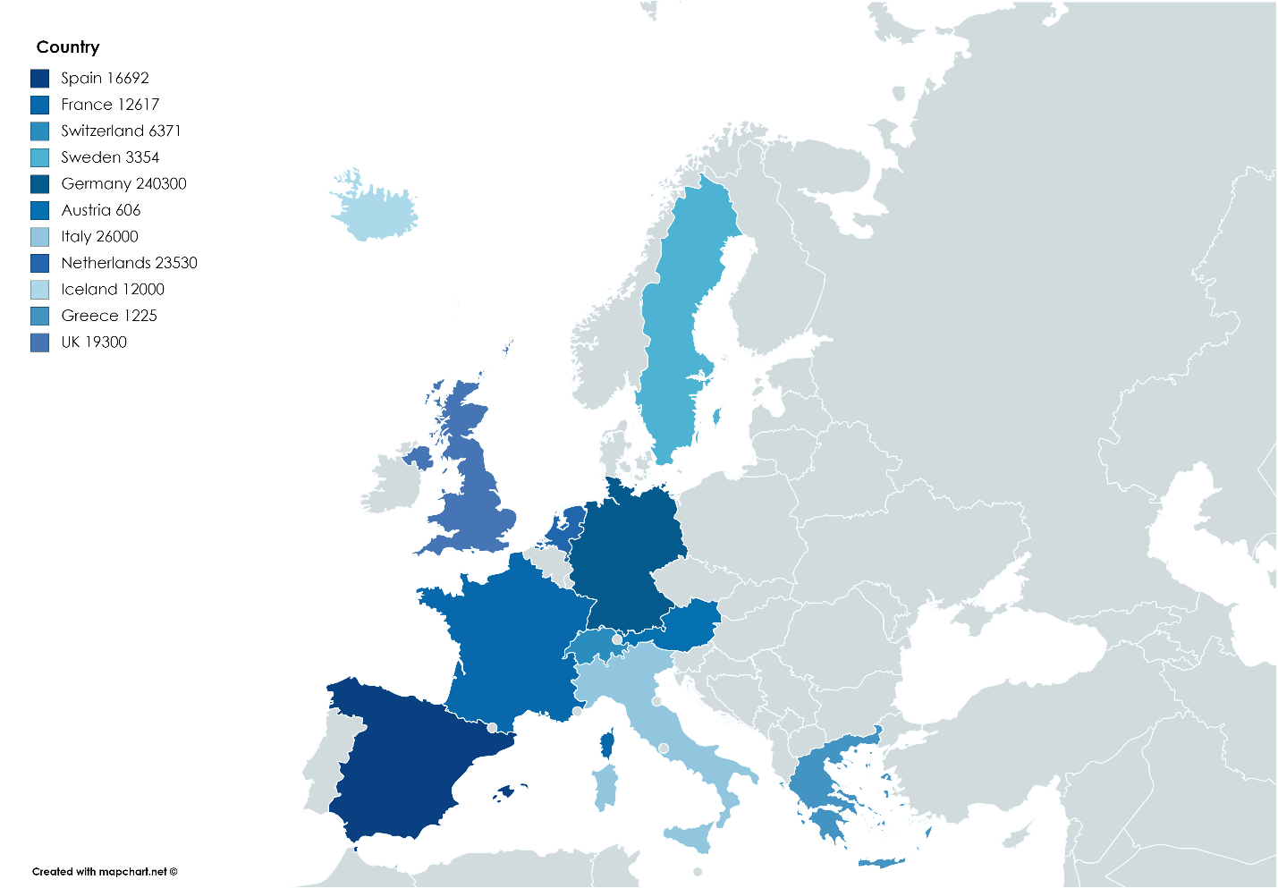
TG Progress : Data catalogue
Identification of new cohorts to be included
Create a catalogue of potential studies that can be included in the future.
++ Protential large datasets
challenges : Harmonization
-- Only in Europe

Slide 9
TG Progress
Identification of new cohorts to be included
Create a catalogue of potential studies that can be included in the future.
++ Protential large datasets
challenges : Harmonization
-- Only in Europe
Criteria |  | SUBJECTS NUMEROSITY (baseline)
Type of data Collected | Bio-Bank | 95782
 | Biological | 296963
 | Clinical | 332045
 | Cognitive abilities | 320743
 | EEG | 4000
 | Epidemiological | 360564
 | Genetic | 315910
 | Imaging | 349394

Slide 10
TG Progress
Identification of new cohorts to be included
Create a catalogue of potential studies that can be included in the future.
++ Protential Comorbidities

Slide 11
TG Progress
Promotion
ITU Telecom World – Budapest September 2019 – Leadership meeting
ECPRD – Tallinn October 2019 - 100 participants from 25 European countries representing offices of parliaments
FK and TW attend a meeting A meeting/workshop in Brussels : Experts meeting 14 Oct 2019 in Brussels, European Commission “GDPR-compliant data sharing in health research – concrete use cases & technical/ELSI infrastructure support”
Issues discussed :
Data capture: distributed sites, data quality, curation, standards, formats …
Data sets: (FAIR) findability, interoperable long-term sustainability, regulatory validation (TW)
Access platforms : de-centralized, locally hosted data sets federated platform (FK)

Slide 12
Next steps
Onboard new proposals in the TG
Refine TG description document according to TDD (FGAI4H-C-105)

