Slide 1
FGAI4H-F-020-A01
Zanzibar, 3-5 September 2019
The Diabetic Retinopathy Network
DR-NET
Dr Covadonga Bascaran
FG-AI4H Meeting Zanzibar , 4 Sept 2019

Slide 2
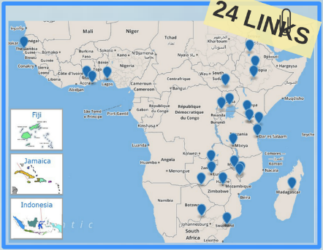
VISION 2020 LINKS Programme – Health Partnerships
Africa – UK Health Partnerships
Needs assessment and identification of priorities
Multidisciplinary team approach for training
Institutional agreement MOU
Three year action plan
Exchange training visits

Slide 3
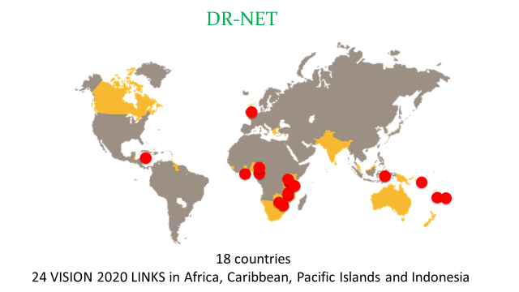
Establishment of Networks

Slide 4
Key activities in numbers
18 countries 24 DR LINKS
DR-NET original 5-year target:
to treat 3,750 extra patients
(one more per centre per week)
Actual achievement:
8,063 extra patients treated 80,630 years of sight saved
93 ophthalmologists laser trained in 10 countries
92 training visits
81 screener-graders from 10 countries trained
4 international workshops

Slide 5
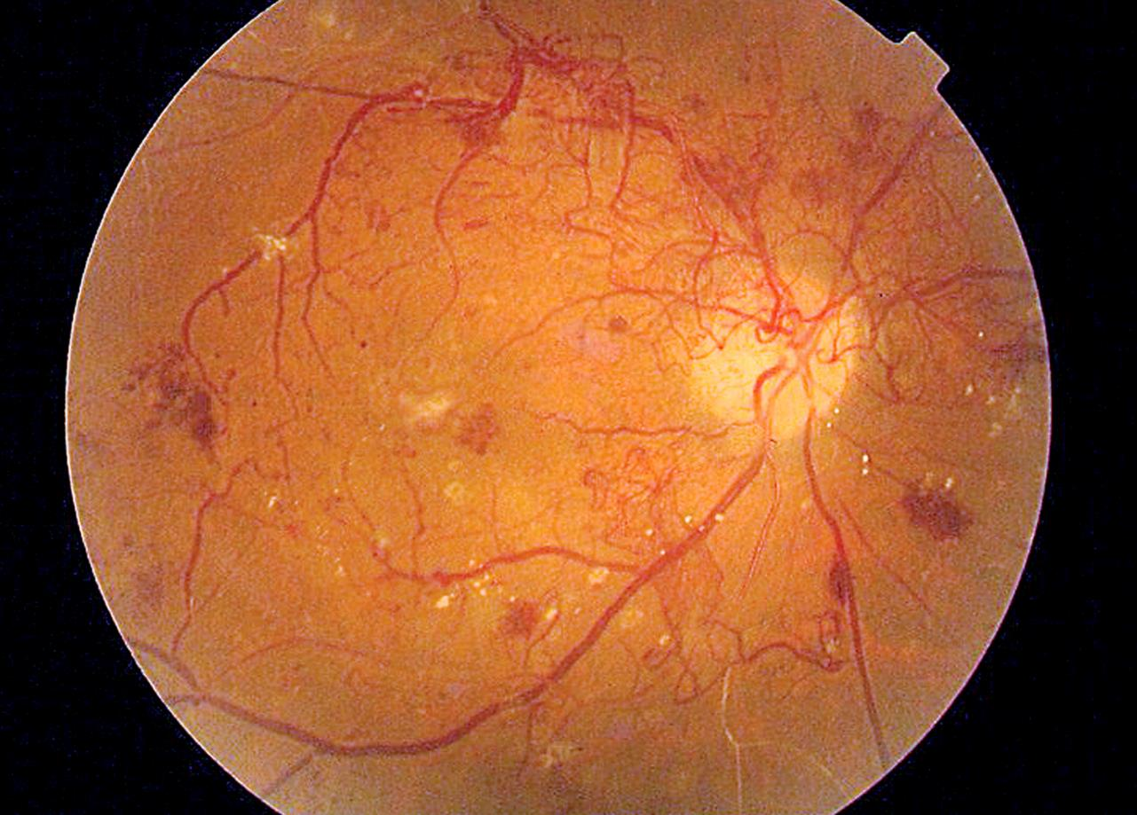
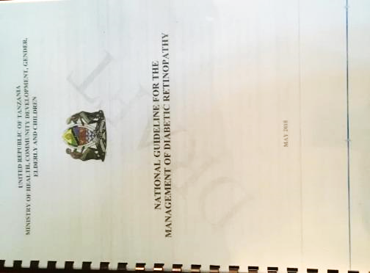
Guidelines
COMMONWEALTH EYE HEALTH CONSORTIUM

Slide 6
DR-NET and AI
Key Advantages
Services - Patients
Task shifting: screener – graders trained at international standards
Point of care decision making: more efficient and may increase uptake of treatment services
Decrease the workload of ophthalmologists in DR
Issues
Different cameras used across the network and within programmes
Many of the partnerships are already being approached by different AI manufacturers
Majority black ethnicity population – unknown how existing algorithms will work
DR-NET seeks to be part of benchmarking so that African DR screening programmes can be confident that new technology will be apt to use in their context

Slide 7
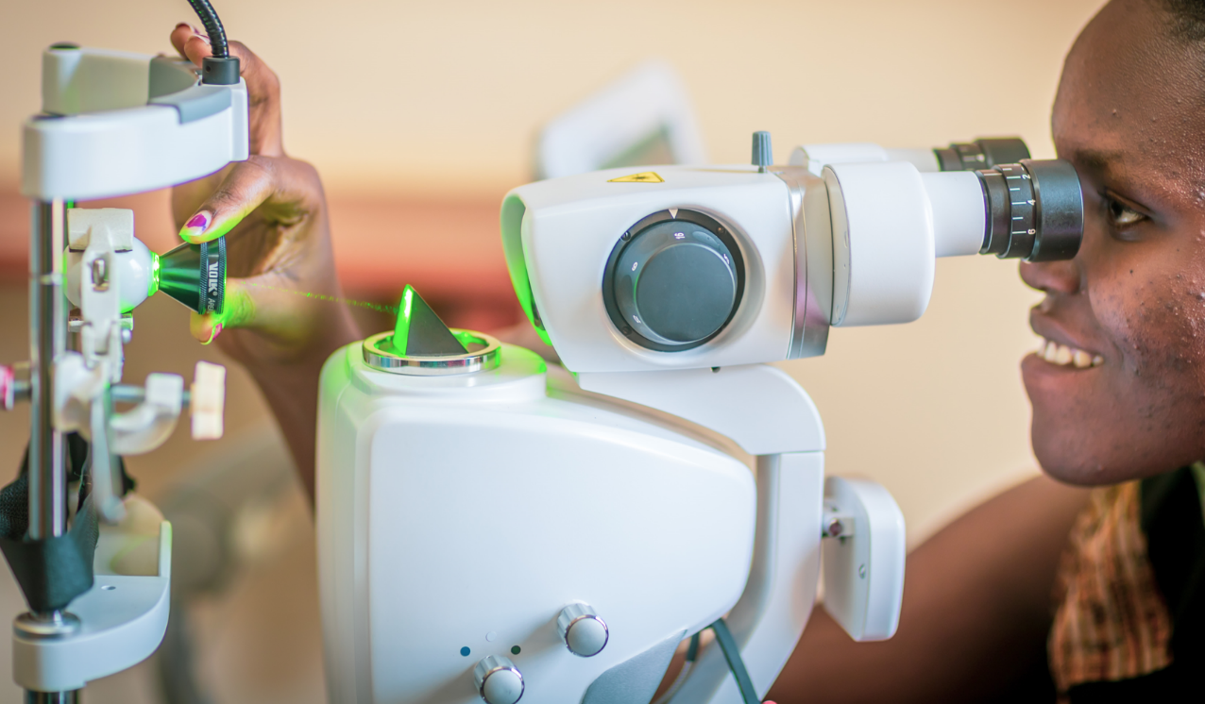
DR-NET five year progress (cumulative ALL sites)
Total screened: 107,389
Total treated: 22,769
88%
47%
DR-NET has access to programme data from real service delivery DR Programmes in Africa
Some of this data is “raw data” unlabelled , but resources to label it can be sought
Some programmes already have labelled data with relevant permissions

Slide 8
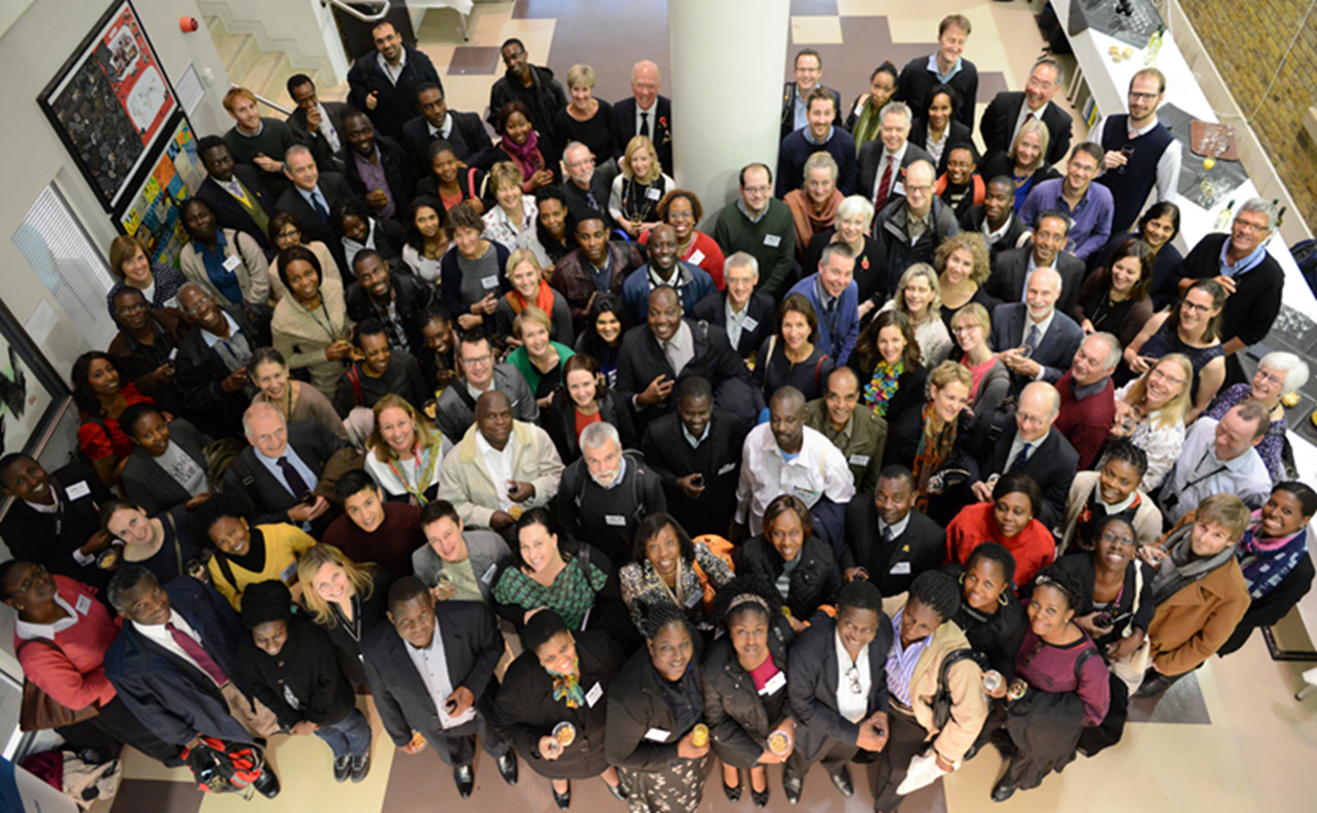
Thank you

