Slide 1
FGAI4H-F-013-A01
Zanzibar, 3-5 September 2019
Source: | TG-Outbreaks topic driver
Title: | TDD update: Outbreaks (AI for Outbreak Detection)
Purpose: | Discussion
Contact: | Martina Fischer Topic driver Robert Koch Institute, Germany | E-mail: fischerma@rki.de
Abstract: | This PPT summarizes the activities for the TG-Outbreaks, for presentation and discussion during the meeting.

Slide 2
Topic Group: Disease Outbreak Detection Data & Benchmarking challenges
Dr. Martina Fischer
Robert Koch-Institute, Berlin, Germany
Zanzibar 3rd-5th Sept 2019

Slide 3
Background
Infectious disease outbreaks pose a major risk to public health
Early detection of outbreaks can prompt fast interventions
Case data are collected by diverse surveillance systems
AI algorithms can be applied to detect aberrant case numbers based on these data collections
AI algorithms have the potential to increase the timeliness and accuracy of outbreak detection

Slide 4
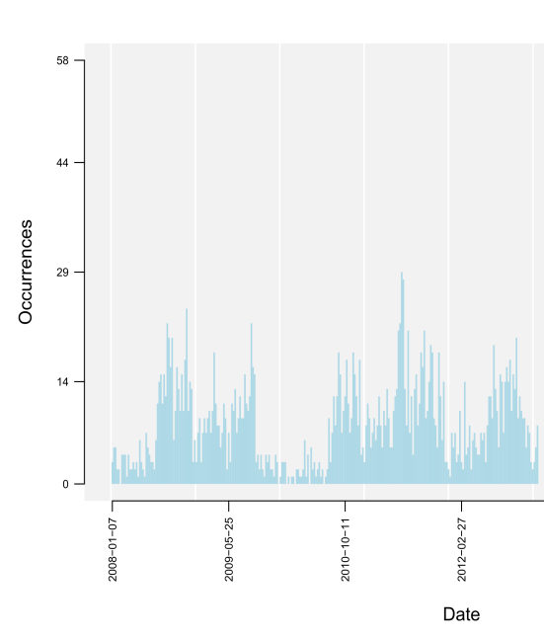
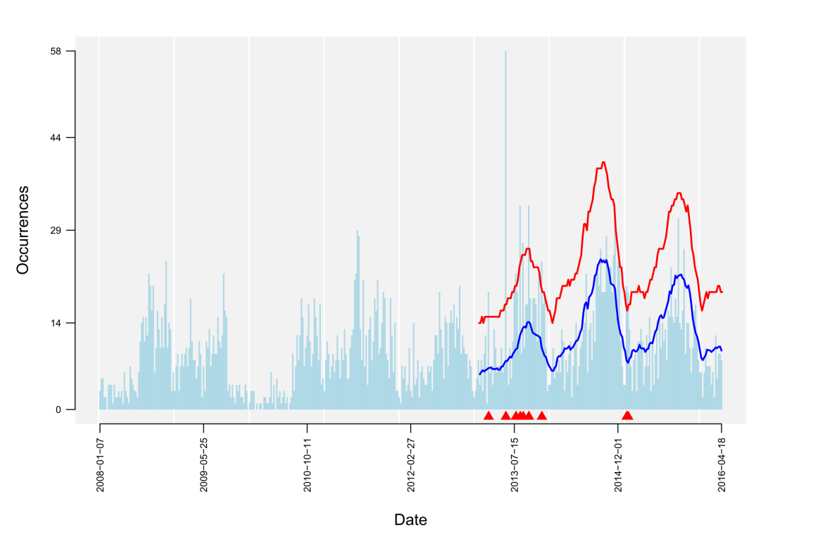
Objective
Data
AI task
warning signal
(spatio-)temporal data (reported cases of infection, symptom counts, etc.)
Detection of aberrant case numbers ( )
hint on potential outbreak event

Slide 5
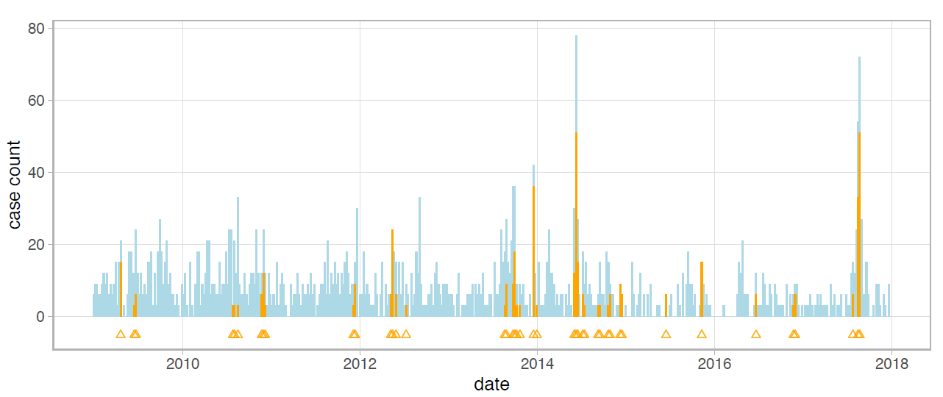
Objective
AI task
warning signal
Detection of aberrant numbers ( )
hint on potential outbreak event
Benchmarking
Test Data: confirmed outbreak labels

Slide 6
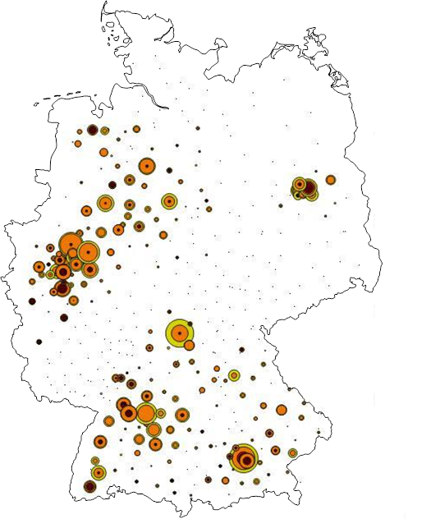
Example: German reporting system
German Reporting System
Notifiable pathogens (Infection Protection Act)
ECDC / WHO
IfSG §7.1
Robert Koch Institute
Adenoviren | Ebolavirus | Lassavirus | Rickettsia prowazekii
Bacillus anthracis | EHEC | Legionella spp. | Rubellavirus
Bordetella parapertussis | Francisella tularensis | Leptospira interrogans | Salmonella Paratyphi
Bordetella pertussis | FSME-Virus | Listeria monocytogenes | Salmonella Typhi
Borrelia recurrentis | Gelbfiebervirus | Marburgvirus | Salmonella, sonstige
Brucella sp. | Giardia lamblia | Masernvirus | Shigella sp.
Campylobacter sp. | Haemophilus influenzae | Mumpsvirus | Trichinella spiralis
Chlamydophila psittaci | Hantaviren | Mycobacterium leprae | Varizella-Zoster-Virus
Clostridium botulinum | Hepatitis-B-Virus | Mycobacterium tuberculosis | Vibrio cholerae O 1 und O 139
Corynebacterium diphtheriae | Hepatitis-C-Virus | Neisseria meningitidis | Yersinia enterocolitica
Coxiella burnetii | Hepatitis-D-Virus | Norovirus; Stuhl | Yersinia pestis
Cryptosporidium sp. | Hepatitis-E-Virus | Poliovirus
E. coli | Influenzaviren | Rabiesvirus
state health agencies
local health agencies
laboratories
doctors
Aim:
Early outbreak detection for fast intervention
patient
Surveillance of > 80 pathogens and > 400 counties recording ~ 500.000 cases/year
detection ~ 20.000 outbreaks/year

Slide 7
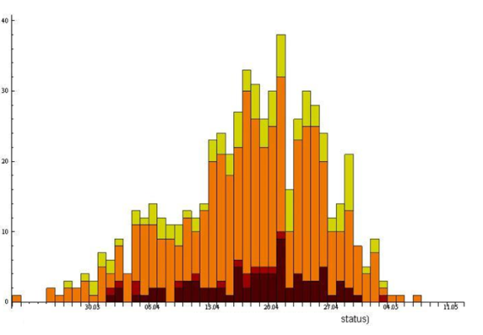
Example: German reporting system
German Reporting System
Notifiable pathogens (Infection Protection Act)
ECDC / WHO
IfSG §7.1
Robert Koch Institute
Adenoviren | Ebolavirus | Lassavirus | Rickettsia prowazekii
Bacillus anthracis | EHEC | Legionella spp. | Rubellavirus
Bordetella parapertussis | Francisella tularensis | Leptospira interrogans | Salmonella Paratyphi
Bordetella pertussis | FSME-Virus | Listeria monocytogenes | Salmonella Typhi
Borrelia recurrentis | Gelbfiebervirus | Marburgvirus | Salmonella, sonstige
Brucella sp. | Giardia lamblia | Masernvirus | Shigella sp.
Campylobacter sp. | Haemophilus influenzae | Mumpsvirus | Trichinella spiralis
Chlamydophila psittaci | Hantaviren | Mycobacterium leprae | Varizella-Zoster-Virus
Clostridium botulinum | Hepatitis-B-Virus | Mycobacterium tuberculosis | Vibrio cholerae O 1 und O 139
Corynebacterium diphtheriae | Hepatitis-C-Virus | Neisseria meningitidis | Yersinia enterocolitica
Coxiella burnetii | Hepatitis-D-Virus | Norovirus; Stuhl | Yersinia pestis
Cryptosporidium sp. | Hepatitis-E-Virus | Poliovirus
E. coli | Influenzaviren | Rabiesvirus
state health agencies
local health agencies
laboratories
doctors
patient
Aggregate case data into timeseries:
Surveillance of > 80 pathogens and > 400 counties recording ~ 500.000 cases/year
detection ~ 20.000 outbreaks/year
number of cases
Time (calender week)

Slide 8
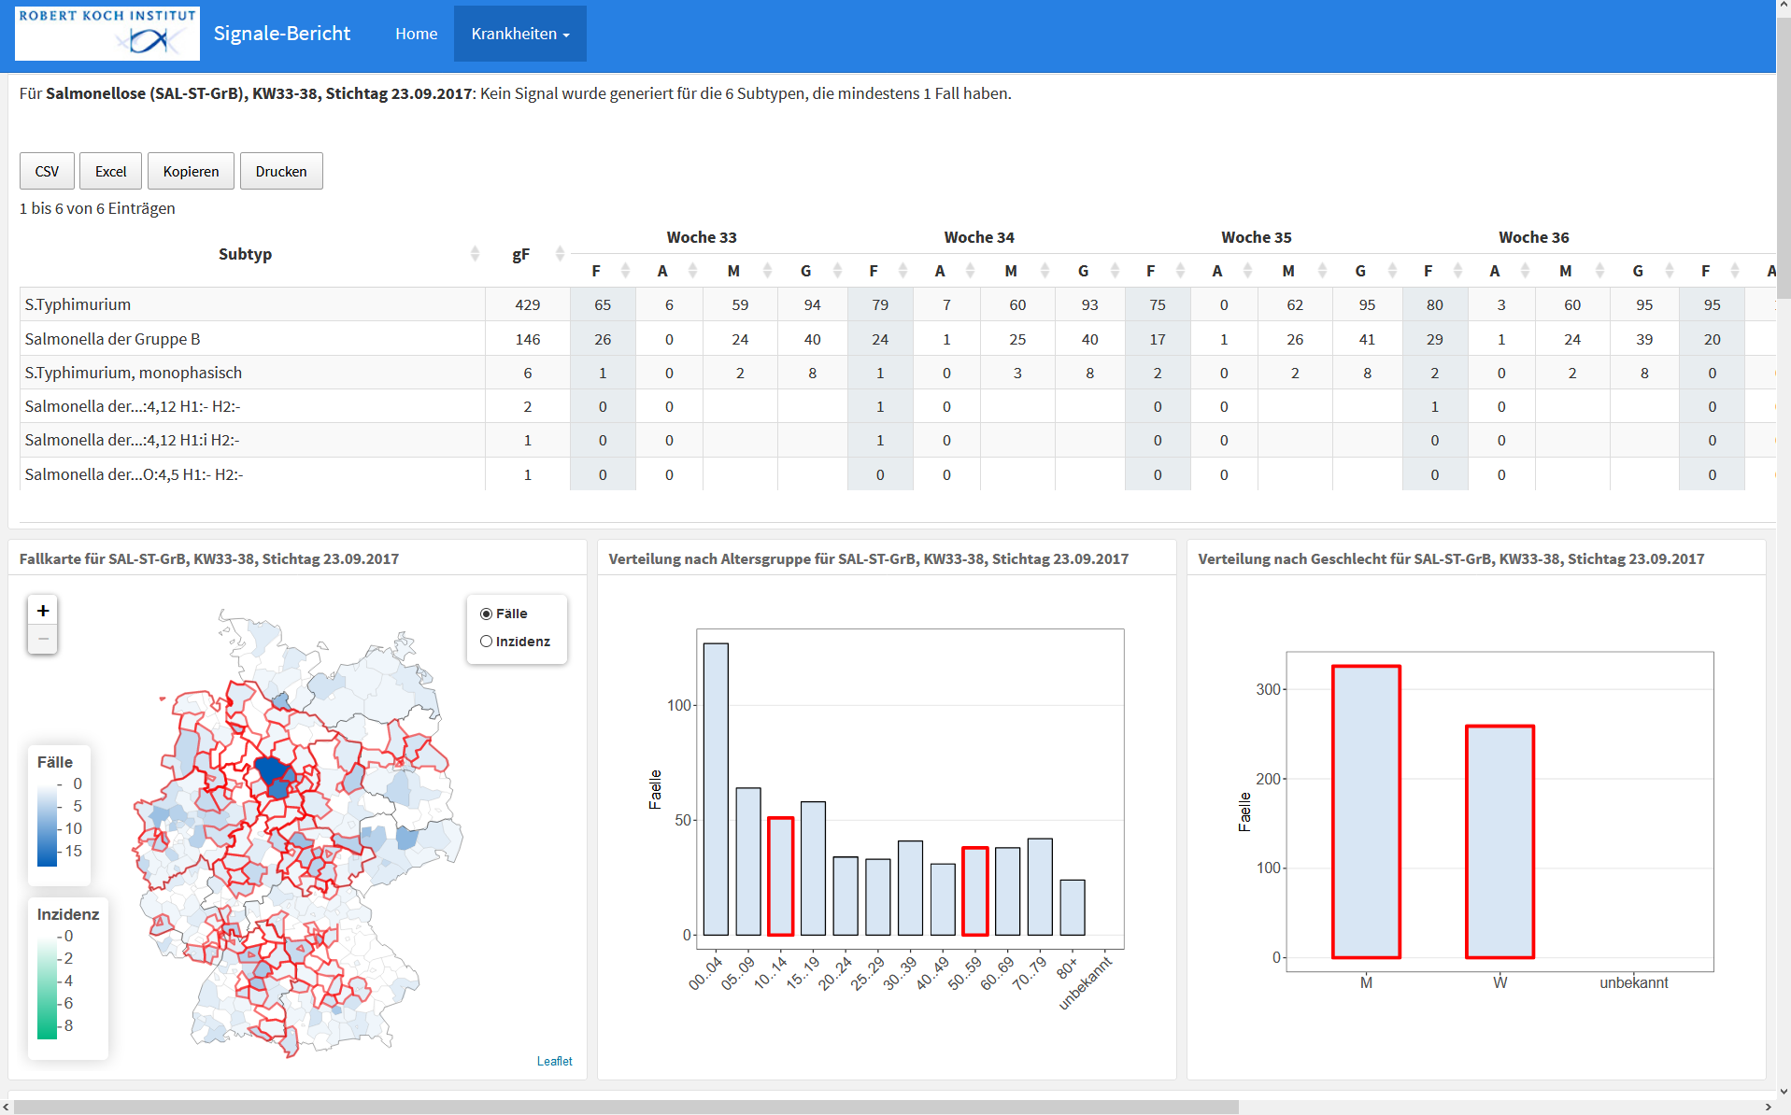
Example: weekly case data of Salmonella

Slide 9
Data sources for outbreak detection algorithms
Different surveillance systems:
national/ mandatory reporting systems
(syndromic) surveillance systems:
Near-real-time syndromic surveillance: e.g. routine data from emergency departments and hospitals (e.g. ESEG-project in Germany)
Antibiotic Resistance Surveillance (ARS project in Germany)
…
potential other data sources:
publicly available sources (e.g. meterological data,..)
online data sources (wikipedia, google clicks, HealthTweets, Twitter, etc.)
near real-time symptom data by self-assessment health apps
…

Slide 10
Benchmarking challenges: (1) Data
Definition label ‚Outbreak‘
Exact start/end-time point → size of outbreaks often unknown
Number of epidemiologically connected cases?
Confirmation by simple lab test or molecular analysis
Label uncertainties
How to deal with unlabelled outbreak cases for benchmarking?
Minor peaks (with no confirmation): outbreak or random variation?
Data diversity
Highly diverse outbreak data patterns of the different pathogens
Detection necessary per pathogen and per feature combinations (regions, risk groups,..)
Test data
Needs to reflect national/international outbreak realities
Each country relies on individual national disease surveillance systems.
→ How do we optimally define a test set (undisclosed) to serve as a gold standard for benchmarking?

Slide 11
Benchmarking challenges: (2) Metrics
Definition of epidemiologically relevant metrics for AI-algorithm evaluation:
Sensitivity & Specificity → How to strike the balance?
precise + early detection of outbreaks
minimize number of false alarms
accounting for case numbers: missed large outbreaks penalized more than missed small ones
precise outbreak size detection
Timeliness
by time (days/weeks) passed
by number of occurred cases
before outbreak detection
Pathogen-specific
specific metrics according to pattern diversity?
Metrics & test data need to be usable for evaluation comparison of AI and established statistical models for outbreak detection

Slide 12
Current members in topic group:
Robert-Koch-Institute (National Public Health Institute Germany), involving members from different groups within the institute
Dr. Alexander Ullrich, Infection epidemiology, Signale team (RKI, Unit 31)
Dr. Stéphane Ghozzi, Infection epidemiology, Signale team (RKI, Unit 31)
Dr. Benedikt Zacher, Infection epidemiology, Nosocomial infections (RKI, Unit 37)
Dr. Bernhard Renard, Bioinformatics (RKI, Unit MF1)
Dr. Martina Fischer, Method development and research infrastructure (RKI, Dep. MF)
Dr. Janina Esins, Method development and research infrastructure (RKI, Dep. MF)

Slide 13
Interested in topic group:
Name | Affiliation
Philippe Verstraete, Dr. Giovanna Gutierrez | Co-founders of "Milan and Associates“, consultancy in epidemic intelligence, outbreak response, and more
Elaine Nsoesie, PhD | Assistant Professor of Global Health; School of Public Health; Boston University
Victor Akelo, MD, MPH | Co-lead for Child health and mortality Prevention Surveillance (CHAMPS) project in Kenya
Claire Jarashow, PhD, MPH | Chief, Epidemiology and Data Unit; Acute Communicable Disease Control; LA County Department of Public Health
Sharon Greene, PhD, MPH | Director, Data Analysis Unit; Bureau of Communicable Disease; NYC Department of Health and Mental Hygiene

Slide 14
Contacted by us for participation in topic group:
Name | Affiliation
Dr. Andre Charlett Alex J Elliot, PhD Roger Morbey, PhD | Public Health England; National Infection Service; * Statistics, Modelling and Economics * Real-time Syndromic Surveillance

Slide 15
Call for participation
Contributions by:
Collecting labelled test data → data stream directly linked to outbreak labels (expert/lab confirmed) of high value.
AI models and algorithms for outbreak detection → contributing to the development of a viable benchmarking framework
General support on different aspects of this topic (data, methods, benchmarking, etc.)

