Slide 1
FGAI4H-F-010-A01
Zanzibar, 3-5 September 2019
Source: | TG-Fall topic driver
Title: | TDD update: TG-Falls (Falls among the elderly)
Purpose: | Discussion
Contact: | Inês Sousa Fraunhofer AICOS, Portugal | Tel: +351 220 430 326 Email: ines.sousa@fraunhofer.pt
Contact: | Maria Vasconcelos Fraunhofer AICOS, Portugal | Tel: +351 220 430 353 Email: maria.vasconcelos@fraunhofer.pt
Contact: | Pierpaolo Palumbo Bologna, Italy | Tel: +39 3402378412 Email: pierpaolo.palumbo@unibo.it
Abstract: | This PPT summarizes the content of F-010 with the TDD for the TG-Falls, for presentation and discussion during the meeting.

Slide 2
ITU-T Focus Group on AI for Health
TG-Falls (Falls among the elderly)

Slide 3
Falls Topic Description
Problem
Falls have a multifactorial origin and most factors are amendable
Multifactorial assessment of fall risk factors is recommended but still not widespread in the clinical practice.
Difficulty in combining the multiple parameters in order to differentiate in high risk of falling.
Fall Risk Screening
Prevention

Slide 4
Falls Topic Description
Relevance
30% of 65+ and 50% of 80+ community-dwelling people fall each year.
Falls are one of the most common health related problems in the elderly population, representing more than 50% of the hospitalizations due to injuries.
Direct costs of falls are 25 billion EUR1 in EU and $31 billion2 in USA per year.
Falls are also considered one of the main causes for institutionalization and loss of independence.
¹Hartholt, K, Falls and drugs in older population: medical and societal consequences, Erasmus University Rotterdam, 2011.
²Burns EB, Stevens JA, Lee RL. The direct costs of fatal and non-fatal falls among older adults—United States. J Safety Res 2016:58.

Slide 5
Falls Topic Description
Impact
Artificial Intelligence (AI) techniques can be of great value in generating models that combine multiple sources of data.
Standardize multifactorial fall risk assessment.
Create AI-based tools to easily implement multifactorial fall risk assessment in the clinical practice.

Slide 6
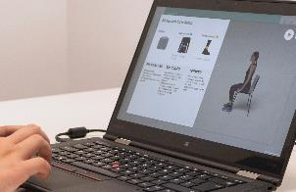
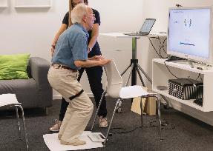
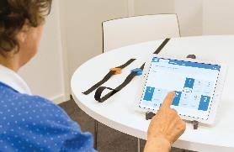
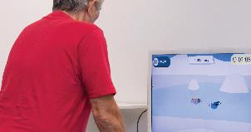
Falls Topic Description
Existing AI Solution – FallSensing Project
FallSensing
Clinical Screening
Clinical
Intervention
Home
Games
Mobile Apps
Portal

Slide 7
AI4H Topic Group Falls
Data Availability

Slide 8
AI4H Topic Group Falls
Data Availability
Undisclosed data: 403 annotated data samples from Portuguese community-dwelling adults
Data collection
Ethical approval was obtained from the Research Ethics Committee of Polytechnic Institute of Coimbra (Nº6/2017). All participants gave written informed consent before data collection begins as per the Declaration of Helsinki.
Data was acquired by health professionals trained to the effect in a prospective longitudinal study, following a convenience sampling method.
Annotation
participants received monthly phone calls over a 12-month period to record whether a fall occurred in this period.

Slide 9
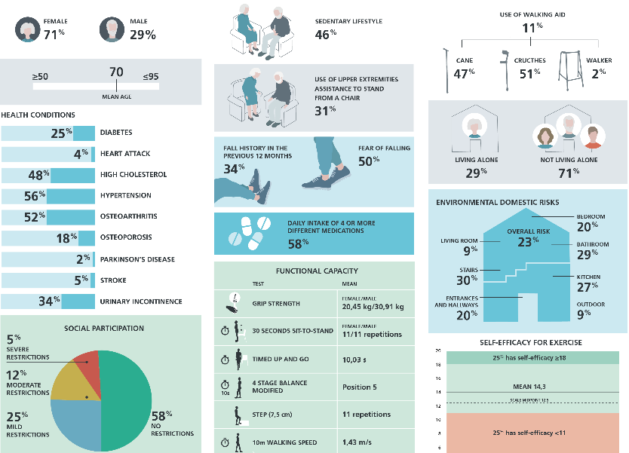

Slide 10
AI4H Topic Group Falls
Benchmarking Methodology and Architecture
AI problem formulation - outcomes:
binary classification problem (occurrence of at least one fall in subsequent year vs. non-occurrence of falls in that period)
multiclass classification (first-time fallers after the assessment, recurrent fallers and non-fallers, …)
predicted time until the first fall (in months)
probability of suffering a fall in a given period during the year after the assessment
Possible metrics:
Sensitivity/Recall, Specificity, Precision
Area under the receiver operating characteristic curve (ROC AUC)
Youden's J statistic - Informedness

Slide 11
AI4H Topic Group Falls
Participants
Pierpaolo Palumbo, biomedical engineer, working on algorithms for health risk assessment, with a focus on fall risk in community-dwelling older adults and lower-limb amputees. He is a post-doctoral fellow at the Personal Health Systems Laboratory, headed by Prof. Lorenzo Chiari, at the University of Bologna.

Slide 12
Contact Longitudinal Studies on Ageing

Slide 13
Thank you

