Slide 1
Meeting D - Topic Group Update
Neurocognitive disorders (TG-Cogni)
Marc Lecoultre
ml@mllab.ai

Slide 2
Overview
This topic group is dedicated to AI against neuro-cognitive diseases.
Co-editor Kherif Ferah
Laboratory for Research in Neuroimaging, Department of Clinical Neurosciences, Faculty of Biology and Medicine, UNIL Centre Hospitalier Universitaire Vaudois (CHUV) (Switzerland)

Slide 3
Received proposals
Provide an empirical basis for testing the clinical validity of machine learning-based diagnostics for Alzheimer’s disease (AD) and related dementia syndromes (defined by DSM V as ‘Neurocognitive disorders’) using real world brain imaging and genetic data

Slide 4
Alzheimer’s disease proposal overview
Current estimates count world-wide over 48 million people suffering from dementia bringing the social cost of care to 1% of world’s gross domestic product – GDP. These numbers led the World Health Organization to classify neurocognitive disorders as a global public health priority.

Slide 5
Problem we want to solve
Early-stage detection and classification of dementia using clinical scores, diagnostic, cognitive measures and biological measures (PET, MRI, fMRI, lab results)

Slide 6
Data availability
Data include both real world patient’s data and data collected from research cohorts.
The data include clinical scores, diagnostic, cognitive measures and biological measures (PET, MRI, fMRI, lab results).
The data include patients on more than 6 000 patients on dementia (one of the largest patients’ cohort) different stages of the disease (subjective complains, mild impairments or demented)

Slide 7
Data description
 | Diagnostic- Labels :
Total count | Alzheimer's Disease | Mild cognitive impairment (MCI) | Cognitively normal (CN) | Other Mixed Dementia (MD)
6787 | 2082 | 1165 | 1779 | 1761
 | 30.67% | 17.16% | 26.21% | 25.94%

Slide 8
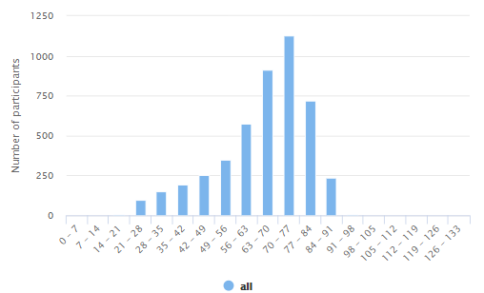
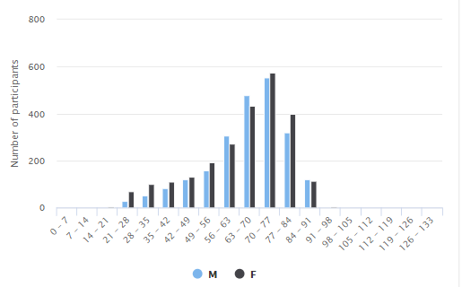
Data description

Slide 9
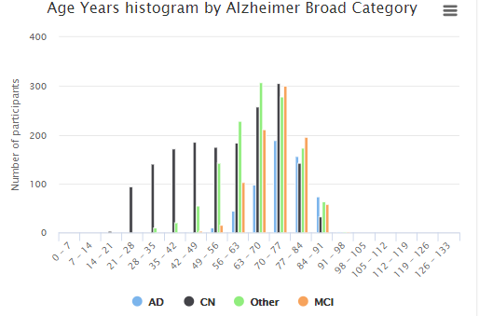
Data description

Slide 10
Data description
Subset of features
Age
Gender
educationlevel
educationyears
ab1_40
ab1_42
tau
adas
MMSE
MOCA
leftaccumbensarea
leftacgganteriorcingulategyrus
leftainsanteriorinsula
leftamygdala
leftangangulargyrus
leftaorganteriororbitalgyrus

Slide 11
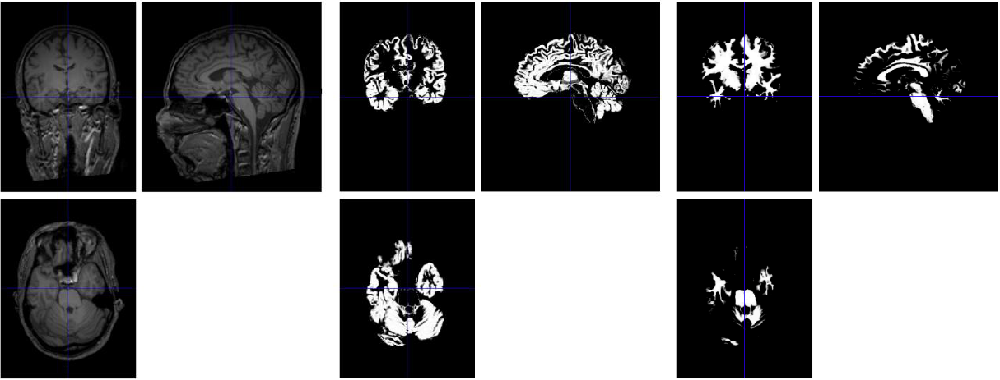
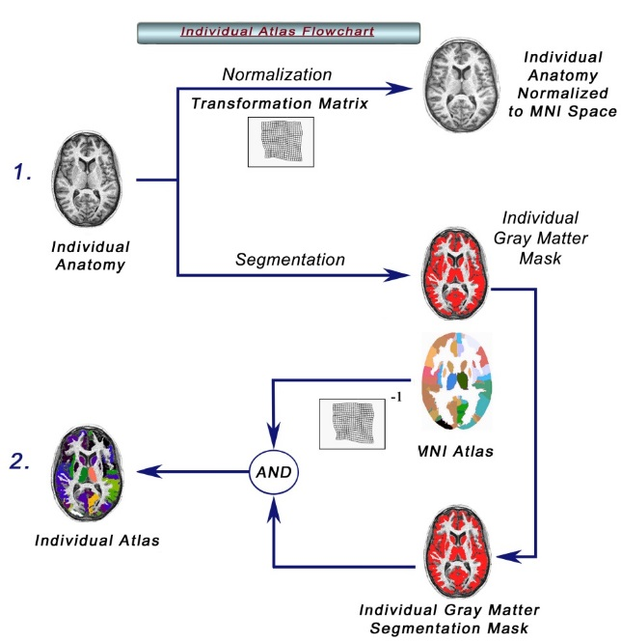
Data description
Images format requirements:
  Must be full brain scans
  Must be provided either in DICOM or NIFTI format
  The images must be high-resolution (max. 1.5 mm) T1-weighted sagittal images.

Slide 12
Data quality
The data have been obtained under each country ethical and regulation policies, including patient informed consents. The data have been annotated using best clinical practice and described using Common data Element and international classifications (ICD10).
The Quality Check evaluates essential image parameters, such as signal-to-noise ratio, inhomogeneity and image resolution. It evaluates images for problems during the processing steps. It allows for comparing quality measures across different scans and sequences.

Slide 13
Benchmarking
A large representative sample will be created and will be use for the creation of the models. The models will be then validated on the real-world undisclosed patient’s data.

Slide 14
TG Progress
Updated status report for Alzheimer’s disease use case
Wrote Call for Topic Group Participation
Held 2 meetings in Lausanne
Met potential participants in UK

Slide 15



Community
We contacted several organizations to build a community around our TG (proposals, data, experts, …)
Northumberland, Tyne and Wear NHS Foundation Trust – providing mental health, learning disabilities and neuro-rehabilitation services.

Slide 16
Next steps
Onboard new proposals in the TG
Refine TG description document according to TDD (FGAI4H-C-105)
Release public data set for AD
Prepare private (undisclosed) data set for AD

