Slide 1
Join ITU-T Standardization Activity
Xu Weiling
Vice Chairman of ITU-T TSAG
Secretariat of ITU Working Committee of MIIT
April, 2019

Slide 2
Content
一、Introduction to ITU
二、Study Group vs Focus Group
三、Participation – China case

Slide 3
Introduction to ITU
1. International Telecommunication Union (ITU) is a specialized agency of the United Nations that is responsible for information and communications technologies (ICT) issues. It is committed to promoting the interconnectivity of communications networks worldwide, allocating and coordinating numbers, radio spectrum and satellite orbit resources, boosting the development of global information and communications, and bridging the digital divide.
2. Its membership includes 193 Member States, and more than 700 private-sector entities and academic institutions, which are divided into Sector Members, Associates and Academia. ITU piloted SME Members since November 2018.
3. ITU is dedicated to promoting sustainable growth and universal service of global information and communications through international and regional conferences, projects, exhibitions and publications (Recommendations, technical reports, white papers and statistics, etc), and eventually driving the development of human society and economy.
4. ITU is headquartered in Geneva, Switzerland, and has 12 offices in six regions of the world.

Slide 4

Types of members
▪ Member States （MS）:193 Member States and Regulatory Bodies （有参与最终决策的投票权）
• Sector Members (SM): 536 Companies, Business Associations, NGOs （参与部门工作，可担任各级职务，不能参与最终决策）
• Associate Members: 167 Companies （1/3 SM年费，只能参与特定SG，
最高可担任报告人，不能参与最终决策）
• Academia: 134 Universities& Research Establishments（最高可担任报
告人，不能参与最终决策）
不加限定地提到‘成员’= 以上全部
（来源：国际电信联盟TSB）

Slide 5
Organizational Structure, Mission and Function of ITU
A specialized agency of the United Nations as well as an intergovernmental international organization that is responsible for international telecommunication and ICT affairs. Founded on May 17, 1865, its membership includes 193 Member States, and more than 700 Sector Members, Associates and Academia. It is headquartered in Geneva, Switzerland.
ITU
Allocates global radio-frequency spectrum and satellite orbit resources, formulates technical and service standards, promotes network interconnectivity, shares regulation and successful experience, bridges the digital divide, and boosts sustainable growth and universal service.
ITU-R
ITU-T
ITU-D
Manage international radio spectrum and satellite orbit resources; formulate and implement the Radio Regulations and related regional agreements; make Recommendations to guarantee the operating performance and quality of radio communications systems through the radio-related standardization work.
A cooperation and coordination platform about how governments and private sectors worldwide formulate international standards for global ICT networks, infrastructure and business; formulate technical standards; improve interoperability.
Create a good environment for ICT development, promote the development of telecommunication and ICT networks, enhance the capacity building of developing countries, share regulation and successful experience, improve digital inclusiveness, and facilitate sustainable growth and universal service.
General Secretariat
1. Provide members with the information about the Union’s activities and financial status;
2. Coordinate all administrative aspects of the Union’s activities;
3. Coordinate the cooperation between the ITU and other international organizations;
4. Develop members; 5. Publicize ITU Telecom World and ITU.
Notes:
ITU is a specialized agency of the United Nations as well as an intergovernmental international organization that is responsible for international telecommunication and ICT affairs. It was founded on May 17, 1865. Its membership includes 193 Member States, and more than 700 Sector Members, Associates and Academia. It is headquartered in Geneva, Switzerland.

Slide 6
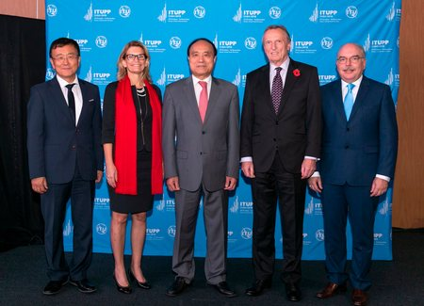
The Management Team of ITU
General Secretariat Secretary-General：Houlin ZHAO
Deputy Secretary-General：Malcolm JOHNSON
Radiocommunication Bureau（BR）Director：Mario MANIEWICZ
Telecommunication Standardization Bureau（TSB）Director ：Chaesub LEE
Development Bureau（BDT）Director：MS Doreen BOGDAN-MARTIN

Slide 7


ITU Structure and Major Events
Plenipotentiary Conference （PP）（every four years，PP-18）
Council（every year）
无线电通信部门
ITU-R
电信标准部门
ITU-T
电信发展部门
ITU-D
世界无线电通信大会（WRC）（四年一次，WRC-19）
世界电信标准化全会（WTSA)
（四年一次，WTSA-20）
世界 / 区域性
电信发展大会（WTDC）
（四年一次，WTDC-17）
无线电通信全会（RA）
区域无线电通信大会 (RRC)
指导委员会
预算委员会
工作方法
委员会
工作项目与组织委员会
编辑
委员会
全球监管机构专题研讨会 (GSR)
世界电信/ICT指标专题研讨会 (WTIS)
无线电规则委员会（RRB）
电信标准顾问组
（TSAG）
电信标准
研究组
(SG和SCV)
电信发展顾问组（TDAG）
电信发展
研究组
（SG）
无线电通信顾问组 (RAG)
无线电通信研究组（SG和CCV）

Slide 8
Main parts of ITU-T
世界电信标准化全会
（WTSA）
为ITU-T设定总体研究方向和组织结构。确定ITU-T的总体政策、建立研究组、批准未来四年工作计划，并任命顾问组和研究组的主席及副主席。 Define ITU-T structure (SGs and its Questions) and working methods, identify priority issues, approve Recs, appoint Chairmen and vice-chairmen
电信标准化顾问组
（TSAG）
在WTSA休会期间行使部分职责，负责对ITU-T的工作重点、计划、运作、财务等进行审议。向TSB主任提供建议，制定A系列建议书（工作方法），协调跨研究组的课题。 Review priorities, programmes, operations, progress, financial matters and strategies. Provide guidelines and foster coordination and cooperation
研究组
（SG）
设立课题和工作项目，讨论和制定技术标准（建议书、技术报告），是ITU-T工作的重中之重Set up Questions and workitems, formulate technical standards (Recs, technical reports). SGs conduct the core business of ITU-T
焦点组
（FG）
围绕新领域展开研究，帮助推进ITU-T研究组的工作，并吸引组织和个人加入ITU-T。其由TSAG或某个研究组管理，实际成果需主管组进一步审议，不制定标准（不输出建议书），存在周期较短（一般不超过2年）。
标准局
（TSB）
承担ITU-T秘书处职能。组织、协调和支撑ITU-T的工作 Provide operational support in organization of meetings, secretary service and coordination of work.

Slide 9
Content
一、Introduction to ITU
二、Study Group vs Focus Group
三、Participation – China case

Slide 10
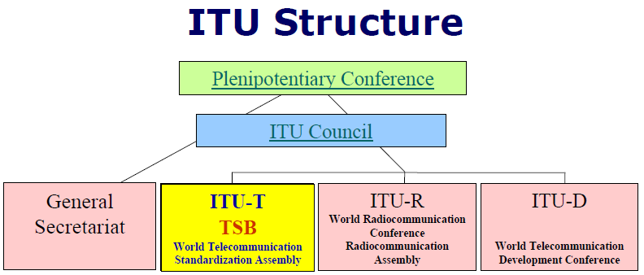
ITU-T as an example
顾问组TSAG
研究组SG
焦点组FG
Workshop and regional meetings
标准建议书
Recommendations
SG2、3、5、9、11、12、13、15、16、17、20
Chairman, vice chairmen
标准补充文件
Supplements
工作组WP
工作组WP
技术白皮书WhitePaper
课题报告人组Q
课题报告人组Q
课题报告人组Q
课题报告人组Q
。。。。。
Rapporteur, Editor
Notes:
TSAG - 电信标准化局顾问组
电信标准化顾问组（TSAG）的最终目标是将ITU-T打造成最具吸引力的开展标准化工作之处。
为此，同时考虑到信息通信技术日益变化的动态环境， TSAG对ITU-T的工作方法进行调整和完善，以便使新工作项目的批准程序和国际标准的形成更加合理化。其结果是，审批一项标准（ITU-T建议书）的时间已从10年前的四年缩短到如今的平均八周时间。对于那些可能具有政策和监管影响的建议书，审批可能需要九个月的时间，以便与世界各国政府进行更多的磋商。
工作要点
TSAG是一个向ITU-T研究组、成员和工作人员提供咨询的机构，需考虑到所有成员的需要，无论是发达国家还是发展中国家，行业还是政府。该组负责履行A系列建议书规定的工作程序，并负责安排ITU-T的工作计划。顾问组在ITU-T内部履行极为重要的职能，跟踪工作计划的实施并向ITU-T秘书处（电信标准化局- TSB）的主任献计献策。
TSAG通常还需应要求解决各研究组之间的协调问题，在ITU-T推广电子工作方法的使用，并就与其他标准机构的关系提出意见和程序。此外，该组每九个月召开一次会议，负责审议ITU-T的运作规划和财务规划，并作为四年举办一届的世界电信标准化全会的筹备组行事。近来顾问组的许多工作围绕着下一代网络（NGN）工作的协调方式进行—这已成为ITU-T所有研究组和焦点组工作的重中之重。

Slide 11
ITU-T SGs and FGs （ 2017 -2020）
SG | AREAS
SG2 | 业务提供和电信管理的运营方面
SG3 | 资费及结算原则和国际电信/ICT的经济和政策问题
SG5 | 环境、气候变化与循环经济
SG9 | 电视和声音传输与综合宽带有线网络
SG11 | 信令要求、协议、测试规范与打击假冒产品
SG12 | 性能、服务质量和体验质量
SG13 | 未来网络（侧重于IMT-2020）、云计算和可信网络基础设施
SG15 | 用于传输、接入及家庭的网络、技术和基础设施
SG16 | 多媒体编码、系统及应用
SG17 | 安全
SG20 | 物联网及智慧城市与社区
FG | AREAS | Parent
FG DPM | 支撑物联网及智慧城市与社区的数据处理与管理 | SG20
FG DFC | 数字货币，含数字法定货币 | TSAG
FG DLT | 分布式账本技术的应用 | TSAG
FG ML5G | 未来网络（包括5G）机器学习 | SG13
FG NET-2030 | 网络技术-2030 | SG13
FG VM | 车载多媒体 | SG16
FG AI4H | 健康医疗人工智能 | SG16
Total 11 Study Groups and 7 Focus Groups, among which four FGs were set up in 2017, three in 2018.
Notes:
目前设有11个研究组。

Slide 12
Study Group vs Focus Group
Study Group
The unit for formulating technical Recommendations
Outcome：ITU-T Recs.，Supplement
Formal procedure: Alternative Approval Procedure (AAP)：adopted by 90% technical standards；Traditional Approval Procedure (TAP)：regulatory aspects implication
Participants are members of ITU-T
Fixed meeting intervals, comparatively long period, once every ten months
As parent group of Focus Group
Established by WTSA or TSAG
Budget by ITU
Focus Group
The working mechanism in quick response to the needs of the members in new technology and emerging area.
Deliverables: Technical specifications, reports on standards gap analysis, base material for drafting Recs.
FG decides its working method. Approval obtained by consensus.
Open to any individual from a country that is a member of ITU and who is willing to contribute actively to the work.
Up to 2 and half years. Frequent meetings, usually a quarterly
Established by Study Group or TSAG
Voluntary budget

Slide 13
Study Groups vs Focus Groups
Study Group
ITU-T 国际电信联盟 电信标准化部门 世界电信标准化全会 2016年10月25 - 11月3日，哈马马特 RESOLUTION 1– Rules of procedure of the ITU Telecommunication Standardization Sector
Focus Group
ITU-T A.7 国际电信联盟 (10/2016) 电信标准化部门 Focus groups: Establishment and working procedures
Resolution 1 of ITU-T was formulated in 1956, and revised every four years.
A.7 was formulated in 2000. The current text is 6.0 edition.

Slide 14
Recommendation ITU-T A.7 Focus groups:
Establishment and working procedures
10 Deliverables – approval and distribution
Deliverables can be in the form of technical specifications, reports on standards gap analysis results, base material for the development of draft Recommendations, etc., and are expected to form input to the advanced work of the parent group. The focus group will send all of its deliverables to the parent group for further consideration (see also clause 7). The deliverables shall be published as TDs of the parent group in accordance with clause 3.3.3 of Recommendation ITU-T A.1, but no later than four calendar weeks before the meeting of the parent group.
Notes:
2

Slide 15
CASE Focus Group Digital Financial Services (FG DFS)
(Established in June 2014, and concluded in Dec. 2016)
Published 85 policy recommendations and 28 supporting thematic reports. The FG brought together more than 60 organizations from over 30 countries to drive greater financial inclusion for the estimated two billion people around the world who remain unbanked. The 85 policy recommendations offer guidance in areas such as digital liquidity, consumer protection to enhance DFS usage, data privacy, digital identity and e-KYC (Know Your Customer), as well as interoperability and fair access to the communication channel.
针对20亿成年人没有银行业务，以及发展中国家数字金融业务缺失的问题进行探讨。焦点组在两年半时间内研究出85条政策性建议和28份技术报告，推动发展中国家实施普惠金融策略，采用数字金融业务，TSAG在2017年5月的会议上通过了这28份报告，包括：区块链技术和普惠金融，DFS技术演进和创新，DFS竞争，DFS移动终端，管制者实施互操作性的正确时机，DFS厂商的平台特性，消费者保护，DFS安全性，身份和认证等。
Notes:
2

Slide 16
Content
一、Introduction to ITU
二、Study Group vs Focus Group
三、Participation – China case

Slide 17
Major Difficulties of New Members
Not familiar with the rules, procedures, working methods of international or regional standardization organizations
Big gap between the developed and developing countries. Lack of experience in standardization process. Lack of motivation at domestic enterprises level, even having recognized the significance of standards..
Too many standardization organizations to fellow due to limited enterprise resources
Cannot persistently take part in due to the costly involvement
The membership fees of international standardization organizations are relatively high
Lack of participating skills such as writing contributions, setting up work items, drafting and editing recommendations.
The number of people holding a position in the work of SGs and FGs is few.
Language
Notes:
2

Slide 18
The national office (The ITU Secretariat of MIIT )
International and Domestic Communication Links
Bridge between government and private sectors
Communication Platform among Members

Slide 19








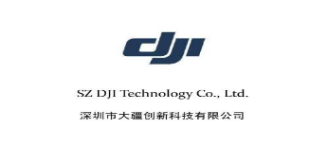





















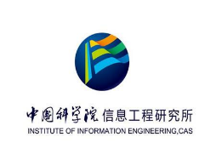


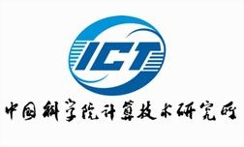




The members from China to ITU-T
Sector members（17）
Associates（13）
Academia （9）

Slide 20
Why Is ITU the First Choice
The ICT standardization work is getting increasingly fragmented, and the number of SDOs is growing
International standardization organizations: ITU, ISO, IEC, 3GPP, IETF, IEEE and W3C
Regional standardization organizations: ETSI
National standardization organizations: SAC and CCSA
Various other industry forums - Over a hundred in the ICT sector, constantly springing up and disappearing
Notes:
2

Slide 21
Why Is ITU the First Choice
An authoritative intergovernmental organization that comprises 193 sovereign states
ITU-TSB is the specialized Secretariat.
The ITU headquarter owns first-class international conference facilities
Six working languages
ITU underscores consensus (which means attendees cannot constantly oppose, but can reserve their views), although the end of game is to vote (a simple majority) in procedure. However, at ITU, voting is a deterrent, and not used frequently.
Participation by developing countries
Notes:
2

Slide 22
Thank you！

