Slide 1
Testing the clinical validity of machine learning-based diagnostics for Alzheimer’s disease (AD).

Slide 2
Studies show early diagnosis may save USD 10-12K per patient
Study 2 – United BioSource Corporation
Study 1 – University of Wisconsin
Stage
MMSE* score between 10-26
Costs
Drug therapy (donepezil)
Continuous screening
Saving
Direct costs = US$ 5.8K
Indirect costs = US$ 6.6K (informal caregiver time)
Total = US$ 12.4K per patient
Stage
Highest benefits at early stages (MMSE* 28)
Costs
Drug therapy (acetylcholinesterase inhibitor)
Early caregiver intervention
Saving
Average delay of 1.5Y nursing home admission
Up to US$ 10K per patient
*Mini-Mental State Examination: Scores 0-30. 24 and higher indicate cognitive normal

Slide 3
Saving potential of CHF 3bn to the Swiss society
*Alzheimer = 80% Dementia cases. Economy of $11K/patient

Slide 4
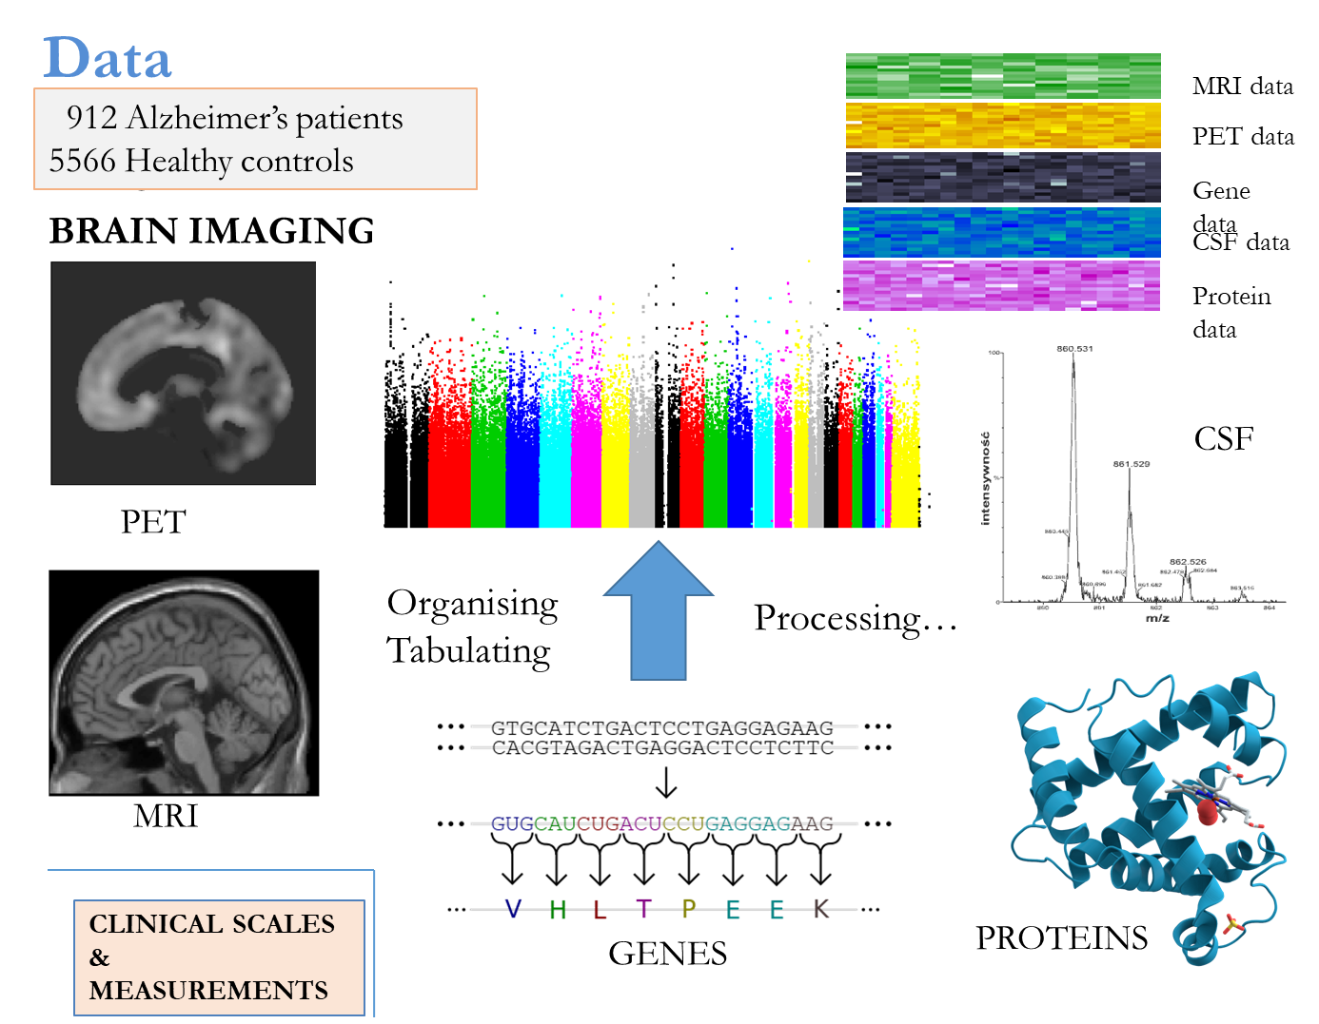

Slide 5
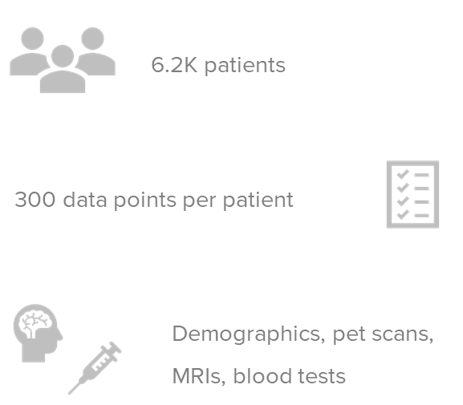
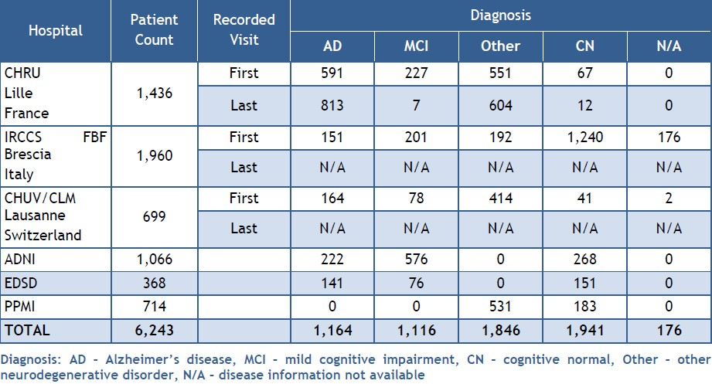

Slide 6
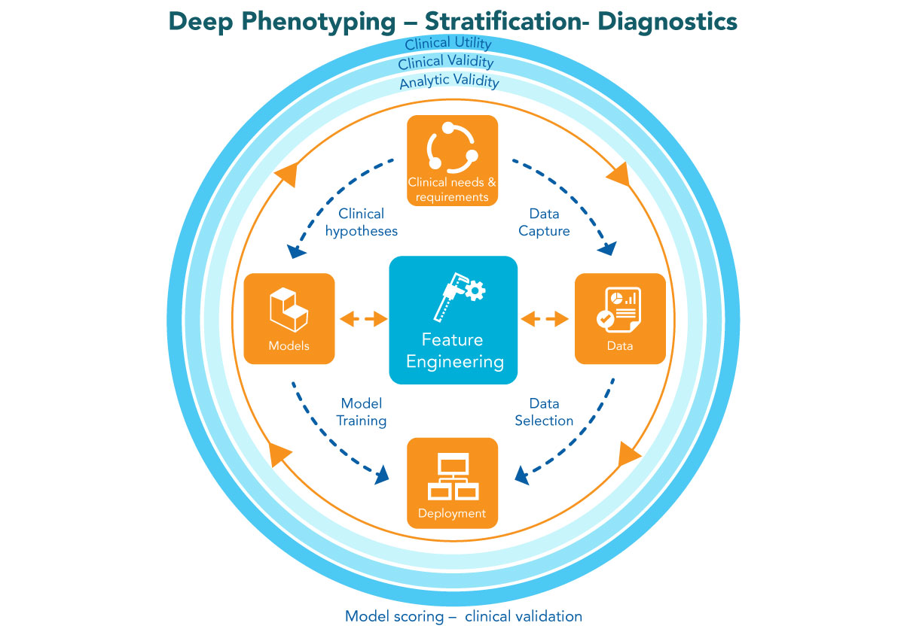
Benchmarking
Tests adherence to doctor’s clinical diagnosis
Test accuracy: F1 score
Clinical sensitivity: ability to identify those who have or will get the disease = TP/(TP+FN)
Clinical specificity ability to identify those who do not have or will not get the disease =TN/(FP+FN)
Clinical precision the probability that the disease is present when the test is positive =sensitivity x prevalence / (sensitivity x prevalence + (1-specificity) x (1-sensitivity) )
Clinical utility.

Slide 7
Data Integration Platform
Users Management
Web-Analytics
Federated
Query
Federated Machine learning
Data Harmonization
Predictive models
Orchestration/cross-validation
/secure aggregation/
Orchestration/cross-validation
/secure aggregation/
Server
Server
Server
Local Machine Learning
Local Machine Learning
Local Machine Learning
Feature Store
Feature Store
Feature Store
Data Factory
Data Factory
Data Factory
Data Capture
Data Capture
Data Capture
Neuroimaging
Neuroimaging
Neuroimaging
Clinical scores + EHR
Clinical scores + EHR
Clinical scores + EHR
Labs
Labs
Labs

