Slide 1
What is the future for PMR ?
Phil Kidner
CEO TCCA

Slide 2
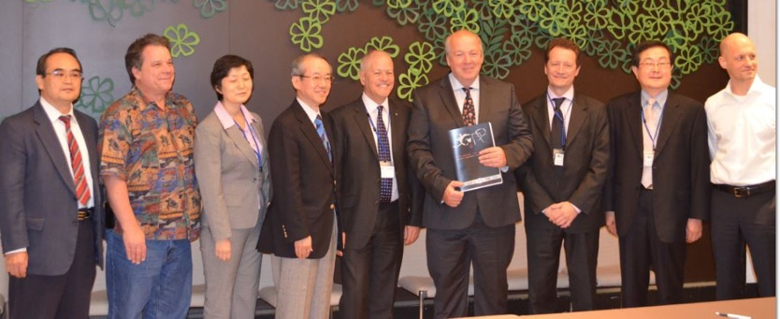
TCCA
Proud to be a 3GPP Market Representation Partner

Slide 3
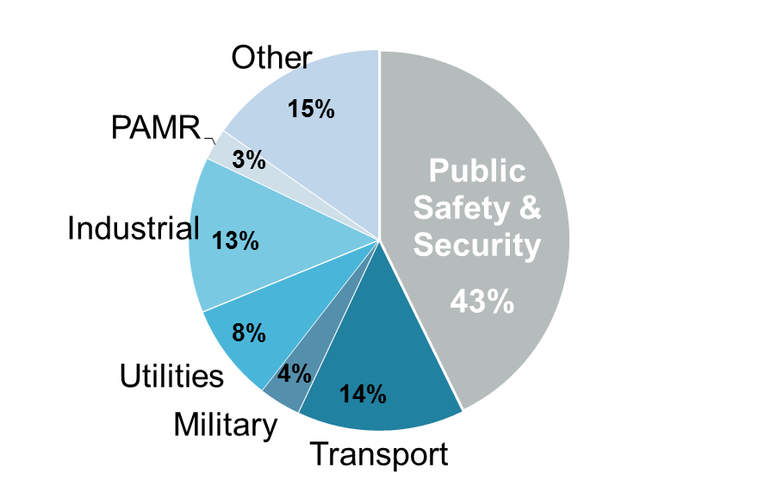
The PMR market today
44 Million Users
<50% Public Safety & Security
A growing industrial and transportation base
Roughly evenly split between EMEA, Asia and Americas
Courtesy of

Slide 4
Essential requirements include:
Essential requirements for all critical communications users include:
Clear voice
Instant group communications voice and data
Person to person private calls
Simultaneous voice and data
Emergency call and priority
Privacy and encryption where needed
Available outside of coverage
Available where you need it
Control of your own communications
And more ….

Slide 5
As well as Japanese standards there is ….

Slide 6
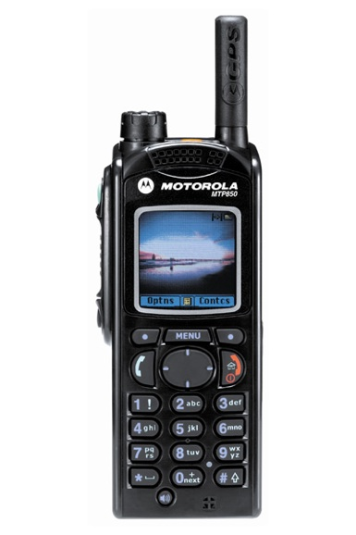
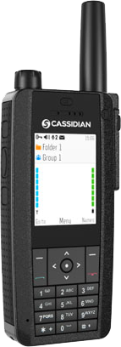
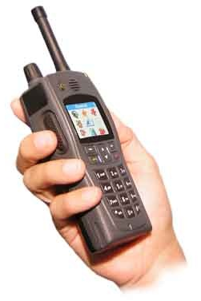
Things we can do today –
Data in your hand!
TETRA terminals include great data features on the radio itself — pull information — push information — alarms (callout).
Big screens that can fit in your hand and are visible in every situation, including in sunshine.
Single device mission and business critical solution for both voice and data.
Examples from Motorola, Sepura, EADS, Teltronic

Slide 7
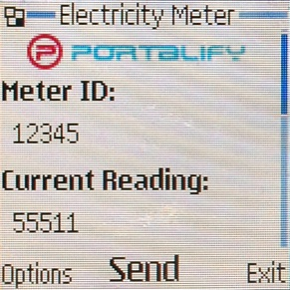
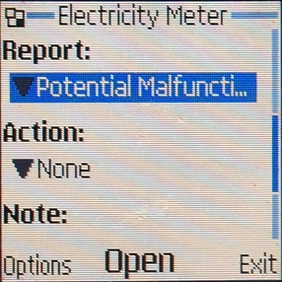
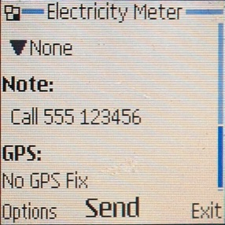
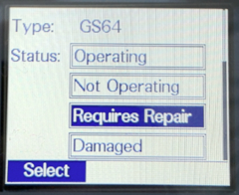
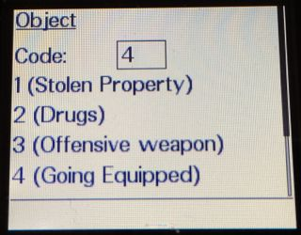
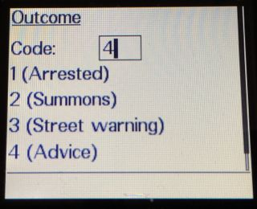
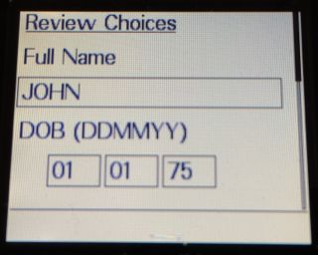
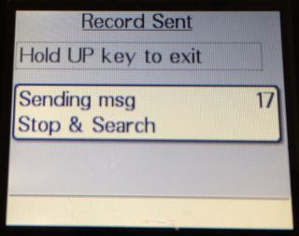
Things we can do today - databases

Slide 8
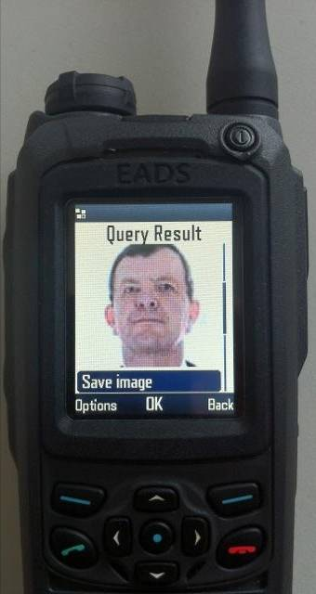
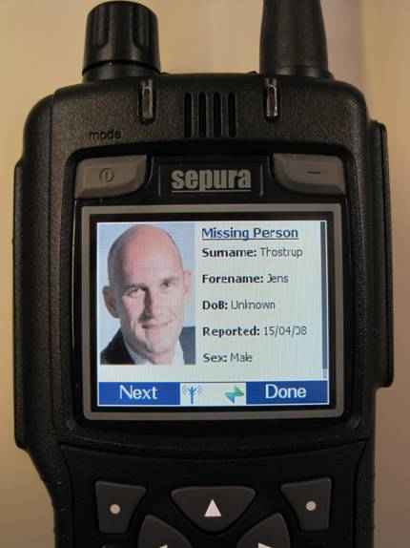
Things we can do today -Images
Notes:
Delivered over SDS.
Concurrent voice and data

Slide 9
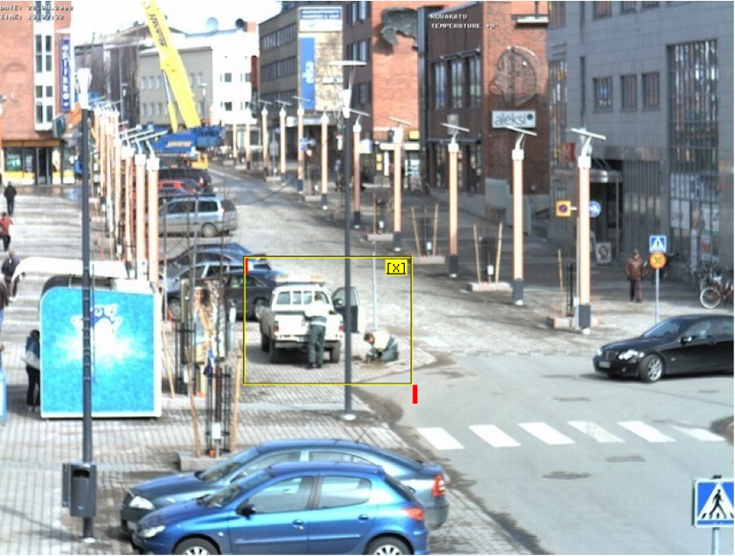
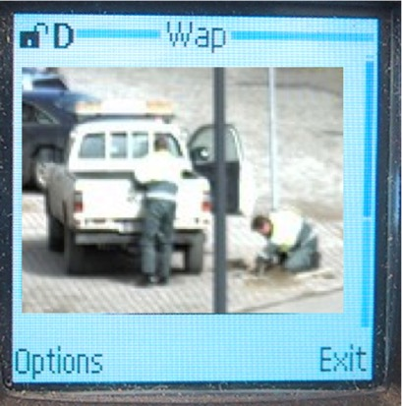
Things we can do today - CCTV
500k
1.5k
Notes:
Summary
- From Picture information to useful commanding tool

Slide 10
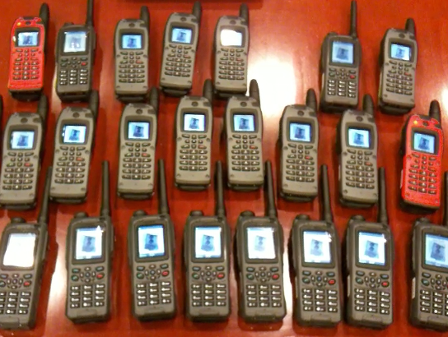
What we can do today – group data

Slide 11
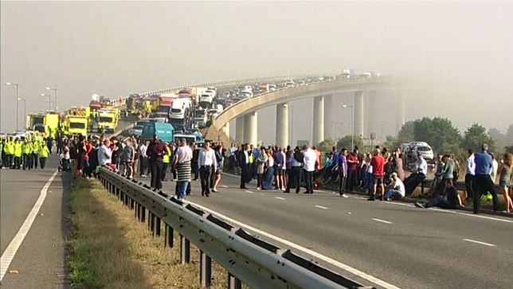
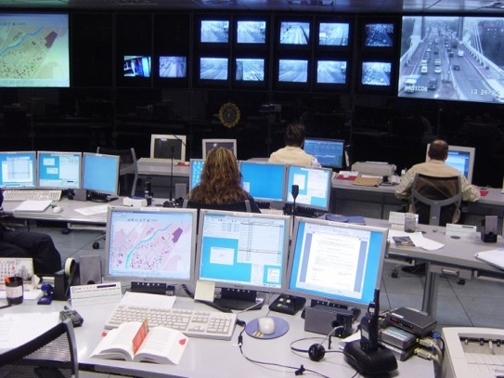
Things we struggle to do today – primarily Live Video Streaming
Notes:
Streaming live video direct from the scene of a Motorway accident….

Slide 12
Consumer networks
So do we need to throw all of this away in order to share networks with over 7 billion consumers ?

Slide 13
LTE will be part of the future But what are the challenges ?

Slide 14
Spectrum
Limited and expensive resource
Some regulators reluctant to dedicate to Public Safety and critical communications
TETRA voice and narrow band data – 25 khz channels and 6.25 khz slots
TETRA wideband data - TEDS 25-150 khz
Predominately in 350 – 470 KHz
Minimum channel sizes for LTE 1.4 MHz upwards often in higher frequencies

Slide 15
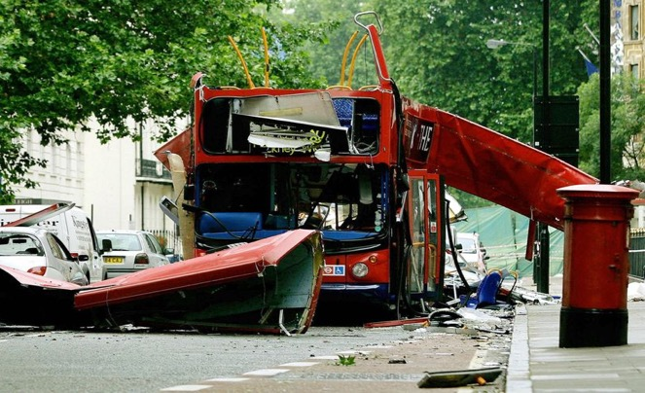
Public systems
Globally public systems have failed to cope with major incidents
Targeted at people not geography
Lack of resilience
Capacity

Slide 16
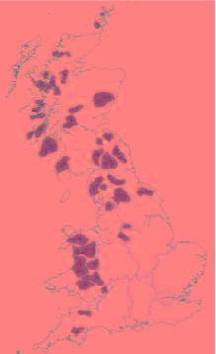
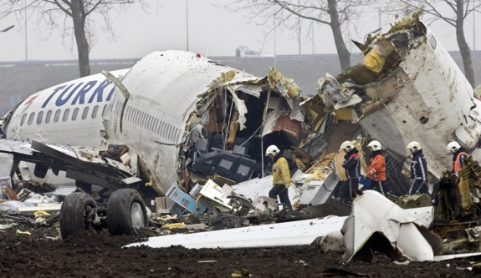
Coverage, capacity & control
Public Safety radios must work first time every time. Even when there is no network coverage.
Sufficient capacity when both the public and critical communications users need it most.
Control

Slide 18
Applications
Applications are becoming increasingly important
What is not mission critical today will be tomorrow

Slide 19
Standards
Creates competition. Drives up functionality. Drives down costs
A key to the success of many current PMR standards

Slide 20
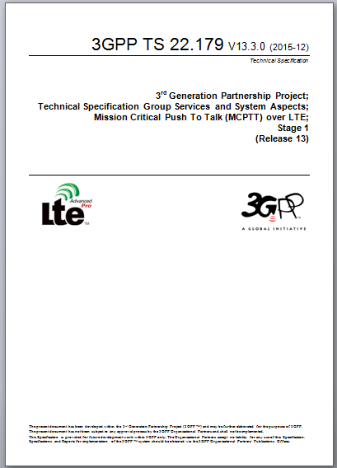
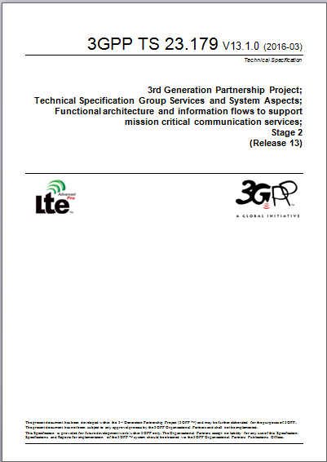
MCPTT – Mission Critical Push to Talk
Voice services similar to existing radio systems
Private call
Group call
Broadcast call
Regrouping
Stage 3 completed and approved March 2016
There is now a complete suite of Release 13 specifications for MCPTT
840 requirements in Stage 1
70% covered in Release 13
10% part covered in Release 13
20% not covered in Release 13
Further requirements will be satisfied in following releases:
Some aspects of group call and group management
Call back
Ambient listening
Interworking between systems
Interworking with non-MCPTT systems (PMR/LMR)
UE to UE relay
Enable/disable

Slide 21
MCData – Mission Critical Data
Mission critical data service
Prioritisation
Group services
Connected to user organisation, not MNO/Internet
Simple messaging
Analogous to TETRA Short Data
Supports messaging and other applications
Status
File distribution
User and group based service
Data streaming
Point to point IP connectivity
Performance suitable for remote control applications (robots, drones etc)
Progress: in requirements phase (stage 1)
Part of Release 14
Requirements phase to be complete June 2016
Release complete ~ March 2017

Slide 22
MCVideo – Mission Critical Video
Mission critical video service
Performance – latency etc
Prioritisation
Group services
Interoperable – does not replace other video applications, but ensures compatibility, e.g. during mutual aid etc
Real time and non real time
‘Push’ and ‘Pull’
Standardised video codec(s) for interoperability
Control of resolution, frame rate etc
Support for camera control protocols
Robots and drones
On and off-network (Direct Mode)
Progress: in requirements phase (stage 1)
Part of Release 14
Requirements phase to be complete June 2016
Release complete ~ March 2017

Slide 23
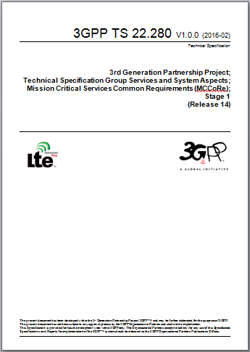
MCCore – identification of common requirements
Recognition that many aspects of mission critical service are common across all applications (speech, video etc)
Identification of users and groups
Group and broadcast communications
Including affiliation, late entry to calls etc
Prioritisation of services
Security
May lead to common requirements and interfaces for future mission critical applications
Progress: in requirements phase (stage 1)
Part of Release 14
Requirements phase to be complete June 2016
Release complete ~ March 2017

Slide 24
Leaders ?
FirstNet
ESN
South Korea
France
Europe

Slide 25
Future: VIRVE TETRA continues – data develops in parallel
Time window for managed transition from TETRA
Non-critical LTE voice
Critical LTE data+voice (LTE Rel 12+) available
Broadband capability
LTE operating capability via MVNO
Commercial complementary data access + MVNO
TBS2 → TB3 renewal
TETRA Rel8/9 LTE voice phase 2+3
TETRA- capabilities
TETRA Rel7 Dual homing + LTE voice phase 1
TETRA Rel6 DXT3
TETRA voice and data
2010
2015
2020
2025
Need for dedicated data solution
Notes:
TETRA kehittyy edelleen – standardointi jatkuu
– valmistauminen siirtymään alkaa (IP transmissio, IP sovellukset …)

Slide 26
The future ?
All PMR networks whether PDT, TETRA, P25 etc will continue to deliver mission critical voice and some narrow band data.
Critical communications users, particularly Public Safety, will deploy LTE devices providing broadband data communications for an increasing number of applications.

Slide 27
Thank you
www.tandcca.com
Find TCCA also on:
LinkedIn
Facebook www.facebook.com/tandcca
Twitter @tandcca
YouTube www.youtube.com/user/tandcca

