Slide 1

Defending Vehicle ECUs from Malicious Attacks and Intrusions
Using Hardware Security Modules (HSM)
ITU/TTC Workshop on
How Communications will Change Vehicles and Transport
July 4, 2016
Seigo Kotani, Ph. D.
Principal Expert, Mobility IoT Business Unit, Fujitsu Ltd.
TCG* Board of Director, Co-Chair of Embedded Systems WG and Vehicle Services Subgroup
*

Slide 2
Agenda
Fujitsu’s activities for vehicle securities
Proposal based on HSM, typically TPM*
Introduction of TCG and TPM 2.0 Automotive Thin
Feasibility study to Remote Firmware Update for Vehicle ECU with TPM
*Trusted Platform Module

Slide 3



Fujitsu’s Mobility IoT Business Unit from Feb. 2016
■ We’ll aim at a global servicer in the Mobility business by providing service application and integration system.
Concept : Mobility as a Service（MaaS） Mobility IoT Platform
■ We’ll support safety, relief and comfortableness of human’s mobility with sensor and AI technologies. Concept : Human Centric Mobility
+
Category | Products/ Service | Description
Mobility as a Service | BigData utilization services | Services to business which related to mobility
Mobility IoT Platform | Cloud Platform | Cloud platform for mobility business
 | Dynamic Map Database | Dynamic Map data management system
 | AI Platform (IoT/Cloud) | Deep Learning Unit (DLU)
 | Security (IoT/Cloud) | Cyberattack protection
Human Centric Mobility | Driver Sensing | Contactless vital sensing (Iris, Pulse, etc.)
Mobility as a Service
Services to business
which related to mobility
(Target businesses)
Insurance
BigData
Police/Security
Logistics/
Transportation
Mobility IoT
Solution
Infrastructure
etc.
IoT Devices
Cloud
Sensor Technology
Cloud platform
Human Centric Technology
Functions utilizing BigData
Human Centric Mobility
Mobility IoT Platform

Slide 4





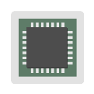

Demo Overview in Fujitsu Forum Tokyo 2016
Planning phase
Design/
development phase
Management phase
Security consulting
Drafting security policies
↓
Security threat analysis
↓
Proposing defense measures
Providing security products
Device authentication (first wall)
Filtering (second wall)
Message authentication (third wall)
Configuration management
Key management
Remote maintenance
Service solutions
Key management system
Configuration management system
Falsification detection system
Maintenance service
Life cycle management
Cloud (Mobility IoT Platform)
Security middleware/
library
Multi-layered defenses effective in protecting the system as a whole from the risk of hacking
Security service
First
wall
Second
wall
G/W
Third
wall
Internet
Virus infection
Hacker
Sending
unauthorized
messages
In-vehicle service 1
In-vehicle service 2
In-vehicle service 3
Unauthorized
access
Hacking
Security library
Eavesdropping
Data falsification

Slide 5
Proposal
Methods for Defending Vehicle ECUs from Malicious Attacks and Intrusions
Using Hardware Security Modules (HSM)
global industry standards, supportive of a hardware-based root of trust, for interoperable trusted computing platforms.
TPM (Trusted Platform Module)
Conventional HSM
(Application)
(Application)
Interface
Interface
Protocol
Protocol
Function
Function
Algorithm
Define in the TCG specifications
Algorithm
IP Core
Define in the international standards
IP Core
Package
Package
Assure a behavior by using TCG testbed
Proprietary product

Slide 6
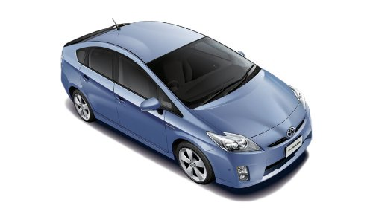


Why TPM?
Require critical functionality for remote maintenance of vehicle
  Secure communications to remotely verify current situation
  Confirm installation completion and success or failure
  Record and retain certifiable audit logs
TPM (ISO11889) /TNC* (IETF RFC5792/5793) technologies could satisfy these requirements with reasonable costs
Support independent third-party verification
⇒Satisfy transparency and fairness
Induction
Log
ECU
TPM
Create & deliver by using open technologies
⇒ Guarantee the verifiability of audit logs
*Trusted Network Connect

Slide 7
TCG: Mission and History
The Trusted Computing Group (TCG) is a not-for-profit organization formed to develop, define and promote open, vendor-neutral, global industry standards, supportive of a hardware-based root of trust, for interoperable trusted computing platforms.
  Work based on hardware root of trust
  Over 10 years of creating widely used and highly vetted industry specifications
  Some specifications are international standards
  Specifications embodied in more than 2 billion products today
Standards Drive Adoption

Slide 8










































TCG: Membership
Total Membership including Commercial, Liaison, Academic, Invited Experts and Government participants: 130+Members:
Vehicle, Chips, Cloud, Embedded, IoT, Mobile, PC
Promoters:
Contributors:

Slide 9
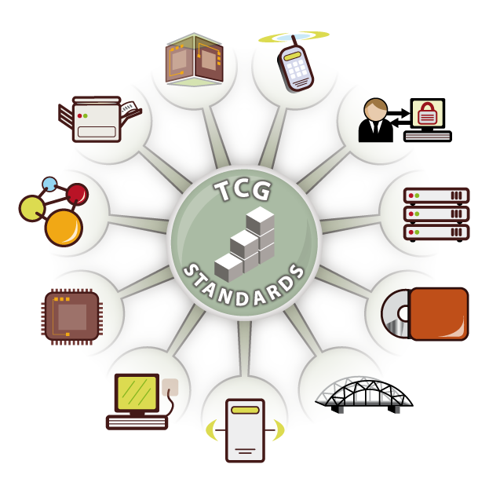

TCG Working Groups
Embedded Systems
– 4 Subgroups: Vehicle Services, IoT, Network Equipment, RTM*
Infrastructure
Mobile
PC Client
Server
Storage
TCG Software Stack
Trusted Mobility Solutions
Trusted Multi-tenant Infrastructure
Trusted Platform Module
Virtualized Platform
…
June 2011
Established
Virtualized Platform
Mobile Phones
Embedded
Systems
Authentication
Storage
Network
Security
Applications
Security
Hardware
Infrastructure
Desktops & Notebooks
Servers
*Root of Trust Measurement

Slide 10
Standardization
Trusted Computing Technologies
  Trusted Platform Module (TPM) – hardware root-of-trust & key storage
  Trusted Network Connect (TNC) – access control & endpoint compliance
  Self-Encrypting Drive (SED) – hardware encryption & fine-grained locking
  Automotive, PC Client, Mobile – Profiles of TPM 2.0 Library Spec
Trusted Computing Platforms
  Interfaces across multiple platforms for trusted data, devices, and networks
  Automotive, Embedded Systems, Internet of Things, Cloud/SDN, Virtual Machines, Servers, Desktops, Laptops, Tablets, Mobile Phones, and more
Formal Liaisons, Collaborators/Partners
  ETSI, Global Platform, Industrial Internet Consortium (IIC), Mobey Forum, ISO, IEEE, IETF, OASIS, and more
TCG TPM 2.0 Automotive Thin Profile Family “2.0” Level 00 Version 1.0 Published: March 16, 2015
http://www.trustedcomputinggroup.org/wp-content/uploads/TCG-TPM-2.0-Automotive-Thin Profile_v1.0.pdf

Slide 11
TPM2.0 Automotive Thin Profile
Features
  For sensors, actuators, and controllers implemented as digital ECUs with limited resources (slow CPU with limited ROM, RAM and NVRAM)
  For deployment in ECUs to support their integrity and attestation for secure boot, normal operation, and remote maintenance services
  ECU measures firmware into TPM PCR*, uses TPM to create an integrity digest and sign the digest, and sends digest to maintenance center
  ECU receives the appropriate firmware update, installs the update, and sends confirmation of the successful installation
*Platform Configuration Registers

Slide 12
Message Flow for Remote Maintenance
Remote Center
Recognize a status of the vehicle by surveying FW Digest
Select & send a suitable update data
“TPM 2.0 for Automotive Rich” installed in Head unit
Work as “TPM 2.0 for whole vehicle”; furthermore
Gateway between the Remote Center and ECU
TNC
Update Data
“TPM 2.0 for Automotive Thin” installed in ECU
Measure ECU FW to create a digest & sign to the digest
FW
Digest
Head Unit / Gateway
Applications
ECU
OS
Application
HW
Update Data
1~2 core
RAM
HW
TPM
1 core
RAM
FW
Digest
Others
Others
TPM
Auto-Rich
Installed
Auto-Thin
Installed

Slide 13
Reference: Auto Thin Resources
Auto Thin Profile – TPM 2.0 Mandatory Resources
  Authorization Sessions
    Minimum of 3 sessions
  Cryptographic Algorithms
    • At least one of RSA 2048 or ECC P256. Additional asymmetric algorithms and key sizes are allowed.
    • At least one symmetric algorithm. AES 128 is recommended, others are allowed.
    • SHA-256. Other hash algorithms are allowed.
  Platform Configuration Registers (PCRs)
    PCR₀ is required – only reset by TPM2_Startup().
    Support for other PCR is optional.

Slide 14
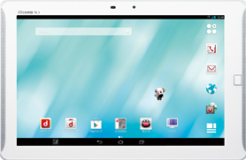
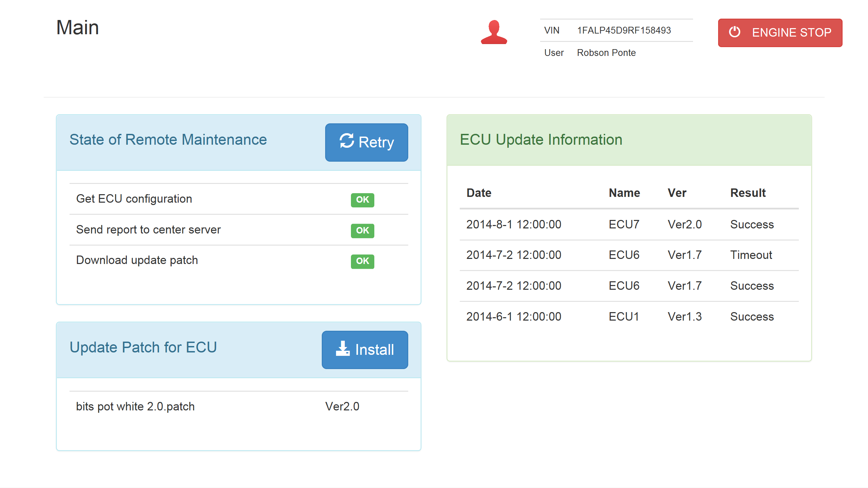
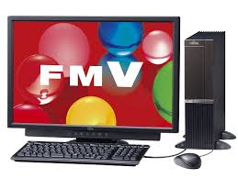
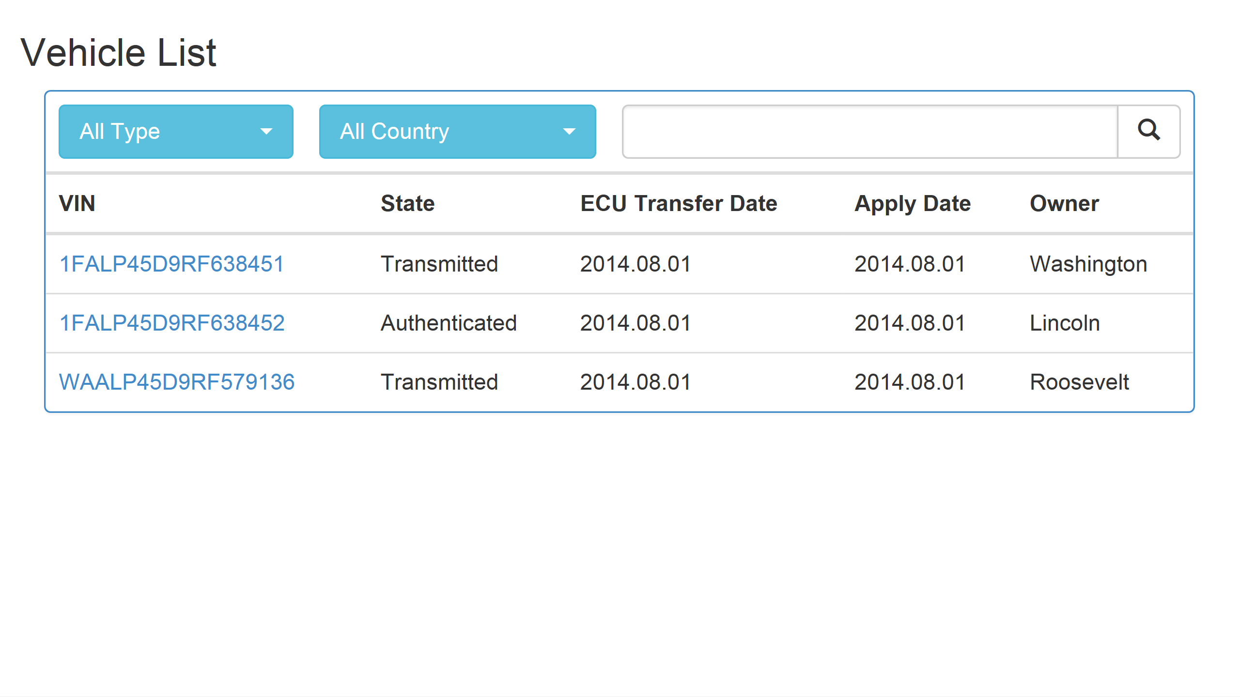


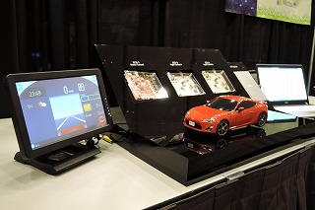
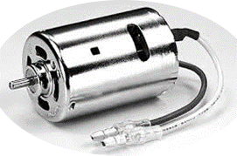

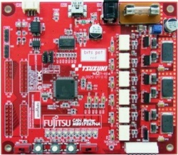
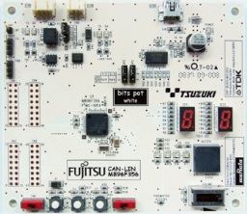
Remote Firmware Update for Vehicle ECU with TPM
Connecting Center, In-vehicle Server and ECUs, files downloaded from Center enable ”ECUs update” with TCG’s TPM authentication procedure.
Cloud
Vehicle
In-Vehicle HMI on Tablet PC
3G LTE
or other
Remote Maintenance
Center
In-Vehicle
Server
Wi-Fi
TCG published TPM 2.0 Automotive Thin Profile v1.0
TrustCube concept is built-in
®
CAN or
other
Motor
ECU1: Actuator
ECU2: LED
2016/2 RSA Conf. SF,
2016/4 SAE World Cong. Detroit

Slide 15

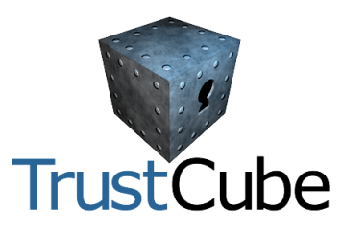

Fujitsu: TrustCube concept
®
Who
Identify operator
by ID/PW, Biometrics
What
Current platform
identify, Registered ID,
PKI Certificate
®
How
Current environment of
platform: software version,
hardware model
3D analysis using trust factors
to determine the level comm. &
actions to be authorized
Record and retain certifiable audit logs
with “who agreed”, “for what platform,”
“why accepted remote maintenance,” etc.
Input as
specifications

Slide 16

Thank you, Questions?
Join us!
TCG
http://www.trustedcomputinggroup.org/
Embedded Systems WG
http://www.trustedcomputinggroup.org/developers/embedded_systems
If you are interested in the following applications;
Standardization for
Automotive
IoT
Hardcopy devices
Mobile communication devices
Household applications (TV/Settop box, etc)
Industrial control and machinery
Financial transaction terminals
Medical equipment
Smart Grid/Smart meter
Sensor network/Monitor cameras …
Please contact
Seigo Kotani
skotani@jp.fujitsu.com

