Slide 1

ITS Radiocommunications Policies in Japan
July 4, 2016
Yuji Nakamura
Director of New-Generation Mobile Communications Office,
Radio Dept., Telecommunications Bureau,
Ministry of Internal Affairs and Communications (MIC),
Japan

Slide 2
ITS Development in Japan

Slide 3
ITS promotion framework of Japanese Government
3
Cabinet Secretariat
(IT Strategic Headquarters)
Cabinet Office
(Council for Science, Technology and Innovation)
NPA
National Police Agency
Road traffic safety
MIC
Ministry of Internal Affairs and Communications
Info-Communication Technology for ITS
METI
Ministry of Economy, Trade and Industry
Promotion of the automobile industry
MLIT
Ministry of Land, Infrastructure, Transport and Tourism
Road Bureau
Deployment of road infrastructure
Road Transport Bureau
Safety standards for automobile

Slide 4


Current Situation of ITS in Japan
4
Enhancement of ITS by effective use of Information Communication Technology
DSRC (Dedicated Short Range Communication)
ETC (Electronic Toll Collection) since 2001
- over 74 million units as of May 2016
ITS Spot since 2011
- About 1600 locations mainly on expressways nationwide
- Providing drivers with safe driving support information
VICS (Vehicle Information and Communication System)
- Since 1996
- traffic information through FM-multiplex broadcasting, radio beacons and infrared beacons
- over 51 million vehicles as of March 2016
ETC
Advanced Driver Assistance Systems
- V2V, V2I and V2P communications via 700MHz band radio waves
Probe information
- Probe information collection by each car maker
- Providing each users with traffic information
Target detection system in front
- On-vehicle radar system using radio waves, supersonic waves and infrared ray, and camera
- Detecting vehicles and obstacles in front
- Warning, emergency brake, keeping inter-vehicle distance
Obstacles detection system around vehicle
- radar system using radio waves and supersonic waves, and camera
- Detecting obstacles and warning

Slide 5
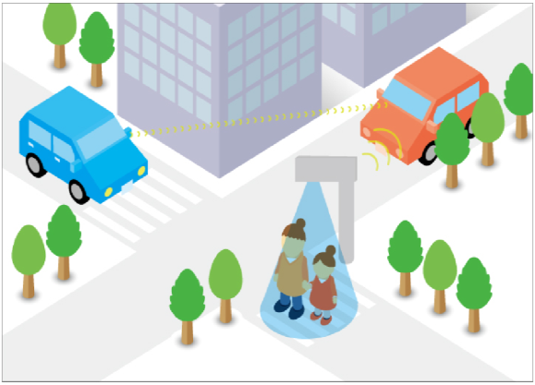
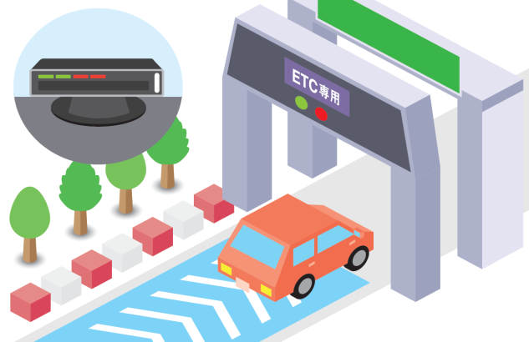

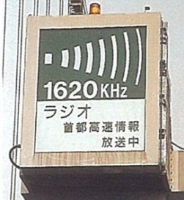
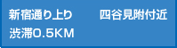
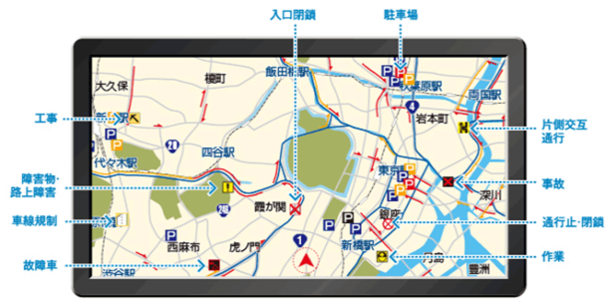
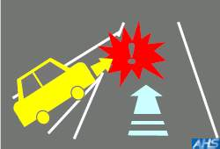
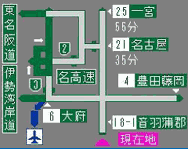
ITS Radiocommunications in Japan (1)
5
700 MHz ITS
（Advanced Driver Assistance Systems）
Electronic Toll Collection System (ETC)
Millimeter Wave Radar
24/26 GHz Band UWB Radar or 79 GHz Band High-resolution Radar
Avoiding Vehicle Collisions by vehicle-to-vehicle communications.
76 GHz Band Long-distance Radar
1620
kHz
76～90
MHz
755.5～764.5
MHz
2.5GHz
5770～5850
MHz
22～29
GHz
60～61
GHz
76～77
GHz
78～81
GHz
kHz
(2) Simplified Graphic display type
GHz
Roadside Broadcasting
(Highway radio)
Vehicle Information and Communication System (VICS)
Dedicated Short Range Communication
(DSRC・ITS Spot)
左から合流車、注意
ITS spots provide information detected by roadside sensors.
(1) Text display type
(2) Simplified Graphic display type
(3) Map display type

Slide 6
ITS Radiocommunications in Japan (2)
6
 | Spectrum | Service | Introduction time
Roadside Broadcasting (Highway Radio) | 1620kHz | Provide Traffic information | Since 1980
VICS (Vehicle Information and Communications System) | 76-90MHz (FM multiplex broadcasting) 2.5 / 5.8GHz (Radio beacon) | Provide Traffic information | Enacted in 1994
ETC (Electronic Toll Collection) | 5.8GHz | Collect highway toll | Enacted in 1997
DSRC (Dedicated Short Range Communication) | 5.8GHz | Provide various information | Enacted in 2001 (Revised in 2007)
700 MHz ITS （Advanced Driver Assistance Systems） | 760MHz | Provide safety information | Enacted in 2011
Millimeter-wave radar | 24/26GHz 60/76GHz 79GHz | Detect obstacles | Enacted in 2010 Enacted in 1997 Enacted in 2012

Slide 7
ITU-R Recommendation on Radio Interface Standards of V2X
7
○ ITU-R Recommendation M.2084
“Radio interface standards of vehicle-to-vehicle and vehicle-to-infrastructure communications for Intelligent Transport Systems applications”
○ World first commercial services of V2V (October 2015)
Specifications | ETSI | IEEE | ARIB（Japan） | TTA（Korea）
Frequency band | 5855-5925 MHz | 5850-5925 MHz | 755.5-764.5 MHz (Single Channel) | 5855-5925 MHz
Channel width | 10 MHz | 10 MHz or 20 MHz | Less than 9 MHz | Less than 10 MHz
Modulation system | BPSK OFDM, QPSK OFDM, 16QAM OFDM, 64QAM OFDM | 64-QAM-OFDM, 16-QAM-OFDM, QPSK-OFDM, BPSK-OFDM 52 subcarriers | BPSK OFDM, QPSK OFDM, 16QAM OFDM, | BPSK OFDM, QPSK OFDM, 16QAM OFDM Option : 64QAM OFDM
Data transmission rate | 3, 4.5, 6, 9, 12, 18, 24, 27 Mbps | 3, 4.5, 6, 9, 12, 18, 24, 27 Mbps (10MHz) 6, 9, 12, 18, 24, 36, 48, 54 Mbps (20MHz) | 3, 4.5, 6, 9, 12, 18 Mbps | 3, 4.5, 6, 9, 12, 18 Mbps Option : 24, 27 Mbps
Media Access Control | CSMA/CA | CSAM/CA | CSMA/CA | CSAM/CA, Option : Time slot based CSMA/CA
FDD/TDD | TDD | TDD | TDD | TDD

Slide 8

WRC-15 Results (Spectrum for Short Range Radar)
8
77-81 GHz band Spectrum Allocation
Past Allocation
Amateur and Amateur Satellite
Radio Location Service
Short Range Automotive Radar
Long Range Automotive Radar
Radio Astronomy
Fixed
frequency
(GHz)
75
76
77
78
79
80
81
WRC-15 approved this allocation.
Agenda Item 1.18
77.5 - 78 GHz
Additional Primary Allocation

Slide 9
WRC-19 AI-1.12: ITS Application
9
Global or regional harmonization of spectrum for ITS Application
Agenda for the 2019 World Radiocommunication Conference
1.12 to consider possible global or regional harmonized frequency bands, to the maximum extent possible, for the implementation of evolving Intelligent Transport Systems (ITS) under existing mobile-service allocations, in accordance with Resolution 237 (WRC-15);

Slide 10
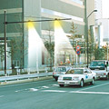





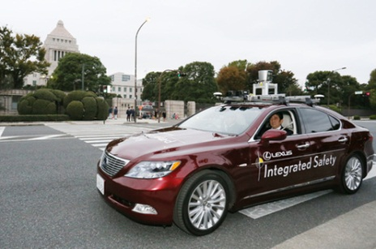
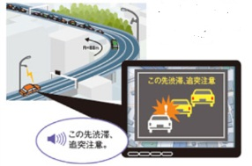
Development of ITS utilizing Radiocommunications
10
Now
(Already become popular)
Now～Near Future
(Recently becoming popular)
Future
Provision of traffic jam Information, charge setting, etc.
Advanced driving support by utilizing camera or radar
（autonomous type）
Highly advanced driving support by combining V2V communication with high-resolution radar, etc.（autonomous plus cooperative type）
Optical Beacon
FM multiplex
broadcasting
Radio Beacon
Alert sounds
Radar
Pre-collision Brake
(Automated braking)
Car navigation, etc.
Connected Cars
VICS
Alert sounds
White lane
markings
ETC
ETC 2.0
Lane keep assist
Automated Driving
Development of ITS

Slide 11
Automated Driving R&D Program
(SIP-adus) in Japan

Slide 12
SIP (Cross-Ministerial Strategic Innovation Promotion Program)
12
（参考）
- Governance Structure -
SIP is aiming to realize Innovation through promoting R&D at all stages by enhancing cross-ministerial cooperation.
CSTI designated research themes based on the expected extent of impact to solve societal issues and enhance economic growth.
CSTI appointed Program Director (PD) for each research theme and allocates the budget.
SIP-adus (Automated Driving for Universal Services) tries to realize automated driving technologies.
CSTI
Governing Board
PD (Program Director)
Promoting committee
●PD (chair)
●Related ministries,
Management agencies,
Experts from academia and
public sector
Management Agency
(Funding Agency)
Research organizations
Universities,
Corporations,
Research institutes, etc.
*CSTI : Council for Science, Technology
and Innovation
Established for
each project

Slide 13

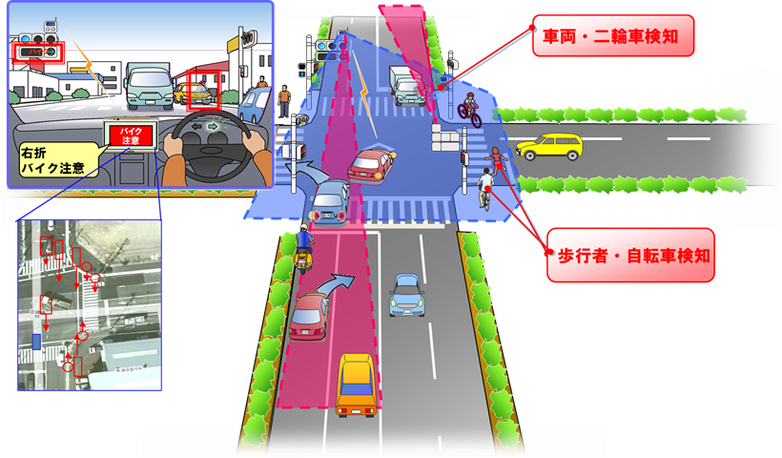
SIP (Strategic Innovative Promotion Program) - Overview
13
Aiming to realize Science & Technology Innovation through promoting R&D overlooking from basic research to implementation and commercialization by cross-ministerial cooperation.
MIC’s efforts in SIP
○ V-V Communication and V-I Communication
Drawing up communications protocol and etc.
Use case of merging
on the free way
○ V-P (Pedestrian) Communication
Developing direct communications style which uses dedicated terminals, mobile phone network application style system and etc.
○ Infrastructure Radar System
Developing 79 GHz band high-resolution radar which can identify pedestrians, cars and etc.
Identify cars and motorcycles
Pedestrian,
bicycle
Alert
Prediction on collusion
and Alert
Alert
Building
Identify pedestrians and bicycles
Detect something in blind spot for drivers
Car（including automated driving car）

Slide 14
Integrated Field Evaluation in 2017
14
Integrating research achievements, SIP-adus will:
- conduct integrated field evaluation tests in 2017
- develop sustainable framework for deployment
- contribute to develop standards and guidelines
Focus areas:
1. Dynamic Map
2. Human Machine Interface
3. Cyber Security
4. Pedestrian Assistance
5. Next Generation Public Transportation

Slide 15
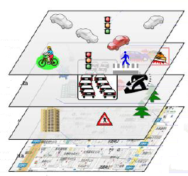
Dynamic Map
15
Hierarchical structure of digital ‘Map’ layered by time frame
Information through V to X
surrounding vehicles
pedestrians
timing of traffic signals
Linked layers
Time frame
Dynamic ( < 1 sec )
Traffic Information
accidents
congestion
local weather
Link
Semi-dynamic ( < 1 min )
Planned and forecast
traffic regulations
road works
weather forecast
Semi-static ( < 1 hour )
Static (<1month )
  Basic Map Database
  Digital cartographic data
Topological data with unique
Road Facilities
Basic Map
A planning company will be established soon to promote marketing and preparation for business start-up on Dynamic Map, based on SIP-adus study results so far.

Slide 16
Roadmaps of Automated Driving System
16
Levels of Automated Driving System（”Public-Private ITS Initiative/Roadmaps 2016 ” - IT Strategic Headquarters）
Categories |  | Outline | Examples of expected service | Schedule for commercialization
Level ４ ※１ | Full Automated Driving Systems | All of the acceleration, steering and control operations are done by the automobile (other than drivers). | Full Automated Driving Systems (non remote control type) | By 2025 ※Target year
 |  |  | Full Automated Driving Systems (remote control type) in limited areas | By 2020
Level ３ | Semi-Automated Driving Systems | All of the acceleration, steering, and braking operations are done by the automobile. (Drivers respond to emergencies) | Auto pilot | By 2020 ※Target year
 |  | More than one of the acceleration, steering and braking operations is done by the automobile at the same time. | Semi auto pilot | By 2020
Level ２
 |  |  | Automated lane change | By 2017
 |  |  | Adaptive cruise control, Lane keep assist | already commercialized
Level １ | Safety Driving Support Systems | Any of the acceleration, steering or braking operations is done by the automobile. | Pre-collision Brake | Some of the systems are already commercialized
－(informational) |  | Alerting drivers etc. | Alerting drivers of nearby vehicles and red light
Difficulty of technology

Slide 17
Current Status and Future Trends of Mobile Communications in Japan

Slide 18
Number of Subscribers (Mobile Phones and BWA)
Number of Subscribers (as of December 2015)
・Mobile Phones and BWA Total：157million（124.1%）
（breakdown）
・Mobile Phones: 154 million （122.4%）
・3G: 72million （56.8%）
・3.9G (LTE): 83million （65.6%）
・BWA: 31million （24.5%）
※Population 126 million（as of January 1, 2015）
（Million）
Analog mobile phone service (2G) ended in July 2012
2G (Analog)
3G (IMT-2000)
3.9G (LTE)
LTE Service started in December 2010
3G Service started in March 2001
BWA service started in July 2009
Source: Ministry of Internal Affairs and Communications

Slide 19
Transition of Mobile data traffic over the last three years
Increased 1.2 times
over one year!
Increased 1.4 times
over one year!

Slide 20
Evolution of Mobile Communications Systems
Traffic speed will be 10,000 times faster in 30 years
(bps)
5G
10G
1G
LTE-Advanced
1Gbps
4G
100M
Movie
LTE
100Mbps
14.4Mbps
Web Browser
HSDPA
3.9G
10M
HSUPA
Capacity increased by introducing OFDMA & MIMO
Photos
(still images)
3.5G
CDMA2000
1x EV-DO
2.4Mbps
1M
E-Mail
3G (IMT-2000)
Packet Communications
W-CDMA
384Kbps
A New Generation Comes
Every 10 Years
100k
Capacity increased by transition from TDMA to CDMA
cdmaOne
64Kbps
Voice
PDC
28.8Kbps
10k
Analogue
9.6Kbps
2G (Digital Based)
1G (Analogue Based)
1980
1990
2000
2010
2020
(year)
5G: The Fifth Generation mobile Communications Systems

Slide 21



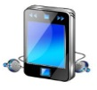



Key Capabilities of 5G
✓ Key Capabilities for 5G (IMT-2020) :
1 Ultra high speed data (eMBB) Peak data rate 10Gbps (100 x current LTE)
2 Ultra Low Latency (URLLC) Ultra Low Latency 1ms （1/10 of current LTE system）
3 Massive Machine Type Connections (mMTC):
Connection Density 100 devices/km² （100 x current LTE）
✓ 5G is expected to create a new market as a key infrastructure of IoT
Ex: Quick transmission of Ultra high definition TV (4K/8K).
comparable to optic fiber
Ultra High Speed Data
(eMBB)
Automated Driving Cars
Large numbers of devices, sensors and terminals
Key Capabilities
for 5G
Massive Machine Type Connections
(mMTC)
Ultra Low Latency
(URLLC)
Ex: Automated Driving, Remote control Robots (real-time remote control, IoT for mission critical)
Ex: Massive Simultaneous Connections for sensor networks in small area, Smart Meters, Infrastructure Maintenance etc.
Source: MIC, Nikkei Communications 4/2015

Slide 22
Changes in earnings structure that 5G will bring
✓ Once 5G arrives, new markets will be created for the Internet of Things such as cars, industrial devices, and smart meters rather than in businesses in traditional devices such as smartphones
✓ There will be a need to make new partnerships with wide a variety of industries to deal with the changes in profit structures that will come about due to 5G mobile
High Profits
Current Business Field
5G Business Strategies needs to consider making new partnerships with a wide variety of industries
Smart Phones / Tablets
Automotive
Industrial Equipment
Home Security
Smart
Meters
Internet of Things
/Others
Low Profits
Large # of
Connections
Small # of
Connections
New Fields 5G will target
Source: Nikkei Communications April 2015
Main Target of 4G

Slide 23
Roadmap toward 5G realization for 2020 and beyond
✓ Promote three activities to support 5G realization for 2020 and beyond
1. Support activities by Fifth Generation Mobile Forum (5GMF)
2. R&Ds on 5G Technologies through Industry-Academic-Government Cooperation
3. Standardization Activities at the ITU and 3GPP
✓ The 5G System Trial to test radio access, networks, and applications for 5G will be started in Tokyo and local cities of Japan in FY2017
2012
2013
2014
2015
2016
2017
2018
2019
2020
2021
(year)
ARIB
2020 and Beyond Adhoc
Rugby
World Cup
Tokyo Olympic/
Paralympic Games
Deployment
5G
implemen-
tation
Promoting
Body
Activities by ５ＧＭＦ
Established on September 30th, 2014
Strategic guidance on R&Ds, standardization activities, international cooperation
R&Ds
R&Ds on 5G Technologies
Promote R&Ds on 5G key technologies through Industry-Academic-Government Cooperation from 2015
5G System
Trial
５Ｇ Standardization Activities
●Report ITU-R M.2320(11/2014) Future technology trends of terrestrial IMT systems
International
Affairs
ITU Radio
Communications
Assembly
（WRC-12）
●ITU 5G International Workshp
●Recommendation ITU-R M.2083 : IMT Vision
World Radio Conf.
（WRC-15）
World Radio Conf.
（WRC-19）
5G Requirements and Applications
Propose & Evaluate Interface
Study on spectrum for 5G
as a preparation of WRC-19 with attention to international harmonization

