Slide 1
Status report on ITS security in SG17
- Update on ITS-related activities in ITU-T SG17
23 Sep. 2022
ITU-T Q13 in SG 17

Slide 2
Contents
Introduction of Q13 in SG17
Current status of work items related to ITS security in Q13/17
Future plan

Slide 3
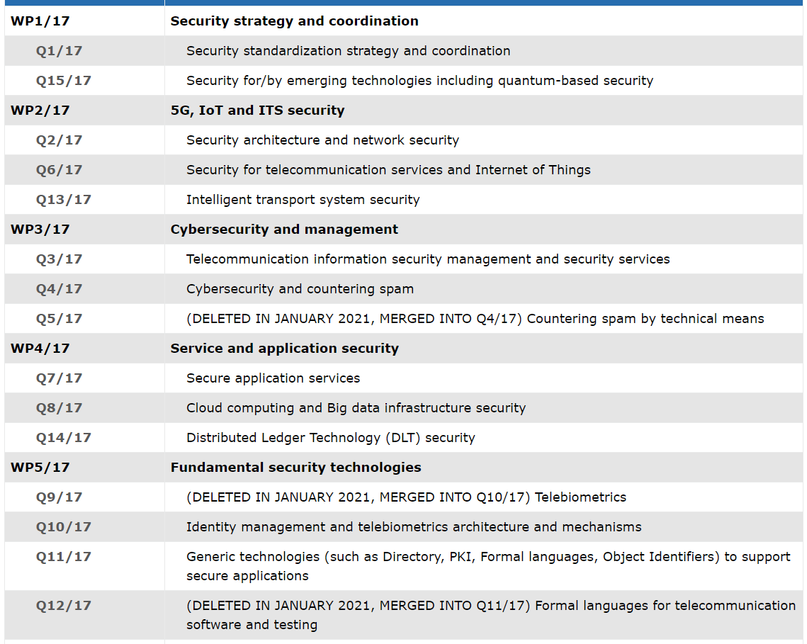
ITU-T SG17 Q13
  SG17
    SG 17 in ITU Telecommunication Standardization Sector (ITU-T) has been working on security aspects including generic security architecture, mechanisms and management guidelines for heterogeneous networks/systems/services, cloud computing, smart grid, intelligent transportation systems (ITS) including V2X communication, the 5G cellular network, software-defined networks, Big Data analytics, Internet-of-Things, protection of the personally identifiable information (PII) as the lead Study Group on Security in ITU-T.
  Question 13 in SG 17
    a lead Question for developing Recommendations regarding security aspect for ITS including road transport, railway, maritime and air transport as well.
ITS security
As of September 2022

Slide 4
Approved Rec. in Q13/17
Number | Acronym | Title | Status
1 | X.1371 (Published) | Security threats in connected vehicles | 2020.05 (Approved)
2 | X.1372 (Published) | Security guidelines for Vehicle-to-Everything(V2X) communication | 2020.03 (Approved)
3 | X.1374 (Published) | Security requirements for external interfaces and devices with vehicle access capability | 2020.10 (Approved)
4 | X.1375 (Published) | Methodologies for intrusion detection system on in- vehicle networks | 2020.10 (Approved)
5 | X.1376 (Published) | Security-related misbehavior detection mechanism for connected vehicles | 2021.01 (Approved)
6 | X.1379 (Published) | Security requirements for road-side units in intelligent transportation systems | 2022.07 (Approved)

Slide 5
Ongoing work items in Q13
Number | Acronym | Title | Status
1 | (X.1377) X.ipscv | Guidelines for an intrusion prevention system in connected vehicles | Consented (2022.09)
2 | (X.1380) X.edr-sec | Security guidelines for cloud-based data recorders in automotive environments | Determined (2022.09)
3 | (X.1381) X.eivn-sec | Security guidelines for Ethernet-based In-Vehicle networks | Determined (2022.09)
4 | (X.1382) X.fstiscv | Framework of security threat information sharing for connected vehicles | Determined (2022.09)
5 | (X.1383) X.srcd | Security requirements for categorized data in V2X communication | Determined (2022.09)
6 | X.1373Rev | Software update capability for ITS communications devices | 2023.4Q
7 | X.itssec-5 | Security guidelines for vehicular edge computing | 2023.4Q
8 | X.evtol-sec | Security guidelines for an electric vertical take-off and landing (eVTOL) vehicle in an urban air mobility environment | 2024.4Q
9 | X.idse | Evaluation methodology for in-vehicle intrusion detection systems | 2023.4Q
10 | X.evpnc-sec | Security guidelines for electric vehicle plug and charge (PnC) services using vehicle identity (VID) | NWIP establish (2022.09)
11 | X.sup-cv2x-sec | Supplement to X.1813 -Security deployment scenarios for cellular vehicle-to-everything (C-V2X) services supporting ultra-reliable and low latency communication (URLLC) | NWIP establish (2022.09)

Slide 6
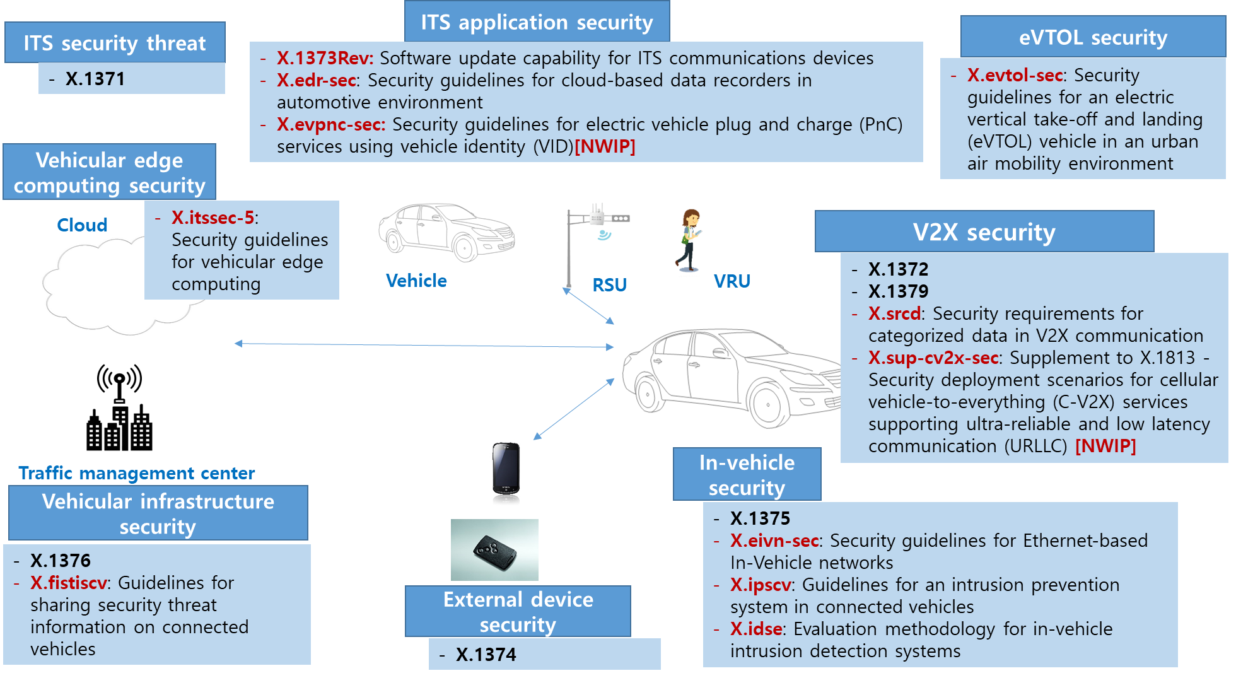
Scope in Q13/17

Slide 7
X.ipscv(X.1377)
  Title: Methodologies of intrusion prevention systems for connected vehicles
  Motivation:
    Intrusion detection and prevention systems (IDPS): IDS and IPS software applications or appliances that monitor systems for malicious activities, where IDS focus is to only alert on the discovery of such activity while IPS have the potent to prevent some intrusions upon detection (ISO/IEC 27039).
    A convectional in-vehicle intrusion detection system(IDS) requires a lot of computing resources.
  Scope:
    This Recommendation aims to provide the methodologies of IPS for connected vehicles. This Recommendation mainly focuses on aspects of active response capability for intrusion and includes implementation guidance and use cases of IPS for connected vehicles
  Data plain: Each in-vehicle networks to be protected by IPS
  Control plain: Connect between external IDS and data plane. A switch controller gathers event messages from data plane and transfers them to an external IDS. In addition, it transfers policy of in-vehicle network gateway from the external IDS.
  Detection plan: determines intrusion and policy from the gathered in-vehicle traffics.
  <Intrusion prevention system framework for connected vehicles (Source : X.ipscv)>

Slide 8
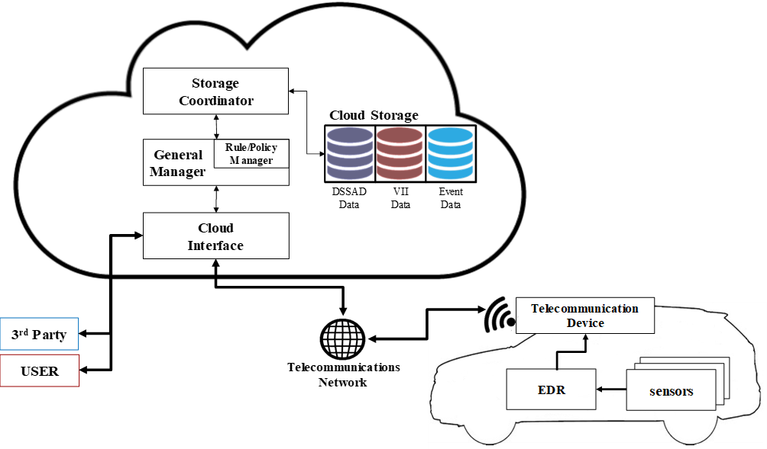
X.edr-sec(X.1380)
  Title: Security guidelines for cloud-based data recorders in automotive environments
  in-vehicle networks
  Motivation:
    Event data recorders are one of the most important components installed in automotive road vehicles in order to record vehicle status, vehicle movements and user inputs during crashes. Through analysing the event data, we can understand the cause of a crash and eventually use it to improve safety in automotive environments.
    A data storage system for automated driving is also an important component to record a set of data that will give a clear picture of the interactions between the driver and the automated driving system. However, conventional event data recorders record and manage the whole data locally, and in this way the data might come under threats of loss and destruction.
  Scope: This Recommendation provides cloud-based data recorders in automotive environments. It covers security threat analysis, security requirements and use cases for the Ethernet-based in-vehicle networks, taking into account a cyber-security perspective.
  <Cloud-based EDR (source: X.edr-sec)>

Slide 9
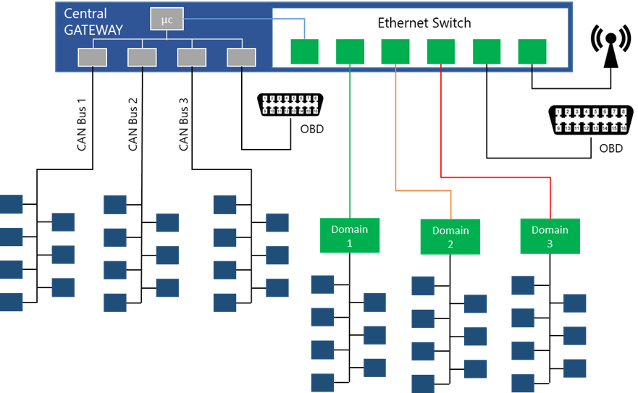
X.eivn-sec(X.1381)
  Title: Security guidelines for the Ethernet-based in-vehicle networks
  Motivation:
    The current trend in in-vehicle networks is to integrate the automotive Ethernet with the traditional in-vehicle networks such as CAN, LIN, MOST and FlexRay.
    As an autonomous vehicle and ADAS (Advanced Driver-Assistance Systems) technologies are getting a lot of attention, modern vehicles are usually equipped with multiple cameras, on-board diagnostics, infotainment systems, which require high bandwidth.
  Scope:
    This Recommendation provides security guidelines for the Ethernet-based in-vehicle networks. It covers security threat analysis, security requirements and use cases for the Ethernet-based in-vehicle networks, taking into account a cyber-security perspective.
  <In-vehicle network, based on legacy protocols and automotive Ethernet(source: X.eivnsec>

Slide 10
X.fstiscv(X.1382)
  Title: Guidelines for sharing security threat information on connected vehicles
  Motivation:
    Connected vehicles are facing increasingly prominent network security issues along with their rapid development. Security threat information of connected vehicles means any information that can help an organization identify, assess, monitor, and respond to the connected vehicle, which plays an integral role in securing connected vehicles.
  Scope:
    The purpose of this Recommendation is to provide guidelines for sharing threat information of connected vehicles ecosystems, including the roles and partnership of organizations, sharing scopes, procedures and guidance for sharing threat information of connected vehicles.

Slide 11
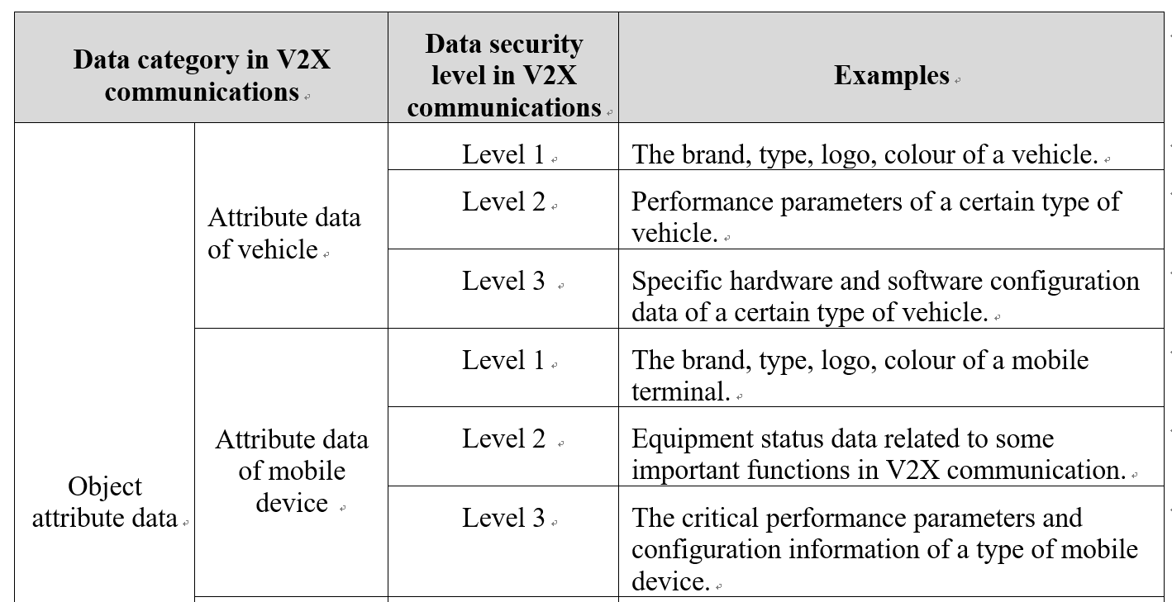
X.srcd(X.1383)
  Title: Security requirements for categorized data in vehicle-to-everything (V2X) communication
  Motivation:
    Data security is one of the most important works for vehicle-to-everything (V2X) communication. However, in a resource constrained environment such as in-vehicle communication, a lot of resources are consumed protecting data as cryptographic functions are required
  Scope:
    This Recommendation categorizes the data used in vehicle-to-everything (V2X) communication into several types and defines the security level for each categorized data type. Based on these categorized data types in each security level, this Recommendation provides security requirements for categorized data in V2X communication.
  <Examples of data security levels in V2X communication(source: X.srcd>

Slide 12
Future plan
  Next meeting
    Q13 RGM
      Virtual, 24 ~ 25 November 2022
    Next SG17 meeting
      Geneva, 21 Feb. ~ 3 March 2023
  Liaison Collaborations
    SG16
    CITS
    UNECE WP29
    Hoping to collaborate with TC22 and TC204

