Slide 1
CAR 2 CAR Communication Consortium presentation to ITU - Collaboration on ITS Communication Standards
Niels Peter Skov Andersen
General Manager, CAR 2 CAR Communication Consortium

Slide 2
Introduction
Communication needs
Roadmap towards automated driving
Spectrum needs
An alternative approach

Slide 3
CAR 2 CAR Communication Consortium
The C2C-CC is a non-profit organization initiated and formed 2002 by European vehicle manufacturers
Mission and objective
Support the Vehicle2X deployment
Develop guidelines for a Car2Car communication system
Develop realistic deployment strategies
Establish open European standards for a Car2Car communication system
Push harmonisation of C2C Communication Standards worldwide
Use of Free of charge European wide exclusive frequency band (5.9 GHz)
Establish the necessary profiling of standards

Slide 4
C2C-CC Documentation
Finalised documents are published on C2C-CC webpage
https://www.car-2-car.org/documents/
Contains both General Documents and the Basic System Profile

Slide 5
Introduction
Communication needs
Roadmap towards automated driving
Spectrum needs
An alternative approach

Slide 6
Generalised Automotive Communication needs
Tactical information
Information related to proximity of vehicle, e.g. obstacles, cooperation with nearby cars for lane merging, C-ACC Platooning etc.
Short range, low latency and high QoS
Safety critical information – Communication becomes part of functional safety (ISO 26262)
Strategical information
Information that allows planning ahead, e.g. maps, road conditions, traffic information etc.
Wide area coverage, less constrains on latency and QoS
Infotainment
Other communication not directly related to the driving
Wide area coverage

Slide 7
Introduction
Communication needs
Roadmap towards automated driving
Spectrum needs
A challenge

Slide 8
Roadmap: Services & sample use cases
Intention & Coordination data
Take-over of the driving functions
Fully Automated Driving
Optimal Traffic Flow
Sensor data
Trajectory/maneuver sharing
Static platooning
Area reservation
Traffic light Info optimizations
VRU active advertisement
VRU safety
Coordination and Negotiation
Coop Merging
Coop lane change
Coop overtaking
(I2V) Coop Intersection transit
Dynamic Platooning
…
C-ITS penetration
Status data
Collective Perception
Overtaking W
Ext. Intersection Coll. W
VRU W
Improved coop. awareness & decentralized notification
Motorcycle-related W
Cooperative ACC
Improved Infrastructure support
Long term Roadworks W
Special vehicle prioritization
Coop. awareness & decentralized notification
Intersection Coll. W
Emergency Vehicle W
Dangerous Sit. W
Stationary Vehicle W
Traffic-Jam W
Pre-/Post-Crash W
Hazardous Loc. W
Adverse Weather W
Motorcycle Approach Info
Basic infrastructure support
Short term Roadworks W
Traffic light info
In-vehicle information
Automation Level
Phase 1
Awareness Driving
Phase 2
Sensing Driving
Phase 3 & 4
Cooperative Driving
Phase 5
Accident-free Driving
Dissemination Cooperation

Slide 9
Ongoing work in the area of functionality

Slide 10
Ongoing work in the technical area

Slide 11
Ongoing work in the area of deployment

Slide 12
Introduction
Communication needs
Roadmap towards automated driving
Spectrum needs
A challenge

Slide 13
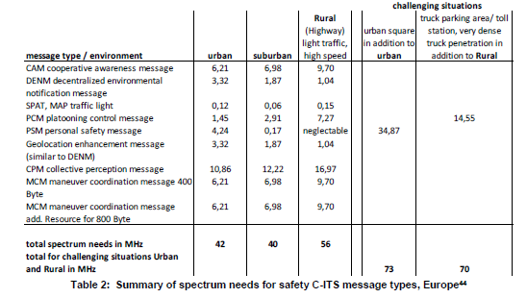
Spectrum need for short range communication
C2C-CC White Paper: Road Safety and Efficiency Spectrum Needs in 5.9 GHz shows need for > 70MHz for safety C-ITS messages www.car-2-car.org/fileadmin/documents/General_Documents/C2CCC_TR_2050_Spectrum_Needs.pdf

Slide 14
Introduction
Communication needs
Roadmap towards automated driving
Spectrum needs
A challenge

Slide 15
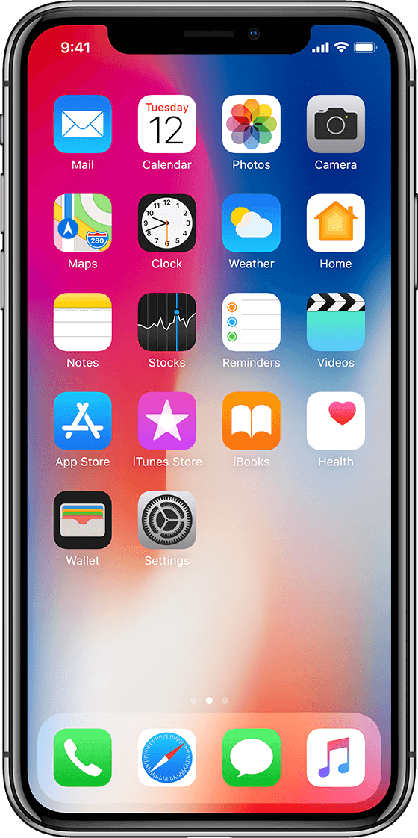
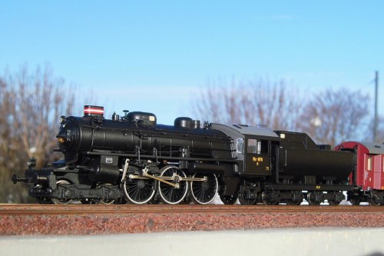
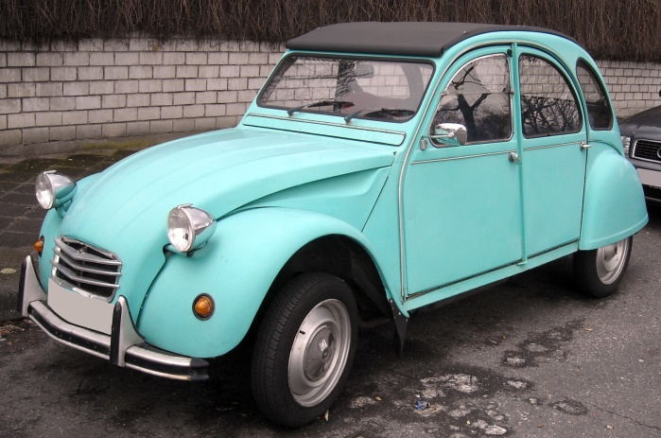
A challenge
A common transport communication platform
Could make it easier to get spectrum access and capacity
Allows to benefit from economies of scale
Allows to increase safety in cross ‘sector’ accident cases
Allows for cross sector use cases that integrate and optimise the multi-modal transport
But is the expected life time the same ?

