Slide 1
ISO/TC 204 Intelligent Transport Systems Liaison Report ITU CITS Meeting 6 March 2020, Geneva, Switzerland​
Adrian Guan, ISO/TC 204 Committee Manager

Slide 2
ISO/TC 204 Projects by Numbers
409 active projects
As of February 2020

Slide 3
ISO/TC 204 Created Artificial Intelligence and Big Data Advisory Group
Co-convenors: Mr András Csepinszky (Hungary) and Mr Neil Frost (South Africa)
The terms of reference under development could include:
Focus on AI and Big Data supporting ITS Applications being developed in ISO TC 204
Foster cooperation with JTC 1/SC 42 (Artificial Intelligence)
Ensure work consistency across ISO/TC 204 WGs and gather requirements, use cases, etc. related to the development of AI and/or Big Data ITS applications within the TC
Other relevant topics

Slide 4
ISO/TC 204 Addresses New Mobility Needs
ISO/TC 204 WG 19 Mobility Integration
Established in September 2018
Scope: the development of ITS standards products supporting enhanced integration of services and applications of ITS solutions focussed on the urban ITS and mobility integration.
Parking data standards were added to the work programme in 2019.

Slide 5
Active Work Items of ISO/TC 204 WG 19 Mobility Integration
ISO/PWI TR 24321 | Intelligent transport systems — Development of data standards for the parking sector
ISO/PWI 24318 | Intelligent transport systems — Mobility integration — Architecture for automation
ISO/PWI 24317 | Intelligent transport systems — Mobility integration — Mobility integration needs for vulnerable users and light modes of transport
ISO/PWI 24315-1 | Intelligent transport systems - Management for Electronic Traffic Regulations (METR) — Part 1: General concept and architecture
ISO/PWI 24312 | Intelligent transport systems — Urban ITS — Air quality management in urban areas
ISO/PWI 24311 | Intelligent transport systems — Urban ITS — 'Controlled zone' management for UVARs using C-ITS
ISO/PWI 24310 | Intelligent transport systems — Urban ITS — Models and definitions for new modes
ISO/PWI 24309-1 | Intelligent transport systems — Location referencing harmonization for Urban ITS — Part 1: State of the art and guidelines
ISO/PWI 24309-2 | Intelligent transport systems — Location referencing harmonization for Urban ITS — Part 2: Transformation methods
ISO/PWI TR 23797 | Intelligent transport systems — Mobility integration — Gap and overlap analysis of ISO/TC 204 work programme for mobility integration
ISO/PWI TR 4448 | Intelligent transport systems — Mobility integration — Investigation of the needs for ITS standardization for kerbside management
ISO/PWI TR 4447 | Intelligent transport systems — Mobility integration — Integrated mobility concept
ISO/PWI TR 4445 | Intelligent transport systems — Mobility integration — Role model of ITS service application

Slide 6
ISO/TC 204 and ISO/TC 22 Joined Force in Leading Automated Driving Standards
ISO/TC 204 and ISO/TC 22 supported to establish Automated Driving Advisory Group (ADAG) to properly place and oversee new work items developed within this domain.
Group representation will be balanced between ISO/TC204 and ISO/TC22 and the Group will be jointly chaired by the two TCs.
The terms of reference is currently under development.

Slide 7
ISO/TC 204’s Liaison Activities
ISO/TC 204 established a new liaison with ISO/IEC/JTC1 WG 11 Smart Cities and ISO/IEC/JTC1 SC41 Internet of Things (IoT).
ISO/TC 204 established a joint working group with ISO/TC211 Geographic information/Geomatics.
ISO/TC 204 established a Category C liaison with W3C and RailML.
ISO/TC 204 supports a 3-year extension of the current ISO/SAE Partnership Standards Development Organization agreement.
The agreement is being extended through 2022.
ISO/SAE AWI PAS 22736 (SAE J3016) Intelligent transport systems — Taxonomy and definitions for terms related to driving automation systems for on-road motor vehicles, is under final edits for publication.

Slide 8
ISO/TC 204’s Leaderships
ISO/TC 204 Chairman Dick Schnacke (USA) was appointed to a new term through 2022.
ISO/TC 204 appointed a Vice Chairman Dean Zabrieszach (Australia) to assist the Chairman in leading the committee.

Slide 9
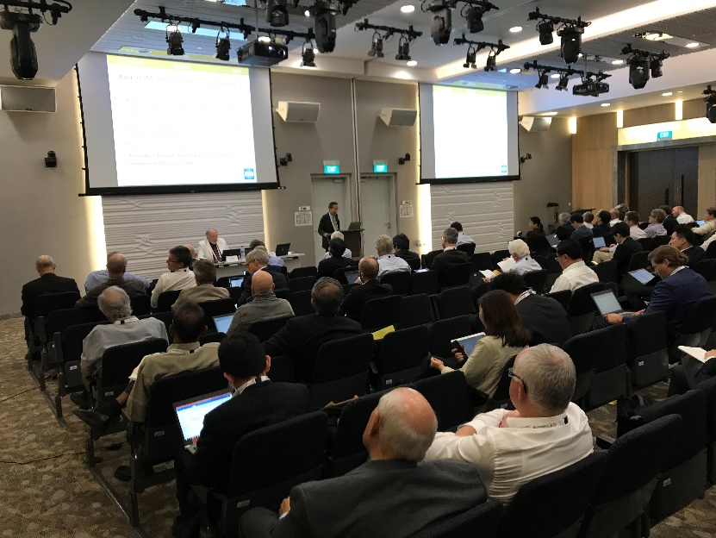
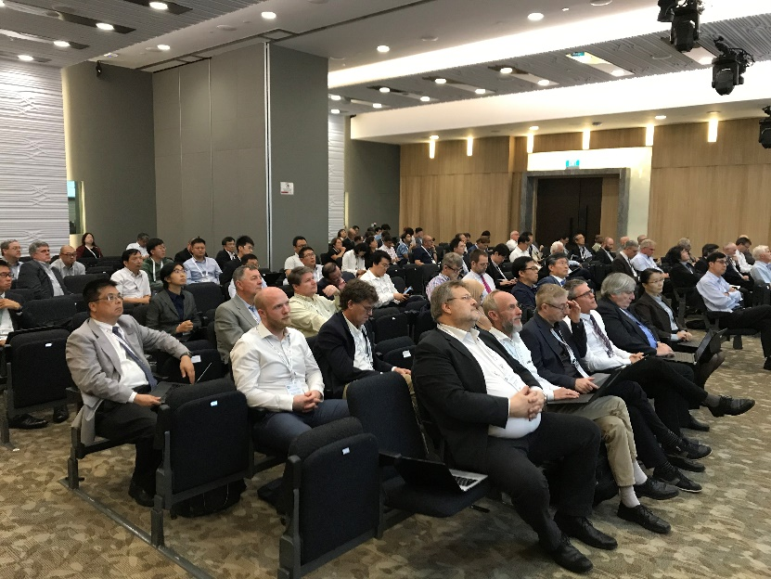
Recap: The 54th ISO/TC 204 Plenary
Singapore, 14-18 October 2019
Attendance: 200+ delegates and 19 P-member countries
11 working group meetings
Four workshops
Data, V2X, Green ITS (G-ITS) & Urban Mobility, and security issues

Slide 10
Next Plenaries
The 55th ISO/TC 204 Plenary in Tampere, Finland, 19-24 April 2020
Registration is open at https://sd.iso.org/meetings/67766, by is 5 April 2020
The 56th ISO/TC 204 Plenary in North America, Fall/Autumn 2020

Slide 11
Contact ISO/TC 204
Chairman
Dick Schnacke, TransCore
Telephone: +1.214.208.2682
E-mail: dick.schnacke@transcoretech.com
Committee Manager
Adrian Guan, SAE International
Telephone: +1.202.336.9744
E-mail: adrian.guan@sae.org
Address: 901 15th Street NW, Suite 520, Washington, DC 20005 USA

