Slide 1
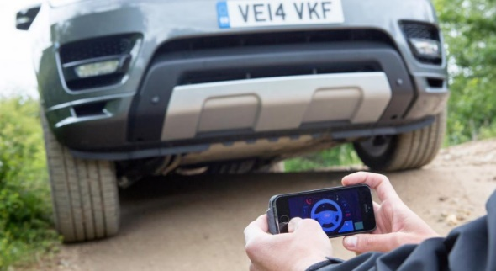
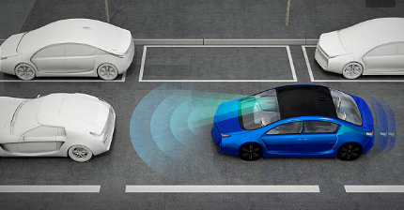
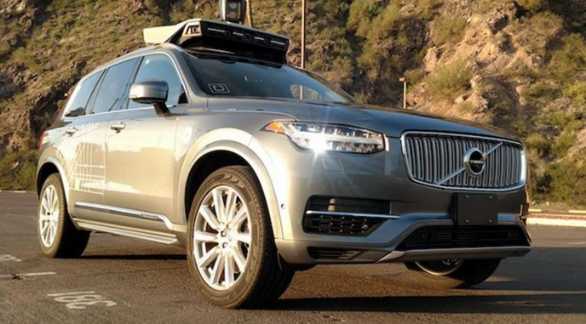
International Telecommunication Union CITS meeting 8 March 2019 Geneva Status report of the GRVA activities Context, current activities and impact
François E. Guichard
Mechanical Engineer
Technical Secretary of the Working Party on Automated/Autonomous and Connected Vehicles
United Nations Economic Commission for Europe

Slide 2
Content
Short presentation WP.29/GRVA and its context
WP.29’s work so far on automated and connected vehicles
New structure of WP.29 and the impact on vehicles and innovation

Slide 3
Agenda 2030 – Sustainable Development Goals
Automated and Connected vehicles are expected to contribute to the solutions needed to address the transport related issues:
Road traffic
Pollution
CO₂ emissions
Road safety crisis

Slide 4
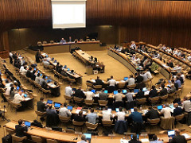
UNECE hosts the World Forum «WP.29»
WP.29 is the World Forum for harmonization of Vehicle Regulations
It is operating according to the provisions of three multilateral agreements (58,97,98):
Its stakeholders are:
Countries, member States of the United Nations.
Accredited NGOs representing:
automotive sector,
suppliers
consumers etc.

Slide 5
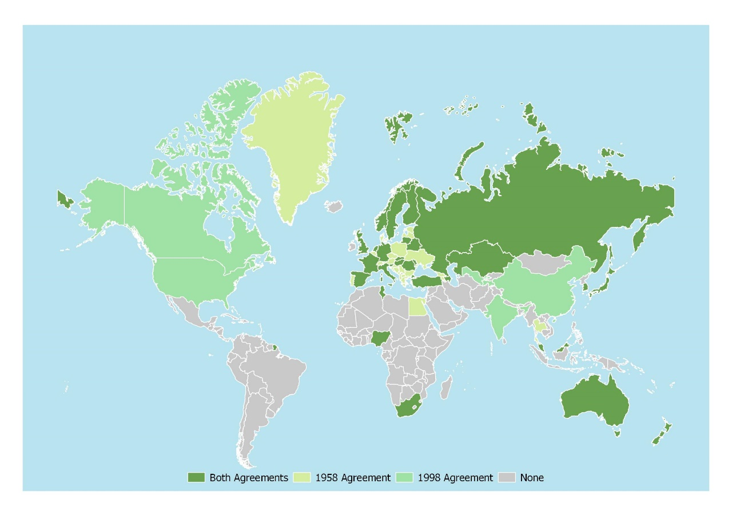
The scope of WP.29
WP.29 regulates the performance of «wheeled» vehicles, their sub-systems and parts

Slide 6
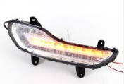
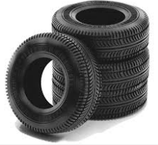
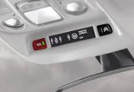
Cooperation with various stakeholders and SDOs
Lighting and Light Signalling sector:
IEC standards: IEC 60061, IEC 60809
Specific UN Regulations on light sources
Tire sector:
ISO, ETRTO, JTMA standards
Regulation on tires
Regulation on tire installation
ICT and Telecom sector:
eCall
Cyber Security and OTA
Notes:
WP.29 is inclusive and work rely on the work of various Standard Developing Organizations

Slide 7
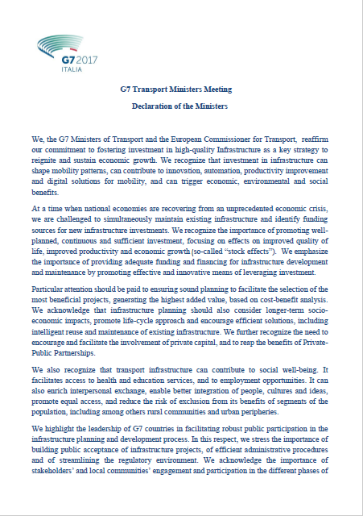
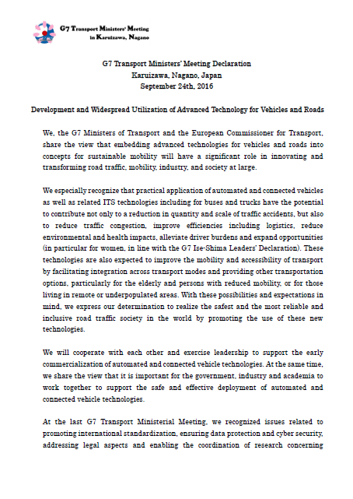
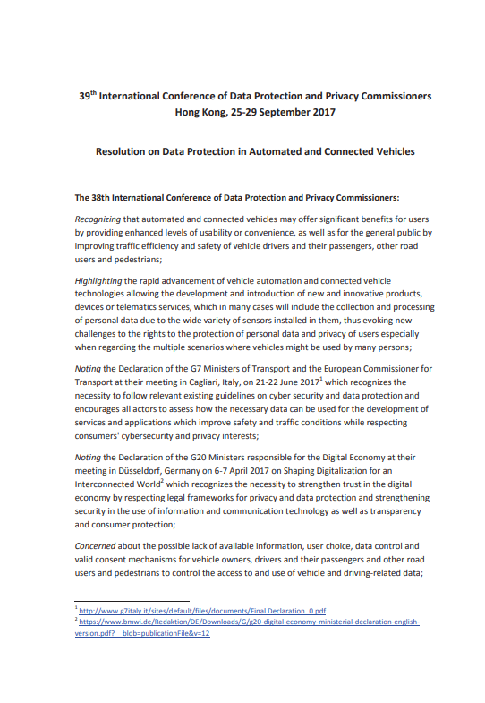
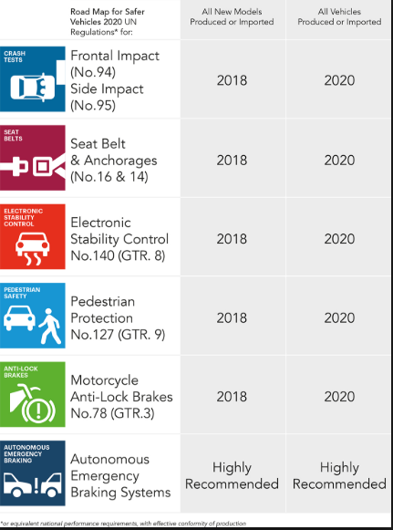
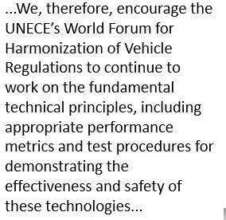
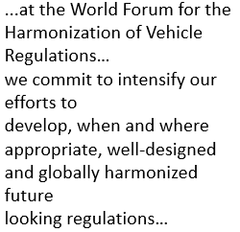
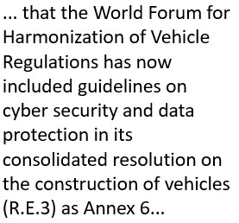
Relevance of WP.29
Various institutions and organization rely on WP.29 and/or commit to work at WP.29 in order to address the safety of conventional vehicles as well as assisted, automated and connected vehicles:
G7 transport ministers
The International Conference of Data Protection and Privacy Commissioners
Global NCAP and other consumer protection groups
Notes:
Various institutions and organization rely on WP.29 and/or commit to work at WP.29 in order to address the safety of conventional vehicles as well as assisted, automated and connected vehicles:
G7 transport ministers
The International Conference of Data Protection and Privacy Commissioners
Global NCAP and other consumer protection groups
The slide shows the first page of:
-The G7 transport ministers’ declaration in Japan (2016)
-The G7 transport ministers’ declaration in Italy (2017)
-The 39th International Conference of Data Protection and Privacy Commissioners declaration
-The Global NCAP roadmap 2020 summary listing the UN Regulations and UN GTRs that they advocate for.

Slide 8
Content
Short presentation of WP.29/GRVA
WP.29’s work so far on automated and connected vehicles
New structure of WP.29

Slide 9
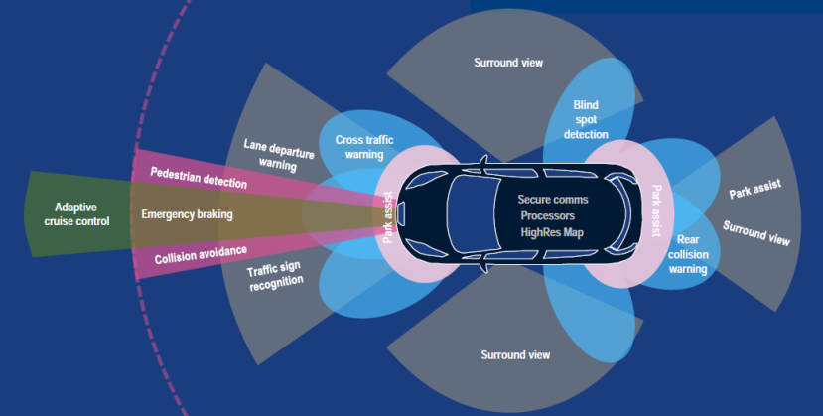
Automated/Autonomous and Connected Vehicles
It is a priority for WP.29
The work started in 2014
IWG on ITS/AD
GRRF
Working Party on road traffic safety (WP.1)
Works together with WP.29 on the integration of the technology in traffic (legal aspects).

Slide 10
Guideline on Cyber Security and Data Protection
United Nations (UNECE) Guideline on Cyber Security and Data Protection adopted in 2016
The guideline includes requirements regarding:
Security (by design)
Privacy (by design and by default)
Secure software updates
Integrity of internal communication as well as online services
It also states (among others) :
The system shall be accessible for verifying the measures implemented by automotive manufacturers, component/system suppliers and service providers to ensure cybersecurity and data protection by independent authorised audit
The protection of connected vehicles [...] requires verifiable security measures according security standards (e.g. ISO 27000 series, ISO/IEC 15408)

Slide 11
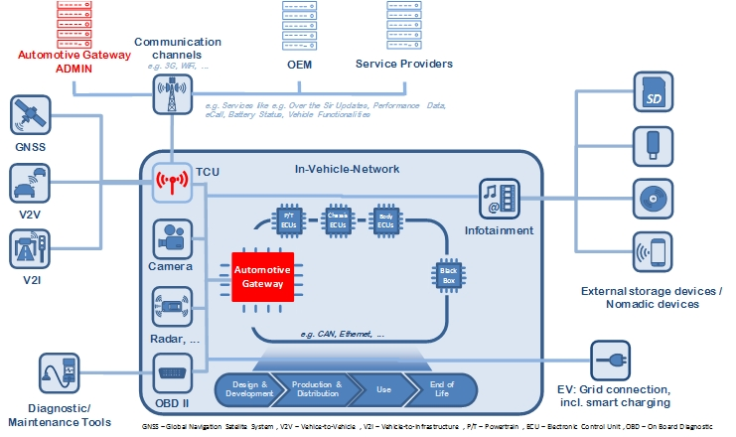
The Task Force on Cyber Security and OTA
Initiated in November 2016, by WP.29
Deliver output in 2018 to GRVA
Cyber security
Software updates incl. SOTA
For both:
Recommendation part
Draft UN Regulatory text
“Round robin testing” ongoing

Slide 12
Content
Short presentation of institution
WP.29’s work so far on automated and connected vehicles
New structure of WP.29
GRVA
IWG on ITS/AD

Slide 13
GRVA
GRVA is the Working Party on Automated/Autonomous and Connected Vehicles
Decided in June 2018
First session in September 2018
Built on GRRF:
Refocus the work on active safety, ADAS, Automation and connectivity.
Includes the IWG on ITS/AD and its subgroups:
AutoVeh (now called VMAD)
Cyber security and OTA

Slide 14
GRVA
Management:
Chairperson: UK
Vice-Chairpersons: China and Japan
First outcomes:
New UN Regulation on Advanced Emergency Braking Systems (AEB systems) for M1/N1
Remote Controlled Maneuvring

Slide 15
To activities impacting the industries and innovation
Activities under the 1998 Agreement:
Indirect impact as the outcome of this work stream «UN GTRs» are primilary for the Member States to implement in their national legislations.
Few UN GTRs adopted so far (rather young Agreement)
But important strategic discussions ongoing…
Activities under the 1958 Agreement:
The Approval applicant (OEM, Supplier etc.) shall comply with the UN Regulation
More UN Regulations already adopted and impacting vehicles and their systems.
More activities ongoing on vehicle automation and connectivity
UN Regulation No. 79 (Steering)
DSSAD
UN Regulation No. 144 (AECS)

Slide 16
How are used UN type approvals / certificates
System
approvals
Whole
Vehicle
Type
Approval
Certificate
for a given
vehicle
Vehicle Registration

Slide 17
Type Approval
Testing
Submission of the information document (documentation of the product)
Performance of the tests prescribed in presence of by a so called nominated “Technical Service”
Approval
Test report and documentation checked by the Type Approval Authority
Type approval issued by the Type Approval Authority
COP
Conformity of Production (COP) process and checks (QM / QA)
COP audit by the Authorities
(According to the provisions of the Regulation)
In Use
End or life
Some regulations require «in use» testing of products (e.g. in the field of emissions)
One regulation is dedicated to the recyclability of vehicles

Slide 18
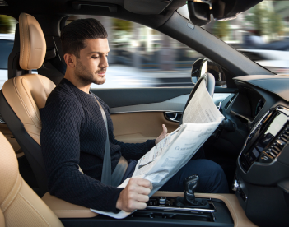
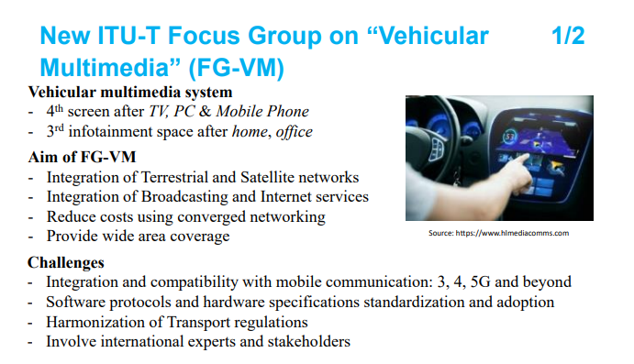
Technical progress and new behaviors
@Volvo
@Faurecia

Slide 19
Technical progress and new behaviors
@Faurecia

Slide 20
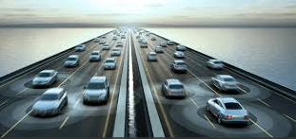
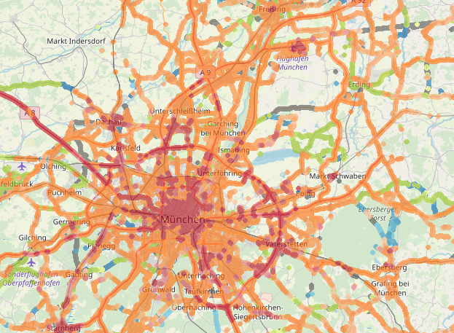
Connectivity and standardization
Discussions outside of WP.29 so far
Competing views on vehicle connectivity:
IEEE 802.11p (DSRC, ITS G5)
LTE-4G
5G
Once decision on standard(s) is made ←→ type approval
WP.29 is liaising with standardization bodies
…

Slide 21
THANK YOU VERY MUCH FOR YOUR ATTENTION
UNECE
http://www.unece.org/automated-vehicles
Francois.Guichard@un.org

