Slide 1
IoT Standardization for ITS support
- Update on ITU-T SG20 related activities
Dr. Shane HE
ITU-T Q3/20 Rapporteur
Nokia Bell Labs & CTO group

Slide 2
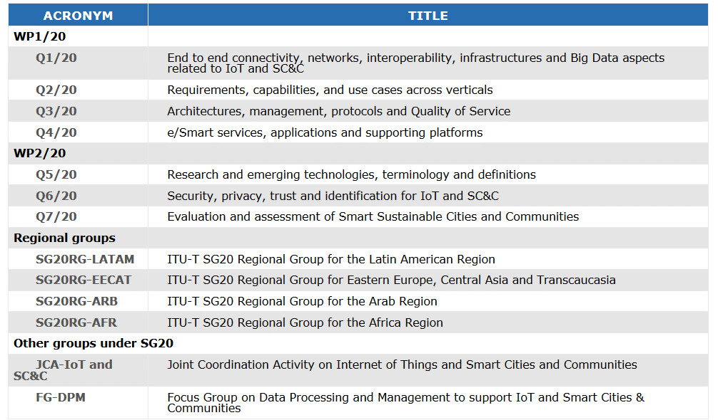
Overview of SG20

Slide 3
SG20 studies related to IoT for ITS –March 2019 status
Q. | Name | Provisional name | Type | Subject/title | Status | Approval | Hyperlink
Q2/20 | Y.4116 | Y.TPS-req | Rec. | Requirements of transportation safety services including use cases and service scenarios | Approved | Oct-17 | http://www.itu.int/ITU-T/workprog/wp_item.aspx?isn=13686
Q2/20 | Y.4119 | Y.AERS-reqts | Rec. | Requirements and capability framework for IoT-based automotive emergency response system | Approved | Feb-18 | https://www.itu.int/ITU-T/workprog/wp_item.aspx?isn=14105
Q2/20 |  | Y.IoT-ITS-framework | Rec. | Framework of Cooperative Intelligent Transport Systems based on the Internet of Things | Under study | Dec-19 | http://www.itu.int/ITU-T/workprog/wp_item.aspx?isn=13688
Q2/20 |  | Y.IoT-UAS-Reqts | Rec. | Use cases, requirements and capabilities of unmanned aircraft systems for Internet of Things | Under study | Dec-19 | https://www.itu.int/ITU-T/workprog/wp_item.aspx?isn=14303
Q2/20 |  | Y.IoT-AV-Reqts | Rec. | Requirements and capability framework of IoT infrastructure to support network-assisted autonomous vehicles | Under study | Q2-2020 | https://www.itu.int/ITU-T/workprog/wp_item.aspx?isn=14958
Q2/20 |  | Y.ACC-PTS | Rec. | Accessibility Requirements for Smart Public Transportation Services | Under study | Q2-2020 | https://www.itu.int/ITU-T/workprog/wp_item.aspx?isn=14646
Q3/20 |  | Y.AERS-msd | Rec. | Minimum set of data structure for automotive emergency response system | Under study | Dec-20 | https://www.itu.int/ITU-T/workprog/wp_item.aspx?isn=14502
Q3/20 |  | Y.AERS-mtp | Rec. | Minimum set of data transfer protocol for automotive emergency response system | Under study | Dec-20 | https://www.itu.int/ITU-T/workprog/wp_item.aspx?isn=14501
Q3/20 |  | Y.NDA-arch | Rec. | Functional architecture of network-based driving assistance for autonomous vehicles | Under study | Q4-19 | https://www.itu.int/ITU-T/workprog/wp_item.aspx?isn=14652
Q4/20 | Y.4457 | Y.TPS-afw | Rec. | Architectural framework for providing transportation safety services | Approved | May-18 | http://www.itu.int/ITU-T/workprog/wp_item.aspx?isn=13677

Slide 4
Y.4119 (ex Y.AERS-reqts)
LS/o/r on automotive emergency response system in reply to SG16 LS 66-E
Informing SG16 about consent of Y.AERS-reqts at WP1/20 meeting, Geneva, 24 Jan 2018, and welcoming any technical comments during LC period
Providing SG20 considerations on some specific points raised about Y.AERS-reqts in SG16 LS 66-E
Informing SG16 about SG20 initiation of two new draft Recs on IoT based AERS:
Y.AERS-msd, Minimum set of data structure for AERS
Y.AERS-mtp, Minimum set of data transfer protocol for AERS
Approval of Y.AERS-reqts on 28 Feb 2018 (no comments received during LC period)

Slide 5
Y.IoT-UAS-Reqts – 1/2
Y.IoT-UAS-Reqts “Use cases, requirements and capabilities of unmanned aircraft systems for Internet of Things”
Scope of the Recommendation
The draft Recommendation aims to describe use cases, requirements and capabilities of unmanned aircraft systems (UASs) for IoT.
UASs can act as a key part of IoT as wireless communication platforms in IoT.
Use cases are specified according to different communication scenarios.
Requirements and capabilities are also specified to satisfy the different use cases.
Regulation and supervision of UASs are out of scope of the Recommendation.
Structure of the Recommendation
Classification of the use cases of UAS-aided communication
Common and specific requirements of UASs for IoT
Common and specific capabilities of UASs for IoT

Slide 6
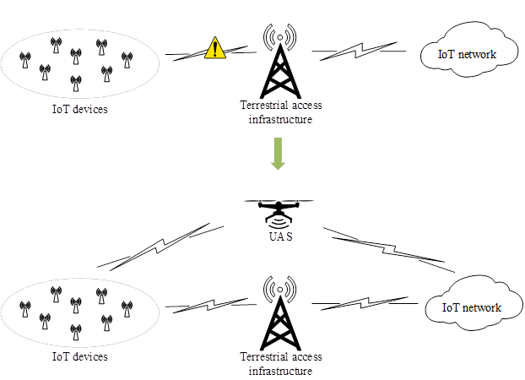
Y.IoT-UAS-Reqts – 2/2
Currently identified use cases
UAS-aided offloading
UAS-aided emergency response
UAS-aided relaying
UAS-aided information dissemination and data collection
Example of UAS-aided offloading

Slide 7
Y.ACC-PTS
Y.ACC-PTS “Accessibility requirements for smart public transportation services”
Motivation of the study
The concept of accessibility in public transportation services have been mainly concerned in eliminating physical barriers such as adopting accessible trains and buses that allows a wheelchair accessibility by mechanical lowering-entrance floors.
In smart public transportation services, the use of Internet of Things, when properly designed, may increase accessibility of public transportation services by providing access of information and physical accessibility.
The Internet of Things can be used to create tools for persons with many types of disabilities and specific needs, including physical, visual, hearing and cognitive disabilities.
In order for the smart transportation services to appropriately provide accessible services, information of accessibility profiles must be agreed upon in advance. Such accessibility profiles should basically include information on accessibility needs while traveling on public transportation services.
Scope of the Recommendation
The Recommendation specifies accessibility requirements for smart public transportation services.
The scope of the Recommendation includes:
Accessibility requirements for smart public transportation services for persons with disabilities, persons with age-related disabilities and those with specific needs to utilize the benefits of IoT applications and services.
Accessibility profiles for accessible smart public transportation services.
A study building over already approved Rec. Y.4204 “Accessibility requirements for the Internet of things applications and services”

Slide 8
Y.IoT-AV-Reqts
Y.IoT-AV-Reqts “Requirements and capability framework of IoT infrastructure to support network-assisted autonomous vehicles”
Motivation of the study
The draft Recommendation aims to develop the requirements and capability framework of IoT infrastructure to support autonomous vehicles in order to enhance the performances of autonomous vehicles.
Scope of the Recommendation
The requirements and capability framework of IoT infrastructure to support autonomous vehicles will be addressed from the viewpoint of autonomous vehicles related data analysis and transmission, e.g. to reduce data transmission and processing latency, increase data analysis reliability and enhance autonomous vehicles’ handover.
The requirements will identify the main elements required for the capability framework and how these elements should interact each other.

Slide 9
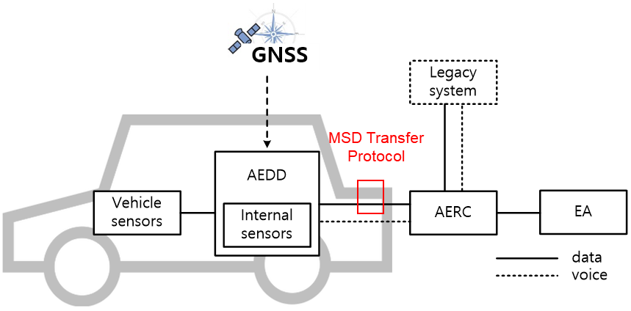
Y.AERS-mtp
Y.AERS-mtp “Minimum set of data transfer protocol for automotive emergency response system”
Motivation of the study
The automotive emergency response system (AERS) for aftermarket devices defined in Recommendation Y.4119 (ex-Y.AERS-reqts) is designed to bring rapid assistance to driver and/or passengers involved in an accident.
For the normal operation of the AERS, the accident related data (so-called minimum set of data, MSD) transfer protocol between automotive emergency detection device (AEDD) in the vehicle and automotive emergency response center (AERC) needs to be defined.
Scope of the Recommendation
To specify a minimum set of data (MSD) transfer protocol for AERS.
In particular, the scope of the Recommendation includes:
MSD transfer protocol parameters
Messages format of MSD transfer protocol
Sequence of MSD transfer protocol

Slide 10
Y.AERS-msd
Y.AERS-msd “Minimum set of data structure for automotive emergency response system”
Motivation of the study
The automotive emergency response system (AERS) for aftermarket devices defined in Recommendation Y.4119 (ex-Y.AERS-reqts) is designed to bring rapid assistance to driver and/or passengers involved in an accident.
For the normal operation of this AERS, the accident related data (so-called minimum set of data, MSD) needs to be sent from automotive emergency detection device (AEDD) to automotive emergency response center (AERC).
The MSD includes essential information and additional information. The essential information of the MSD is a set of information that must be included in the MSD when the AEDD performs normal operation. The additional information of the MSD is a set of information about accident situations that can be additionally included to give more information to AERC.
Scope of the Recommendation
To define common structure and encoding rule for MSD for the interoperability of AERS.
In particular, the scope of the Recommendation includes:
Overview of the MSD for AERS
Essential information of MSD
Additional information of MSD
Encoding rule for MSD

Slide 11
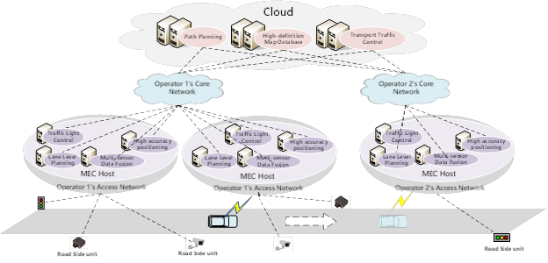
Y.NDA-arch
Y.NDA-arch “Functional architecture of network-based driving assistance for autonomous vehicles”
Motivation of the study
This document specifies a functional architecture of network-based driving assistance for autonomous vehicles, taking into account of the IoT reference model specified in the Recommendation ITU-T Y.4000. It describes functional entities and reference point in order to support the network-based driving assistance for autonomous vehicles.
Scope of the Recommendation
-The functional architecture of network-based driving assistance for autonomous vehicles;
-The functional entities to support network-based
driving assistance for autonomous vehicles;
-The reference points of the
functional architecture.

Slide 12
About SG20 coordination with ISO TC 204
As far as the invited coordination of SG20 with ISO TC 204 on ITS, SG20 sent out LS to ISO TC 204 on ITS related work items of SG20 at Cairo (Egypt), 16 May 2018. (Ref.: SG20-TD858-R2)
ITU-T SG20 is committed to ensuring a close collaboration and coordination with ISO TC204 on matters related to ITS.

Slide 13
Next SG20 meeting: 9-18 April, Geneva
Thank you!
http://itu.int/go/tsg20
Contact:
tsbsg20@itu.int
shane.he@nokia.com

