Slide 1
The Connected
Vehicle
Presented
By
(WWRF VIP CV WG Chair Seshadri Mohan)
at
CITS Meeting
Geneva, Switzerland (8 March2019)

Slide 2
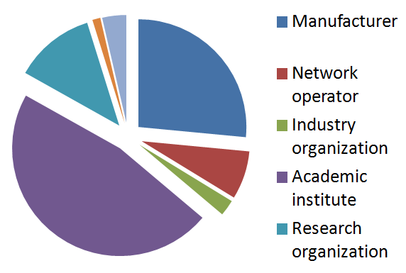
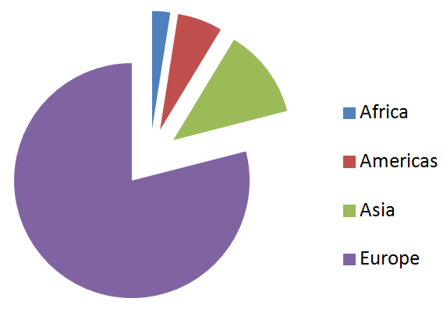
WWRF Overview
Develop future vision of the wireless world
Enable and facilitate the translation of the vision into reality
Bring a wide range of parties together to identify and overcome significant roadblocks to the vision
Inform and educate on trends and developments
Global operation
Covers every technical field of wireless communications and mobile networking
Open to all
Based on membership
60 member organizations

Slide 3
VIP (Vertical Industry Platform): Bringing IoT into 5G
Contributions to international standardizations
are from member organizations
SDOs
(CT)
VIP-WGs
Use cases,
Requirements,
Tech Analysis
Service /
Applications
ORGs
(IT)
WWRF
Visions, Scenarios & Technologies
Telecom
Industry
Vertical
Industries
Academia

Slide 4
WWRF Working Groups
WORKING GROUP A/B: User Needs & Requirements: Services and devices in a Wireless World
WORKING GROUP C: New Directions in Communication Architectures and Technologies
WORKING GROUP D: Radio Communication Technologies
Working Group High Frequencies (mmWAVE and THz) Radio Communications Technologies
Working Group AI for Wireless Communications Networks
VIP WG e/m-Health and Wearables
VIP WG Connected Vehicles
VIP WG Track-to-Train communications
VIP WG Future Business Models supported and enabled by 5G and Beyond wireless technologies
VIP WG 5G for Smart Water Management

Slide 5
VIP CV WG: The Connected Vehicle
Scope
The VIP CV WG focuses on research that looks five to ten years ahead in order to meet the requirements of the automotive and transport industries based on the next generation wireless technology. It also is aimed at the identification of use cases for these industries.

Slide 6
Objectives
Leverage academic research to develop technologies for connected vehicles (CV) that complement developments in standards bodies.
Provide relevant input to government in order to maximize the advantages of CV technologies while addressing concerns with respect to security and privacy.
Develop WWRF as a bridge between the automotive industries and industry organizations such as 5GAA and the wireless standards organizations (such as 3GPP) to provide input to help prepare for standardization.
Create a better understanding in the automotive industries of the potential and capabilities of future wireless technologies.
Enable the telecom and automotive industries to jointly discuss the vision, usage scenarios, requirements and enabling technologies to achieve the targets of future vertical industry communications in 5G and beyond.
Develop use cases and study any gaps that may need to be addressed with respect to existing and evolving standards (e.g., DSRC) for the support of connected car and associated industries
Develop use cases and technical requirements for 5G and beyond support of the connected car and associated industries.

Slide 7
Milestones and deliverables
Outputs include white papers and technical proposals which will be submitted to major standardization bodies of 5G, including ITU and 3GPP, as well as industry organizations such as 5GAA
Launch of working group at WWRF39 meeting in Barcelona (October 2017)
Generate a white paper outline for soliciting contributions at WWRF40 in Durban, South Africa on the research status of 5G and other wireless technologies in the road transport environment (Done)
Develop the white paper further with contributions from WWRF CV WG members and present the results at WWRF ‘41 in Herning, Denmark (Done)

Slide 8
Participation
The major companies, universities and organizations active in the area of V2X, including China Mobile, Intel, the Society of Motor Manufacturers & Traders (SMMT), ITU CITS, King’s College London, UA Little Rock, USA, and Huawei.
Many telecom operators, vendors and car manufacturers have shown interest and some of them are expected to join and contribute.

Slide 9
Summary VIP CV Activities Presented at WWRF ’40, Durbin, South Africa
During Dec. 5-6, Sesh Mohan attended ITU/TIA meeting on CITS in Arlington, Virginia, represented WWRF and presented VIP CC charter, a summary of papers on CC at WWRF’39 in Barcelona, and discussed opportunities for collaboration
During the 5G Huddle in Durban, Eckart Kruger presented the paper titled “5G and Mobility,” which is relevant to connected cars. He concluded connected cars will “significantly improve traffic flows, reduce accidents and enhance safety, relieve the pressure on drivers and the environment, generate added value and create new jobs.”
During VIP CC Session, the paper titled “Advanced Spectrum Management for Next Generation Vehicular Networks: An Artificial Intelligence Approach” was presented by Sesh Mohan. It concluded that “AI/Game-Theoretic-based mechanisms are expected to improve reliability of wireless communication among autonomous vehicles.”

Slide 10
Summary VIP CV Activities Presented at WWRF40, Durban, South Africa
Draft of a white paper outline on VIP CC was presented.
The white paper is under development and the Chair solicited contributors to the paper.
A proposal is under development for organizing a feature topic in one the IEEE Magazines such as IEEE Vehicular Technology Magazine, IEEE Communications Magazine, or IEEE Wireless Magazine.

Slide 11
Summary VIP CV Activities at WWRF ’41, Herning, Denmark
VIP CC White Paper Draft
The Chair briefly discussed the contents
Seven contributors have volunteered
Additional contributors are solicited
Six papers were presented
Topics covered included pedestrian safety, AI and IoT-based smart transportation, localization, Machine learning-based driver drowsiness detection, blockchain-based privacy and security
Sesh Mohan and Nigel Jefferies held a short meeting with Mikko Presser, Vice Chairman of IoT Week to be held in Aarhus in June 2019 to explore participation of WWRF. A couple of possibilities were discussed.

Slide 12
Plans for 2019
VIP CV will meet at the forthcoming WWRF meetings:
WWRF42 in Tokyo, Japan, on 14-16 May (www.wwrf42.ch)
WWRF43 in Thessaloniki, Greece, on 9-11 October (www.wwrf43.ch)
Contributions are still open to both meetings
WWRF42 deadline 15 February for abstracts
Full papers will be published in IEEE VT Magazine (if successfully reviewed)
Contributions can be made by all including non-members

Slide 13
White Paper on Connected Vehicles
Table of Contents
Introduction
State-of-the-Art in the Area of Connected Cars
Relevant Standards
Capabilities and Requirements of CV
Spectrum Issues
Safety Issues
Security, Privacy, and Ethical Issues
Policy and Regulatory Issues
Use Cases
Other Issues Relevant CV
Conclusions and Recommendations

Slide 14
Contact
Dr. Nigel Jefferies, Chair WWRF, chair@wwrf.ch
Prof. Seshadri Mohan, UA Little Rock, sxmohan@ualr.edu

