Slide 1


C-V2X for Cross-Industry
Integration and Innovation
Yuming GE, China Academy of Information and Communications Technology (CAICT)
Leader of the IMT-2020 (5G) PG C-V2X WG and CCSA TC10

Slide 2
Issuing the Guide to the Construction of the Standards System
The MIIT and the Standardization Administration jointly issued the Guide to the Construction of the National Connected Vehicles Industry Standards System, which included general requirements, intelligent & connected vehicles, information communication, electronic products and services, smart transportation, and intelligent vehicle management. The MIIT, Ministry of Transport, and Ministry of Public Security, together with standardization organizations, research institutes, industry alliances, and enterprises, will jointly develop the IoV industry standards.
Intelligent & connected vehicles
Information communication
Electronic products and services
Smart transportation
Intelligent vehicle management
2

Slide 3
LTE-V2X Standardization Architecture in China
LTE-V2X standardization in China has been preliminarily systematized, covering LTE-V2X overview, air interfaces, network and application layers, and security. The overall architecture supports LTE-V2X R&D and application at different layers.
Application layer
Category | Standards Name | Standards Type | Standards Organization
Overview | Overall technical requirements for LTE-based IoV communications | Industry standards | CCSA
Application layer | Cooperative intelligent transportation system – Dedicated short range communications – Part 3: Technical requirements for the network layer and application layer | China national standards | TC/ITS and CCSA
 | Cooperative intelligent transportation system – Application layer and application data interaction standards for vehicle communications | Alliance standards | SAE-C and C-ITS
Network layer | Cooperative intelligent transportation system – Dedicated short range communications – Part 3: Technical requirements for the network layer and application layer | China national standards | TC/ITS and CCSA
Air interface | Technical air interface requirements for LTE-based IoV communications | Industry standards | CCSA
Security | Technical security requirements for IoV communications based on the public LTE network | Industry standards | CCSA
Management
Network layer
Security
Access layer
Physical layer
C-V2X standard protocol architecture in China

Slide 4
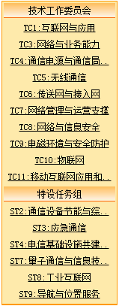
CCSA Organizations
Special Task Groups
Technical Committees
TC1:Internet and application
TC3:Network
TC4:Communication power supply & station operational environment
TC5:Wireless communication
TC6:Transport and access network
TC7:Network management & operation support
TC8:Network & information security
TC9:Electromagnetic environment &protection
TC10:IoT
TC11:Mobile internet application and terminal technical
ST2:Communications Equipment Energy-saving and Comprehensive Utilization
ST3:Emergency Communication
ST4:Telecommunication Infrastructure Construction and Sharing
ST7:Quantum communication and information technology
ST8:Industry Internet
ST9:Navigation and location services
Notes:
CCSA标准组织

Slide 5
CCSA standards with LTE-V2X
 | Standard | SDOs | Completion
Security | LTE V2X security | CCSA TC5 WG5/TC8 | Dec. 2018
Spectrum | LTE V2X spectrum | CCSA TC5 WG5/TIAA&FF | completed
Protocol | General Technical Requirement-LTE V2X architecture | CCSA TC5 WG3/C-ITS | Completed, national standard on-going
 | LTE V2X radio air interface | CCSA TC5 WG3/C-ITS | Completed, national standard on-going
 | Message dictionary standards-phase 1 | C-SAE/C-ITS/National standards/CCSA TC10 | Completed, CCSA work on-going
 | Message dictionary standards-phase 2 | C-SAE/C-ITS/CCSA TC10 | WI approved, Dec. 2019
 | ITS network/transportation/adaptation layer | C-ITS/National standards | completed
 | LTE V2X network/transportation layer | C-ITS/CCSA TC10 | WI approved
 | LTE V2X message layer | C-ITS/CCSA TC10 | WI approved
Profile | LTE V2X UE requirement | CCSA TC5-WG9 | V&V, Dec. 2019
 | LTE V2X UE test spec | CCSA TC5-WG9 | WI approved, Dec. 2019
 | LTE V2X eNB requirement | CCSA TC5-WG9 | V&V, Dec. 2019
 | LTE V2X eNB test spec | CCSA TC5-WG9 | baseline, Dec. 2019
 | LTE V2X RSU requirement | CCSA TC5-WG9 | WI approved, Dec. 2019
 | LTE V2X RSU test spec | CCSA TC5-WG9 | WI approved, Dec. 2019
 | EPC equipment support V2X requirement | CCSA TC5-WG12 | Baseline, Dec. 2019
 | EPC equipment support V2X test spec | CCSA TC5-WG12 | WI approved, Dec. 2019
 | LTE V2V/V2I system requirements | C-SAE/C-ITS | WI approved in C-SAE/C-ITS
New Connected Vehicle (Automotive) TG of CCSA TC 10, focus on cross industry cooperation
Notes:
CCSA标准组织

Slide 6
Gradual Layout of the C-V2X Industry
C-V2X industry chain
C-V2X industry map
Communication chips
Communication modules
Terminals
Vehicle manufacturing
Operations and services
Tests and verification
High-precision locating and map services
6

Slide 7
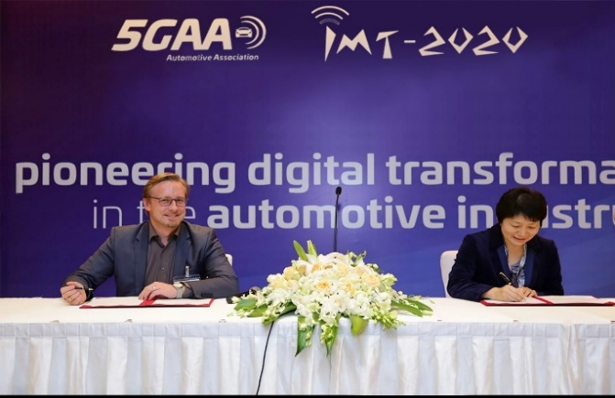
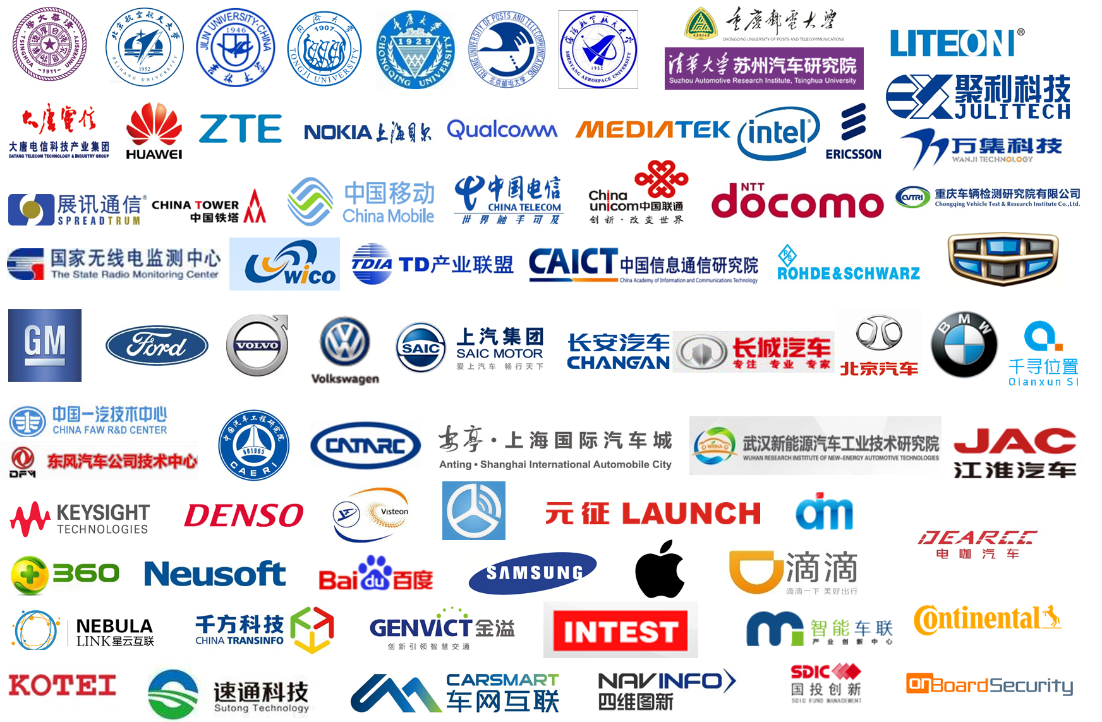
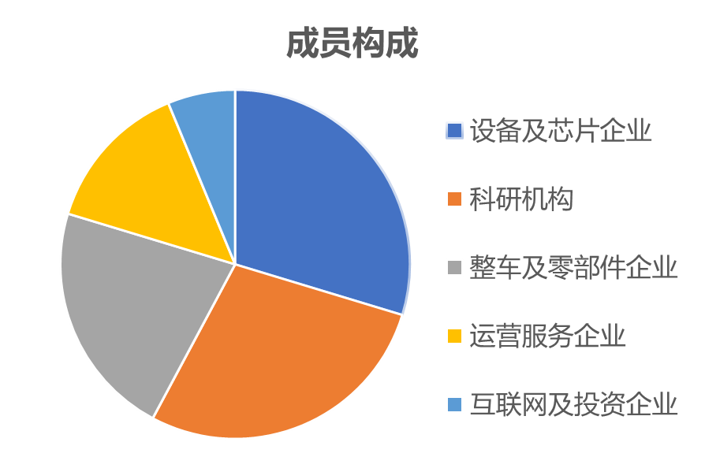
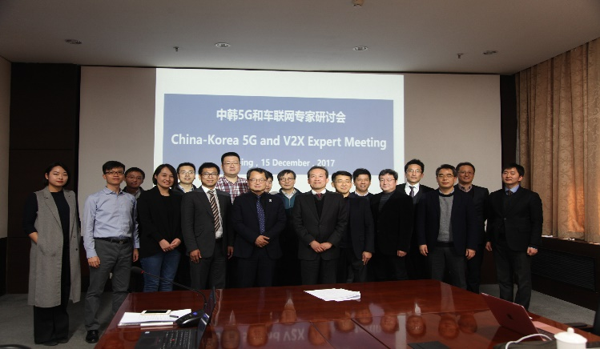
IMT-2020 (5G) Promotion Group Establishing the C-V2X Work Group to Promote the Establishment of a Cross-Industry Innovation Platform
75 institutes and research centers and enterprises joined and formed a member alliance for cooperation among multiple industries, such as automobile, information communications, and transportation.
Sign the memorandum of cooperation with 5GAA.
Joint Symposium on 5G and IoV between China and South Korea
7

Slide 8
Key Tasks of the IMT-2020 C-V2X Working Group
Organize technical researches, tests, certification, and industry and application promotion of LTE-V2X and 5G-V2X.
2017
LTE-V2X tests and verification
LTE-V2X deployment and networking
LTE-V2X business model
C-V2X service requirement evolution
Technology maturing
Industrialization
LTE-V2X frequency requirements and planning
C-V2X testing and certification architecture
LTE-V2X large-scale tests
LTE-V2X security authentication mechanism
Integration with MEC
C-V2X application and business model
High-precision locating enhancement application
2018
Published “C-V2X white Paper” in 22th June, 2018
8

Slide 9
Thank you
Ge Yuming Email: geyuming@caict.ac.cn

