Slide 1
The Connected
Vehicle
Seshadri Mohan
Professor, UA Little Rock
Presented at
Collaboration on ITS Communication Standards
Meeting
At the
ITU/TIA Meeting
Arlington, VA
December 6, 2017
On behalf of WWRF

Slide 2
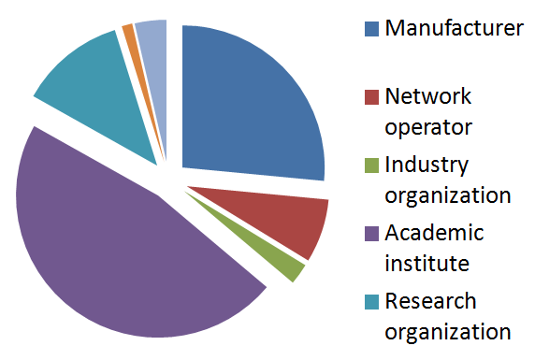
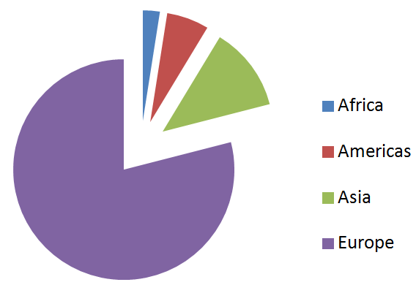
WWRF Overview
Develop future vision of the wireless world
Enable and facilitate the translation of the vision into reality
Bring a wide range of parties together to identify and overcome significant roadblocks to the vision
Inform and educate on trends and developments
Global operation
Covers every technical field of wireless communications and mobile networking
Open to all
Based on membership
60 member organizations

Slide 3





VIP (Vertical Industry Platform):
Bringing IoT into 5G
ORGs
(IT)
Contributions to international standardizations
are from member organizations
SDOs
(CT)
VIP-WGs
Use cases,
Requirements,
Tech Analysis
Service /
Applications
WWRF
Visions, Scenarios & Technologies
Telecom
Industry
Vertical
Industries
Academia

Slide 4
WWRF Working Groups
WORKING GROUP A/B: User Needs & Requirements in a Wireless World/Services, devices and service architectures
WORKING GROUP C: Communication architectures and technologies
WORKING GROUP D: Radio Communication Technologies
WG HIGH-FREQUENCY TECHNOLOGIES
VIP WG 5G E/M-HEALTH AND WEARABLES
VIP WG THE CONNECTED CAR
VIP WG END TO END NETWORK SLICING

Slide 5
VIP CV WG: The Connected Vehicle
Scope
The scope of this Vertical Industry Platform is to identify the requirements of the automotive and transport industries based on 5G technology, and the status and progress of research into the use of 5G technologies in the road transport environment.

Slide 6
Objectives
Develop WWRF as a bridge between the automotive industries and the 5G standards organizations (such as 3GPP) to gather their requirements and prepare for standardization.
Create better understanding in the automotive industries of the potential and capabilities of 5G.
Enable the telecom and automotive industries to jointly discuss the vision, usage scenarios, requirements and enabling technologies to achieve the targets of future vertical industry communications in 5G.
Liaise with industrial and academic partners to monitor and report on research into leading edge technologies.
Work with the global automotive industry to highlight and develop opportunities enabled by 5G.
Provide relevant and timely input to standardization process (3GPP primarily, also ITU-T and ETSI).

Slide 7
Milestones and deliverables
Outputs include white papers and technical proposals which will be submitted to the major standardization bodies of 5G, including ITU and 3GPP, as well as industry organizations such as 5GAA
  Launch meeting in London (January 2016) - DONE
  Relaunch working group at WWRF39 meeting in Barcelona (October 2017) - Done
  Generate a white paper for presentation at WWRF40 on the research status of 5G and other wireless technologies in the road transport environment

Slide 8
Participation
The major companies, universities and organizations active in the area of V2X, including China Mobile, Intel, the Society of Motor Manufacturers & Traders (SMMT), ITU CITS, King’s College London and Huawei.
Many telecom operators, vendors and car manufacturers have shown interest and some of them are expected to join and contribute.

Slide 9
Papers on Connected Vehicle at WWRF ‘39 in Barcelona
The 5GCAR Project - Mikael Fallgren (Ericsson, Sweden).
V2X channel measurements and modeling - Mate Boban (Huawei, Germany) and Taimoor Abbas (Volvo Cars, Sweden).
Integrated Moving Networks - Tommy Svensson (Chalmers University, Sweden).
Fog computing and the connected car- Ricard Vilalta (CTTC, Spain).
5G and the transformation of the automotive ecosystem - Andres Laya (Ericsson, Sweden)

Slide 10
Papers on Connected Vehicle at WWRF ‘39 in Barcelona
Pedestrian safety as a “killer” Application for 5G - Klaus David (Kassel University)
IoT + Mobility ≈ 𝑰𝒐𝑽 - Seshadri Mohan (UA Little Rock, United States)
Survey: Challenges and Perspectives of VANETs Mobility Modelling - Sundire Madhekwana, Alexandros Ladas, Christos Politis (Kingston University, UK).

Slide 11
Contact
Dr. Nigel Jefferies, Chair WWRF, chair@wwrf.ch
Prof. Seshadri Mohan, UA Little Rock, sxmohan@ualr.edu

