Slide 1
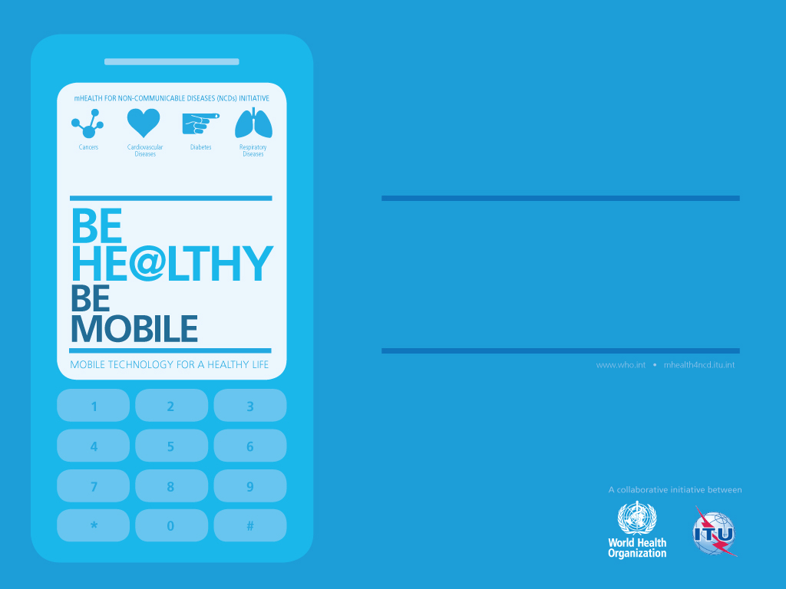
Fighting the global health burden through new technology:
Prevention of NCDs Department World Health Organization
WHO-ITU joint Program on mHealth for NCDs

Slide 2
Non-Communicable Diseases(NCDs) and their causes
Cancer
Diabetes
Chronic
Respiratory
Diseases
Cardiovascular
Diseases
Other NCDs
Physical inactivity
Unhealthy
diets
Obesity
Tobacco
use
Harmful use of alcohol
Malnutrition
Notes:
The following four types of NCDs ‐ cardiovascular diseases, cancers, chronic respiratory diseases and diabetes ‐ make the largest contribution to mortality and overall disease burden in the majority of developing countries and in those economies currently undergoing growth or shrinkage. These diseases are largely preventable if effective steps are taken to reduce four common lifestyle risk factors, namely: tobacco use, unhealthy diet, physical inactivity and excessive alcohol consumption.
The socio-economic impact is staggering. All countries in the world, regardless of GDP, are concerned with saving money in the health sector. This is due to structural debt, the recent global financial crisis as well as the high costs spent on health in all countries and the rise in elderly populations and in chronic disease. This has led to a major push in all countries to find innovations that save money within this sector.

Slide 3
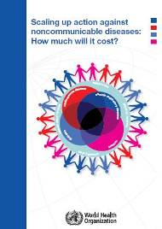
The socio-economic burden of NCDs
US$ 170B
US$ 7T
is the overall cost for all developing countries to scale up action by implementing a set of "best buy" interventions, identified as priority actions by WHO
is the cumulative lost output in developing countries associated with NCDs between 2011-2025
57 million total deaths in 2008 of which 36 million were due to NCDs

Slide 4
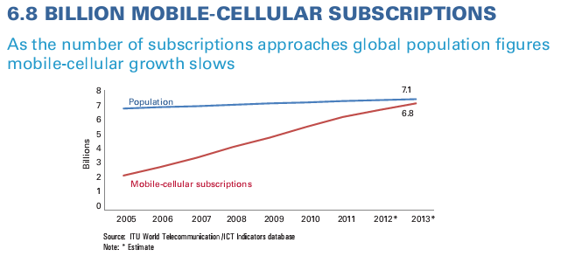
Connected Life…..
Why is mHealth important?
Worldwide penetration
ITU estimates, 2012
Mobile cellular subscriptions
Number (millions) | 6,835m
Per 100 people | 96.2%
Fixed telephone lines
Number (millions) | 1,171m
Per 100 people | 16.5%
Active mobile broadband subscriptions
Number (millions) | 2,096m
Per 100 people | 29.5%
Fixed broadband subscriptions
Number (millions) | 696m
per 100 people | 9.8%
Notes:
2. Role of mHealth: Another parallel increase to the growth of NCDs is that of something much more positive: the mobile phone. Mobile technology is the most rapidly adopted technology in the world. There are more mobile devices than people. More people have access to mobile devices than currently have access to clean water or electricity, and most people are never further than three feet from their phone, 24 hours a day. So how do we leverage this?
This is where mHealth’s adaptability becomes a real strength for our work in non-communicable diseases. The technology provides a generic platform. It can be programmed to focus on any NCD disease or risk factor. By tackling risk factors as well as existing diseases, it allows a much wider outreach and impact and confronts the source of the diseases, minimizing their future impact. This ties in with mHealth’s advantage as a delivery model which is direct, targeted, and could be very cost effective.

Slide 5
There are a number of challenges with mHealth
Evidence
Scattered pilots
Costs not analyzed
No evaluation/review
Closed technology
Govt Ownership
Expensive technology
Pilotitis
No integration of systems
Business model?

Slide 6
Tackling the challenges
Evidence

Slide 7
Looking at evidence for NCDs (PREVENT, TREAT, ENFORCE)
Prevention
Enforcement
Treatment
mAwareness
mTraining (Health workforce development)
mSocialnetworking, mGaming
mDiabetes
mWellness
m Agriculture
mPhysicalActivity
mSurveillance
mTAPS
Guidelines
development
mSmokeFree
mCessation
mGeoMapping
mDisease Management
mWhistleblowers
mIllicit

Slide 8
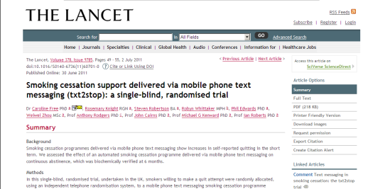
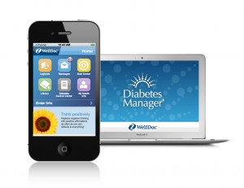
TREATMENT: mCessation, disease management
Number of successful SMS-based behavioural change programmes for smokers have been successful in the US, UK and New Zealand, Europe (mostly High income nations)
Diabetes Manager: Proven clinical impact observed during early trials reported a 1.9% A1c drop in participants***
Notes:
Quitting tobacco is not easy as tobacco dependence is a cluster of behavioural, cognitive and physiological phenomena. Very few tobacco users can successfully quit the habit in their first attempt. Traditional methods to quit smoking are based on brief advice through counselling and possible the use of nicotine replacement therapy and prescription medicines.
In a recently published study in the Lancet, mobile cessation, or mCessation as it is known, was shown to be at least two times more effective, and sometime up to six times more effective than traditional methods in increasing quit rates. The study concluded that "smoking cessation support delivered via mobile phone text messaging …. is effective in all socioeconomic groups and in younger and older smokers". These results were significant in how they demonstrate that mobile-technology-based interventions can be effective in changing behavior that can lead to other risk factors for NCDs.
Text messaging has been used, with and without additional incentives, to increase the use of sunscreen, to improve compliance in the management of diabetes and to encourage and increase the use of condoms, among many other behavioural change initiatives. Examples of other mHealth NCD interventions range from applications that allow individuals to monitor their diabetes and to plan their treatment programs.

Slide 9
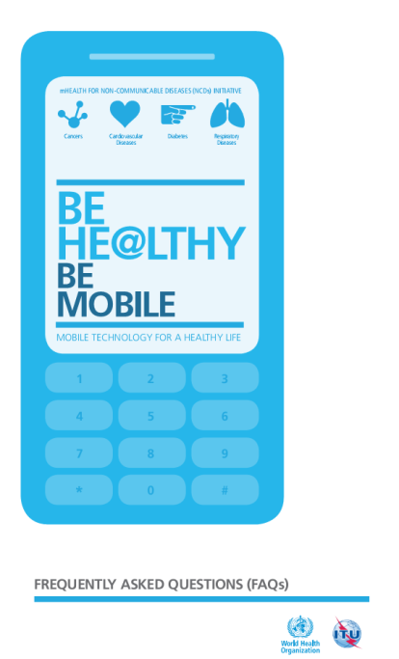
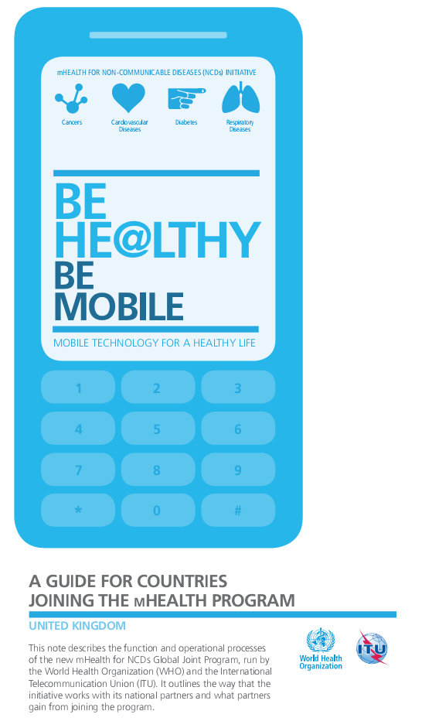
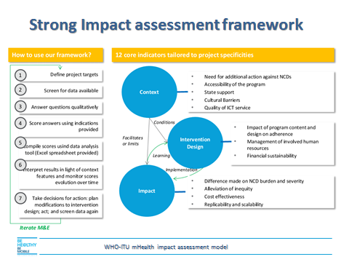
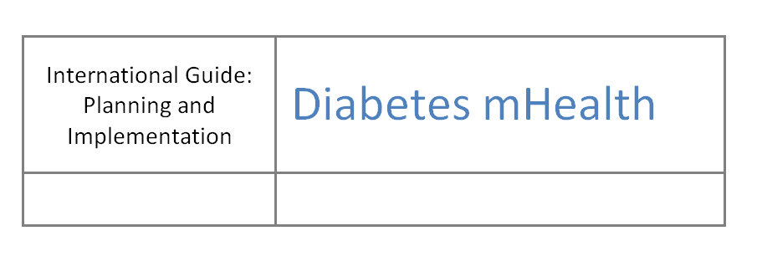
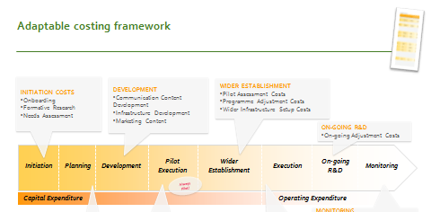
mHealth for NCDs Toolkit

Slide 10
mHealth for Diabetes control
mPrevention
mAdvocacy
Can have a progressive approach:
mTraining
Mobile based training of Health workers
Help spread advocacy
Help direct diabetics to assistance
Mobile based training of teachers
mDisease Management
One or two ways SMS or App-based / Apps Based
Existing best practices;
Welldoc - Diabetes Manager: Proven clinical impact observed during early trials reported a 1.9% A1c drop in participants
A Project Initiation Document (PID) is provided to assist in conceptualizing and planning the intervention
Needs and Situation Assessment
Stakeholders engagement
Message development, Refinement and testing
Marketing and Promotion
Monitoring and Evaluation
mSurveillance
Data from all other tools feed into a monitoring and evaluation mechanism for ongoing assessment and
Measuring use and impact
Conduct surveys for measurement
Simple SMS-based mHealth Diabetes Prevention
Advanced interactive Diabetes intervention where messages are tailored to individual’s Follow-up
There is medical proof that diabetes can be prevented through change in lifestyle (e.g. physical activity and healthy diet)
Arogya in partnership with NOKIA to educate 1m people in India about Diabetes prevention and lifestyle change

Slide 11
Example: the mDiabetes process
Diabetic patient
Pre-diabetic individual
Self-registers for SMS disease management support (text code) or referred by doctor
Receives an initial outreach SMS engaging them in the programme.
Receives daily reminders for measuring blood glucose and taking insulin
Individual replies to the SMS, enrolling them in the prevention programme.
The patient controls the disease
rather than the disease controlling the patient.
Receives regular advice on ways to manage diabetes through diet (e.g. replacement foods or help managing insulin levels)
Individual receives SMS-based advice on small changes they can make to reduce risk factors for diabetes – e.g. diet, exercise, information on diabetes development
Result: a happy, health diabetic with reduced A1c.
Numerous studies show that mobiles help diabetics to keep blood glucose stable and are acceptable to users.
Result: a happy, diabetic-free individual

Slide 12
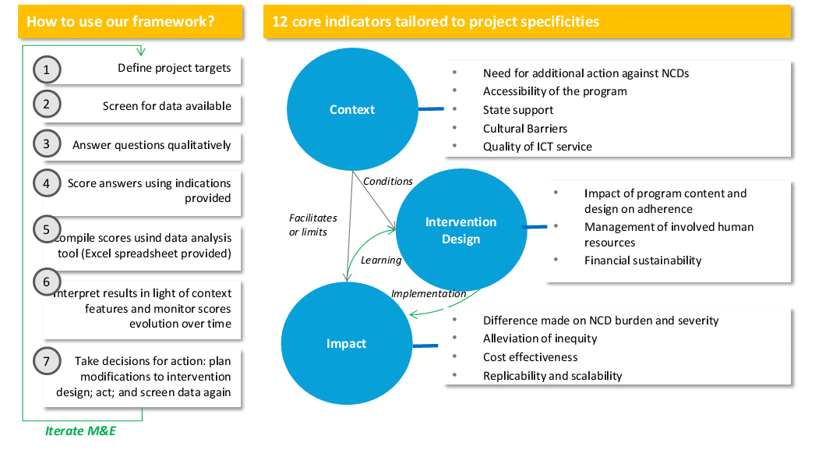
M&E Impact assessment framework
WHO-ITU mHealth impact assessment model

Slide 13
Tackling the challenges
Encouraging Government ownership – through a UN convening platform

Slide 14
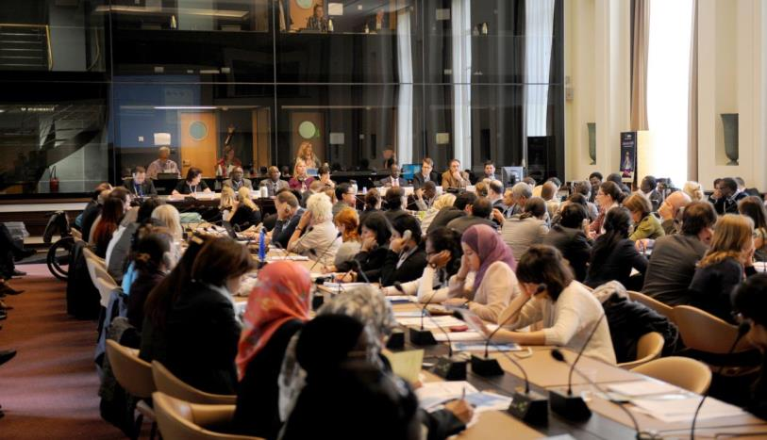
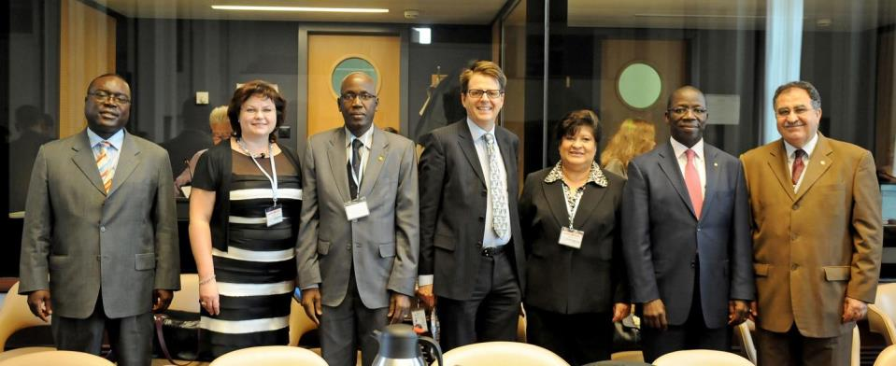
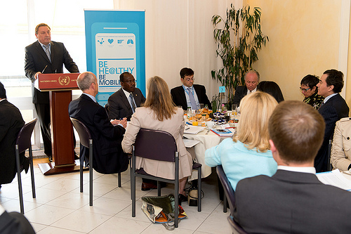
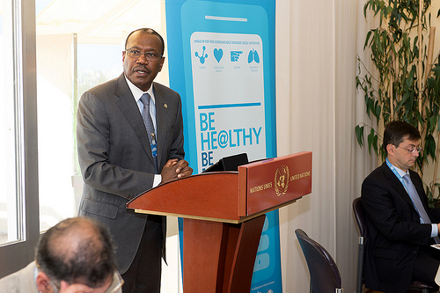
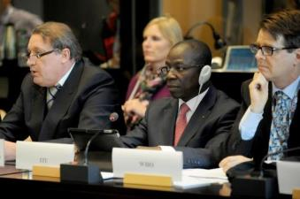
There is changing political will and extreme interest…

Slide 15
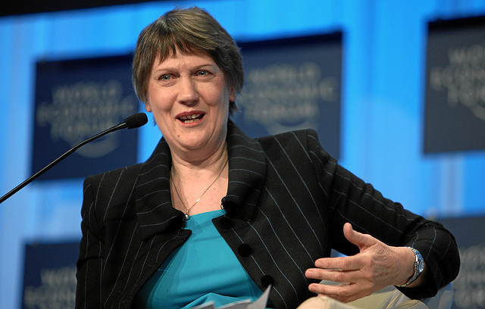
“The WHO ITU joint initiative on mHealth for NCDs is a promising innovative intervention to see how to use new technologies to better health outcome"
Helen Clark • UNDP Administrator • 31 January 2013 • Harvard School Public Health• Boston, Massachusetts

Slide 16
Tackling the challenges
From Pilotitis to
Health systems approach

Slide 17
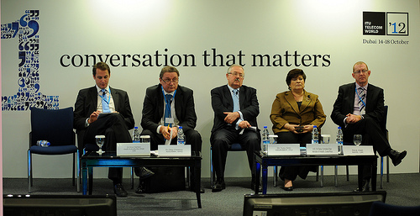
In October 2012 we launched the WHO-ITU Joint Initiative on mHealth with clear objectives
NCD Problem
WHO ITU mHealth program on NCDs
Supporting framework
36 m deaths / year
Resource Mapping: identify “who is doing what” in mHealth for NCD space
Coordinate: technical groups & partners
Validate: NCD content and solutions
Evaluate: cost effectiveness & health outcomes
Promote: results and best practices
Build capacity: where gaps exist
Mobilize countries: to implement
Mobilize Resources: governments & partners
Provide…
Global Platform
Partnerships
9 m premature deaths / year
To enable…
Health systems
Capacity building
To overcome…
$7 tr
health-care costs & productivity losses 2011-2025
Evidence challenges
Scaling challenge
Notes:
2 min
NCDs cause an
estimated 36 million deaths every year, including 9 million people dying prematurely before the age of 60. Harvard University now estimates that the cumulative lost economic output in developing countries associated with NCDs is US$7 trillion over the period 2011-2025 through health-care costs and productivity losses.
The “mHealth for NCD Tool-Box” as a key deliverable of this programme will include:
Best Practices: such as "best apps for NCDs", case study series, literature review, projects database, etc.
Content: including database of validated content and Community Health Workers (CHWs) eLearning materials and professional development curricula for NCD prevention and treatment.
Technology solutions and platforms: including available validated m-apps and service delivery platforms that are preferably Open, standardized, secured and modular that can be reused by countries for NCD prevention and treatment.
Deployment Strategies and Business models: This can include the development of materials such as “mHealth Standard Operating Procedures (SOPs), marketing strategies and sustainable business models.
Policies: that induce an enabling environment for scalable and sustainable mHealth services.
Monitoring, Evaluation and Evidence: including evaluation methodologies and mHealth for NCD impact assessment literature reviews.
The two biggest barriers to success of mHealth identified to date are in gaining funding through proof of concept, and in the subsequent scale up of pilots. The first barrier is largely due to poor planning and difficulty in solution identification and the second due to complexity of projecting accurate costs. A framework has been created to assist the WHO when working with participant nations to overcome the key mHealth challenges by identifying appropriate mHealth programmes tailored to the needs and budget of the nation in question.
The purpose of the framework is to:
Steer conversation during selection of mHealth programmes with research based decision making criteria; and
Form a high level structure of costs to drive the detailed costing exercises undertaken during initial project launch stages

Slide 18
The mHealth for NCDs scale-up factors
Political commitment+ Cross sectoral partnership
Mobile phone penetration and technology
Financing model
NCD burden/ proven interventions
Evidence
Pilots to health systems (toolkit)
Standards and Guidelines

Slide 19
Cross sectoral partnership model
Telecoms, Insurance , Pharma, Wellness, IT, Sporting Industry, Other Private Sector
Best Practices
Government
Best Practices
NGOs and Academia
UN
Best Practices
Content
Technology
Deployment strategy
M&E
Content
Technology
Deployment strategy
M&E
Policies
Best Practices
Content
Deployment strategy
M&E
Content
Technology
Deployment strategy
Policies
M&E

Slide 20
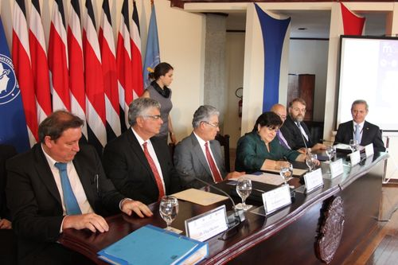
Costa Rica : Champion example
Commitment from the President’s office from day 1.
1 million dollars committed by the Government
Strong leadership from the MoH
High end coordination between MoH , MoICT, eGovernance group

Slide 21
VERSION AT THURSDAY, 12 SEPT
There is significant interest in participation among low-, middle- and high-income countries
Attractive to donors
Official request
No. | Country | OECD income | Intervention area | Status | Next steps | Lead
1 | Bahrain | High | mDiabetes, mWellness | Email discussions |  | Hani
2 | Brazil | Middle | mCessation, mWellness | Email discussions |  | Gini
3 | Brunei | High | mWellness |  |  | Paul
4 | Bulgaria | Middle | To be confirmed | Official request (but Govt has changed) | Put on hold
5 | China | Middle | To be confirmed |  | Develop strategy | TBC
6 | Costa Rica | Middle | mCessation, mDiabetes, mWellness | Underway | Launch services | Sameer, Hani
7 | Estonia | Middle | To be confirmed | Official request | WHO EURO will meet govt. | Gini
8 | Ethiopia | Low | mTraining
9 | Germany | High | mWellness (cancer) |  |  | Vinayak
10 | India | Middle | mDiabetes |  | Discussions w/Govt in person and w/WEF | Vinayak
11 | Indonesia | Middle | To be confirmed |  |  | Sameer
12 | Israel | High | mCessation |  |  | Sameer
13 | Jordan | Middle | mDiabetes, mWellness | Formal request to do mSurveillance, possible link w/other mHealth |  | Sameer
14 | Mali | Low | To be confirmed |  |  | Hani
15 | Malta | High | To be confirmed |  |  | Sameer
16 | Mexico | Middle | mWellness |  |  | Paul
17 | Norway | High | mCessation |  |  | Gini
18 | Pacific Islands | Middle | mDiabetes, mWellness |  | Discuss w/Paul Erikson and Christana MS | Sameer
19 | Philippines | Middle | To be confirmed |  |  | Sameer
20 | Russian Federation | Middle | To be confirmed | Official request | Translated info sent to Russian PM | ADG
21 | Senegal | Low | mCessation, mDiabetes, mWellness | Official request | Teleconference | Hani
22 | Surinam | Low | To be confirmed
23 | Turkey | Middle | mCessation
24 | UAE | High | To be confirmed
25 | United Kingdom | High | mWellness |  |  | Oliver
26 | Zambia | Low | mTraining, mWellness | Official request | Teleconference held | Gini

Slide 22
Our Core Partner Strategy combines inclusiveness and focus
Focus on five key partnership sectors:
Governments;
Telecoms;
Pharmaceutical companies;
Health insurance providers; and
Wellness groups

Slide 23
ITU Partners (already signed on/late stage negotiations)
Associations
Strategic partners

Slide 24
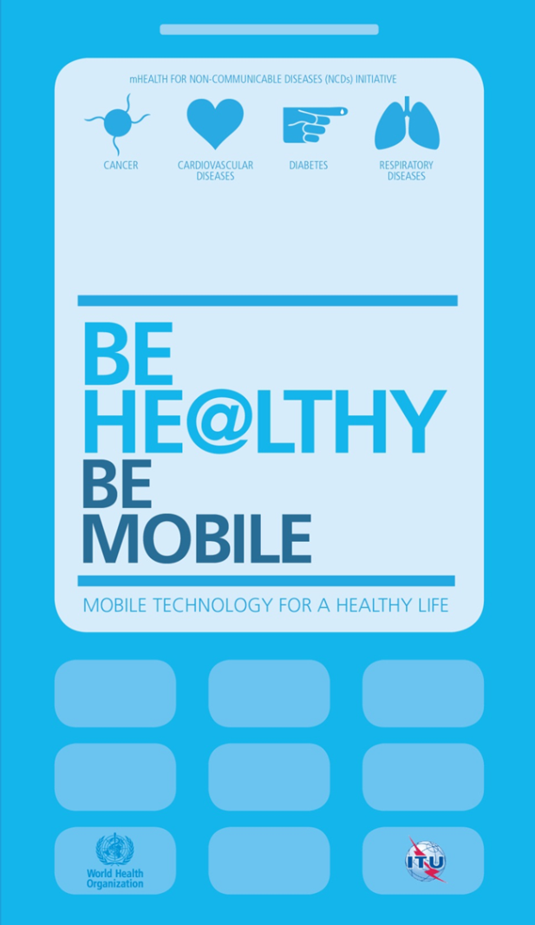
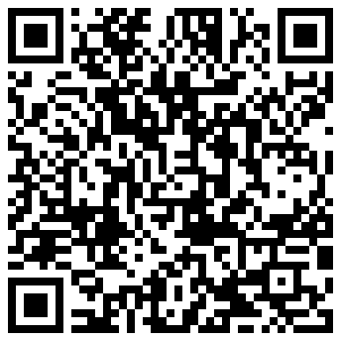
Contact: mHealthforNCDs@who.int Sameer Pujari (pujaris@who.int)
THANK YOU!

