Slide 1
WRC-15 impact in the context of SDGs
Vadim Nozdrin, Counselor, ITU-R Study Group,
International Telecommunication Union
21/04/16
11th Symposium on ICT, Environment and Climate Change
Kuala Lumpur, Malaysia

Slide 2

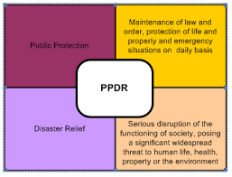
Mobile services
 | Broadband mobile | PPDR
Issue | New applications, growing requirements for high data rate | New requirements for high data rate (video)
Economic effect | Worldwide annual revenue ≅3 trillion US$ (GSMA,2015) 7.1 billion users, 2015 (ITU,2015) | 1980- 2005, 7000 natural disasters, 2 million lives, economic losses 1.2 trillion US$.
WRC-15 decision | Identification harmonized additional 318 MHz in more than 80% countries (total 1228 MHz) +10% in Region 3 (total 976 MHz) | Encouragement to use of harmonized bands 694 – 894 MHz – Global 4 940-4 990 MHz – Region 3 Use Rec. ITU-R M.2015 for national planning
Impact | Economy of scale, increase number and quality of service, interoperability | Economy of scale, interoperability, cross-border circulation

Slide 3
Satellite allocations
Issue: Spectrum/GSO overloading. About 480 existing satellites. 18 satellites to be launched each year (FAA).
Economic effect: Satellite revenue in 2014 - 112 billion US$ (SIA)
WRC-15 decision:
  250 MHz down-link in Region 1,
  250 MHz up-link in 30 countries of Regions 1 and 2
  300 MHz up-link in 10 countries of Region 3
Impact: Enhance satellite access and service delivery, competition, reduced cost per transponder

Slide 4
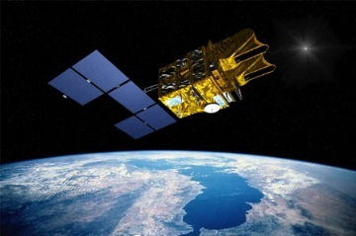


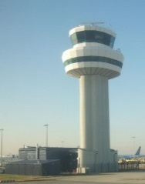
Satellite applications
Issues | Unmanned aircraft system | Earth station on vessels | Earth station in motion
Economic effect | Future use for civil aviation | Annual revenue 1.8 billions US$ (SES) | Use of existing infrastructure
WRC decision | Possibility to use Ku band: 970 MHz globally, 1520 MHz regionally, Ka band: 1000 MHz globally Antenna pattern specification | Min 1.2 m antenna in C-band (2.4 m before) Increasing of coordination distance- from 300 to 330 km | Use of 500 MHz in Ka-band under defined technical conditions Futher ITU-R studies
Impact | Framework for new ICAO standard and ITU studies up to 2023 | Simplification operation and installation, ↓ service cost | New ICT services for all kind transport

Slide 5
Radiolocation service
Issue: Introduction of Intelligent Transport System- safe, efficient user-friendly and green road transport
Economic effect: Annual turnover of road transport-
2.9 trillion US$ (European Union Road Federation)
WRC decisions: Allocation of 500 MHz for ground based application- 5 GHz (76-81 GHz) worldwide continuous band for automotive radars
Impact: in EU in 2020 reduction up to 3250 fatalities and 52000 injuries after car accidents (eImpact)
    Reduction of traffic congestion costs -EU 100 billion in 2013 (wasted fuel, insurance, delivery delay, cargo damage)

Slide 6
Aeronautical services
 | Global flight tracking | Wireless avionics intra-communication
Issue | Lack of global tracking , e.g tragedy of MH370 | Wirelines-up to 30% plane weight
Economic effect | 2,4 trillion US$ or 3,4% global GDP (ATAG) supported by aviation
WRC-15 decision | New allocation of 4.6 MHz for ↑AMS(R)S | Allocation 200 MHz for AMS(R)
Impact | Improving safety of flight and rescue operations | Producer's surplus 21 billion US$/year, ↓CO₂

Slide 7


Maritime services
Issue: Overloading existing maritime spectrum, introduction of broadband applications, safety of life requirements
Economic effect: 0,5 trillion US$ (UNCTAD, 2014)
WRC decisions:
new channel arrangement for on-board communications- introduction of digital modulation
161.9375-161.9625 MHz and 161.9875-162.0125 MHz for mmss (Earth-space) – satellite receipt of Automatic identification signal 375 MHz allocation for MMSS (space-Earth)- new broadband
Impact: increase safety and efficiency of maritime transport, global coverage, introduction of new broadband services on ships

Slide 8
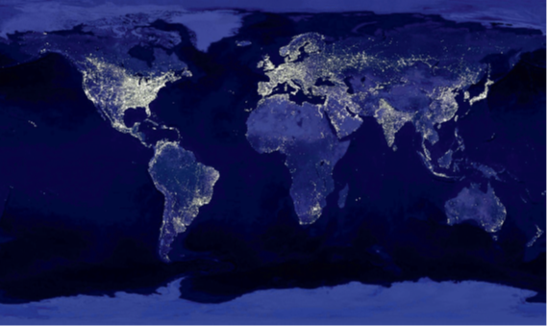
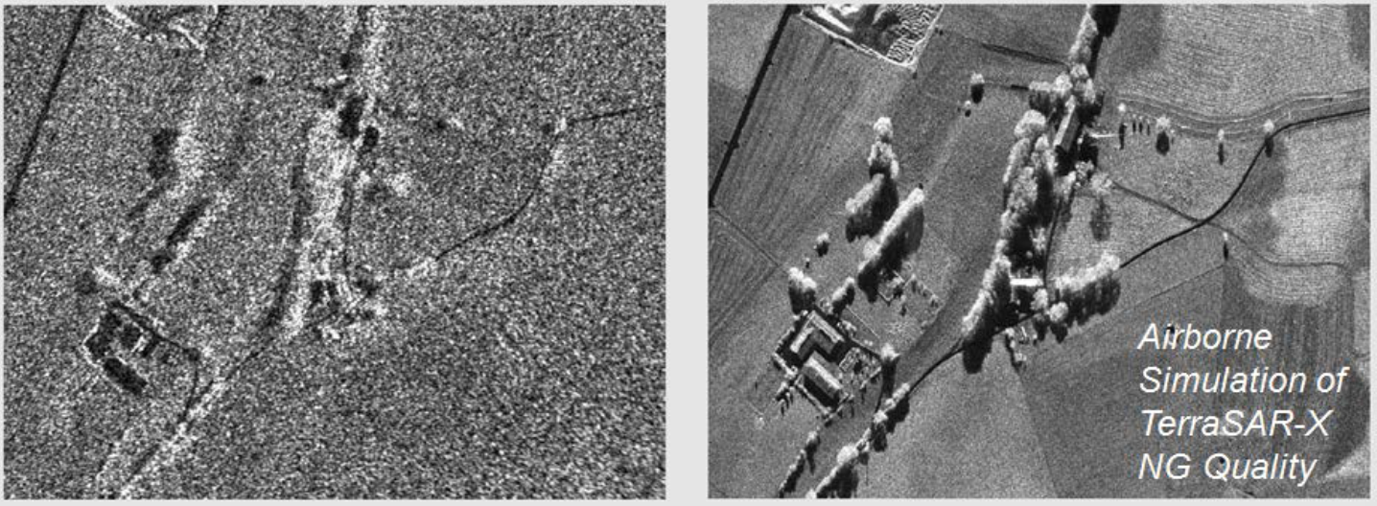
EESS allocations
 | TT&C | Active sensing
Issue: | Only TT&C 2 025-2 110 MHz and 2 200-2 290 MHz. About 100 existing and up to 90 new satellites to be launched until 2019 (FAA). High-speed data for operations and software modifications. Existing TT&C 8 025−8 400 МHz allocation. | Existing EESS (active) allocation in 8-9 GHz 600 MHz. Higher resolution (less than 0.2 m) requires continuous 1200 MHz
Economic benefit | in EU decreasing of economic losses caused by natural disasters up to €61.5 billion/year (Eumetsat)
WRC-15 results | Primary EESS up-link allocation of 60 MHz | Primary EESS(active) allocation of 600 MHz (RR No. 9.21 in 8 countries)
Impact | Simplification operation and maintenance, ↓ service cost | New high resolution scanning service

Slide 9

Future Universal Time
Issue: UTC adjusts atomic time UT1 and ephemeris time TAI based on Earth rotation time by the insertion of leap seconds. Digital systems are highly dependent on keeping very precise time synchronization
Economic Benefits: to prevent discontinuities that can lead to serious financial consequences in case of time maintenance or failure.
WRC-15 decision: Keep current UTC until WRC-23
Impact: Currently, there are 4 billion GNSS devices in use worldwide and the number will triple by 2023 (GNSS Market Report) Location is key component of future IT security
6% of EU GDP- GNSS dependent (∼80 billion EURO/year)
(Munich SatNav Summit 16)

Slide 10
WRC-19
Future broadband- RLAN (6 GHz), pico-, femto- cells (24.25-86 GHz,) IoT, HAPS, global NGSO FSS ( >30 GHz) , identification in 275-450 GHz for land-mobile and fixed services
ITS and unmanned transport- M2M for maritime, railway, road transport
Green economy- wireless power transmission
Safety of life- development of Global Aeronautical and Maritime distress and safety systems (GADSS and GDMSS)

Slide 11


