Slide 1
ITU Symposium on ICTs, the Environment and Climate Change
Kuala Lumpur, Malaysia 21 April 2016
Session2: Damage prevention and safety
Resistibility of ICT (Information and Communication Technology) Equipment
Phillip Havens, PE
Vice-Chairman, Working Party 1/5
Rapporteur Q4/5
Littelfuse, Inc.

Slide 2
Exposure types (from ITU-T K.98)
S1 = Lightning strike to the building
S2 = Lightning strike near the building
S3 = Lightning strike to power line or telcom line
S4 = Lightning strike near a telcom line

Slide 3
Four Specific Recommendations to be reviewed
ITU-T K.44 Resistibility tests for telecommunication equipment exposed to overvoltages and overcurrents – Basic Recommendation
  ITU-T K.20 Resistibility of telecommunication equipment installed in a telecommunications centre to overvoltages and overcurrents
  ITU-T K.21 Resistibility of telecommunication equipment installed in customer premises to overvoltages and overcurrents
  ITU-T K.45 Resistibility of telecommunication equipment installed in the access and trunk networks to overvoltages and overcurrents

Slide 4
Where do the Recommendations apply?
Base Station
POTS Phone
Remote Terminal (RT) K.45
NID
K.21
Central Office (CO) K.20
K.20/45/56
SLIC/ DSLAM Cards
Network Switch/ Router
SLIC, DSLAM Cards
ONU
Network Switch/ Router
MDF
DSLAM K.45
NID
Customer Premises Equipment (CPE) K.21
ITUK.21
FTTH NID
DSLAM Cards
Router
VoIP Phone
PBX K.21
Broadband Modem

Slide 5
What is resistibility????
(defined in ITU-T K.44)
The ability of telecommunication equipment ... to withstand, ....without damage, the effects of overvoltages or overcurrents, up to a certain specified extent.....
....resistibility requirements are based on the following electromagnetic phenomena: lightning, power induction, earth potential rise and low-voltage power contact.
K.44 describes the tests, which should simulate the various exposure types
K20/21/45 provide the test values
Two criteria
  Criterion A (must be operational afterwards)
  Criterion B (cannot cause fire, shock, or other safety hazard)
Two levels:
  Basic
  Enhanced

Slide 6
Why different levels of resistibility ?
Basic level represents installations with good earthing and bonding practices AND the use of primary protectors.
Enhanced level requirements added due to:
  Higher lightning activity AND/OR power induction occurring in some countries
  Lack of good grounding and bonding (often found in areas with permafrost issues during long winter seasons)

Slide 7
What are these K20/21/45 Recommendations specifying????
Resistibility levels (voltage and current magnitudes & waveforms)
Test procedures to show compliance to these resistibility levels
Resistibility to:
  Overvoltages
  Overcurrents
    Caused by:
      near-by lightning strikes
      Caused by induction from near-by ac power lines
      Caused by direct contact between telecom lines and power lines
  ESD

Slide 8
What are these are test conditions?
Overvoltage test conditions:
  1.2/50-8/20 waveshape
  10/700-5/310 waveshape
Overcurrent test conditions:
  50 Hz various voltage/current magnitudes and test durations (230V/600V - .2s up to 15 minutes)
ESD
  See IEC 61000-4-2 (air discharge and contact discharge)

Slide 9
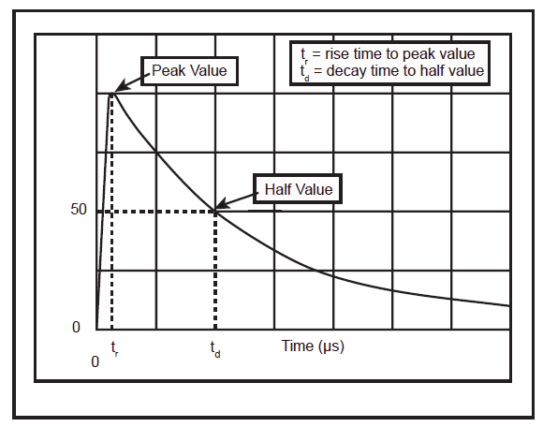
Waveshape definition

Slide 10
Why different Recommendations with different levels of resistibility ?
Location of equipment:
  1) customer premises will have fewer wire pairs so ALL of induced event is not divided
  2) CO locations that have many wires pairs which allows for a dividing factor of induced events
  3) Remote sites with higher exposure and possible lower grade grounding and bonding systems due to local soil properties
These Recommendations take these and many other factors into consideration

Slide 11
A partial list of other telcom related Recommendations that are available
ITU-T K.11(2009), Principles of protection against overvoltages and overcurrents.
ITU-T K.12 (2010), Characteristics of gas discharge tubes for the protection of telecommunications installations.
ITU-T K.39(1996), Risk assessment of damages to telecommunication sites due to lightning discharges.
ITU-T K.46 (2008), Protection of telecommunication lines using metallic symmetric conductors against lightning-induced surges.
ITU-T K.50 (2000) Safe limits of operating voltages and currents for telecommunication systems powered over the network
ITU-T K.51 (2009) Safety criteria for telecommunication equipment
ITU-T K.56 (2010) Protection of radio base stations against lightning discharges
ITU-T K.66 (2006) Protection of customer premises from overvoltages
ITU-T K.98 (2014), Overvoltage protection guide for telecommunication equipment installed in customer premises.

Slide 12



