Slide 1
Eleventh ITU Symposium on ICTs, the Environment and Climate Change Kuala Lumpur, Malaysia, 21 April 2016
Damage prevention and safety
Requirements for Lightning Protection in Telecommunications
Michael J. Maytum
Rapporteur, Questions Q2/5 and Q12/5
Bourns – UK
Content created by Célio F. Barbosa WP1/5 Chairman

Slide 2
Climate Change and Lightning
“There could be a 50% increase in lightning strikes across USA this century due to the warming temperatures associated with climate change”, Prof. David Romps, LBNL California, in USA Today, Nov.2014.
“Increase in the number of lightning days are projected for all four seasons across the whole of the UK”, UKCP09 Technical Note.
“For every one degree Celsius of long-term warming there will be a near 10% increase in lightning activity”, Prof. Colin Price, Tel Aviv University, Israel, in AccuWeather.com, July 2012.
“The global trend of increasing lightning activity is due to the temperature increase due to the higher concentration of green house gases in the atmosphere”, Prof. Osmar Pinto, INPE, Brazil, 2009.
“Climate change may spark more lightning, igniting wildfires”, National Geographic, 2014.
“Lightning strikes will increase due to climate change”, The Guardian

Slide 3
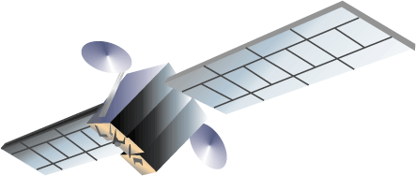
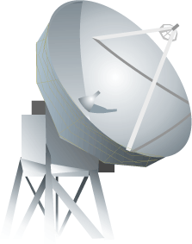
Why lightning protection is necessary for telecommunications?
Telecommunication equipment operates with very low power signals, ranging down to a few pW (10⁻¹² W).

Slide 4
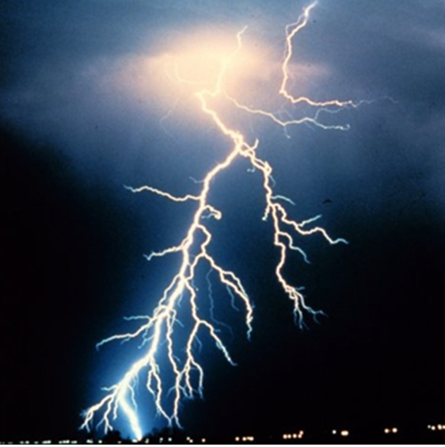
Why lightning protection is necessary for telecommunications?
Lightning flashes provide a high current (hundreds kA) in a very short time (μs), releasing a very high power in the order of tens of GW (10⁹ W) per unit resistance (Ω) in the current path.
NOAA Photo Library, NOAA Central Library; OAR/ERL/National Severe Storms Laboratory (NSSL)

Slide 5
Lightning types

Slide 6
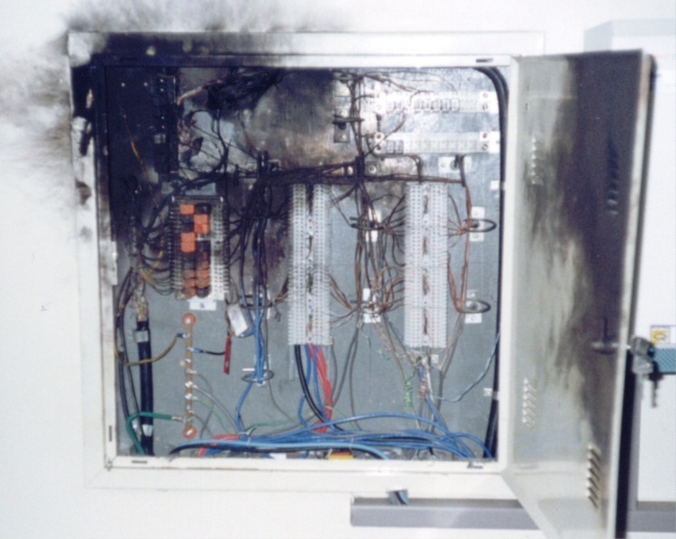
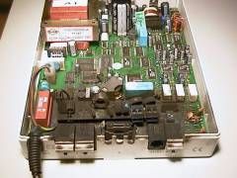
Why lightning protection is necessary for telecommunications?
Therefore, lightning flashes can damage telecommunication infrastructure and equipment either due to direct hits or due to the coupling of the intense electromagnetic fields released by the the flash with the telecommunication wiring and circuitry.

Slide 7
The recipe for lightning protection
The lightning protection in telecommunication can be achieved by two actions:
Use of the lightning protection standards by the telecommunication operators (e.g., ITU-T K series Recommendations, IEC 62305 series Standards);
Adoption by the telecommunication authority of a certification process for the telecommunication equipment purchased by the public.

Slide 8
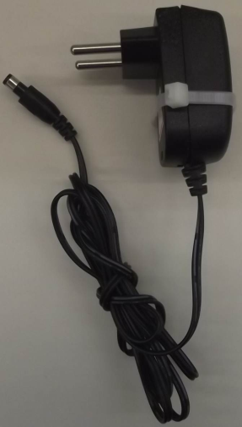
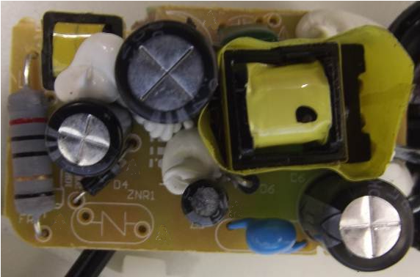
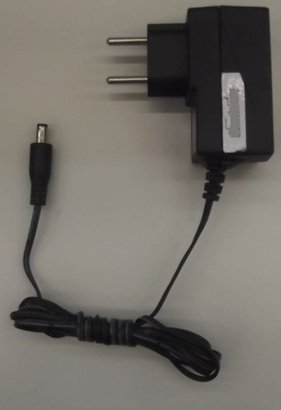
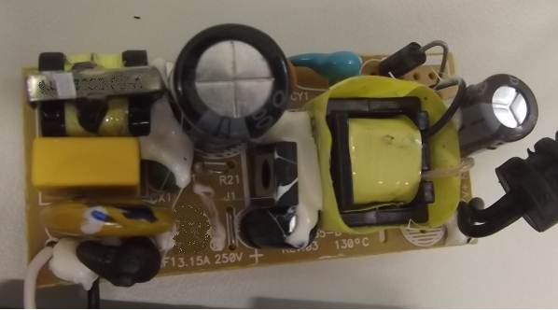
Why equipment certification is necessary?
Power supplies for ADSL modems that look alike,
but a surge protective component is missing in one of them ...

Slide 9
Development of ITU-T Lightning Protection Recommendations
ITU-T SG5 WP1 relies on the contributions from delegates of different countries and backgrounds (Regulatory Agencies, Telecom Operators, Industry, and Academia).
Specific needs of the represented members are considered and compromise solutions are sought.
Theoretical and experimental investigations are carried out during the development of the Recommendations.

Slide 10
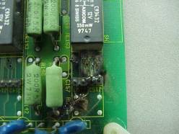
Description of Protection Recommendations
Equipment resistibility:
K.20: Resistibility of telecommunication equipment installed in a telecommunications centre to overvoltages and overcurrents
K.21: Resistibility of telecommunication equipment installed in customer premises to overvoltages and overcurrents
K.45: Resistibility of telecommunication equipment installed in the access and trunk networks to overvoltages and overcurrents
K.44: Resistibility tests for telecommunication equipment exposed to overvoltages and overcurrents – Basic Recommendation

Slide 11
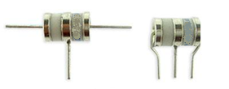
Description of Protection Recommendations
Surge protective components:
K.12: Characteristics of gas discharge tubes for the protection of telecommunications installations.
K.28: Parameters of thyristor-based surge protective devices for the protection of telecommunication installations
K.77: Characteristics of metal oxide varistors for the protection of telecommunication installations
K.82: Characteristics and ratings of solid-state, self-restoring overcurrent protectors for the protection of telecommunications installations.
K.95: Surge parameters of isolating transformers used in telecommunication devices and equipment.
K.96: Surge protective components: Overview of surge mitigation functions and technologies
K.99: Surge protective component application guide - Gas discharge tubes
K.102: Parameters of fixed-voltage thyristor overvoltage protector components used for the protection of telecommunication installations
K.103: Surge protective component application guide: Silicon PN junction components

Slide 12
Description of Protection Recommendations
Interference from power lines:
K.26: Protection of telecommunication lines against harmful effects from electric power and electrified railway lines.
K.57: Protection measures for radio base stations sited on power line towers.
K.66: Protection of customer premises from overvoltages.
K.104: Method for identifying the transfer potential of the earth potential rise from high or medium voltage networks to the earthing system or neutral of low voltage networks
K.107: Method for determining the impedance to earth of earthing systems.
K.108: Joint-use of poles by telecommunication and solidly earthed power lines.
K.109: Installation of telecommunication equipment on utility poles.

Slide 13
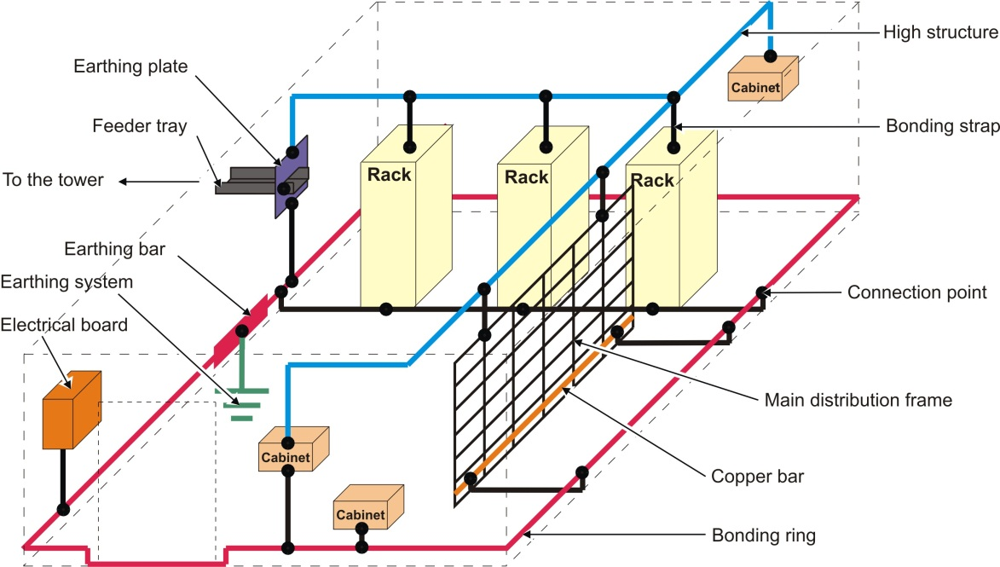
Description of Protection Recommendations
Earthing and Bonding:
K.27: Bonding configurations and earthing inside a telecommunication building.
K.35: Bonding configurations and earthing at remote electronic sites.
K.66: Protection of customer premises from overvoltages.
K.73: Shielding and bonding for cables between buildings.
K.98: Overvoltage protection guide for telecommunication equipment installed in customer premises.

Slide 14
Description of Protection Recommendations
Lightning Protection:
K.39: Risk assessment of damages to telecommunication sites due to lightning discharges.
K.40: Protection against LEMP in telecommunications centres.
K.46: Protection of telecommunication lines using metallic symmetric conductors against lightning-induced surges.
K.47: Protection of telecommunication lines against direct lightning flashes.
K.56: Protection of radio base stations against lightning discharges.
K.67: Expected surges on telecommunications networks due to lightning.
K.85: Requirements for the mitigation of lightning effects on home networks installed in customer premises.
K.89: Protection of persons inside a structure using telecommunication services provided by metallic conductors against lightning - Risk management.
K.97: Lightning protection of distributed base stations.
K.101: Shielding factors for lightning protection.
K.110: Lightning protection of the dedicated transformer for radio base station.
K.111: Protection of surrounding structures of telecommunication towers against lightning.
K.112: Lightning protection, earthing and bonding: practical procedures for radio base stations.

Slide 15
Final remarks
Series K Recommendations have the relevant information for the protection of telecommunication equipment and installations against the dangerous surges generated by the electromagnetic environment.
Telecom Authorities are encouraged to use Series K Recommendations in their National Regulations for equipment certification.
Telecom operators are encouraged to use Series K Recommendations in their standards for network installation and maintenance.
If you wish to have your needs reflected into Series K Recommendations, come and join ITU-T SG5!

Slide 16
Links & Additional Information
ITU-T/SG5 “Environment & Climate Change”
http://www.itu.int/en/ITU-T/studygroups/2013-2016/05/Pages/default.aspx
ITU-T/SG5 Series K Recommendations (free of charge)
http://www.itu.int/ITU-T/recommendations/index_sg.aspx?sg=5

Slide 17
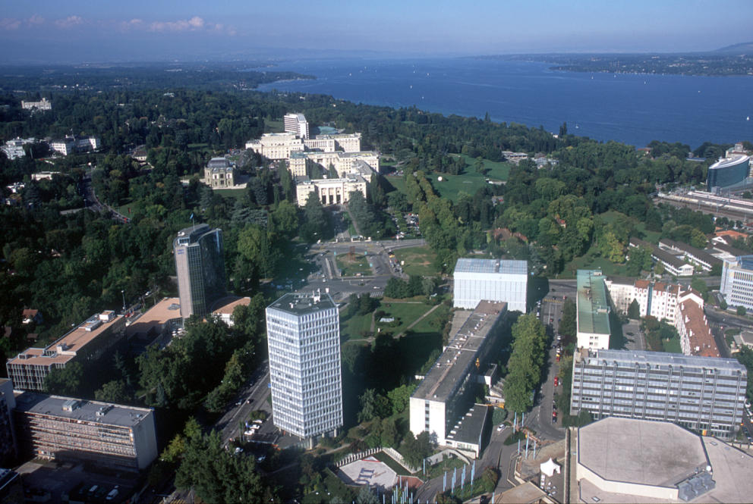
Thank YOU
grcelio@cpqd.com.br
tsbsg5@itu.int

