Slide 1
ENFORCEMENT AND REGULATORY APPROACHES IN MALAYSIA
Aisharuddin Bin Nuruddin
Senior Director, Technology & Society Division
MCMC
Notes:
ENFORCEMENT AND REGULATORY APPROACHES IN MALAYSIA
Presented by Aisharuddin Bin Nuruddin
Senior Director, Technology & Society Division

Slide 2
Content
About MCMC
About EMF
EMF Regulatory Instrument
Advocacy Programs
Research Collaborations
Notes:
Brief introduction about Malaysian Communications and Multimedia Commission (MCMC)

Slide 3
About MCMC
MCMC is a regulatory agency that regulates based on
Communications and Multimedia Act 1998 (CMA)
Postal Services Act 2012 (PSA)
Digital Signature Act 1997 (DSA)
Strategic Trade Act 2010 (STA)
Other roles include, but not limited to the following
to implement and promote the Government's national policy objectives for the communications and multimedia sector
overseeing the new regulatory framework for the converging telecommunications and broadcasting industries and on-line activities
The 10 National Policy Objectives for C&M Industry in Malaysia
1. Creating a Global Hub | 6. Promote Access and Equity
2. Building a Civil Society | 7. Creating Robust Application Environment
3. Nurturing Local Content and Culture | 8. Facilitating Efficient Allocation of Resources
4. Ensuring Long Term Benefits for the End Users | 9. Developing Industry Capabilities
5. Nurturing User Confidence | 10. Promoting Secure and Safe Networking
Notes:
Malaysian Communications and Multimedia Malaysia (MCMC) is the regulatory agency that governs the communications and multimedia industry via the Communications and Multimedia Act 1998 and the Communications and Multimedia Commission Act 1998.
In 2001, the Commission’s role was expanded to include overseeing the postal service sector pursuant to the Postal Services Act 1991 and licensing of the Certification Authorities under the Digital Signature Act 1997.
MCMC also is designated as an authorized licensing and enforcement agency under Strategic Trade Act (STA) 2010. As licensing agency, MCMC is responsible for the issuance of permits for strategic items related to Category 4 (Computers), Category 5 (Communications and Information Security) and the transfer of technology.
With the creation of MCMC, the Commission has set forth 10 national policy objectives as presented in the table. The 10 national policy objectives are the regulatory basis of MCMC's regulatory framework which include, economic regulation, technical regulation, consumer protection and social regulation.

Slide 4
Content
About MCMC
About EMF
EMF Regulatory Instrument
EMF Advocacy Programs
Research Collaborations
Notes:
About EMF

Slide 5
About EMF
Non-ionizing | Ionizing
Does not cause ionization in biological systems (body cells) | Carries enough energy to free electrons out of atoms
Certain effects can arise heating in tissues and cells | Causes genetic damage
e.g. radio waves | e.g. X-rays
Source: ITU EMF Guide
Notes:
EMF is an electromagnetic field consists of waves of electric and magnetic energy moving together through space. Often the term "electromagnetic field" or EMF is used to indicate the presence of electromagnetic radiation.
Electric and magnetic fields are part of the electromagnetic spectrum which extends from static electric and magnetic fields, through radio frequency (RF), infrared radiation, and visible light to X and gamma-rays.
Radio frequency (RF) is part of the electromagnetic spectrum extending from 3 kHz frequency to 300 GHz is referred as radio frequency (RF). Television and radio transmitters (including base stations) and microwaves, mobile telephones, and radars produce radio frequency fields. These fields are used to transmit information and form the basis of telecommunications as well as radio and television broadcasting all over the world
Electromagnetic radiation at frequencies above the UV band are classified as "ionising radiation", because they have enough energy to effect changes in the atoms, by liberating electrons (ionizing) and thus altering their chemical bonds.
Electromagnetic radiation at frequencies below the UV band are classified as "non-ionizing radiation (NIR)" because they lack the energy to liberate electrons, i.e. ionize or effect changes in atomic structure.
NIR – does not have sufficient energy to ionize the atoms and molecules in the body. However, NIR does cause a heating effect which is proportional to its intensity. The Radio Frequency (RF) which is commonly used for telecommunication and broadcasting transmission is an example type of non-ionizing radiation.

Slide 6
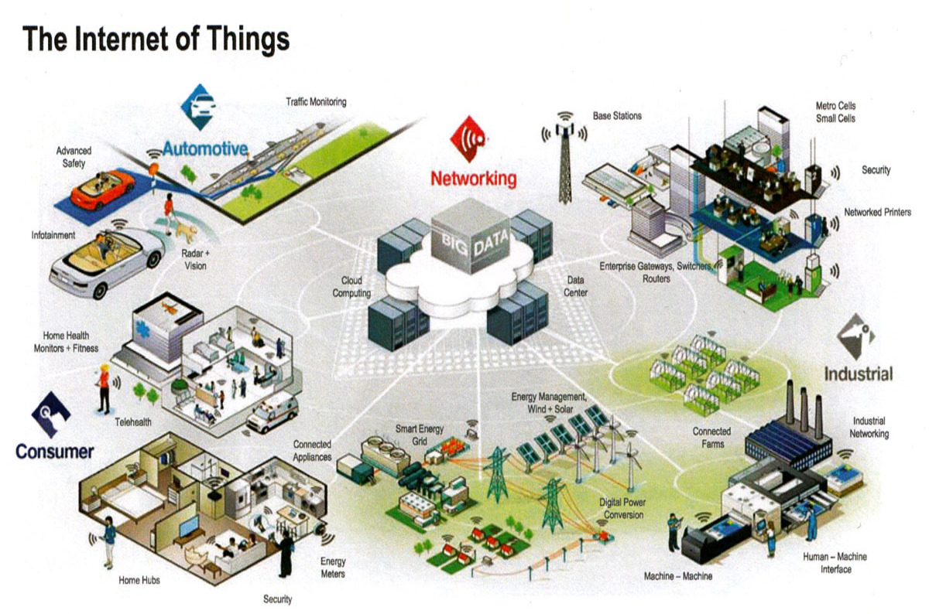
IoT, Smart Cities & EMF
Source: http://www.theregister.co.uk/2015/09/01/intel_nsf_tip_dollars_into_iot_security/
Notes:
Wireless communication technology has become indispensable part of the modern society. The use of mobile phones, tablets and wireless devices have become basic communication tools of everyday life for billions of people around the world, and also common for medical applications. Base stations and telecommunications towers are continuously being erected to provide good quality wireless communications.
Connected devices, distributed sensors and Internet technologies are enabling smart sustainable cities (SSC) to capture valuable data, deploy new services and enhance existing services. The use of these tools can contribute to improving the effectiveness of city management, generating new growth opportunities for local businesses, improving sustainability and raising the quality of citizens’ lives, among other benefits. Wireless technologies and services are playing a pivotal role in enabling smart sustainable cities around the world.
Wireless and wired networks provide the underlying connections that underpin smart sustainable cities. The design and deployment of wireless networks must ensure compliance with the required quality of service as well as with the standards and regulations on human exposure to radio frequency (RF) electromagnetic fields (EMFs). Efficient deployment of wireless infrastructure will reduce the transmitted RF power in providing services and support the maximum efficiency for ICTs.

Slide 7
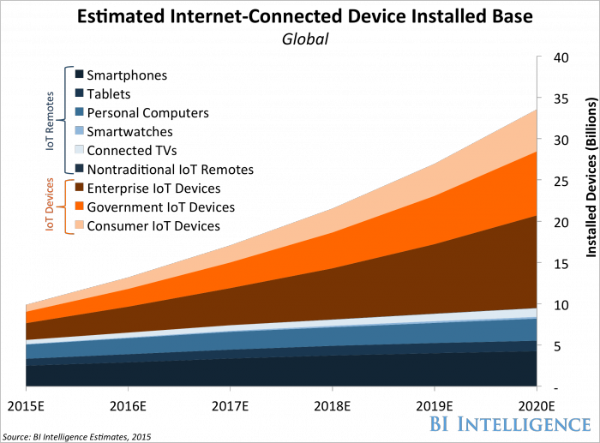
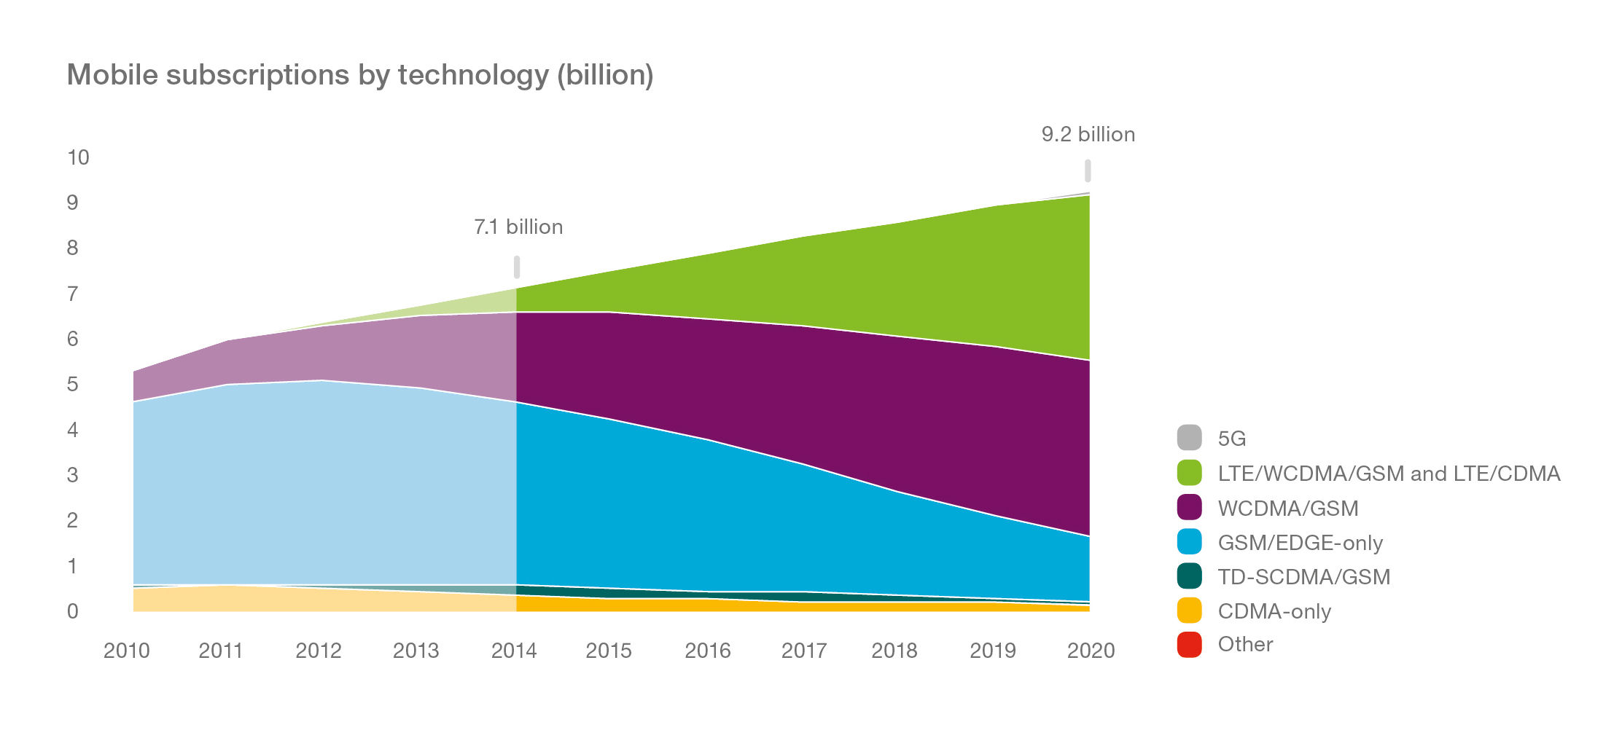
Connected Devices
By 2020, there will be:
34 billion devices connected to the internet – BI Intelligence, 2015
9.2 billion mobile subscriptions - Ericsson, June 2015.
72% of the world’s population will be connected to a mobile network – GSMA, 22 Feb 2016
Notes:
According to BI Intelligence study- there will be 34 billion devices connected to the internet by 2020, up from 10 billion in 2015, representing a 28% five-year compound annual growth rate (CAGR).
Ericsson forecasts 9.2 billion total mobile subscriptions (note an individual can have more than one subscription) in 2020.
Almost three-quarters of the world’s population will be connected to a mobile network by 2020, according to the latest study from GSMA Intelligence, the research arm of the GSMA. The new study indicates that an additional one billion people will become mobile subscribers over the next five years, bringing the total to 5.6 billion – equivalent to 72 per cent of the expected global population by this point.

Slide 8
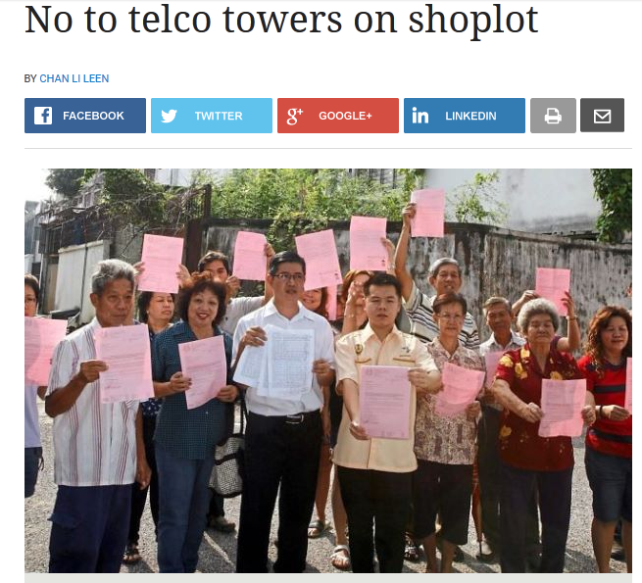
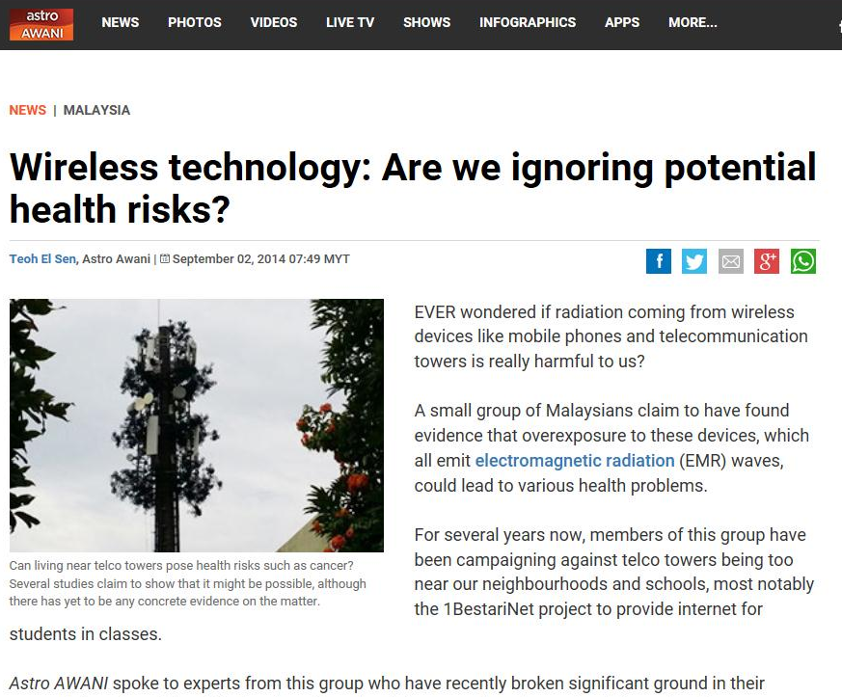
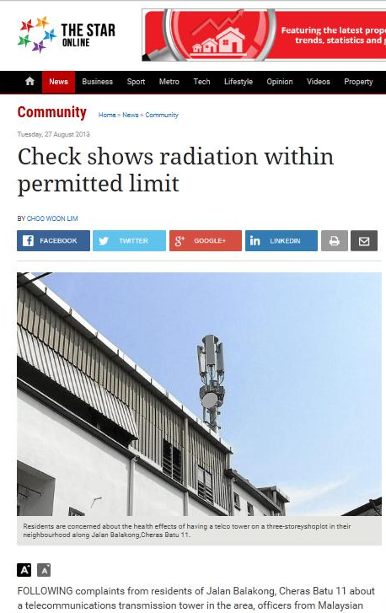
The Issue on EMF Emission
Public concern on possible adverse health effects of exposure to EMF
MCMC adopt World Health Organization (WHO) approaches in managing public’s perception on RF EMF:-
Risk Assessment
The Evidence
Risk Perception
The Public Concern
Risk Management
The Policies
Notes:
The gaps in knowledge and the uncertainty on the possible adverse health effects of exposure to EMF even at very low levels cause the public to be concerned and health issues of EMF are still major issues. The robust growth of the mobile phone industry and the availability of mobile phones explicitly designed for young children together with the publicity generated by the mass media have caused great concern among the public; especially in regards to brain cancer and cognitive function in children.
Many local communities also have come forward to voice their concern of these radiations emitted from the base station (BS) within their community area. Sometimes despite the BS is yet transmitting any frequencies, public claims to have experience of several symptoms such as dizziness, headache, sleep disorder and change in heart rate.
Furthermore, with the growing access to the internet, public perception is now susceptible by contradictory and often inaccurate sources of information which are widely circulated on the social media.
Due to these concerns, we realized the importance of conveying the correct information and message to the public, managing the public’s perception on RF-EMF and engaging the appropriate stakeholders to create awareness on the issues
MCMC implemented 3 coordinated programmes in managing public perception on RF EMF:
Risk Management – the management of EMF risk through regulating and monitoring the emission levels of radiocommunication towers. It can be done through standards formulation, regulations and enforcement actions.
Risk Perception – the perception and concerns among the general public and workers about the possible health effects of exposure to EMF. It is necessary to handle negative perception through reliable, credible and accurate information
Risk Assessment – the assessment of possible long-term health and environmental effects due to emissions from radiocommunication towers. These assessments are conducted through scientific laboratory and epidemiological studies.

Slide 9
Content
About MCMC
About EMF
EMF Regulatory Instrument
EMF Advocacy Programs
Research Collaboration
Notes:
EMF Regulatory Instrument

Slide 10
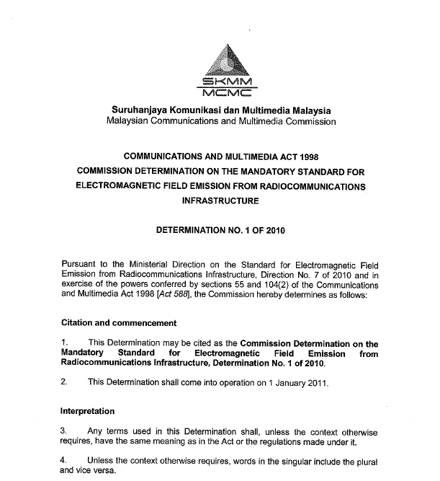
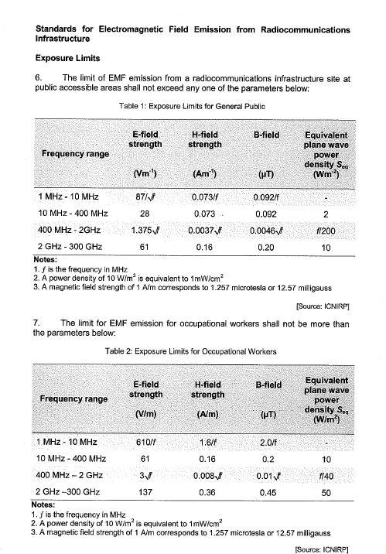
Mandatory Standard (MS) for EMF Emission from
Radiocommunications Infrastructure
The MCMC has determined a mandatory standard (MS) titled “Commission Determination on the Mandatory Standard for Electromagnetic Field Emission from Radio-communications Infrastructure”,
Registered in late 2010.
This MS applies to Network Facility Providers (NFP) and Network Service Providers (NSP) owning and operating the radiocommunications infrastructures such as the base station transmitters.
Mandatory standard
The MS is based on the ICNIRP standards and the need for NFP/NSP to submit EMF emission simulations as recommended by the ITU.
The mandatory standard can be retrieved at MCMC website
Notes:
MCMC has determined a mandatory standard titled “Commission Determination on the Mandatory Standard for Electromagnetic Field Emission from Radio-communications Infrastructure”, registered in late 2010, to regulate the EMF emission in Communication and Multimedia (C&M) industry.
This mandatory standard is targeted at the industry Network Facility Providers (NFP) and Network Service Providers (NSP) owning and operating the radiocommunications infrastructure such as base station transmitters.
The mandatory standard is based on ICNIRP and the need for service providers to submit EMF emission simulations as recommended by the ITU. This activity is basically complementary to the works carried out in other international bodies in this subject.

Slide 11
(MS) Prediction Methods for
EMF Compliance
EMF assessment method depends on site & environment
Compliance by EIRP calculation
In the case of single transmitter sites
Compliance by software simulation
For complex sites (where there are two(2) or more transmitters/antennas)
Compliance of shared sites
Measurements - required in very complex environments
Field monitoring
Field monitoring is effective when working on towers for safety
Field surveys can provide public reassurance
Continuous monitoring – limited long term benefit where EMF levels are low and stable
☞ ITU-T Recommendations - guidance on both calculation and measurements
Notes:
MS Prediction Methods for Compliance
EMF assessment methods depend on site and environment of the area. Examples of the assessment methods are either through calculations, measurements and field monitoring.
In the MS EMF stated prediction methods for EMF compliance:-
Compliance by EIRP calculation
In the case of single transmitter sites
Compliance by software simulation
For complex sites (where there are two(2) or more transmitters/antennas)
Compliance of shared sites
------------------------------------------------
Calculations - suitable in many cases, & have significant benefits - accurate, fast & cost effective
Measurements - required in very complex environments. Difficulty to take into account the time variation, the presence of staff and equipment may influence the results.
Field monitoring
Field monitoring is effective when working on towers for safety
Field surveys can provide public reassurance
Continuous monitoring – limited long term benefit where EMF levels are low and stable
Most of ITU-T Recommendations provides guidance on both calculation and measurement.

Slide 12
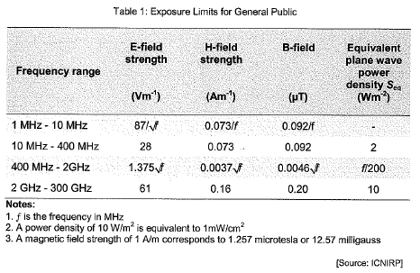
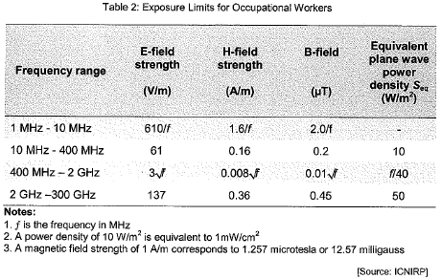
EMF Simulation Report
Network Service Providers are required to submit EMF simulation report to MCMC to ensure their compliance with the Mandatory Standard.
About 4700 simulation reports submitted to date since 2013
The average simulation results for 100 sites of WiMAX 2.3 GHz is 0.0000363 Wm⁻² (for 2 meter above ground)
The limit of EMF emission for occupational workers and for public accessible area shall not exceed the following parameters:
GSM 900MHz = 900/200 = 4.5 Wm⁻²
GSM 1800MHz = 1800/200 = 9 Wm⁻²
GSM 900MHz = 900/40 = 22.5 Wm⁻²
GSM 1800MHz = 1800/40 = 45 Wm⁻²
Notes:
Network Service Providers are required to submit EMF simulation report to MCMC to ensure their compliance with the Mandatory Standard.
About 4700 simulation reports submitted to date since 2013
The average simulation results for 100 sites of WiMAX 2.3 GHz is 0.0000363 Wm-2 (for 2 meter above ground)

Slide 13
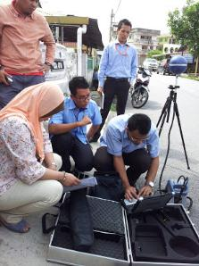
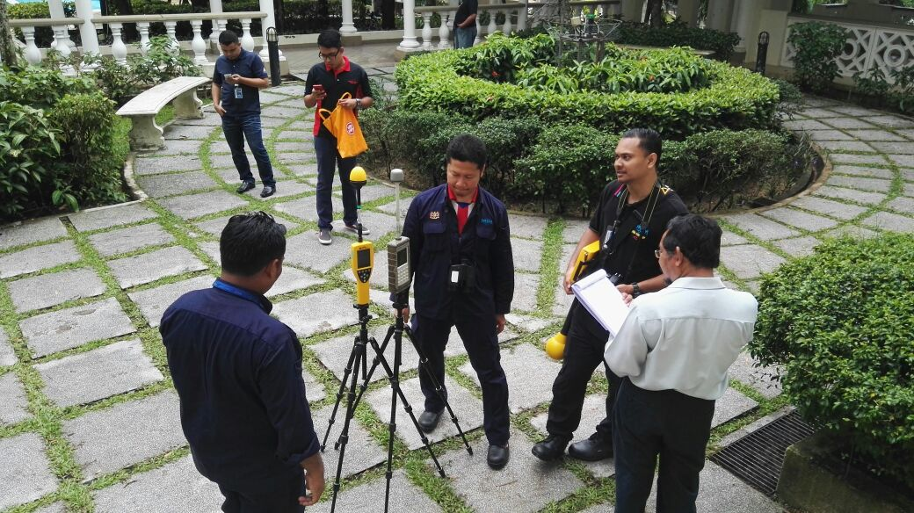
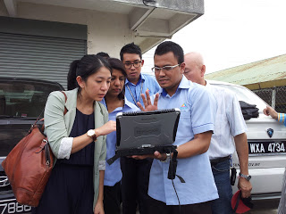
EMF Site Assessment
RF-EMF readings at random radiocommunications sites are periodically measured & audited to ensure compliance with the MS on EMF.
MCMC in collaboration with Malaysia Nuclear Agency conducts periodical measurements to ensure compliance at sites and to provide reassurances to the public.
For 2015, MCMC conducted EMF measurements at 65 sites nationwide.
Results of measurements
The emission levels are well below the exposure limits stipulated by International Commission on Non Ionizing Radiation Protection (ICNIRP) guidelines for members of the public.
Notes:
RF-EMF readings at random radiocommunications sites are periodically measured & audited to ensure compliance with the MS on EMF.
MCMC in collaboration with Malaysia Nuclear conducts measurements to ensure compliance at sites and to provide reassurances to the public.
For 2015, MCMC conducted EMF measurements at 65 sites nationwide. The highest radiation measured at site was 0.02612 Wm⁻² for frequency between 100kHz – 6GHz. This level corresponds to about 0.28 % power density of the exposure limit as stated in MCMC Mandatory Standard.

Slide 14
Content
About MCMC
About EMF
EMF Regulatory Instrument
EMF Advocacy Programs
Research Collaborations
Notes:
EMF Advocacy Programs

Slide 15
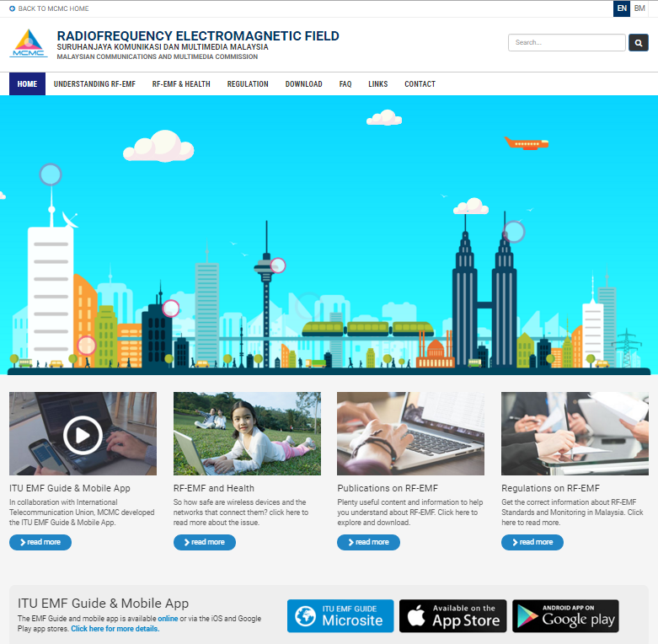
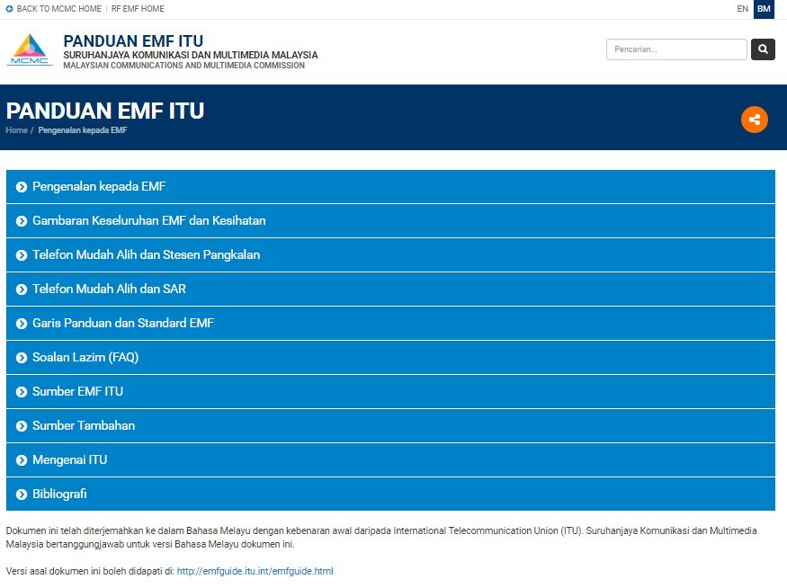
MCMC EMF Advocacy Programs
RF Emissions Website: http://rfemf.mcmc.gov.my/
ITU EMF Guide (EN|BM) http://rfemf.mcmc.gov.my/ituemfguide
Notes:
Engaging all relevant stakeholders in EMF field will help maximize efficiency of communications strategies and managing public’s perception on RF-EMF. Due to that reason, MCMC have created various communication channels to convey the correct information of EMF emission.
Dissemination of information through the use of RF Emission Website. You are welcome to visit our newly revamped website at http://rfemf.mcmc.gov.my to get latest information on RF EMF activities in Malaysia
Today we witnessed launching of ITU EMF Guide in Malay language version to advocate for plain language. This ITU EMF Guide can be found at our RF EMF website (http://rfemf.mcmc.gov.my/ituemfguide) as well as in mobile applications (Android and iOS).

Slide 16
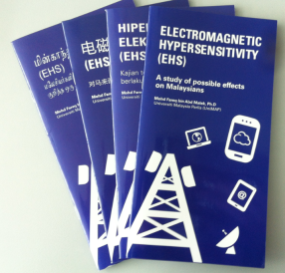
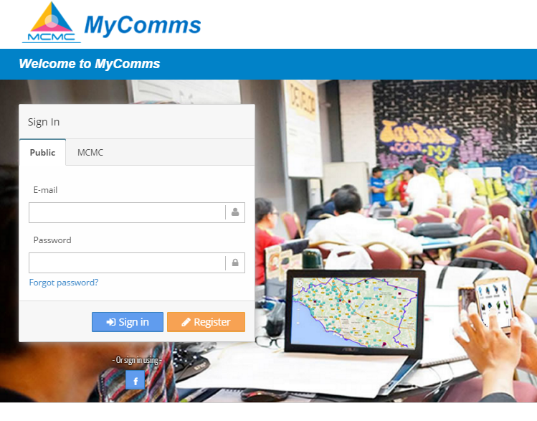
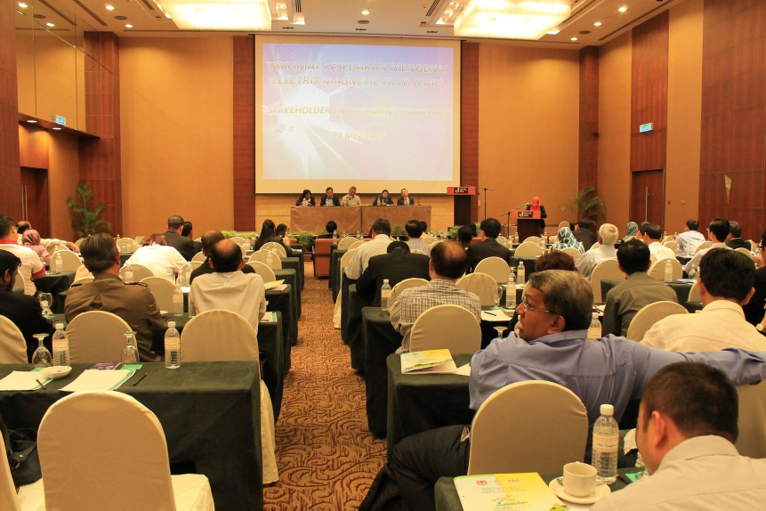
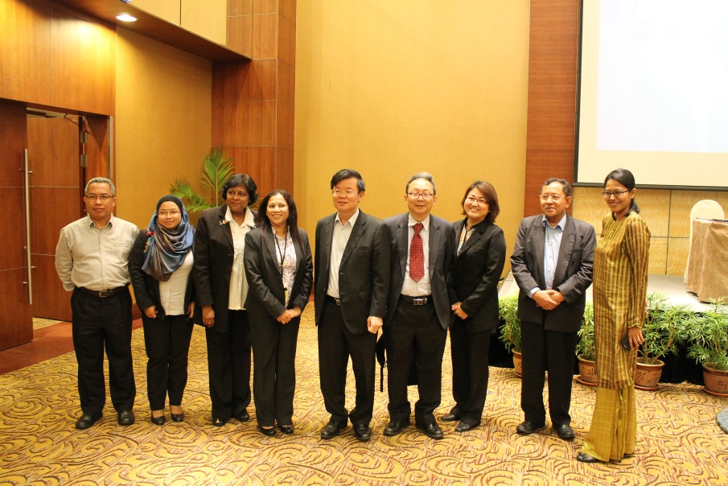
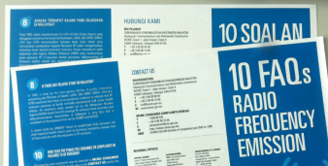
MCMC EMF Advocacy Programs
Information mapping service developed to share information with regards to EMF, RF and Wi-Fi coverage in Malaysia
49 EMF advocacy programs for year 2015
EMF booklet and flyer
EMF awareness seminar
Notes:
Among other initiatives includes:
Supporting publications and materials such as booklets and flyers;
The central database of EMF, RF and wi-fi coverage information for nationwide – MyComms Website; and
EMF workshop / seminar to promote public awareness in a highly transparent and simple language. In 2015, MCMC conducted 49 EMF advocacy programs nationwide

Slide 17
Content
About MCMC
About EMF
EMF Regulatory Instrument
EMF Advocacy Programs
Research Collaborations
Notes:
Research Collaborations

Slide 18
MCMC Research Collaborations
MCMC has collaborated with local universities to fill knowledge gaps and scientific uncertainty that exists in assessing health risks of EMF emissions
2013
University | Research | Findings
Universiti Malaysia Perlis | Research on Electromagnetic Hypersensitivity (EHS) Effects of Short-term GSM and 3G Base Station Signal Exposure on Cognitive Performance, Well-being and Physiological Parameters of the Malaysian People | There is no significant effects of Short-term GSM and UMTS base station signal exposure on cognitive performance, well-being and physiological parameters of the Malaysian people.
Notes:
MCMC has collaborated with local universities to fill knowledge gaps and scientific uncertainty that exists in assessing health risks of EMF emissions. These studies also help strengthen local expertise in building public confidence of EMF issues.
In 2013, we conducted Research on Electromagnetic Hypersensitivity (EHS).
Effects of Short-term GSM and 3G Base Station Signal Exposure on Cognitive Performance, Well-being and Physiological Parameters of the Malaysian People
(Findings) There is no significant effects of Short-term GSM and UMTS base station signal exposure on cognitive performance, well-being and physiological parameters of the Malaysian people

Slide 19
MCMC Research Collaborations
2014
University | Research | Findings
University of Malaya | Investigates risk communication in the media as well as various stakeholders Investigation into public perception of RF-EMF’s effect on health risks and well-being | Public’s anxiety of RF-EMF is heavily influenced by media, personality and psychology. Statistics shows that public knowledge with regard to RF-EMF and its risk are still low, hence, their views are easily manipulated by media.
Notes:
MCMC collaborated with University of Malaya on EMF Risk Communications research, which successfully completed in 2013. Based on the studies, it can be summarized that it is important to develop different communication strategies in dealing with public perception.
It also important to provide regular reassurances to the public alongside concrete actions which display the lack of risk. Scientists also must communicate scientific evidence clearly and the government agencies must inform people about the existence of safety regulations and policy measures
often the best sources of information are from panels of independent experts who periodically provide summaries of the current state of knowledge. Thus, it is also important to pprovide a large base of credible experts from the scientific community for public reference.

Slide 20
MCMC Research Collaborations
2015
University | Research | Findings
Universiti Teknologi Malaysia | Remote EMF Monitoring System through Wireless Industry Emission (WIE) Laboratory Specific Absorption Rate (SAR) Measurement Systems for the Test and Certification of Mobile Telecommunication Equipment. | The measured EMF radiation levels are significantly below the reference limit.
Notes:
In 2015, UTM established Remote EMF Monitoring System through Wireless Industry Emission (WIE) Laboratory & Specific Absorption Rate (SAR) Measurement Systems for the Test and Certification of Mobile Telecommunication Equipment.
(Findings) The measured EMF radiation levels are significantly below the reference limit.

Slide 21
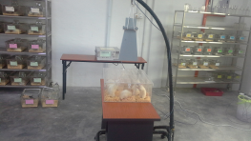
MCMC Research Collaborations
2015 - 2016
University | Research | Findings
 | Effects of Short-Term LTE (850, 1800, 2600 MHz) Base Station Signal Exposure on Cognitive Performance, Well Being, Physiological Parameters and Electroencephalography (EEG) of the Malaysian Children A Study on the Biological Effects of LTE (850, 1800, 2600 MHz) Electromagnetic Fields (EMF) Exposures. | There is no significant difference between the exposure to the Short-term LTE base station signals and Sham exposure towards EMF perception, EEG response, cognitive performance, well-being, physiological parameters (P’s > 0.05) of the Malaysian Children
Notes:
2015 – 2016: UniMAP & UMK conducted research on the ‘Effects of Short-Term LTE (850, 1800, 2600 MHz) Base Station Signal Exposure on Cognitive Performance, Well Being, Physiological Parameters and Electroencephalography (EEG) of the Malaysian Children’ and ‘A Study on the Biological Effects of LTE (850, 1800, 2600 MHz) Electromagnetic Fields (EMF) Exposures’
(Findings) There is no significant difference between the exposure to the Short-term LTE base station signals and Sham exposure towards EMF perception, EEG response, cognitive performance, well-being, physiological parameters (P’s > 0.05) of the Malaysian Children

Slide 22
THANK YOU
Notes:
Thank you
Open floor for Q&A session

