Slide 1
ITU Symposium on ICT, Environment and Climate Change
(Kuala Lumpur, Malaysia, 21 April 2016)
MEASUREMENTS AND CALCULATIONS OF EMF
Fryderyk Lewicki,
ITU-T SG5, Vice chairman WP2
Orange Polska, Poland

Slide 2
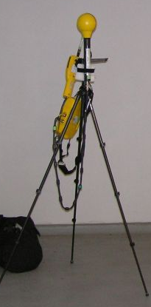
Introduction - general guidance
There are many methods to show the compliance
National regulations are most important
The simplest method is recommended to be applied first, even if other methods are more accurate
More sophisticated (and accurate) methods should be used if no compliance is observed by less sophisticated (and accurate method)
The assessment can be performed either by measurements or by calculations (computer simulations).
both have advantages and disadvantages
comparable accuracy / uncertainty (∼3dB)

Slide 3
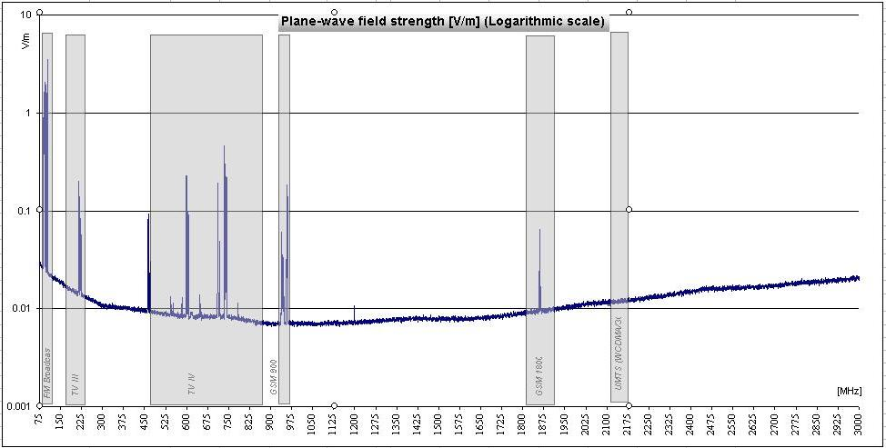
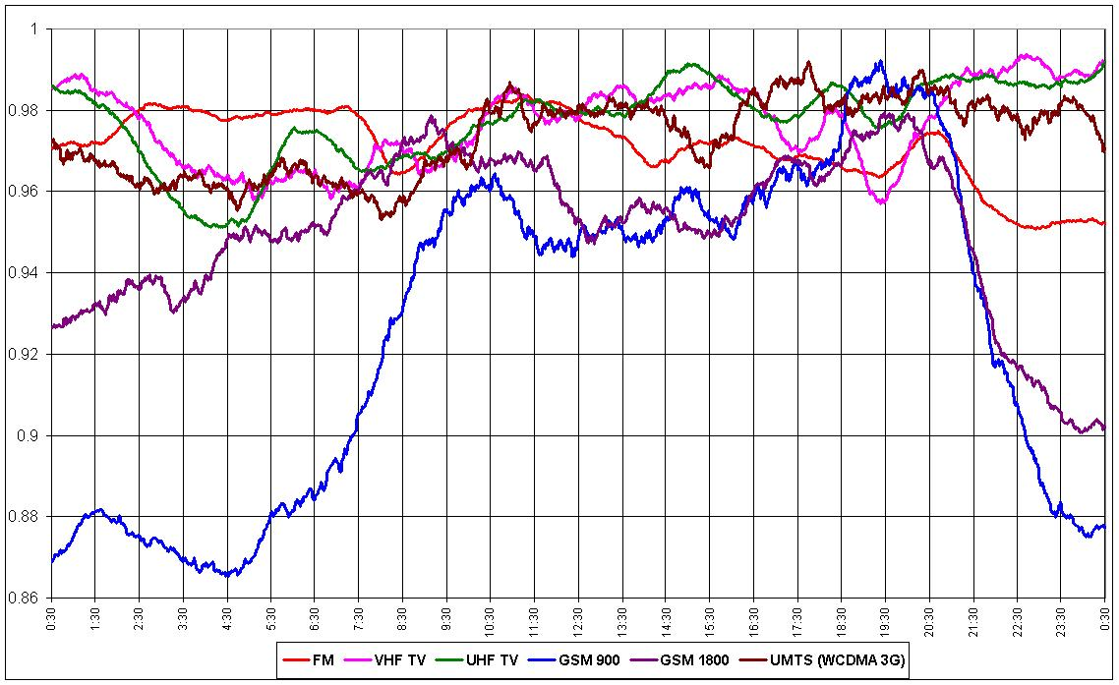
Measurement
Except for very special cases the field measurements are sufficient
Broad band – cheap but leading to overestimation
Frequency selective – more expensive and time consuming, requires post processing
Usually the broadband measurement is performed, frequency selective measurement is the reference – for special cases

Slide 4
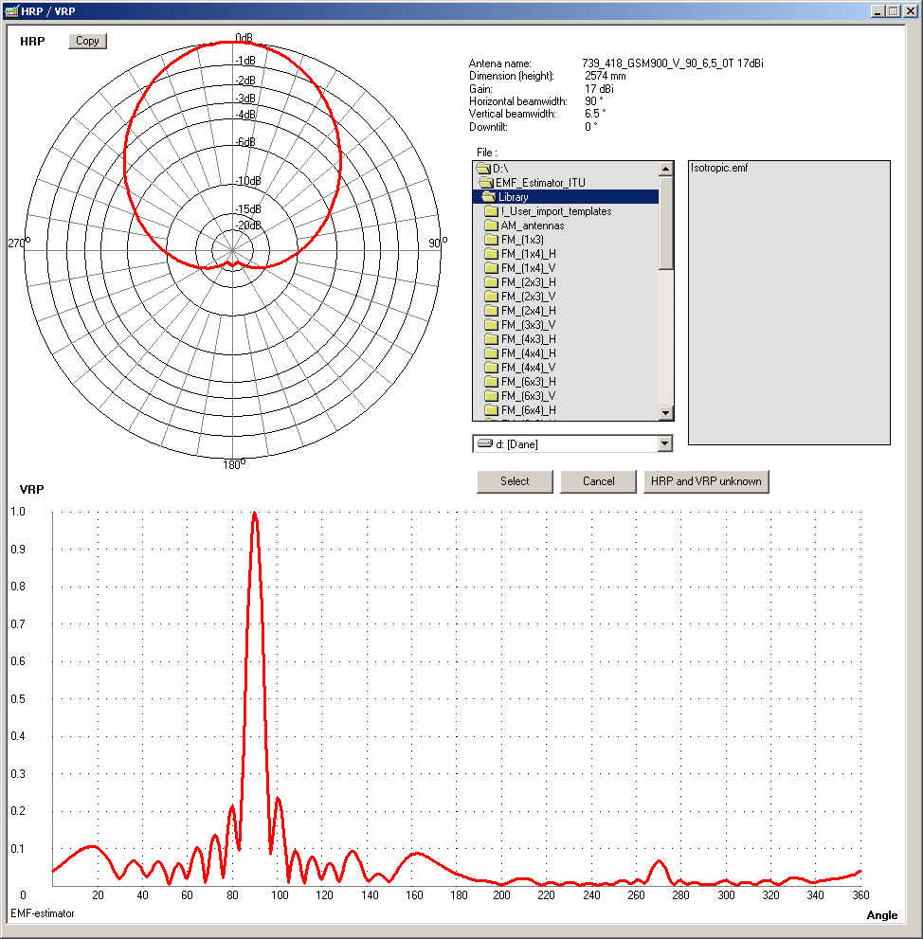
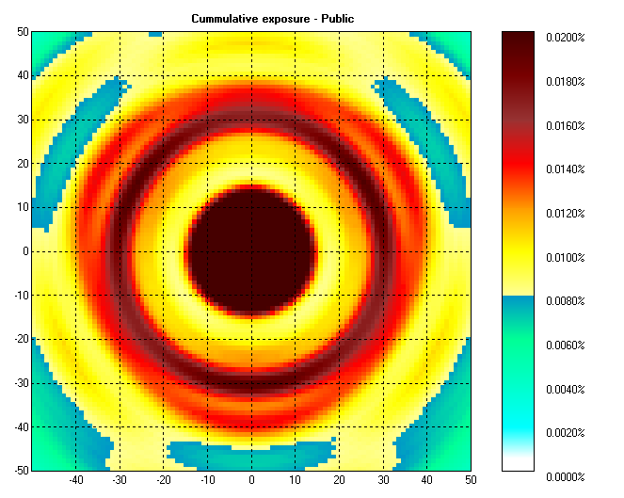
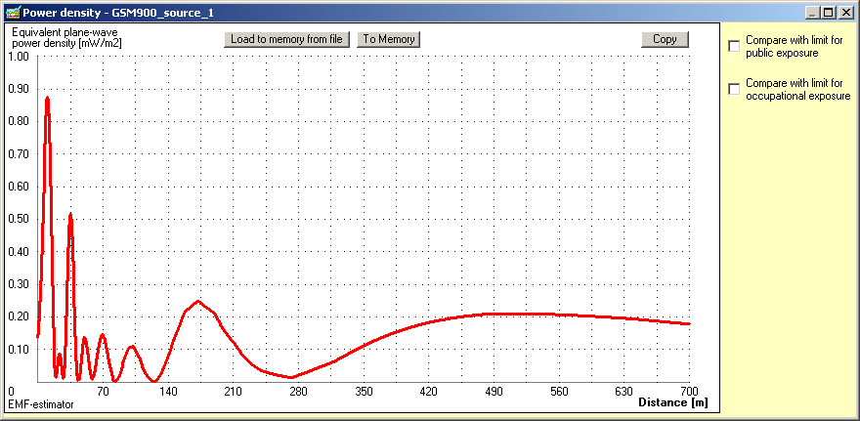
Calculations
Isotropic source with maximum EIRP, Very easy but giving big overestimation, Valid for all cases
Far field model (point source model) – EMF-estimator (Appendix to ITU-T Rec. K.70): http://www.itu.int/rec/T-REC-K.70-200905-I!Amd1

Slide 5
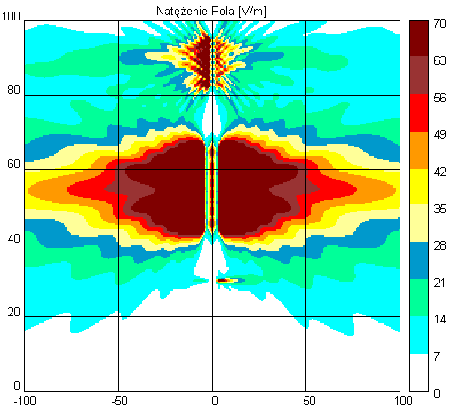
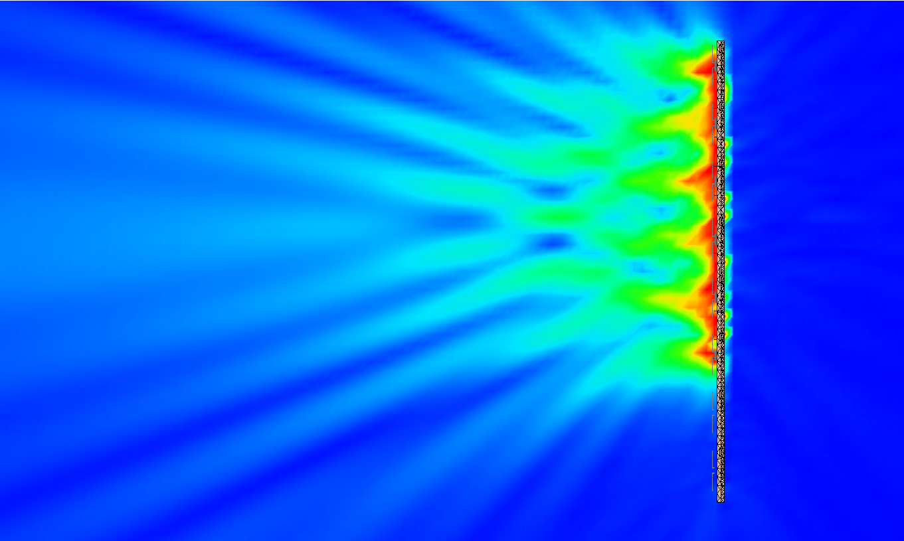
Calculations
Synthetic model
Full wave models (MoM, FDTD etc.)
Both require detailed information concerning configuration of the antenna
Full wave models allow to take into account even environment

Slide 6
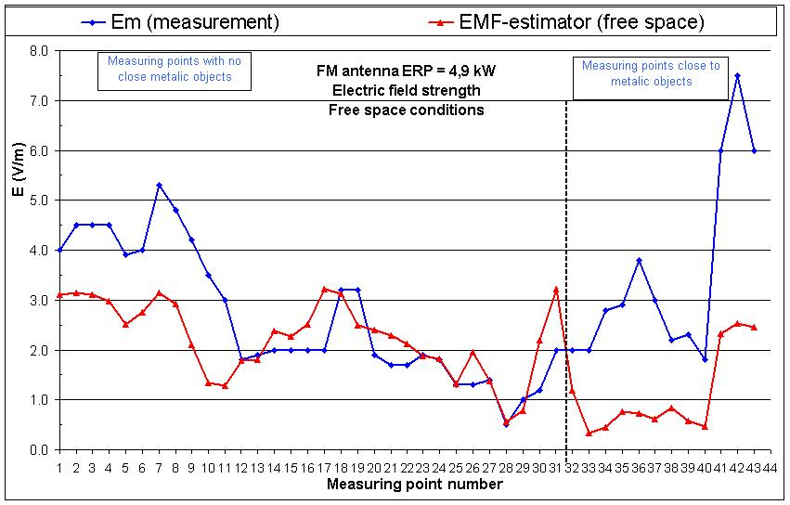
Measurement vs. calculation
Measurements takes into account all radiating sources with real parameters and environment
Calculations – low cost, possible for planned sources and areas with no access

Slide 7
Measurement vs. calculation
Measurement - difficult to take into account time variation, influence of personnel & environment
Calculations – require knowledge of the antennas, software and usually not take into account reflections from the ground

Slide 8
Conclusions
EMF radiation levels in the areas accessible to people may be controlled very efficiently by the measurement or calculation
There are many methods that may by used to show compliance – the simplest appropriate method is recommended
ITU provide several Recommendations (see guidance in K.91) including software tools

Slide 9
Thank you
Questions,
Comments?
fryderyk.lewicki@orange.com
Notes:
9

Slide 10
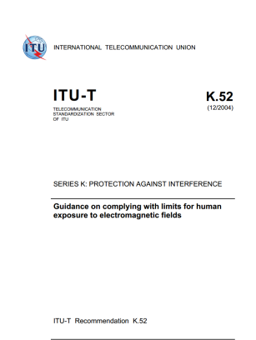
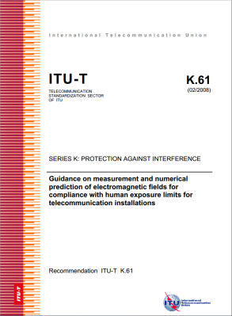
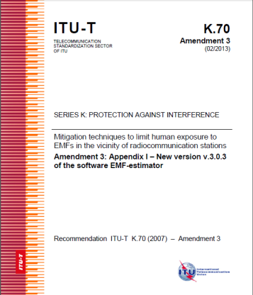
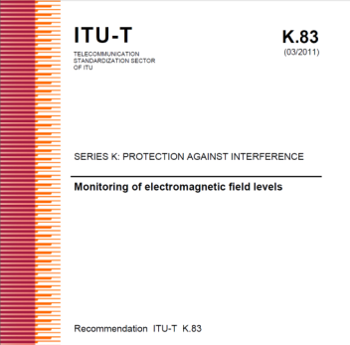
ITU-T Recommendations for EMF assessment
Recommendation ITU-T K.52 (2000/2014) - Guidance on complying with limits for human exposure to electromagnetic fields – includes „K.52calculator software”
Recommendation ITU-T K.61 (2003/2008) - Guidance on measurement and numerical prediction of electromagnetic fields for compliance with human exposure limits for telecommunication installations
Recommendation ITU-T K.70 (2007/2014) - Mitigation techniques to limit human exposure to EMFs in the vicinity of radiocommunication stations – includes „EMF Estimator software”
Recommendation ITU-T K.83 (2011/2014) - Monitoring of electromagnetic field levels

Slide 11
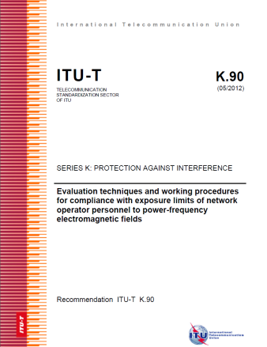
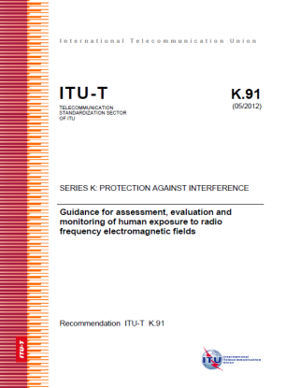
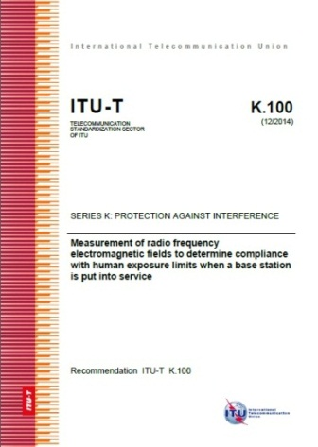
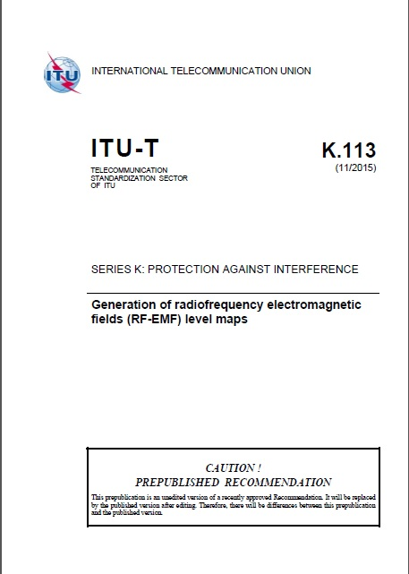
ITU-T Recommendations for EMF assessment
Recommendation ITU-T K.90 (2012) - Evaluation techniques and working procedures for compliance with limits to power-frequency (DC, 50 Hz, and 60 Hz), electromagnetic field exposure of network operator personnel – includes EMFACDC software
Recommendation ITU-T K.91 (2012/2014) - Guidance for assessment, evaluation and monitoring of human exposure to radio frequency electromagnetic fields – includes „Uncertainty calculator” and „Watt_Guard” software and Supplement „EMF-guide”
Recommendation ITU-T K.100 (2014) - Measurement of radio frequency electromagnetic fields to determine compliance with human exposure limits when a base station is put into service
Recommendation ITU-T K.113 (2015) - Maps of the RF EMF

Slide 12
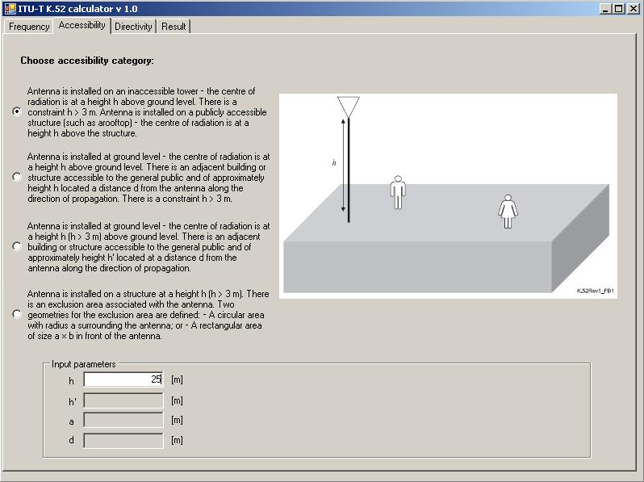
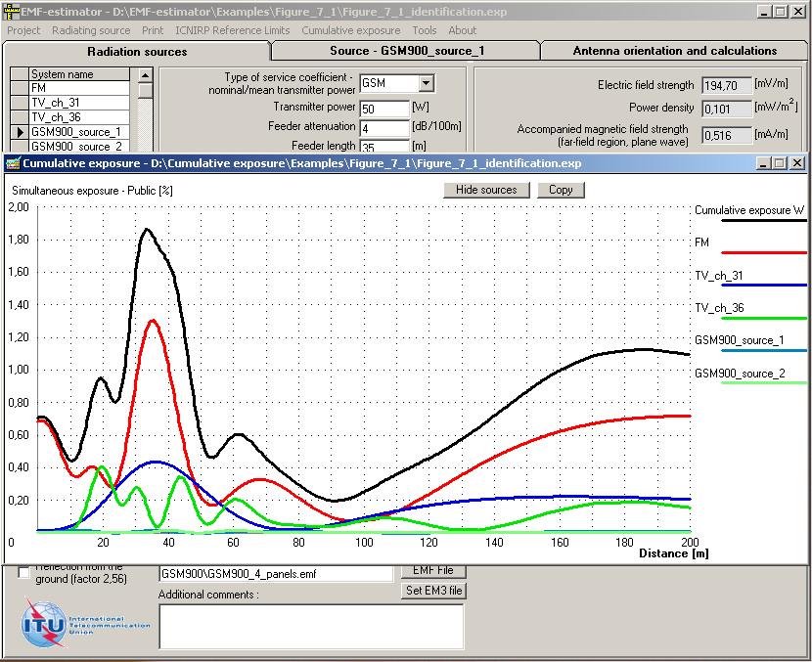
ITU-T Recommendations – additional tools
Software:
  K.52-calculator (Recommendation K.52)
  EMF-estimator (Recommendation K.70)

Slide 13
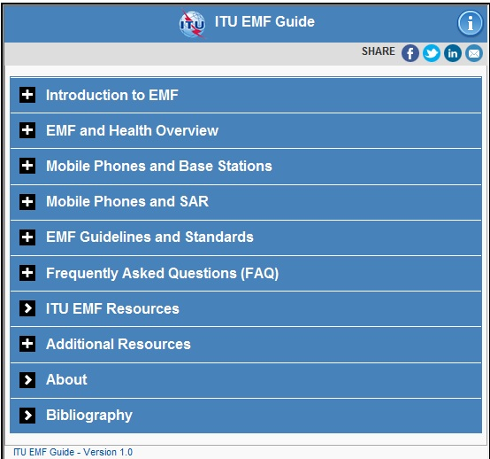
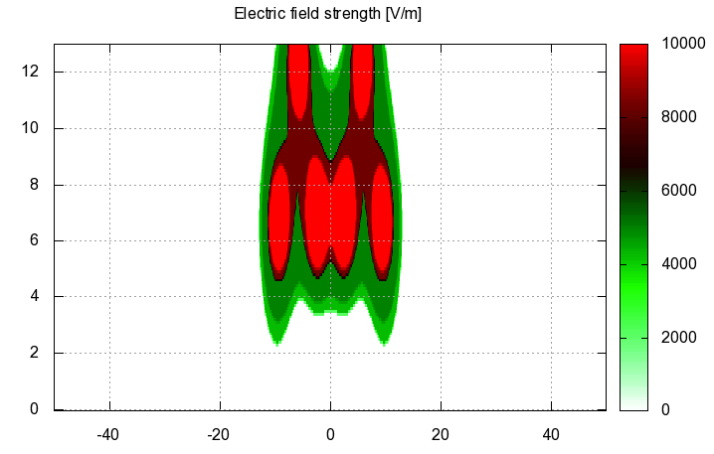
ITU-T Recommendations – additional tools
Software:
  EMFACDC (Recommendation K.90)
  Uncertainty calculator (Recommendation K.91) and „Watt_Guard” (Recommendation K.91)
Application for smartphones and tablets on EMF: „Guide on electromagnetic fields and health”, Supplement 1 to ITU-T Recommendation K.91

Slide 14
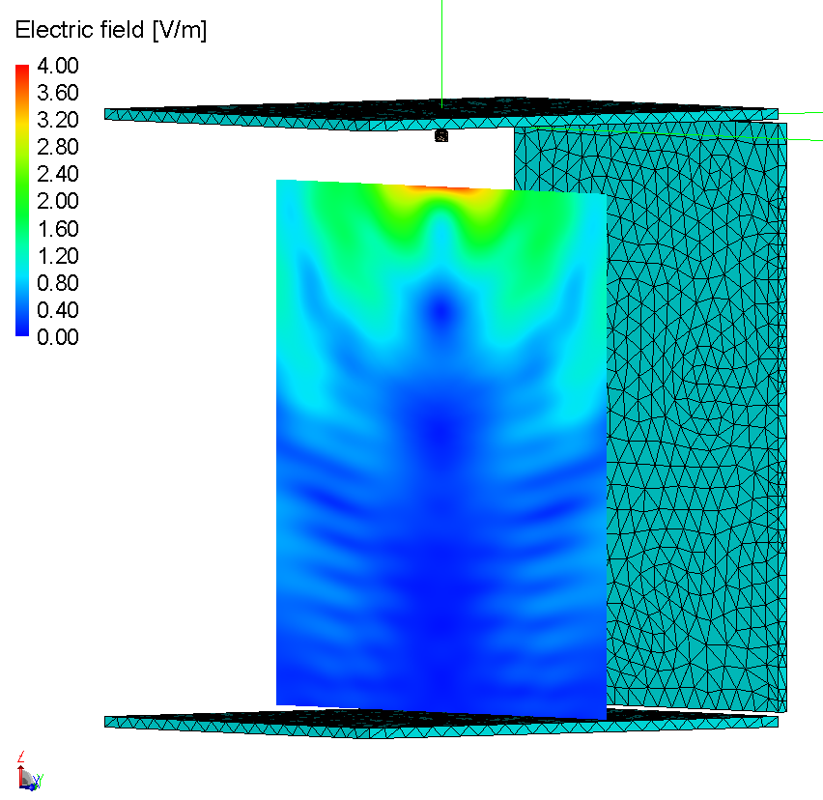
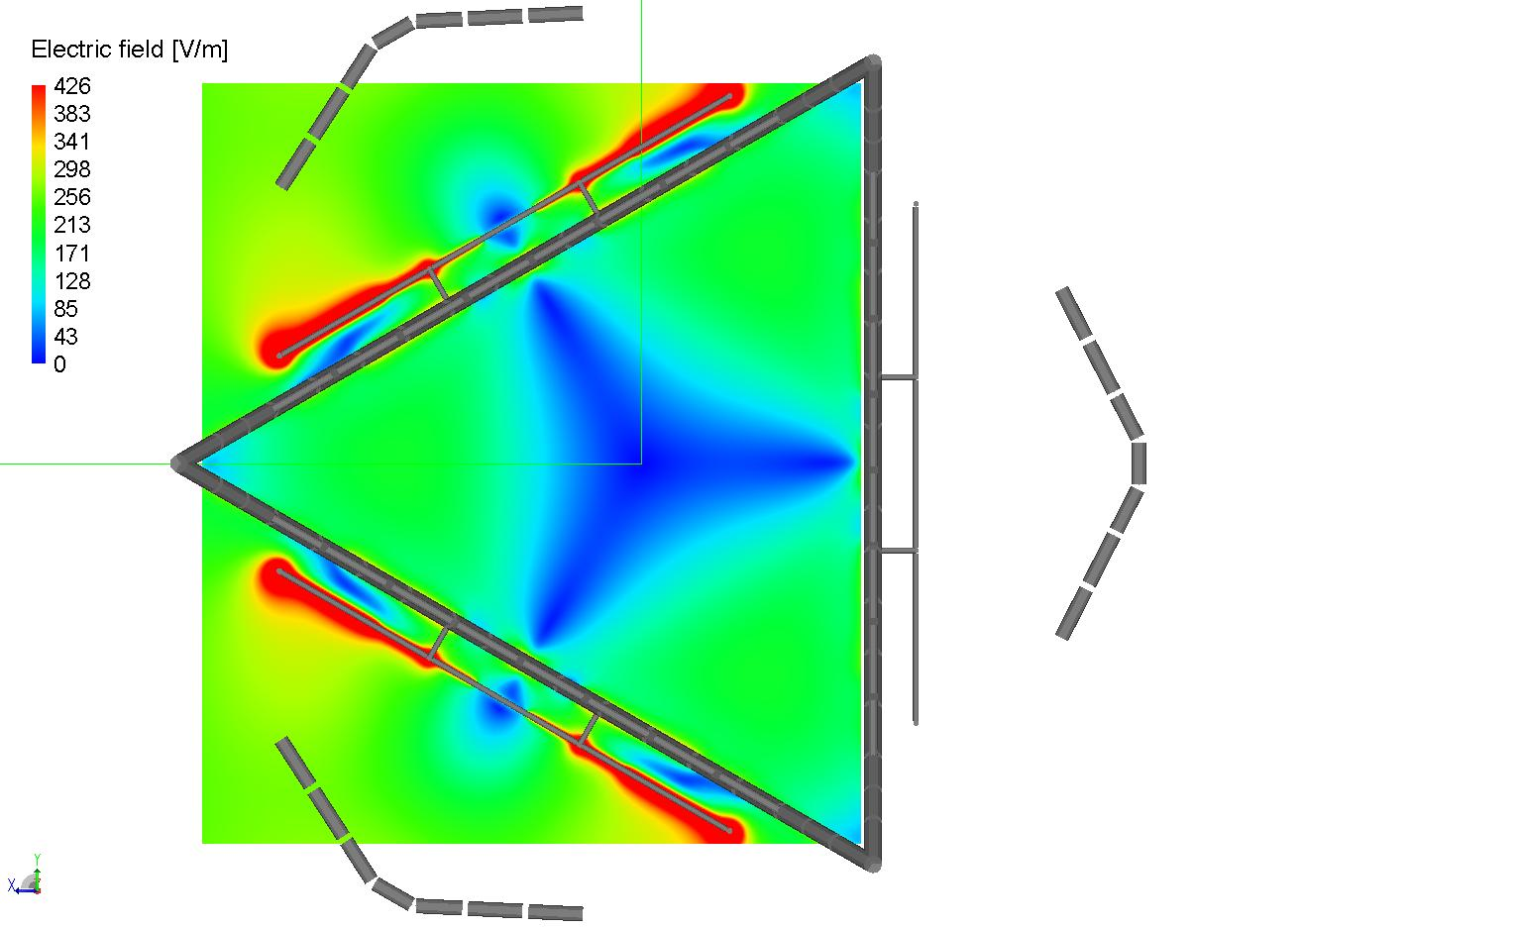
ITU-T Recommendations for EMF assessment
Recommendation ITU-T K.env (planned for 2016) – Guidance on the Environmental Management for Electromagnetic Radiation from Radiocommunication Base Stations
Recommendation ITU-T K.emf (planned for 2017) - Exposure levels in the close proximity of the radiocommunication antennas”

