Slide 1
Implementing Mobile Network Energy Efficiency Standards
Overview of Standardization Initiatives for Energy Efficiency in Radio Access Networks
Kochi, 15 December 2014
Mauro Boldi (Telecom Italia)
Rapporteur of ETSI TC EE ES 203 228
© ETSI 2013. All rights reserved

Slide 2
Outline
ETSI Standards
What is ETSI and Environmental Engineering Group
More info on the ETSI EE Structure and Activities on Efficiency
ETSI Standards for EE in Radio Access Networks
The Standards working on EE in ETSI EE Working Groups
Insight on ETSI EE-EEPS Specifications, some notes on EE2

Slide 3
ETSI Standards
What is ETSI and Environmental Engineering Group
More info on the ETSI EE Structure and Activities on Efficiency

Slide 4
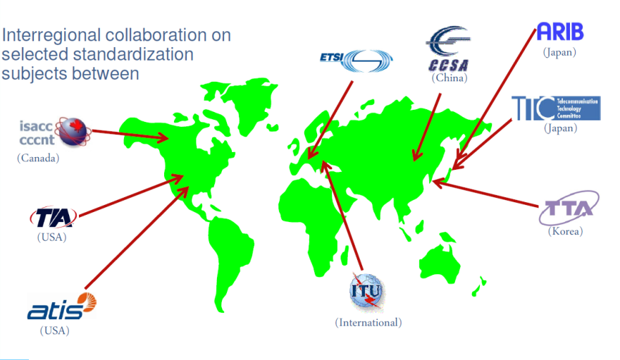
ETSI: European roots, global outreach
ETSI is a world leading standards developing organization for Information and Communication Technologies (ICT)
Founded initially to serve European needs, ETSI has become highly-respected as a producer of technical standards for worldwide use

Slide 5
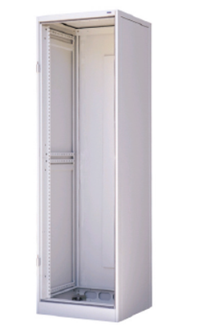
ETSI Technical Committee on Environmental Engineering (ETSI TC EE)
«Multi-task» Technical Committee for ICT Infrastructures
Environmental topics (Temperature, humidity, mechanical,…)
Acoustic
Equipment practice
Power supply interface
Power architectures and grounding
Alternative energy sources
Energy Efficiency
Eco-environmental impact assessment (LCA)

Slide 6
Overview of ETSI TC-EE standards for measurement methods of energy efficiency
Customer Premises Equipment
EN 301 575 V1.1.1, 5/2012
end-user broadband equipment in the scope of EU regulation 1275/2008
Wireline Broadband Access equipment
ES 203 215 V1.3.1, 10/2011
In approval the new EN that includes new technologies
Wireless Broadband Access equipment
TS 102 706 V1.1.1, 7/2013
In approval process ES 202 706
Core network equipment
ES 201 554 V1.1.1, 04/2012
Equipment defined in TS 123 002
Under revision to include Radio access control nodes
Switching and router equipment
ES 203 136 V1.1.1, 05/2013
Transport equipment
ES 203 184 V1.1.1, 03/2013
Green Abstraction Layer
ES 203 237 V1.1.1, 3/2013
To manage/monitor energy and performance profiles of device hardware
Mobile networks
ES 203 228 in preparation
Control & monitoring
ES 202 336-x (12 parts)
These deliverables are published under the frame of Mandate M/462 “ICT to enable efficient energy use in fixed and mobile information and communication networks”

Slide 7
ETSI activity on EU regulation N°801/2013 “Network Standby”
The EU regulation 801/2013 amends the EU regulation 1275/2008 on standby and off-mode power consumption
It defines power consumption limits for equipment with activation through a network interface (wireless or wireline)
ETSI and CENELEC JWG 59X/100X will produce the standards for the measurement methods
ETSI and CENELEC work with mode 4 cooperation agreement to develop two standards (one in CENELEC and one in ETSI) that are mutually exclusives;
These standards have to cover the household appliances and the ICT office equipment with network interface
The two standards will have an introduction with what is 'in scope' and 'out of scope' and with cross-reference to each other's standards
The work repartition is:
CENELEC to cover the “edge equipment” (networked equipment that can be connected to a network and interact with that network or other devices and that does not have, as its primary function, the passing of network traffic to provide a network)
ETSI to cover the “interconnecting equipment” (networked equipment that has, as its primary function, the passing of network traffic to provide a network)

Slide 8
ETSI Standards for EE in Radio Access Networks
The Standards working on EE in ETSI EE Working Groups
Insight on ETSI EE-EEPS Specifications, some notes on EE2

Slide 9
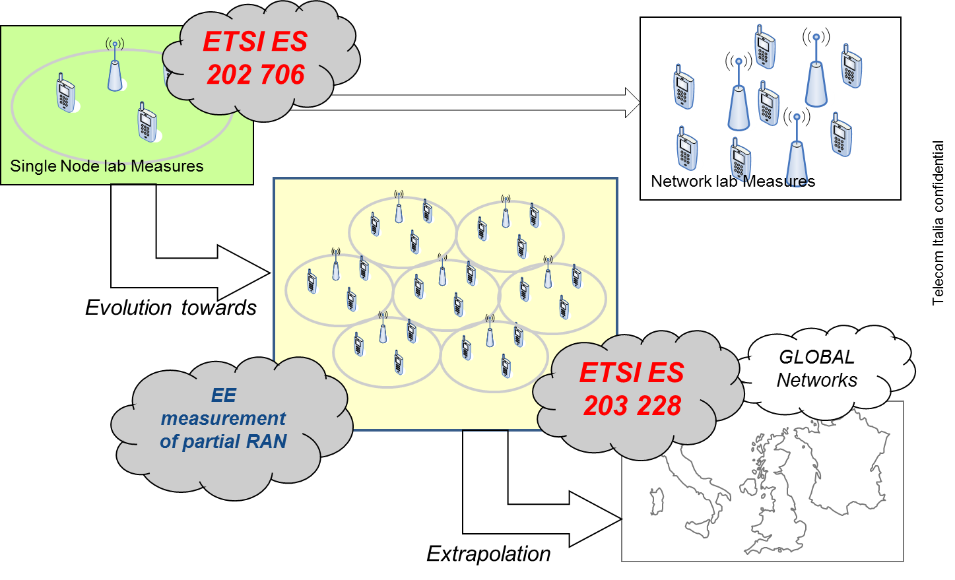
Energy Efficiency for mobile radio access (ES 202 706 and ES 203 228)
ES 203228 developed in joint WI with ITU-T SG5

Slide 10
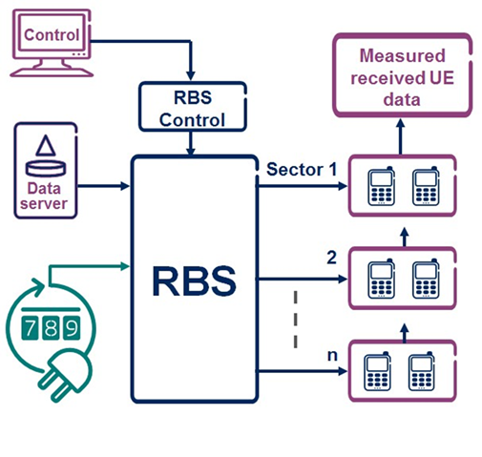
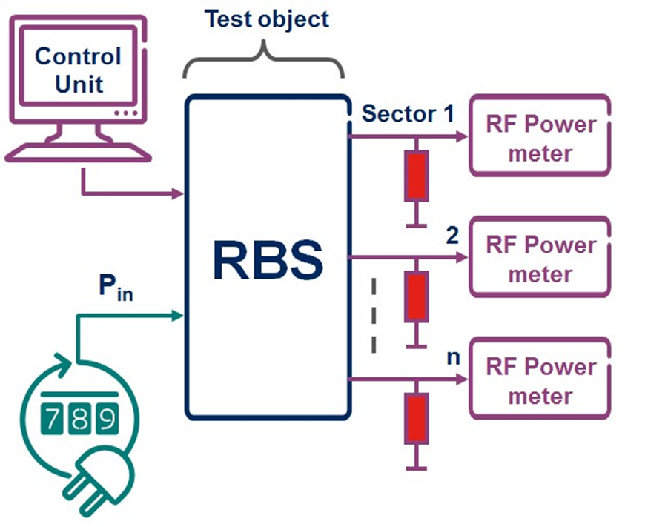
ES 202 706; Static and dynamic test setup
Static method is a basic method for consumption measurement
Dynamic method is a basic method for energy efficiency measurements

Slide 11
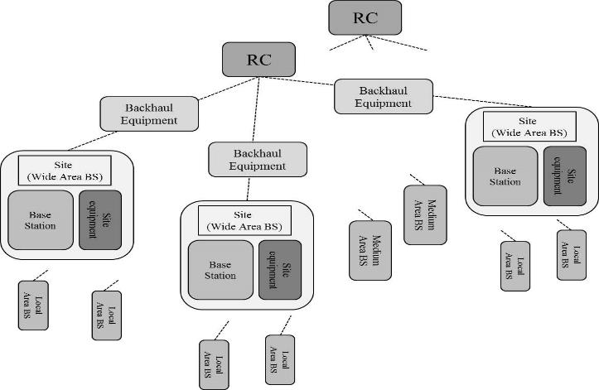
Measurement method of energy efficiency in wireless access networks: ES 203 228
In liaison with ITU-T and 3GPP
The document deals with both a homogeneous and heterogeneous networks (GSM, UMTS, LTE-LTE/A) considering networks whose size and scale could be defined by
topologic (a possible example a control node, its supported access nodes as well as the related network elements)
geographic (city-wide, national or continental networks)
demographic (urban or rural networks)
Stable draft v0.0.8, approved in December

Slide 12
Measurement method of energy efficiency in wireless access networks: ES 203 228
EE_{MN, D} | b/J
Consumption | Energy EC_{MN} | Wh or J
Performance | Data volume DV_{MN} | bit
3GPP ref. | TS 36.314 §4.1.8.1&2 TS 32.425 §4.4/4.5/4.10
Time period | week/month/year (week granularity)
Comment | EC Based on metering information DV Based on O&M counters at node level Availability/reliability as quality indicator
EE_{MN, C} | m²/J
Consumption | Energy EC_{MN} | Wh or J
Performance | Coverage Area | m²
3GPP ref. | TS 36.314 §4.1.8.1&2 TS 32.425 §4.4/4.5/4.10
Time period | week/month/year (week granularity)
Comment | EC Based on metering information Coverage based on counters, for each RAT Metric to be used in rural or deep rural areas

Slide 13
Measurement method of energy efficiency in wireless access networks: ES 203 228
Demography Classification | Percentage of presence in the global area | EE_{MN}
 |  | EE_{MN,DV} | EE_{MN,C}
Dense Urban (DU) | 42% | 200 b/J | 2,7 m²/MJ
Urban (U) | 20% | 40 b/J | 19 m²/MJ
Sub-urban (SU) | 15% | 8 b/J | 38 m²/MJ
Rural (RU) | 13% | 2 b/J | 115 m²/MJ
Unpopulated | 10% | NA | NA
Global EE |  | 103,8 b/J | 28,4 m²/MJ
Example without any reference to actual networks
Hypothesis of 2 weeks measurement in a network with a hypothetical demography distribution as in column 2; weighted measurement of the “available” sub-networks

Slide 14
Questions?

