Slide 1
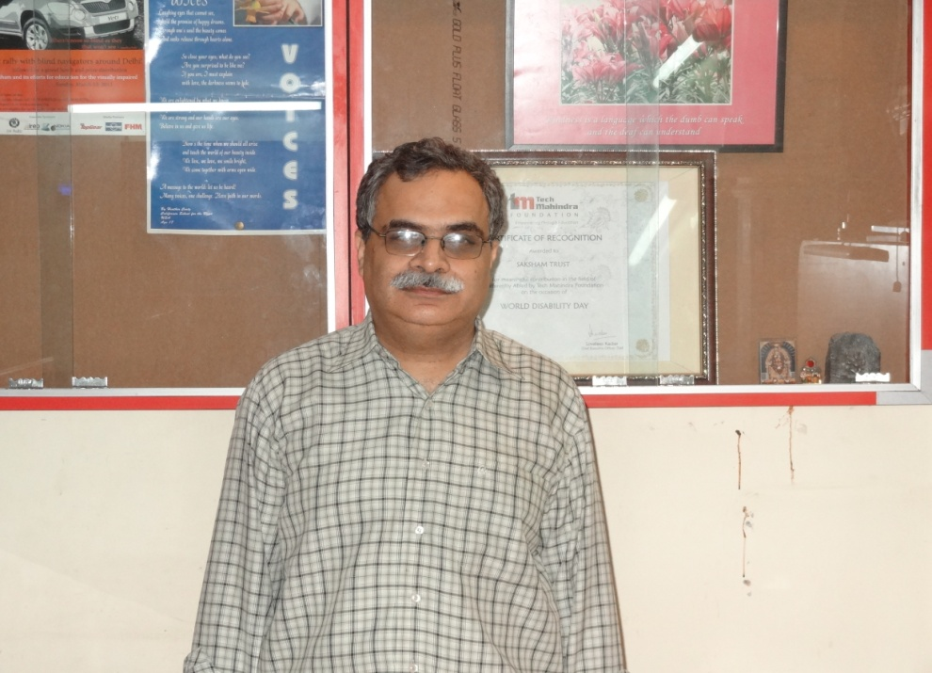
ACCESS TO DIGITAL INFORMATION FOR THE PRINT DISABLED Gap analysis and solutions
DIPENDRA MANOCHA
Coordinator
Developing Countries Program
DAISY CONSORTIUM

Slide 2
GAP ANALYSIS STUDY
Gap analysis study conducted jointly by DAISY Consortium and WBU. Supported by ATDO Japan
24 countries covered from Asia, Africa and South America
Analysis done for 76 languages in which books are published
Mission to find gaps in holistic solution for accessible digital information

Slide 3
GAPS IN KEY TECHNOLOGIES
TTS 15/76
Braille Translation software 30/76
OCR 20/76
Assistive technology to read e-text or DAISY talking books: less than 1%

Slide 4
GAPS IN INFRASTRUCTURE
Braille Library: 16/24
Talking book library: 10/24
Accessible e-text library: 2/24

Slide 5
Conclusion
There are three main components of accessible publication:
Production of accessible format books
Distribution system and infrastructure that can reach out to persons with print disabilities
Assistive technology and reading equipment required to read accessible format books
Accessibility to publications for persons with print disabilities cannot happen even if one of the above mentioned components is missing for any specific Language.
Unfortunately, a very large part of the population of persons with print disabilities living in developing countries are slipping into the gaps mentioned above and are forced to live in world of dependence for all their reading and writing needs.
Only a very systematic and well-coordinated effort among multiple development agencies and governments of the developing country can help in plugging the gaps that this study has found in developing countries.

Slide 6
Developing Countries Alliance
Working group consists of development organisations and disabled persons organisations
Identified common goals and requirements for holistic solution for access to information to persons with disabilities
Coordination among multiple agencies to work on complementary projects to achieve holistic solution
To join, write to dmanocha@daisy.org
Full text of report is available at
http://www.daisy.org/daisy-developing-countries-alliance

