Slide 1
9th Annual Internet Governance Forum
Multi-stakeholder involvement in e-accessibility policy development among States Parties to the Convention on the Rights of Persons with Disabilities
Joint ITU/G3ict/DCAD Workshop 89
Multi-Stakeholder Engagement: Imperative for Accessibility Istanbul, Turkey
2 September 2014
Francesca Cesa Bianchi Vice President, Institutional Relations G3ict, Global Initiative for Inclusive ICTs
Notes:
Ladies and gentlemen, it’s a pleasure for me to join you today for this joint ITU/G3ict/DCAD workshop and to share some insights

Slide 2
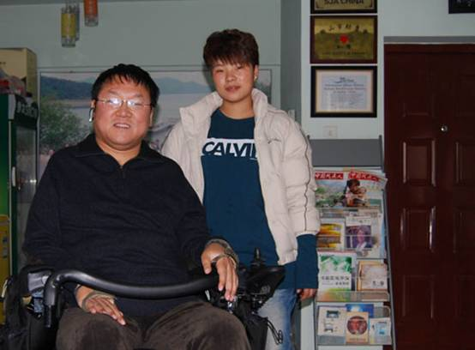
“If anybody asks me what the Internet means to me…
…I will tell him without hesitation: To me (a quadriplegic) the Internet occupies the most important part in my life. It is my feet that can take me to any part of the world; it is my hands which help me to accomplish my work; it is my best friend – it gives my life meaning.”
Dr. Zhang Xu, Founder and Director of Bethesda Rehabilitation Ministry of Anshan, China

Slide 3
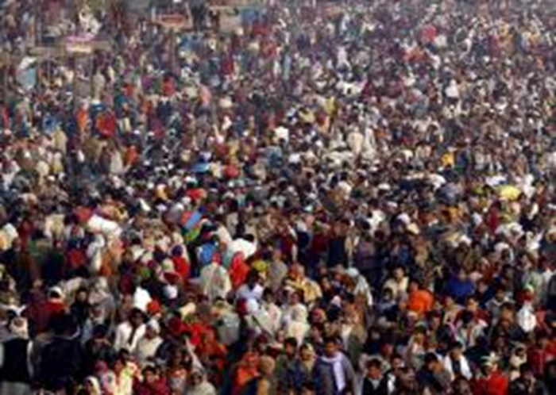
Demographic Realities:
1 billion people live with some
form of disability
World Population is aging
Everything is run by digital interfaces
Notes:
3
3

Slide 4
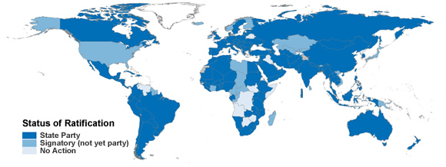
CRPD: A Unified Framework for Policies and Programs, with Global Impact
A Timely Opportunity for ICT Leaders
Notes:
Introducing the United Nations Convention on the Rights of Persons with Disabilities (CRPD) and its provisions on ICT accessibility

Slide 5
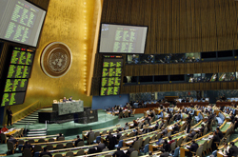
Why the Convention on the Rights of Persons with Disabilities Matters to Internet Stakeholders
Adopted by the United Nations General Assembly December 13, 2006 as the 8th Human Rights Treaty
158 countries have signed it and 147 ratified it as of August 2014
Defines accessibility obligations for all areas of ICTs including web accessibility, impacting 147 States Parties
5
Notes:
5

Slide 6
Article 9: Addressing Accessibility Barriers in the Digital Age and Promoting Accessibility Standards and Internet Usage among Persons with Disabilities
“To enable persons with disabilities to live independently and participate fully in all aspects of life, States Parties shall take appropriate measures to ensure to persons with disabilities access, on an equal basis with others, to the physical environment, to transportation, to information and communications, including information and communications technologies and systems”
Notes:
ICT Accessibility provisions to States Parties to the CRPD include:
Article 9: Accessibility
Article 21: Freedom of Expression and Opinion, and Access to Information

Slide 7
Participation of PWDs in Policy Making, a Cornerstone of CRPD Implementation
In the development and implementation of legislation and policies to implement the present Convention, and in other decision-making processes concerning issues relating to persons with disabilities, States Parties shall closely consult with and actively involve persons with disabilities, including children with disabilities, through their representative organizations. (Art. 4.3, General Obligations)
Notes:
The development of new policies and regulations or the revision of existing policies and laws should be done in consultation with persons with disabilities and other stakeholders.

Slide 8
Benefits of the Participation of Persons with Disabilities in Policy Making
A great source of knowledge
Knowledge of issues
Knowledge of solutions
Best advocates to convince policy makers
Most disabled persons organizations aware of their new Rights as per CRPD
Findings from the G3ict 2012 CRPD ICT Accessibility Progress Report showed that most successful countries in ICT accessibility were those involving DPOs in policy making

Slide 9
However, the 2013 G3ict CRPD ICT Accessibility Progress Report Shows a Lack of Participation of Persons with Disabilities
In Your Country, Are There? | Yes
Financial supports for DPOs and NGOs working in field of digital accessibility * | 34%
Forum for active cooperation between NGOs working in field of digital accessibility * | 24%
A systematic mechanism to involve the DPOs working the field of digital accessibility to the drafting, designing, implementation and evaluation of laws/policies * | 13%
Most importantly, only 11% of States Parties surveyed involve Persons with Disabilities in ICT Accessibility Policy Making
* Key success factors for countries capacity to implement identified through regression analysis for significance Source: G3ict 2013 CRPD ICT Accessibility Progress Report
Notes:
A minority of countries comply with CRPD Provisions for ICT Accessibility Implementation, according to findings from the “G3ict 2013 CRPD ICT Accessibility Progress Report."

Slide 10
ITU-G3ict Model ICT Accessibility Policy Report – Publication Fall 2014
Developed by ITU and G3ict, pursuant to the CRPD (successful achievement relies on adoption and early implementation of policies by countries)
Intended as a resource for ICT policy makers, regulators and other stakeholders including NGOs, persons with disabilities and parliamentarians, to promote ICT accessibility in national markets
Designed to assist in revising existing ICT laws and developing new policies for ICT accessibility
Organized by type of ICT because the accessibility needs and requirements of persons with disabilities vary by type of ICT
ICT Accessibility Policy Modules include:
ICT Accessibility Legal, Policy and Regulatory Framework
Model ICT Accessibility Framework on Public Access
Model Mobile Communications Accessibility Policy Framework
Model Television/Video Programming Accessibility Policy Framework
Model Web Accessibility Policy Framework
Model Accessible ICT Public Procurement Policy Framework

Slide 11
ITU-G3ict Model ICT Accessibility Policy Report – Publication Fall 2014 (2)
Legal framework and each individual module address current key issues and specify the rule of engagement of persons with disabilities in policy making:
Fostering consensus building and inclusive policy-making through public consultation with persons with disabilities, including establishing a “Committee on ICT Accessibility” and publishing accessible documents
Defining implementation roadmaps
Participating in codes of conduct or regulatory developments
Adopting international standards
Promoting the setting of clear targets, and periodic monitoring and evaluation
Encouraging training, capacity building and educational programs on disability awareness
Fostering the hiring or promotion of persons with disabilities for Web accessibility program implementations (Model Web Accessibility Policy Framework)

Slide 12
Thank You for your Attention!
www.g3ict.org
fcesabianchi@g3ict.org
Thank You
For Your Attention!
www.g3ict.org
www.e-accessibilitytoolkit.org
www.m-enabling.com
axel_leblois@g3ict.org
Notes:
12

