Slide 1
Use and non-use of ICT by people with disability in small island developing states
Gunela Astbrink
Women With Disabilities Australia

Slide 2
Small island developing states
Caribbean region
Pacific region
Other regions of world
African coast
Indian Ocean

Slide 3
Pacific region
Extremely large ocean with small land areas
Relatively small populations
Majority are small island developing states
22 countries or territories
Transport and infrastructure costs are high

Slide 4
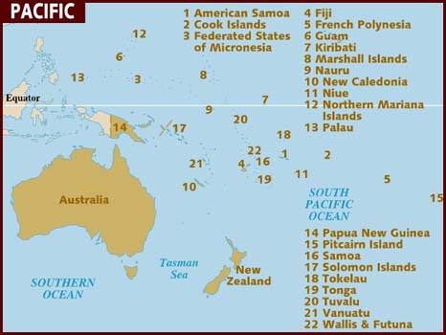

Slide 5
Status of ICT in the Pacific
Growing ICT usage in the Pacific
Satellite services and submarine cables are increasingly bringing faster and more reliable broadband services
Widely varying usage in different countries
Costs – computers are expensive
Internet usage mainly through smart phones
Remoteness
Some countries such as Vanuatu - 75% of population use mobile phones

Slide 6
People with disability in the Pacific
People with disability have more than double disadvantages
Cultural and socio-economic factors
Lack of educational and employment opportunities
Affordability issues

Slide 7
Vanuatu pilot project
ITU pilot project in Vanuatu with Pacific Disability Forum and the Government of Vanuatu
Baseline data – first of its kind in the Pacific
Building evidence base for improving ICT accessibility
Interviews with over 200 people with disability in towns and villages

Slide 8
Vanuatu pilot project
Preliminary findings:
Many have not heard of the Internet
Many do not have a mobile phone and if they do, it is not a smart phone
Mobiles with long battery life are important because of limited access to electricity

Slide 9
Vanuatu pilot project
Web accessibility audit of 28 Government websites
Important as Vanuatu has strong e-government focus
98% of population to have access to broadband by 2018
Through health centres and schools
Findings indicate that web sites do not meet W3C Web Content Accessibility Guidelines 2.0
Move to improve web accessibility as new Government websites are developed

Slide 10
Outcomes
Government Right to Information Web Accessibility Guidelines
Clarification and support for WCAG 2.0 with specific recommendations for Vanuatu government agencies
Consultation with Civil Society Disability Network and other relevant agencies
Right to Information Unit of the Office of the Government Chief Information Officer (ie Freedom of Information)
Launch in September 2016 at the National Library

Slide 11
Outcomes
Pacific Disability Forum supportive of ICT accessibility (key advocacy organisation)
Extended project by Pacific Disability Forum to survey more countries including:
Papua New Guinea
Cook Islands
Fiji

Slide 12
Ways forward – relevant for small island developing states
Multi-faceted approach
Support for gradual cultural change
Recognition of traditional values
Disability awareness-raising for government and NGOs
Disability inclusive development
Implementation of policy, legislative and regulatory mechanisms

Slide 13
Ways forward – relevant for small island developing states
Practical measures
Accessible websites, facilities, products and services
Subsidised costs
Training in ICT usage for people with disability
Inclusion of people with disability in planning

Slide 14
Thank you!
Gunela Astbrink
www.gsa.com.au
g.astbrink@gsa.com.au

