Slide 1
4th SG13 Regional Workshop for Africa on
“Future Networks for a better Africa: IMT-2020, Trust, Cloud Computing and Big Data”
(Accra, Ghana, 14-15 March 2016)
Big Data – The Analytic Vision
Abdallah Ajlani Ph.D.,
Principal Consultant, ERICSSON
Abdallah.ajlani@ericsson.com
Byline

Slide 2
Outline
APPROACH TO BIG DATA
EEA USE CASES
INTEGRATION IN OOREDOO TN

Slide 3


Telecom Big Data Unique Challenges
VIP
Facebook
Roaming
Subscriber
Service
Device
Care
Tethering
Speed
Voice
How to interpret
Incident
Churn
QoE
Coverage
Location
GUMMEI
BCCH
Ic/No
Iups
X2AP
kHz
RNTI
DRX
RTT
QCI
ISUP
ARQ
RAB
PHICH
NBAP
HSDSCH-CC
ICIC
RACH/FACH
RANAF
QPSK
CQI
PSP
RSCP
S1APID
How to correlate
E2E
OSS/BSS
CONTENT
NETWORK
RADIO
CORE
Notes:
Telecom big data has some specific characteristics that are not present in typical big data systems:
1) Data Technology challenge
Geo distribution
Data is highly cross-referenced: the interpretation of one event depends on another event
No unique identifier
No easy way to partition
Timing and order of events carries a meaning
-> hadoop/mapreduce and other standard data tools cannot be directly applied
2) Interpretation challenge
-> You need to combine data processing science with domain knowledge to make sense of telecom big data

Slide 4
REAL TIME INSIGHTS AND ACTIONS
Networks, SOC, Care, Marketing
Telecom Data Models & Insights
Subscriber
Subscriber Profile
Service Usage
Lifecycle, CE index, CLV
Location, mobility, roaming…
Service
OTT usage
Service Profile & Sessions
Service Level Index
Quality Indicators (S-KPIs)…
Analytics
application
?
Closed loop
action, e.g.
Self Care
?
Query
Real-Time
Human “data scientist”
TELECOM DATA MODELS
AND INSIGHTS
Big Data
Store
?
Network
Incidents and Root Cause
Traffic, Load and Forecast
Performance
Radio, Core, Data Center…
Device
Device Profile
Tethering
Device usage
Replacement patterns…
Network
Raw
data
Stream
analysis
Real-Time
Closed loop
action, e.g. Policy
Control
ACTIONABLE INSIGHTS FROM COMBINATION OF OFFLINE AND ONLINE DATA
UNIQUE, END-TO-END EXPERTISE THAT
EMPOWERS REAL WORLD USE CASES
Notes:
Google analogy: we “index” telecom big data the way google is indexing the internet

Slide 5

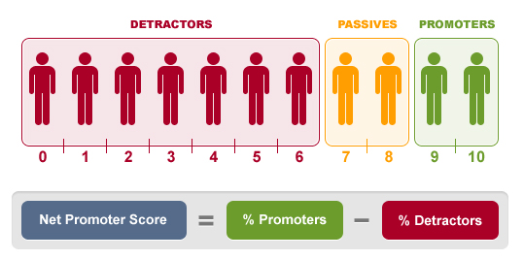
UNIQUE data modeling
Technical Network Performance
Session QoE per User
User Overall Perception of Service Quality
User Satisfaction
Resource-KPIs
& Counters
Service-KPIs &
E2E session record
Service Level
Index (SLI)
Net Promoter
Score (NPS)
Took too long to start
Video didn’t start
Video stopped
Video/App crashed
Buffer time is too long
Video freezes often
Video quality is bad
Part of the video is lost
Accessibility
Video Accessibility
Video Access Time
Retainability
Video Retainability
Integrity
Video Freeze Rate
Video Quality
☹
☺
Resolve
& Retain
Drive ARPU
Notes:
When shifting from network to per customer understanding a structured approach is needed. Traditionally service providers are either monitoring the network resources or relying on interviews to get customer satisfaction trends or the Net Promoter Score. But with the user centric approach in Expert Analytics for every session it is possible to bride these two extremes.
This is done by obtaining user centric KPI’s for each session and then predict each users overall satisfaction of the service quality.
This slide show how to bridge the gap and with a single indication about satisfaction per user. This is even going beyond the NPS survey satisfaction indicator as the Service Level Index is calculated for each and every user while NPS surveys are for a subset.

Slide 6
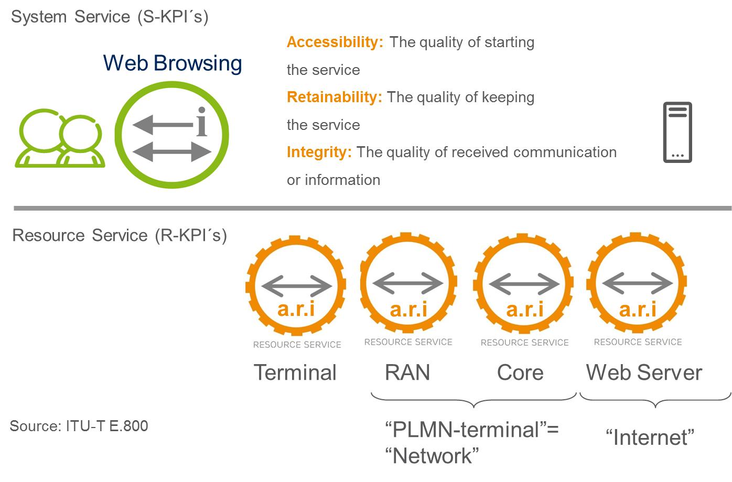
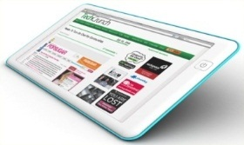
The Service kpi concept
How to measure service
experience?
Accessibility e.g.
Video Accessibility
Video Access Time
Retainability e.g.
Video Retainability
Integrity e.g.
Video Freeze Rate
Video Quality
A/R/I For Video
End-users
Services & Apps
Identify
Understand
Act
Network
Notes:
2012-11-23
6
Assurance in CEM
S-KPIs are not derived from R-KPIs in EEA!
The USP concept serves as a solid foundation for a management system on
which an enterprise can base business and investment decisions, and from
which its service offerings can be expanded.
Implementation of the concept leads to the creation of an enriched set
of network-level information with the granularity of individual customers
and transactions, enabling a wide range of customer and service-centric
applications.
Indicators and probable cause incident data from vast amounts of network
and other data requires a paradigm shift from isolated or ‘siloed’ data, to truly
end-to-end-correlated data from multiple sources, and multiple vendors.
The USP Concept is built-up based on the following:
• Definitions of SySe and S-KPIs, Resource Services (ReSe) and R-KPIs,
and a single value QoSS (Quality of SySe) representing all S-KPIs
• Formal Structure between SySe (with S-KPIs), ReSe (with R-KPIs) and
Resources (with PIs)
• Methodology to give priority and identify S-KPIs and also to obtain operator
unique S-KPI quality targets
• Methodology to classify and identify which resource service is responsible
for a potential S-KPI degradation
A SySe, is a service consumed by the user, for example, TV. It is delivered
by all resources that make possible for an end user to consume this SySe,
for instance, Terminal, fixed or radio or core networks and internet as shown
The SySe entity is created in order to clearly define what Ericsson means
instead of using the commonly used word “service”. A SySe is consumable,
usable and possible to experience by a consumer, a human or a machine. A
terminal provides the interface through which the consumer consumes a SySe.

Slide 7

Understand the Why of issues
Determine the most probable cause when an S-KPI has a threshold violation using the Correlate Subscriber QoE with Device, Radio and Core network Resource KPIs (R-KPIs) for each session
Device
“Individual Customer”
“Holistic”
“Real Time”
Subscription
Coverage
End-to-End Session Record (ESR)
User
Service
QoE
Device
Location
Radio
Core
Transport
…
App usage
Handovers
Cell load
Web
experience
Throughput
PDP connectivity
UE type
Topology
Subscription
Content type
QoE
Interference
Coverage
Video
freeze
Service
providers
Attach
Roaming
Service
Catalog
CRM data
Service quality
Usage
Congestion
CPU load
Radio bearer
Drop/outage
Page delays
Voice quality
QoS class
Load
Charging
Profile
Settings
Probes
…..
Internet
2G
OSS/BSS
CONTENT
NETWORK
Terminals
ENB
MME
SGW
PDN GW

Slide 8
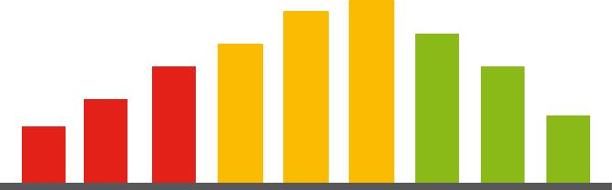
Service Level Index (SLI)
VoLTE Sessions
Service Level Index (SLI)
Predictor of Customer Satisfaction
Available for Every User, Continuously Updated
Correlates with Net Promoter Score
Voice / SMS Sessions
Web Browsing Sessions
Video Streaming Sessions
Objective Service-KPIs:
Video Streaming
Subjective Weight – Early Adopter
Subjective Weight – Family
Subjective Weight – Student
=
Video Start Time
Subjective Weight – Professional
Video Image Quality
X
Service Significance
Incident Repetition
Memory Fading
X
X
Video Freeze
Video Retainability
Notes:
When shifting from network to per customer understanding a structured approach is needed. Traditionally service providers are either monitoring the network resources or relying on interviews to get customer satisfaction trends or the Net Promoter Score. But with the user centric approach in Expert Analytics for every session it is possible to bride these two extremes.
This is done by obtaining user centric KPI’s for each session and then predict each users overall satisfaction of the service quality.
This slide show how to bridge the gap and with a single indication about satisfaction per user. This is even going beyond the NPS survey satisfaction indicator as the Service Level Index is calculated for each and every user while NPS surveys are for a subset.

Slide 9
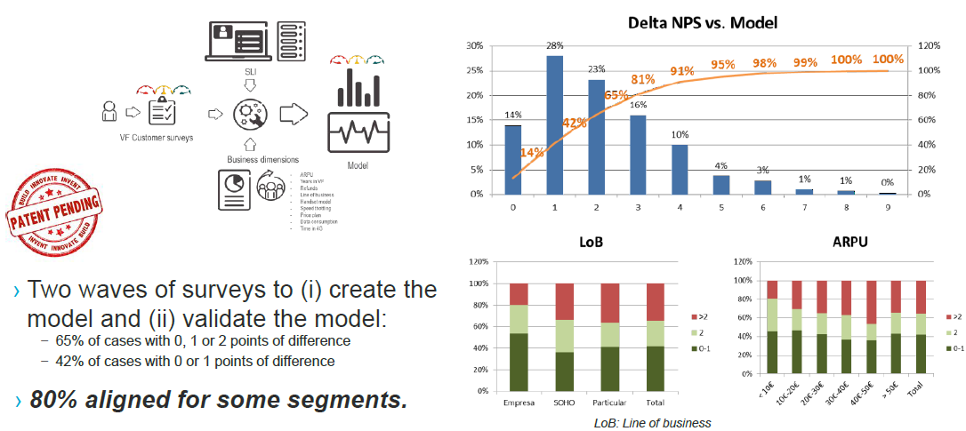
SLI Correlation with NPS

Slide 10
Outline
APPROACH TO BIG DATA
EEA USE CASES
INTEGRATION

Slide 11
Expert analytics themes
8
OPERATIONAL & BUSINESS EFFICIENCY
CUSTOMER EXPERIENCE
& MARKETING
BUSINESS
INNOVATION
2
3
4
5
6
7
PROACTIVE
SERVICE
OPERATIONS
EMPOWERED
CUSTOMER
CARE
EXPERIENCE
BASED
MARKETING
CUSTOMER
JOURNEY
OPTIMIZATION
DATA
MONETIZATION
INDUSTRY &
SOCIETY
(IoT)
1
ANALYTICS PLATFORM & INSIGHTS
Notes:
Use cases: Icluding real-time video experience management, enterprise SLA, customer retention and upsell, location data monetization and OTT application analytics
Improve 1st call resolution in customer care
Optimize experience for valuable customers
Customer retention with improved marketing
Optimize network after value and experience
Improve experience for enterprise customers

Slide 12
ANALYTICS PLATFORM & insights
1
FLEXIBILITY
REDUCED COST
Flexible KPI Management
Data Source Ingestion
Micro-service architecture
Reduced TCO (HW footprint and 3PP license cost)
Data Center Deployment
Hadoop 2.0
CAPABILITY
ADVANCED MODELS
Self Learning Rules
Streaming Analytics to provide near real-time insights
Actuation Logic
CLI - Cell Level Index
CEI - Customer Journey
Cell 567340
CLI: 8.4
Video CLI: 8.1
Web CLI: 9.3
Nita
Notes:
Use cases: Icluding real-time video experience management, enterprise SLA, customer retention and upsell, location data monetization and OTT application analytics
Improve 1st call resolution in customer care
Optimize experience for valuable customers
Customer retention with improved marketing
Optimize network after value and experience
Improve experience for enterprise customers

Slide 13
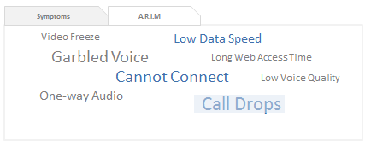
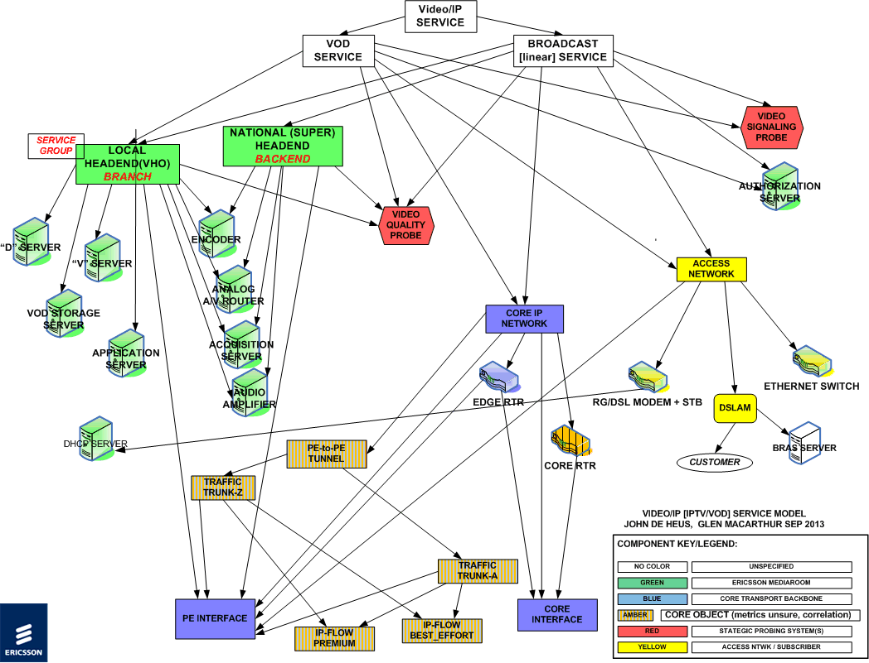
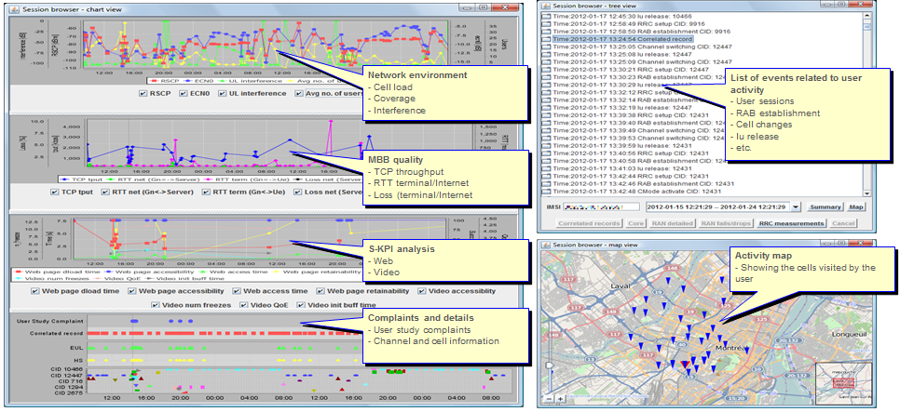
Proactive service operations
2
IMPROVED EFFICENCY IN OPERATIONS
SERVICE QUALITY MANAGEMENT
Customer-centric analysis and added drill-down capability
Workflows and functionalities (e.g. roaming, CSP Incidents, Drill-down to Incident Summary/List)
Proactive / (Near) real-time
monitoring of Service Quality / SLA’s
Reduce handling time with root cause and Impact analysis
SESSION BROWSER
VIP AND ENTERPRISE CUSTOMERS
Rapid identification of root cause
Deep flow cross-protocol analysis
Per subscriber control & user plane event browser
Assure strict Enterprise level Service SLAs
E2E Actuations to optimize experience of certain VIP and Enterprise customers.
Notes:
Use cases: Icluding real-time video experience management, enterprise SLA, customer retention and upsell, location data monetization and OTT application analytics
Improve 1st call resolution in customer care
Optimize experience for valuable customers
Customer retention with improved marketing
Optimize network after value and experience
Improve experience for enterprise customers

Slide 14
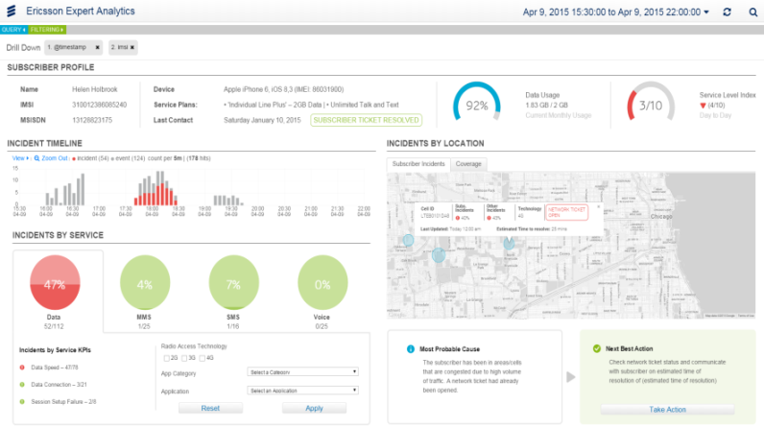
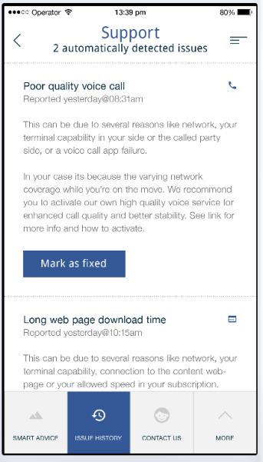
EMPOWERED CUSTOMER CARE
3
TIER 1 & TIER 2 IMPROVEMENTS
INTELLIGENT SELF-CARE
Further Improve Efficiency
of Tier-1 Customer Care Agents and Expand Use to Tier-2+ Agents
Improve out-of-box Most Probable Causes and next Best Actions
Reduce cost with self care capabilities to manage complaints
Intelligent self-service recommendations
ROAMING ANALYTICS
CHARGING & BILLING INSIGHTS
Proactive monitoring of Inbound Roaming to avoid Revenue Leakage
Experience on Inbound/ Outbound Roaming
Including input from UDM
Enrich with per transaction data from call & account history
Find correlation between charging & experience

Slide 15
Experience based marketing
4
SLI ENHANCEMENTS
PRE-PAID RETENTION
Calibration Enhancements
Improved SLI Root Cause drilldown
SLI Validation improvements with statistics and tracing
Service Level Index
Profit
CLV
Identify pre-paid customers to keep and start monitor
Trigger action when users at a critical stage of their lifecycle
Loss
Extend Customer Lifecycle
ARPU OPTIMIZATION
MOBILE BROADBAND BOOSTER
Profit
CLV
Identify customers holding back on their spending
Trigger action when user demand increases
Profit
CLV
Identify users at a critical stage of their lifecycle
Convert ad hoc data users to a re-occurring data package
Loss
Loss
Expand Customer
Lifecycle Value (CLV)
Expand Customer
Lifecycle Value (CLV)

Slide 16
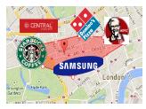
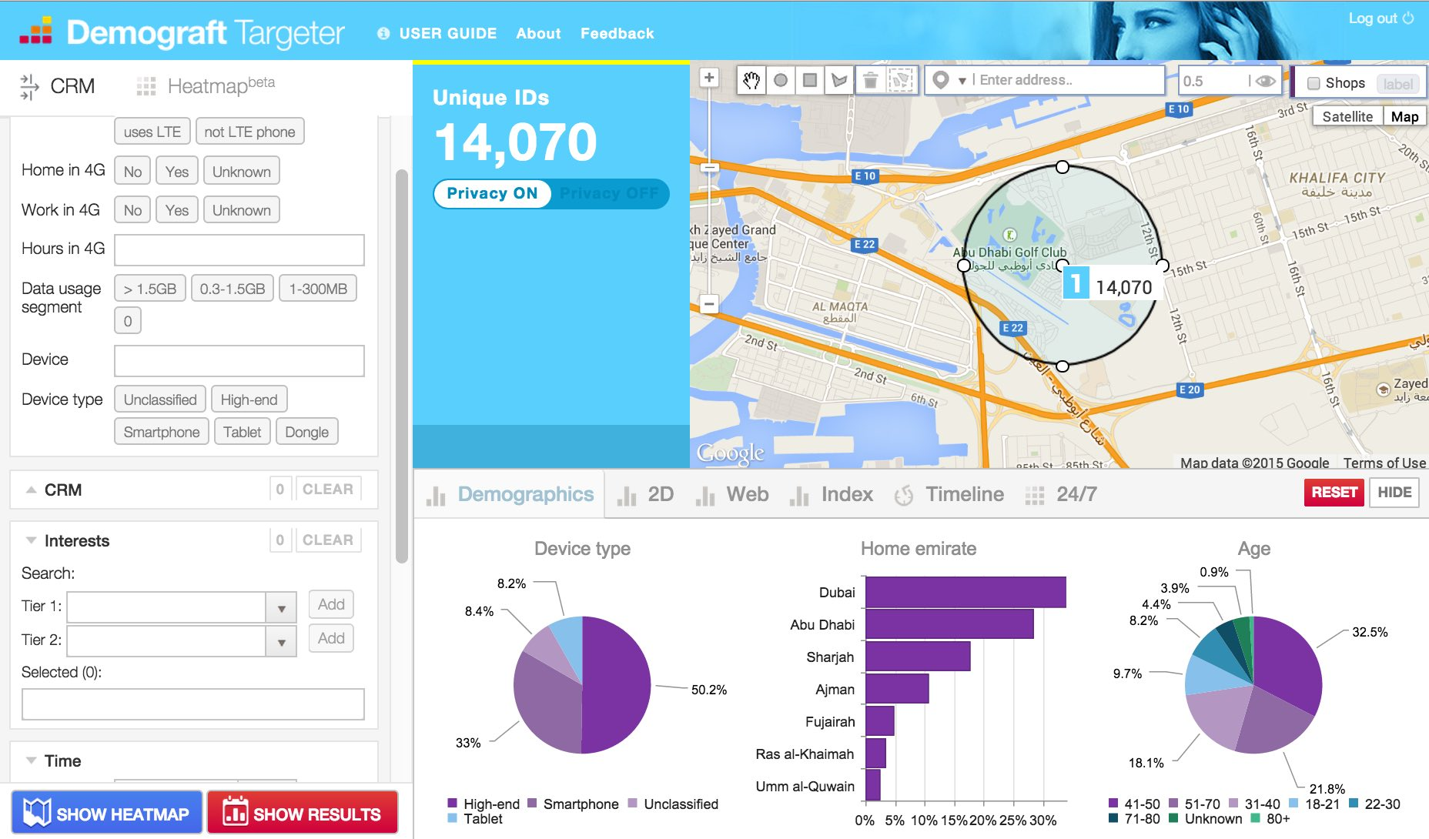
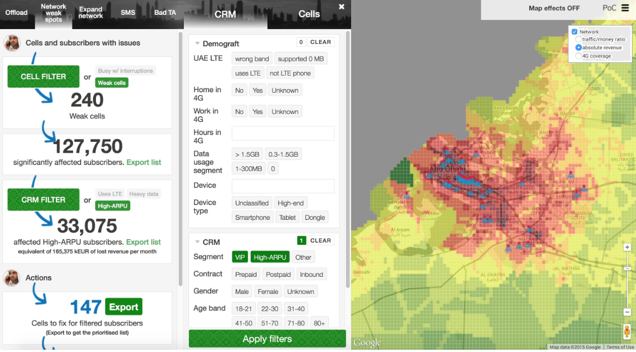
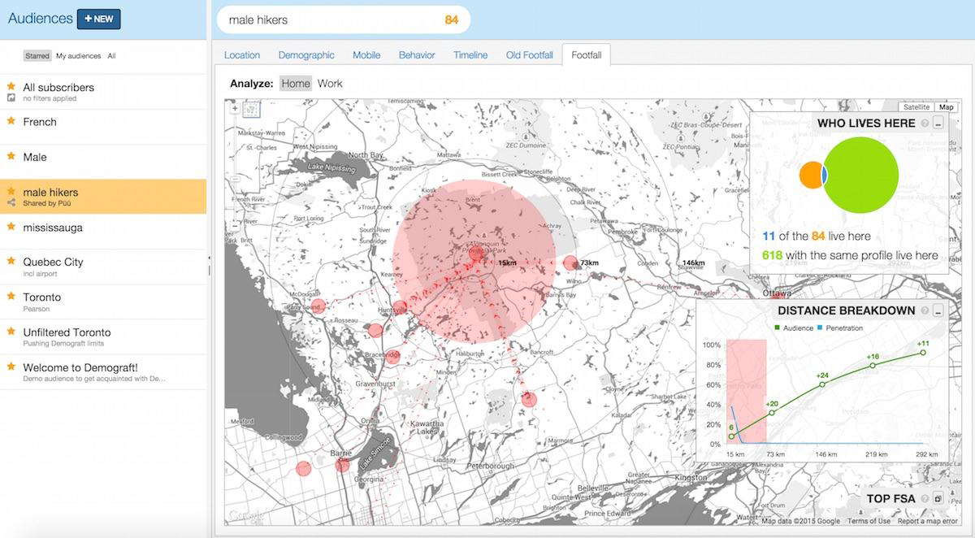
Data MONETIZATION
6
RETAIL CAMPAIGNS OPTIMIZATION
SPECIAL EVENTS
Allow operators to monetize anonymized subsciber insights based on their interests.
Footfall analysis
Lead generation
Demograpic analysis
Traffic patterns and footfall analysis
Upsell / Crossell
LOCATION BASED NETWORK ANALYTICS
CONTEXTUAL MARKETING
Combine network quality and location data and improve network customer experience
Real time context, interests and behavioural patterns to allow B2B monetization
Notes:
Use cases: Icluding real-time video experience management, enterprise SLA, customer retention and upsell, location data monetization and OTT application analytics
Improve 1st call resolution in customer care
Optimize experience for valuable customers
Customer retention with improved marketing
Optimize network after value and experience
Improve experience for enterprise customers

Slide 17

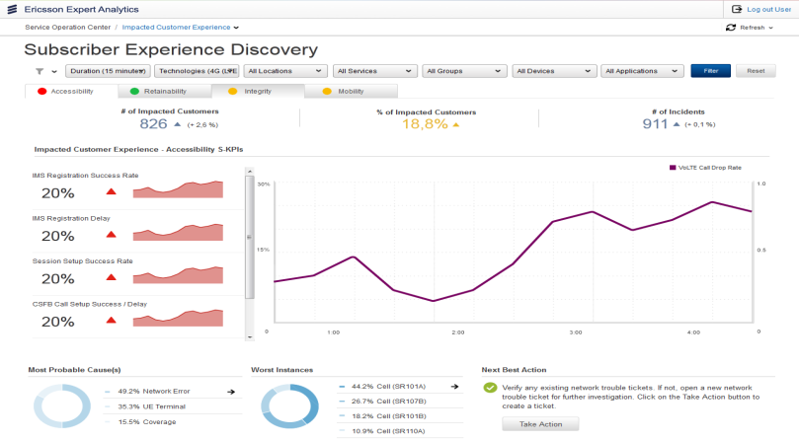
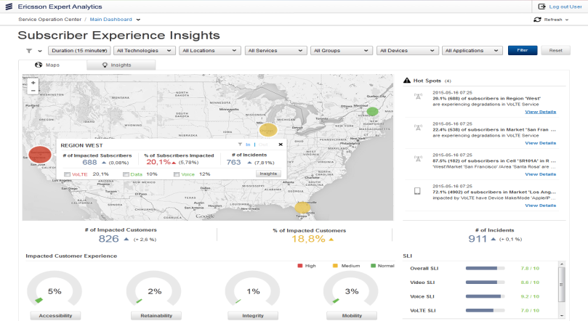
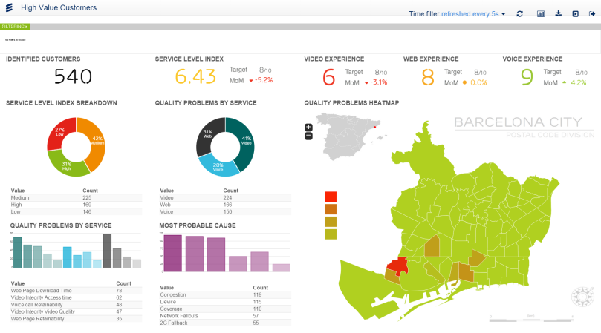
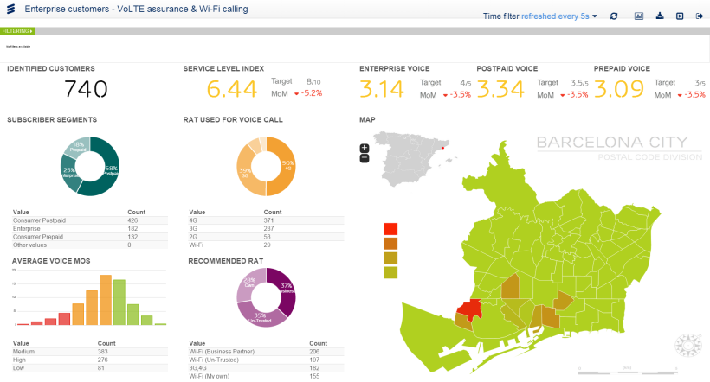
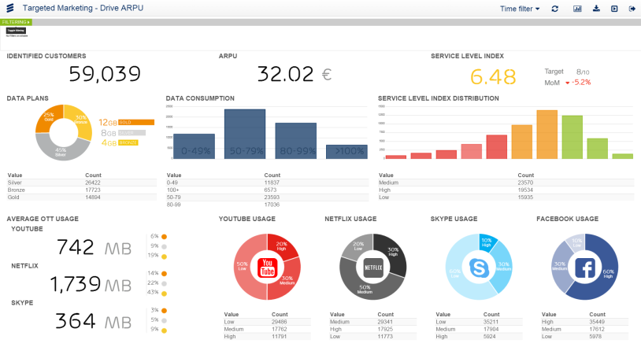
Analytics use cases
SoC: Proactive Service Operations
SoC: VoLTE Analytics
CC: Improve call resolution in customer care
Marketing Analytics:
Dynamic Experience Management
SoC: Real-Time Enterprise SLA Assurance
Marketing Analytics:
Customer Retention & Drive Spend
Notes:
Use cases: Icluding real-time video experience management, enterprise SLA, customer retention and upsell, location data monetization and OTT application analytics
Improve 1st call resolution in customer care
Optimize experience for valuable customers
Customer retention with improved marketing
Optimize network after value and experience
Improve experience for enterprise customers

Slide 18
Outline
APPROACH TO BIG DATA
EEA USE CASES
INTEGRATION

Slide 19
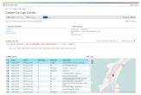
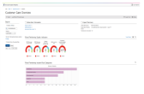
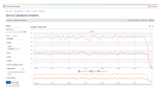
ANALYTICS ARCHITECTURE
JMS
actuation**
Trouble ticket
request**
Operator’s
Map server*
3PP Exposure
and Analytics
tools *
Exposure and Visualization Layer
Web service
(Api’s)
Customer
Care Views
Service Operations Views
Executive
Dashboard
Dynamic QoE
Management Views
Marketing
Analytics
Web application server
Storage Layer
Online repository (GREENPLUM)
In memory
data grids
Offline repository
(HADOOP)
Processing Layer
SNCD
loader
Incident
generator
Esr
data
loader
Aggregator
Stream
analytics
Data
loaders
Real time
Actuation
Subscriber
Profiler and
Sli calculation
PCRF
Reference data
CRM
Cell info
IMEI TAC
Billing
Correlation Layer
Extended session records
Real time event stream
Real Time Correlator
Connection Layer
External
Subscriber
data
Generic RNC /
eNodeB If
E/// GPEH
adapters
E/// CTR
adapters
E/// EBM
adapters
Generic SGSN /
MME Interface
E/// ctum
adapters
Generic KPI
Interface
GTP
Probes
CDR
Adapters
IMS
Probes
3G
UE
OSS
rnc
sgsn
IMS
sgsn / MME
4G
UE
MSC
EMM
enb
ggsn

Slide 20
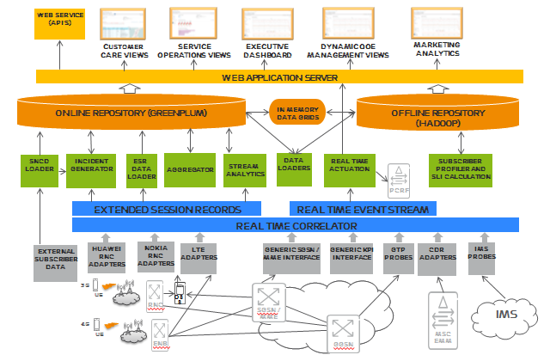
Integration with OSS/BSS SUITE
TroubleTicketing
3PP Exposure
and Analytics
tools
CRM
API for CRM GUI
Self Care
Reference data
CRM Customer info
SLA / SLI
Cell topology (NIM)
billing
ETSI IMEI / TAC db
EEA
SMS Notifications
Customer Surveys DB
NPS

Slide 21

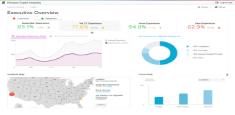




expert analytics summary
Award Winning Solution
Productized Applications
Winner in the Mobile CEM category
CTIA 2015, Las Vegas
Planning
Sales&Marketing
I&S
Operations
Customer Care
Advanced Business Logic
E2E Actuation
Subscriber
Service
Closed Loop
Actions
Device
Network
Network
SERVICE LEVEL INDEX
Customer
Pre-packaged logic:
- Data Models
- Service KPIs
- Patented Data Correlation
- Machine Learning
Resolve
& Retain
Unlock
ARPU
☹
☺
Real-Time
Insights

Slide 23


Slide 24


