Slide 1
4th SG13 Regional Workshop for Africa on “Future Networks for a better Africa: IMT-2020, Trust, Cloud Computing and Big Data” (Accra, Ghana, 14-15 March 2016)
Standardization Activities
on Cloud Computing
Dr. Rim Belhassine-Cherif Products and Services Executive Director, Tunisie Telecom
SG13 Vice-chair & SG13 RG-AFR Vice-chair
Rim.belhassine-cherif@tunisietelecom.tn

Slide 2
PLAN
Why should CC be standardized?
Global Activities on Cloud Computing Standardization
ITU-T activities on Cloud Computing
Conclusion & Recommendations

Slide 3
PLAN
Why should CC be standardized?
Global Activities on Cloud Computing Standardization
ITU-T activities on Cloud Computing
Conclusion & Recommendations

Slide 4
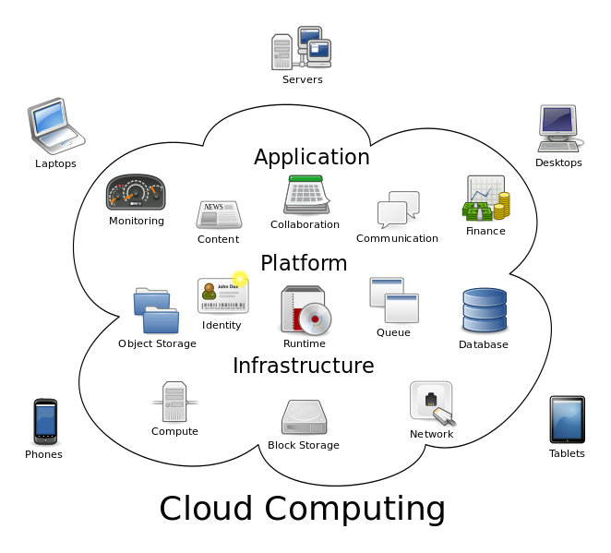
What is Cloud Computing ?
1
Cloud computing: “Paradigm for enabling network access to a scalable and elastic pool of shareable physical or virtual resources with self-service provisioning and administration on-demand”
Examples of resources include servers, operating systems, networks, software, applications, and storage equipment
Source: ISO/IEC 17788 | Recommendation ITU-T Y.3500 “Information technology - Cloud computing - Overview and vocabulary”

Slide 5
What is Cloud Computing ? Main Characteristics
2
1
Measured Service
Broad network access
2
3
Multi-tenacy
4
On-demand self-service
5
Rapid Elasticity & Scalability
6
Resource pooling
Source: ISO/IEC 17788 | Recommendation ITU-T Y.3500 “Information technology - Cloud computing - Overview and vocabulary”

Slide 6
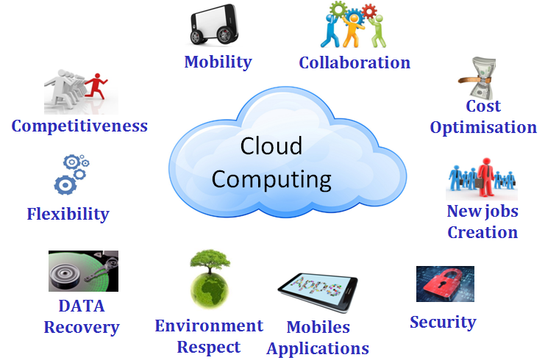
Cloud Computing Advantages for Enterprises, Governments and Individuals
Increasing adoption of CC services at a global scale

Slide 7
CC Fast Growth & Wide Adoption Some Forecasts
1
Cloud business growth will reach 17% from 2013 to 2018 [Gartner]
244 billion USD will be the global cloud revenue in 2017 [Gartner]
11% of IT budget in 2016 will shift from traditional IT in-house to Cloud [IDC, 2015]
Around 28% of the worldwide enterprise applications market will be SaaS-based, generating approximately 51 Billion USD in revenue by 2018 [IDC]

Slide 8
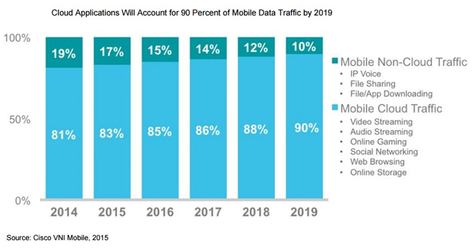
CC Fast Growth & Wide Adoption Some Forecasts
2
80% of enterprises globally and 75% of enterprises in Europe Middle East & Africa region will be using IaaS by 2016
Cloud applications will represent 90% of worldwide mobile traffic in 2019, compared to 81% at the end of 2014
The effectiveness of cloud computing is being limited by many challenges and concerns that affect both providers and users and influence the adoption rate of CC services
8

Slide 9
Challenges in CC
1
Efficiency of Service Provisioning
Information Security
Usage of development tools & components
Creation of scalable architectures
Resource management & flexibility
Availability of services
Identity & rights management
Privacy & integrity
Access control, logging, & attack prevention
Verification & certification
Source: Standardizing the Cloud, A Call to Action, Booz & Company 2012
Portability
Between Providers
Data Privacy
Service portability
Data portability
Compliance with Regulatory Requirements

Slide 10
Challenges in CC
2
Effectiveness of Service Usage & Control
Interoperability
Migration into/out of the cloud
Ability to integrate into on-premise IT
Cloud federation
Contracts including questions of liability
Control of services by users
Governance/escalation mechanisms
Source: Standardizing the Cloud, A Call to Action, Booz & Company 2012
Ensuring Fair Competition in the Market
Transparency of Service Delivery & Billing
Billing including license management
Quality assurance & monitoring SLA
Type & location of data processing
Necessity of the development and adoption of industry-wide standards covering each of these areas

Slide 11
PLAN
Why should CC be standardized?
Global Activities on Cloud Computing Standardization
ITU-T activities on Cloud Computing
Conclusion & Recommendations

Slide 12
CC Standardization
Cloud computing standardization was started by industrial organizations, which develop what are called forum standards
Since late 2009, lawful standards bodies and ICT-oriented standards bodies have also begun to study it
In the USA and Europe, government-affiliated organizations are also discussing it
Source: Standardization Activities for Cloud Computing, NTT, 2011

Slide 13
Forum Standards Bodies Some Examples
1
Organization | Involvement in standardization in cloud computing (examples)
DTMF (Distributed Management Task Force) | OVF, System Virtualization Management Standards (VMAN), management data model
OGF (Open Grid Forum) | Open Cloud Computing Interface (OCCI) or Grid FTP
OASIS (Organization for the Advancement of Structured Information Standards) | Concepts, use cases and gaps in cloud identity (in ID Cloud), many implicitly relevant standards (e.g. SAML, ODF, SOA, …)
Source: The Standardization Environment for Cloud Computing , Federal Ministry of Economics and Technology, Germany, 2012

Slide 14
Forum Standards Bodies Some Examples
2
Organization | Involvement in standardization in cloud computing (examples)
OCC (Open Cloud Consortium) | Cloud infrastructure – infrastructure for research purposes, cloud computing test environments, reference implementations, Benchmark
CSA (Cloud Security Alliance) | Best practices, orientational knowledge and standards in the field of security for cloud computing (e.g. GRC-Stack)
SNIA (Storage Networking Industry Association) | Cloud Data Management Interface (CDMI), Storage Management Initiative Specification (SMI-S), eXtensible Access Method (XAM)
Source: The Standardization Environment for Cloud Computing , Federal Ministry of Economics and Technology, Germany, 2012

Slide 15
ICT-oriented Standards Bodies Some Examples
Organization | Involvement in standardization in cloud computing (examples)
IEEE (Institute of Electrical and Electronics Engineers) | Cloud Portability and Interoperability Profiles , Inter-cloud Interoperability and Federation
IETF (Internet Engineering Task Force) | Internet protocols and standards, such as FTP, HTTP/HTTPS, TCP/IP, X.509 Certificates, PKI or OAuth; overview of responsible bodies
TM-Forum | Adaption of Frameworks for CC, Cloud Billing, Cloud SLA Mgmt., Cloud Security & Risk, Cloud Business Process Framework
Source: The Standardization Environment for Cloud Computing , Federal Ministry of Economics and Technology, Germany, 2012

Slide 16
Lawful Standards Bodies Some Examples
Organization | Involvement in standardization in cloud computing (examples)
ITU (International Telecommunication Union) | Ecosystem, general requirements and capabilities, Cloud functional architecture, Infrastructure and networking, End-to-end Cloud computing service and resource management, security, interoperability testing
ISO (International Organization for Standardization) | OSIMM, OVF, SOA, orientational knowledge, specifications and co-ordination of cloud standardization (e.g. in JTC 1/SC 38)
ETSI (European Telecommunications Standards Institute) | Standards, analysis of gaps and testing systems for interoperability, specifications, use cases, co-ordination, standardization roadmap
Source: The Standardization Environment for Cloud Computing , Federal Ministry of Economics and Technology, Germany, 2012

Slide 17
Government-affiliated Bodies Some Examples
Organization | Involvement in standardization in cloud computing (examples)
NIST (National Institute of Standards and Technology) | Cloud Computing Standardization Roadmap, reference architectures, taxonomy, use cases, orientational knowledge, co-ordination
ENISA (European Network and Information Security Agency) | Cloud Computing – SME Survey, Cloud Computing Information Assurance Framework, Cloud Computing Risk Assessment
Source: The Standardization Environment for Cloud Computing , Federal Ministry of Economics and Technology, Germany, 2012

Slide 18
PLAN
Why should CC be standardized?
Global Activities on Cloud Computing Standardization
ITU-T activities on Cloud Computing
Conclusion & Recommendations

Slide 19
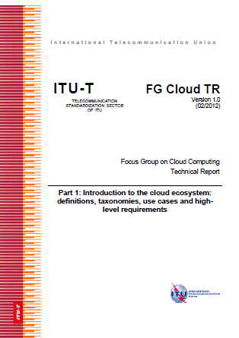
Focus Group Cloud Computing 02/2010 – 12/2011
Objective : Collect and document information and concepts that would be helpful for developing Recommendations to support cloud computing services/applications from a telecommunication/ICT perspective
Introduction to the cloud ecosystem: Definitions, taxonomies, use cases and high-level requirements
Functional requirements and reference architecture
Requirements and framework architecture of cloud infrastructure
Published technical reports
Cloud resource management gap analysis
Cloud security
Overview of SDOs involved in cloud computing
Cloud computing benefits from telecommunication and ICT perspectives

Slide 20
SG 13 Work on CC Study period 2009-2012
1
3 Questions under WP 6/13 : Cloud Computing
(created on February 2012)
Q26/13
Cloud computing ecosystem, inter-cloud and general requirements
Q27/13
Cloud functional architecture, infrastructure and networking
Q28/13
Cloud computing resource management and virtualization

Slide 21
SG 13 Work on CC Study period 2009-2012
2
The main task of WP6/13’s questions was to develop new recommendations on Cloud Computing regarding:
Definition and vocabulary
Ecosystem , use cases & general requirements
Reference Architecture of cloud computing
Infrastructure functional requirements
Resource Management, DaaS & InterCloud
…

Slide 22
SG 13 Work on CC Study period 2013-2016
1
3 Questions under WP 2/13 :
Cloud Computing and Common Capabilities
2009-2012
2013-2016
Q26/13
Q17/13
Cloud computing ecosystem, general requirements, and capabilities
Q27/13
Q18/13
Cloud functional architecture,
Infrastructure and networking
Q28/13
Q19/13
End-to-end Cloud computing service and resource management
Common task: Providing necessary collaboration with external SDOs, consortia and forums working on CC

Slide 23
SG 13 Work on CC Study period 2013-2016
2
Cloud computing and big data high-level requirements, general capabilities
Cloud computing and big data definitions, overview, ecosystem, and use cases
Requirements for interoperability data portability and exchange information in cloud computing and big data
Scope of Q17/13
General and functional requirements for DaaS including functional requirements and reference architecture
Relationship between cloud computing and big data

Slide 24
SG 13 Work on CC Study period 2013-2016
3
Cloud computing functional reference architecture
Cloud computing infrastructure including cloud networking aspects
Scope of Q18/13
Cloud federated identity and access management (if deemed necessary)
Cloud computing security as defined in the Cloud Computing security collaboration between SG13 and SG17
Scope of Q19/13
High level requirements and capabilities for end-to-end cloud computing service management including cloud infrastructure and resource management
24

Slide 25
SG 13 Work on CC Approved Recommendations
4
Y.3500: Cloud computing - Overview and Vocabulary (2014-08)
Y.3501: Cloud computing framework and high-level requirements (2013-05)
Y.3503: Requirements for desktop as a service (2014-05)
Y.3600: Big data – cloud computing based requirements and capabilities (2015-11)
Y.3520: Cloud computing framework for end to end resource management (2013-06:Superseded / 2015-09: in force)
Y.3511: Framework of inter-cloud computing (2014-03)
Y.3512: Cloud computing - Functional requirements of Network as a Service (2014-08)
Y.3513: Cloud computing - Functional requirements of Infrastructure as a Service (2014-08)
Y.3502: Cloud computing - reference architecture (2014-08)
Y.3510: Cloud computing infrastructure requirements (2013-05)

Slide 26
SG13 Work on CC New Work Item for Q5/13
5
Supp-Y.Cloud Computing Scenarios for Developing Countries
Objective : Develop a Supplement /Handbook/Guide on “Scenarios and Requirements in Terms of Services and Deployments for Cloud Computing in Developing Countries”
The Supplement /Handbook/Guide will :
present the situation of CC adoption in developing countries
highlight the current scenarios and the requirements of developing countries in terms of CC services and deployments
2 questionnaires (for CSP and CSC) were elaborated in order to collect input information for the Supplement /Handbook/Guide

Slide 27
ITU-T Work on CC Involvement of Other Study Groups
1
Study Group 2
Joint Rapporteur Group on Cloud Computing Management (JRG-CCM) with SG13 (Created in May-July 2014)
Study Group 11
Q14/11: Cloud Interoperability Testing
Study Group 16
H.248.Cloud: "Gateway control protocol: Cloudification of packet gateways (Draft)
Study Group 17:
Q8/17: Cloud Computing Security

Slide 28
ITU-T Work on CC Joint Coordination Activity for Cloud Computing (JCA-Cloud)
2
Established in January 2012 with SG13 as parent group and concluded in May 2015
Scope :
coordination of the ITU-T cloud computing standardization work within ITU-T
For example: SG2 on telecommunication management, SG5 on ICT and climate change, SG11 on protocols and interoperability, SG12 on QoS and SG17 on security
coordination of the communication with standards development organizations and forums working on Cloud Computing protocols and standards

Slide 29
ITU-T Work on CC Focus Group on Aviation Applications of Cloud Computing for Flight Data Monitoring (FG AC)
3
Established in June 2014 and concluded in February 2016 with the endorsement of 4 Deliverables by TSAG
Objectives :
Explore how ICTs, including CC and big data analytics, can support aviation applications (such as real-time monitoring of flight data)
Identify the requirements for related ICT/telecommunication standards

Slide 30
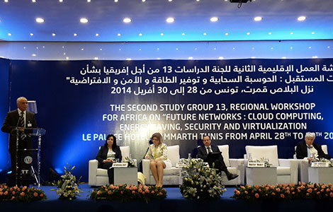
ITU-T Work on CC Some Past Workshops
4
3rd SG13 Regional Workshop for Africa on "ITU-T Standardization Challenges for Developing Countries Working for a Connected Africa", Livingstone, Zambia, 23-24 February 2015
ITU Workshop on "Cloud Computing Standards - Today and the Future”, Geneva, Switzerland, 14 November 2014
2nd SG13 Regional Workshop for Africa on "Future Networks: Cloud Computing, Energy Saving, Security & Virtualization”, Tunis, Tunisia, 28 April 2014
ITU Workshop on “Standardization on IMT, M2M, IoT, Cloud Computing and SDN​”, Algiers, Algeria, 8 September 2013
ITU Workshop on Cloud Computing, Tunis, Tunisia, 18-19 June 2012

Slide 31
PLAN
Why should CC be standardized?
Global Activities on Cloud Computing Standardization
ITU-T activities on Cloud Computing
Conclusion & Recommendations

Slide 32
Conclusion
Cloud Computing, with its interesting characteristics, is offering plenty of opportunities for enterprises, governments and end-users and it is forecasted to achieve higher growth and penetration rates in the next few years
However, Cloud Computing is still facing many challenges that should be addressed in order to accelerate the adoption of CC services worldwide : the solution is Standardization
ITU, as other worldwide SDOs, was interested in the Cloud Computing concept, and that, since 2010 and it is continuing its work on Cloud Computing under the lead of its ITU-T Study Group 13
SG 13 is deploying serious efforts in developing standards that encloses many Cloud Computing-related aspects (definition, ecosystem , general requirements, Reference Architecture, Infrastructure, Resource Management, DaaS,...) and that, in collaboration with other study groups and SDOs

Slide 33
Recommendations
1
1
Awareness regarding the importance of standards in the field of Cloud Computing should be raised as well as awareness regarding the faced challenges
2
Cloud Computing standards should follow the accelerating rhythm of Cloud Computing growth and evolution and that, in order to make it reach its full potential, become universally accepted and implemented and avoid service provider lock-in
3
Cloud computing standardization should be managed to support both innovation and competition, maximize contribution in the standardization process and minimize incompatibility of competing cloud services

Slide 34
Recommendations
1
4
Cloud Computing standardization stakeholders should further collaborate and work together in order to avoid standards fragmentation
5
Standardization should focus on the most important challenges of Cloud Computing (efficiency of service provisioning, effectiveness of service usage and control, information security, data privacy, interoperability, portability between providers, …) which are slowing down the adoption of Cloud Computing in markets around the world
6
Governments need to promulgate legal and regulatory standards to ensure the consistent regulatory environment to concentrate on specific CC issues such as privacy

Slide 35
4th SG13 Regional Workshop for Africa on “Future Networks for a better Africa: IMT-2020, Trust, Cloud Computing and Big Data” (Accra, Ghana, 14-15 March 2016)
Thank you for your Attention
Dr. Rim Belhassine-Cherif Products and Services Executive Director, Tunisie Telecom
SG13 Vice-chair & SG13 RG-AFR Vice-chair
Rim.belhassine-cherif@tunisietelecom.tn

