Slide 1
4th SG13 Regional Workshop for Africa on “Future Networks for a better Africa: IMT-2020, Trust, Cloud Computing and Big Data” (Accra, Ghana, 14-15 March 2016)
Initial Requirements for Africa for IMT 2020
Bugaba Simon Manager Spectrum Monitoring & Utilization
Uganda Communications Commission
Email: stripleb@ucc.co.ug

Slide 2
Agenda
Current Africa’s situation
Current Deployment in Africa
Challenges
General Future Requirements by Africa
Next steps

Slide 3
Current Africa’s situation
I. Resourced by Governments
Most of them are resourced by governments.
PPPs are few but growing
Also Privately owned is growing
II. Have limited reach
Mostly in cities and commercial areas
Rural areas where most people live are still underserved

Slide 4
Current Africa’s situation
III. Technologically inferior
Traditional PSTN still present
2G is predominant
3G and 4G are is growing
Low speeds of Data
Back bone still microwave

Slide 5
Current Africa’s situation
IV. Regional networks
Concept is becoming popular
E.g. Regional submarine projects are growing
V. National Backbone Infrastructure ( NBI)
This is growing in Africa
Majority are IP based
Government has a big stake in most

Slide 6
Deployment of networks in Africa

Slide 7
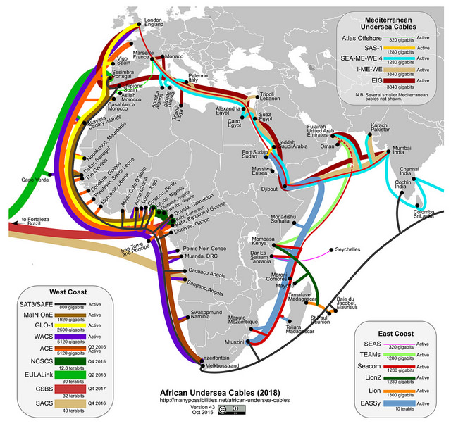
Undersea cable reaching Africa

Slide 8
Challenges of African Networks
Infrastructure
Finances
Consumer Demand
Awareness
Complicated processes
Interconnection
Skilled manpower

Slide 9
Challenges to new networks
I. Challenges of installing new networks
“Old” networks still exist
Investments in “old” networks not yet fully recovered
II. Transitioning/Migrating is hard
Cost
Human capacity
Consumer Awareness

Slide 10
Challenges :Common deficiencies of African networks
Lack of modern technologies in the networks
Lack of sufficient capacities in networks
Lack of coverage beyond big towns and cities
High costs of services
One size “Fits All” types of networks

Slide 11
Africa’s Key Requirements for IMT 2020
Overall low cost to acquire or migrate
High capacity ( IoT, Big Data, Cloud Computing)
Adaptable ( to different users and uses)
Scalable & Incremental installations
Environmental & Climatic Sensitivity
Shared Resources
Backward Compatibility and Interconnectivity ( Network of networks)
The new NBI and FTTH

Slide 12
Africa’s Key Requirements for IMT 2020
Low End- to End latency
Everything to Everybody ( Network, Application support, Switch, storage)
Very high mobility ( even roaming)
Energy Efficiency ( Network & Terminals)
Very high intelligence
Adapt to rural and urban requirements
Security ( Equipment, User, network and country)

Slide 13
Next Steps for Africa for IMT 2020
Stay in step with developments ( ITU Focus Group)
Send requirements and use cases for inclusion
Develop local expertise for IMT 2020
Work together with other ITU members on IMT 2020

