Slide 1
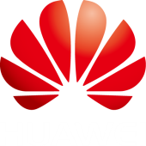
The 5G Wireline Challenge
March 2016
Peter Ashwood-Smith
Chair – FG IMT-2020 Wireline

Slide 2
Agenda
Some wireless 4G basics
5G goals
What is 5G slicing
Potential 5G architecture incorporating multiple cloud concepts
Challenges and futures/ITU-T FG

Slide 3
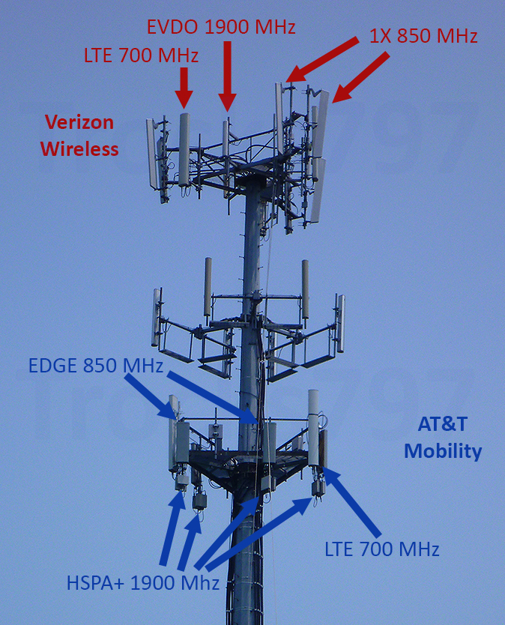
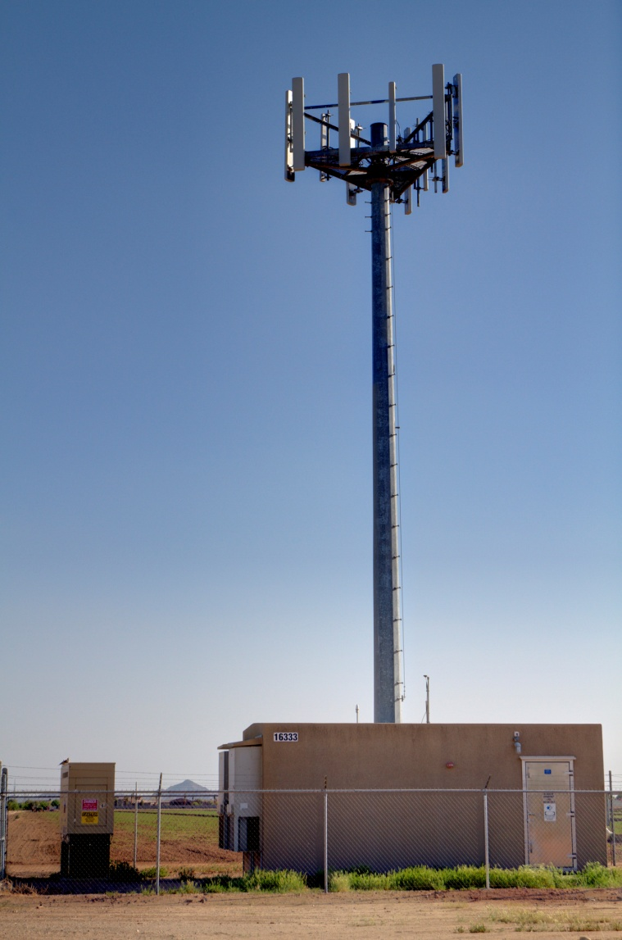
Some current wireless basics – Antenna Site
))))
(I)FFT
Front Haul
CPRI
))))
VZ
))))
Back Haul IP - Packet
AT&T
Different bands =>
Different Antennas
Different Service providers =>
Different Antennas
Analog (or digitally encoded
Analog) signals runs up the mast.
Cooled/Heated enclosure at base of mast for equipment
driving antennas.
IP network delivers packets to / from antenna site.
Devices at base of the mast process packets and generate analog signals to antennas.

Slide 4
Some current wireless basics – Packet Processing(Core)
IP Multimedia Core Sys
))))
IP
Internet
DATA
Fronthaul
SERVING GW
PDN GW
CTRL
MOBILITY MGMT ENTITY
MME
eNODEb
HOME SUBSCRIBER SERVER HSS
Core network is responsible for packet processing and consists of multiple different functions that inter-communicate over IP tunnels over the IP backhaul.
Functions are often run in different dedicated hardware!
Functions are often aware of the radio access interfaces, tightly coupled.
NFV was basically created to consolidate these core functions and lower costs.

Slide 5
A few areas for improvement
))))
SECURITY
))))
01
07
IP Multimedia Core Sys
IP
Fronthaul
Internet
DATA
SERVING GW
PDN GW
02
06
05
03
CTRL
04
MOBILITY MGMT ENTITY
MME
eNODEb
07
HOME SUBSCRIBER SERVER HSS
01
More flexible antennas
Lower bandwidth, longer reach fronthaul reduced energy/cooling costs
Centralized ‘numerology’ / programmable
04
No more custom hardware
Flexible allocations of functions, OPEX reductions
Lower ‘stress’ mobility
02
05
03
06

Slide 6
Cloud can help with many of these issues
NFV was primarily created to address 4G cost/flexibility issues.
NFV essentially brings cloud computing to ‘one’ aspect of wireless networking. The core (i.e. the packet processing).
5G will look at end to end virtualization and what values that can bring.
This includes all the ‘Radio Access Technologies” or RAT.
This imposes new challenges if cloud is to be used to process the RAT.
And then there is the concept of slicing …
Cloud and its related technologies are central to 5G but also impose challenging new requirements.
Notes:
If we look at some of the goals of 5G vs where we are today we an see the gap that has to be bridged over the next few years. The goal of 1ms latency is nearly 50x better than current LTE systems, to get from 100Mbps per user to 10G we need 100x the throughput per connection. The current 10,000 connections per square kilometer needs to increase to 1Million connetions so a 100x increase in density. Reliabile communications today with LTE top out about 350km/h and we expect to bring that up by 1.5x to 500km/h . Finally the current core networks and backhaul/front haul are inflexible with wasted pools of bandwidth. The introduction of SDN/NFV will allow much better ability to chop up and virtualize the network resources for lower operational costs and capital costs and much greater flexibility.

Slide 7
Agenda
Some wireless 4G basics
5G goals
What is 5G slicing
Potential 5G architecture incorporating multiple cloud concepts
Challenges and futures and ITU-T FG.

Slide 8
Diversified Challenges and Gaps to Reach 5G
Network Architecture
Latency
Throughput
Connections
Mobility
5G
1 ms
E2E
Latency
10Gbps
Per
Connection
1,000K
Connections
Per km²
500km/h
High-speed
Railway
Slicing
Ability
Required
GAP
30~50x
100x
100x
1.5x
NFV/SDN
30~50ms
100Mbps
10K
350Km/h
Inflexible
LTE
Challenges because many of these requirements are conflicting
Notes:
If we look at some of the goals of 5G vs where we are today we an see the gap that has to be bridged over the next few years. The goal of 1ms latency is nearly 50x better than current LTE systems, to get from 100Mbps per user to 10G we need 100x the throughput per connection. The current 10,000 connections per square kilometer needs to increase to 1Million connetions so a 100x increase in density. Reliabile communications today with LTE top out about 350km/h and we expect to bring that up by 1.5x to 500km/h . Finally the current core networks and backhaul/front haul are inflexible with wasted pools of bandwidth. The introduction of SDN/NFV will allow much better ability to chop up and virtualize the network resources for lower operational costs and capital costs and much greater flexibility.

Slide 9
Agenda
Some wireless 4G basics
5G goals
What is 5G slicing
Potential 5G architecture incorporating multiple cloud concepts
Challenges and futures and ITU-T FG

Slide 10
What is slicing and why is it useful
Not all devices need the same QOS/QOE from the network
IOT “things” (low B/W) not the same as smart phones (high B/W)
Delay requirements for cars.
Value in ability to create network for short term use.
Emergency/Events
Future proof technique , migration to new technologies
Group similar { speed, capacity, coverage, delay, admin etc } devices into a ‘slice’
FROM DEVICE PERSPECTIVE
Notes:
If we look at some of the goals of 5G vs where we are today we an see the gap that has to be bridged over the next few years. The goal of 1ms latency is nearly 50x better than current LTE systems, to get from 100Mbps per user to 10G we need 100x the throughput per connection. The current 10,000 connections per square kilometer needs to increase to 1Million connetions so a 100x increase in density. Reliabile communications today with LTE top out about 350km/h and we expect to bring that up by 1.5x to 500km/h . Finally the current core networks and backhaul/front haul are inflexible with wasted pools of bandwidth. The introduction of SDN/NFV will allow much better ability to chop up and virtualize the network resources for lower operational costs and capital costs and much greater flexibility.

Slide 11
Agenda
Some wireless 4G basics
5G goals
What is 5G slicing
Potential 5G architecture incorporating multiple cloud concepts
Challenges and futures and ITU-T FG

Slide 12
5G will support many varied Radio Access Technologies (RATs) – “numerology”
Error Correction
Attr - Z
Number of Antennas
Frequencies /bands
Attr - X
Attr - Y
Power
Long Range, High Power Lower Bandwidth
Direction
No signaling, No reservation
SCMA Attributes..
Short Range, High Bandwidth, Signaling/ Reservations
F-OFDM Attributes..
Notes:
We expect to see SDN and Transport SDN play important roles in the integration of the various networks under one orchestration umbrella. T-SDN can be used to control the microwave links between antenna sites, likewise T-SDN can be used to control the metro network where the front-haul and back-haul wire-line is executed. SDN again plays a role managing the network and servers that resides in the data center where the NFV functions and/or C-RAN functions execute.
Various applications/services can reside on top of the 5G orchestration system which provide them with an unprecedented flexibility to operate on the entire 5G network end to end and if suitable hooks are provided into the C-RAN functions and the EPC functions the 5G applications can co-ordinate all the behavior of their slice of a 5G network end to end.

Slide 13
Cloud Radio Access Network (CRAN)
))))
))))
))))
))))
Place expensive equipment in small DC/CLOUD < 20km
Place extremely cheap equipment at antenna site.
Statistical gain from sharing expensive equipment.
Power/cooling at antenna sites decreases (40%).
Operations costs of antenna sites decreases.
Upgrades / differences mostly at CRAN site.
Can more easily coordinate multiple antennas (50% gain).
Notes:
We expect to see SDN and Transport SDN play important roles in the integration of the various networks under one orchestration umbrella. T-SDN can be used to control the microwave links between antenna sites, likewise T-SDN can be used to control the metro network where the front-haul and back-haul wire-line is executed. SDN again plays a role managing the network and servers that resides in the data center where the NFV functions and/or C-RAN functions execute.
Various applications/services can reside on top of the 5G orchestration system which provide them with an unprecedented flexibility to operate on the entire 5G network end to end and if suitable hooks are provided into the C-RAN functions and the EPC functions the 5G applications can co-ordinate all the behavior of their slice of a 5G network end to end.

Slide 14
5G - how much kit at antenna vs CRAN? “the split”
Moderate F/H Bandwidth usage
Extremely flexible, all RAT in CRAN
Low OPEX , most equipment in CRAN
Migration 3G,4G,5G from same CRAN
))))
Analog over fiber
X,Y,Z
High F/H Bandwdith usage
Extremely flexible, all RAT in CRAN
Low OPEX, most equipment in CRAN
Migration T.B.D
))))
Digitized Analog(CPRI)
011011,1001010,101010,1010110,1011
X,Y,Z
Very High F/H Bandwidth usage
Extremely flexible, all RAT in CRAN
OPEX higher, need time of day clocking
Easily switched
))))
Packetized Analog (ROE)
10110
10110
10110
10110
X,Y,Z
Lowest F/H bandwidth usage
Inflexible RAT processing at antenna
OPEX higher, truck rolls
Easily switched
))))
Packetized
X
Y
Z
#
#
#
X,Y,Z
Notes:
We expect to see SDN and Transport SDN play important roles in the integration of the various networks under one orchestration umbrella. T-SDN can be used to control the microwave links between antenna sites, likewise T-SDN can be used to control the metro network where the front-haul and back-haul wire-line is executed. SDN again plays a role managing the network and servers that resides in the data center where the NFV functions and/or C-RAN functions execute.
Various applications/services can reside on top of the 5G orchestration system which provide them with an unprecedented flexibility to operate on the entire 5G network end to end and if suitable hooks are provided into the C-RAN functions and the EPC functions the 5G applications can co-ordinate all the behavior of their slice of a 5G network end to end.

Slide 15
5G concept of an end to end “Slice”
CRAN fabric
CRAN CPU/S/W
RAT Numerology
Back Haul
Core CPU/S/W
Antennas
Fronthaul
U =
+
+
+
+
+
+
Σ
If U is the set of all resource sets { Antennas, Fronthaul , ..} then
Slice S_{i} is a set of resource subsets taken from resource sets { Antenna, Fronthaul }
There are a nearly infinite number of possible slices | S* |
U
U
CRAN fabric
CRAN CPU/MEM
RAT Numerology
Back Haul
Core CPU/MEM
Antennas
Fronthaul
S_{i} =
+
+
+
+
+
+
Σ
1010101
Notes:
We expect to see SDN and Transport SDN play important roles in the integration of the various networks under one orchestration umbrella. T-SDN can be used to control the microwave links between antenna sites, likewise T-SDN can be used to control the metro network where the front-haul and back-haul wire-line is executed. SDN again plays a role managing the network and servers that resides in the data center where the NFV functions and/or C-RAN functions execute.
Various applications/services can reside on top of the 5G orchestration system which provide them with an unprecedented flexibility to operate on the entire 5G network end to end and if suitable hooks are provided into the C-RAN functions and the EPC functions the 5G applications can co-ordinate all the behavior of their slice of a 5G network end to end.

Slide 16
Resource Movement Slice to Slice
CRAN fabric
CRAN CPU/MEM
RAT Numerology
Back Haul
Core CPU/MEM
Antennas
Fronthaul
S_{i} =
+
+
+
+
+
+
Σ
1010101
S_{j} =
+
+
+
+
+
+
Σ
1010101
Resources can be moved from a resource set in one slice S_{i} to the corresponding resource set in slice S_{j}. This should be hit-less.
Notes:
We expect to see SDN and Transport SDN play important roles in the integration of the various networks under one orchestration umbrella. T-SDN can be used to control the microwave links between antenna sites, likewise T-SDN can be used to control the metro network where the front-haul and back-haul wire-line is executed. SDN again plays a role managing the network and servers that resides in the data center where the NFV functions and/or C-RAN functions execute.
Various applications/services can reside on top of the 5G orchestration system which provide them with an unprecedented flexibility to operate on the entire 5G network end to end and if suitable hooks are provided into the C-RAN functions and the EPC functions the 5G applications can co-ordinate all the behavior of their slice of a 5G network end to end.

Slide 17
5G will support software defined Front / Back haul.
))))
))))
))))
))))
))))
))))
CRAN
CRAN
TSDN CONTROLLED Packet/Optical
PATH, B/W, QOS, Wavelengths,
Time Slots, Labels,
Protection, etc.
Mm-wave/uWave
))))
))))
))))
))))
))))
))))
))))
))))
))))
CRAN
CRAN
Notes:
We expect to see SDN and Transport SDN play important roles in the integration of the various networks under one orchestration umbrella. T-SDN can be used to control the microwave links between antenna sites, likewise T-SDN can be used to control the metro network where the front-haul and back-haul wire-line is executed. SDN again plays a role managing the network and servers that resides in the data center where the NFV functions and/or C-RAN functions execute.
Various applications/services can reside on top of the 5G orchestration system which provide them with an unprecedented flexibility to operate on the entire 5G network end to end and if suitable hooks are provided into the C-RAN functions and the EPC functions the 5G applications can co-ordinate all the behavior of their slice of a 5G network end to end.

Slide 18
5G will likely use SDN controlled fabrics within the C-RAN/DC
TSDN CONTROLLED XHAUL
Switch
Switch
Switch
SDN CONTROLLED FABRIC – CONNECTIVITY QOS, PATHS, REDUNDENCY CHAINING, ENCAPSULATIONS
Notes:
We expect to see SDN and Transport SDN play important roles in the integration of the various networks under one orchestration umbrella. T-SDN can be used to control the microwave links between antenna sites, likewise T-SDN can be used to control the metro network where the front-haul and back-haul wire-line is executed. SDN again plays a role managing the network and servers that resides in the data center where the NFV functions and/or C-RAN functions execute.
Various applications/services can reside on top of the 5G orchestration system which provide them with an unprecedented flexibility to operate on the entire 5G network end to end and if suitable hooks are provided into the C-RAN functions and the EPC functions the 5G applications can co-ordinate all the behavior of their slice of a 5G network end to end.

Slide 19
5G will likely use Orchestrated NFV for processing within C-RAN/DC etc.
TSDN CONTROLLED XHAUL
ORCHESTRATION SOFTWARE TO ALLOCATE VMs, CPUs, Memory, FPGAs Containers/Processes, Grouping, Affinity, Scheduling, Recovery..
Switch
Switch
Switch
CORE/METAL
VM
CONTAINER
CONTAINER
CONTAINER
CORE/METAL
VM
Lockable Caches
VM
FPGA/Custom
Notes:
We expect to see SDN and Transport SDN play important roles in the integration of the various networks under one orchestration umbrella. T-SDN can be used to control the microwave links between antenna sites, likewise T-SDN can be used to control the metro network where the front-haul and back-haul wire-line is executed. SDN again plays a role managing the network and servers that resides in the data center where the NFV functions and/or C-RAN functions execute.
Various applications/services can reside on top of the 5G orchestration system which provide them with an unprecedented flexibility to operate on the entire 5G network end to end and if suitable hooks are provided into the C-RAN functions and the EPC functions the 5G applications can co-ordinate all the behavior of their slice of a 5G network end to end.

Slide 20
All the packet processing functions vCore are software controllable.
Switch
Packet Processing functions can be split between DC/C-RANs and re-arranged as needed. Different slices can have different configurations and totally different processing:
F1->F4->F5
F2->F6
F3->F7->F8->F9
C-RAN PODS
F5
Switch
Switch
F6
F9
DC POD
F1
F4
F2
F3
F7
F8
Notes:
We expect to see SDN and Transport SDN play important roles in the integration of the various networks under one orchestration umbrella. T-SDN can be used to control the microwave links between antenna sites, likewise T-SDN can be used to control the metro network where the front-haul and back-haul wire-line is executed. SDN again plays a role managing the network and servers that resides in the data center where the NFV functions and/or C-RAN functions execute.
Various applications/services can reside on top of the 5G orchestration system which provide them with an unprecedented flexibility to operate on the entire 5G network end to end and if suitable hooks are provided into the C-RAN functions and the EPC functions the 5G applications can co-ordinate all the behavior of their slice of a 5G network end to end.

Slide 21
Slicing – Software control of all attributes including UE
INTER C-RAN/DC (to CORE/vEPC)
CONTROLLERS
))))
CRANs – runs RAT, CORE and, MEC
Any server/core, any function!
Digital Radio
400 GE
Red Slice – Ultra
Reliable, Low B/W, long range, 400km/hr
DWDM
RAT / CN
RAT/ CN
))))
CN / MEC
))))
Analog or Digital or
Packet Radio
RAT
Yellow Slice – Highest B/W, short range
CN/MEC
RAT/ CN
Blue Slice – Lowest Delay, Low signaling
RAT/MEC
Idle/off
DWDM
Idle resources can be moved from Slice to Slice.
Any resource can be part of any slice.
Dynamic adjustment. Resources include servers, intra/inter C-RAN B/W, C-RAN to Antenna B/W
And UE device antennas/radio components.
Slice UE
Resources OS/Antennas etc.
Any antenna, any server (within delay).
TSDN Hybrid Slice Front Haul IDC Backhaul o DWDM
Notes:
We expect to see SDN and Transport SDN play important roles in the integration of the various networks under one orchestration umbrella. T-SDN can be used to control the microwave links between antenna sites, likewise T-SDN can be used to control the metro network where the front-haul and back-haul wire-line is executed. SDN again plays a role managing the network and servers that resides in the data center where the NFV functions and/or C-RAN functions execute.
Various applications/services can reside on top of the 5G orchestration system which provide them with an unprecedented flexibility to operate on the entire 5G network end to end and if suitable hooks are provided into the C-RAN functions and the EPC functions the 5G applications can co-ordinate all the behavior of their slice of a 5G network end to end.

Slide 22
Slicing – Controller Hierarchy
C-RAN INSTANCE SLICE CONTROLLER
METRO N/W CONTROLLER
MASTER SLICE CONTROLLER
C-RAN INSTANCE SLICE CONTROLLER
C-RAN INSTANCE SLICE CONTROLLER
UE SLICE CTRL
FH SLICE CTRL
IDC SLICE CTRL
DC FABRIC CTRL
DC SERVER CTRL
UE SLICE CTRL
FH SLICE CTRL
IDC SLICE CTRL
DC FABRIC CTRL
DC SERVER
CTRL
DC CONTROLLER
))))
))))
CN
CN
400 GE
CN
CN
DWDM
RAT / CN
CN
CN
DWDM
400 GE
RAT/ CN
CN
CN
RAT / CN
))))
CN / MEC
CN
RAT/ CN
))))
RAT
CN
CN
))))
CN / MEC
CN/MEC
CN
))))
RAT
RAT/ CN
Idle/off
DC POD
CN/MEC
Idle/off
RAT/MEC
DC POD
RAT/ CN
Idle/off
RAT/MEC
DWDM
VX-LAN o IP o
Idle/off
DWDM
Segment Routing (SR) or Custom via POF/PIF
Analog
Analog
Notes:
We expect to see SDN and Transport SDN play important roles in the integration of the various networks under one orchestration umbrella. T-SDN can be used to control the microwave links between antenna sites, likewise T-SDN can be used to control the metro network where the front-haul and back-haul wire-line is executed. SDN again plays a role managing the network and servers that resides in the data center where the NFV functions and/or C-RAN functions execute.
Various applications/services can reside on top of the 5G orchestration system which provide them with an unprecedented flexibility to operate on the entire 5G network end to end and if suitable hooks are provided into the C-RAN functions and the EPC functions the 5G applications can co-ordinate all the behavior of their slice of a 5G network end to end.

Slide 23
Mobile Edge Computing
UE SLICE CTRL
FH SLICE CTRL
IDC SLICE CTRL
DC FABRIC CTRL
DC SERVER CTRL
UE SLICE CTRL
FH SLICE CTRL
IDC SLICE CTRL
DC FABRIC CTRL
DC SERVER
CTRL
DC CONTROLLER
))))
))))
DWDM
400 GE
RAT / CN
400 GE
RAT/ CN
DWDM
RAT / CN
))))
CN / MEC
RAT/ CN
))))
RAT
))))
CN / MEC
CN/MEC
))))
RAT
RAT/ CN
CN/MEC
RAT/MEC
RAT/ CN
Idle/off
RAT/MEC
DWDM
Idle/off
DWDM
+
CN
CN
CN
CN
CN
CN
CN
CN
CN
CN
Resources in DC’s extended into CRAN for general purpose use.
Brings compute/data close to user.
I.e. within about 20km.
How to decide trade-offs between RAT/CORE in CRAN v.s. MEC in CRAN?
CN
CN
Idle/off
Idle/off
DC POD
DC POD
Notes:
We expect to see SDN and Transport SDN play important roles in the integration of the various networks under one orchestration umbrella. T-SDN can be used to control the microwave links between antenna sites, likewise T-SDN can be used to control the metro network where the front-haul and back-haul wire-line is executed. SDN again plays a role managing the network and servers that resides in the data center where the NFV functions and/or C-RAN functions execute.
Various applications/services can reside on top of the 5G orchestration system which provide them with an unprecedented flexibility to operate on the entire 5G network end to end and if suitable hooks are provided into the C-RAN functions and the EPC functions the 5G applications can co-ordinate all the behavior of their slice of a 5G network end to end.

Slide 24
Agenda
Background - some 4G basics.
Some wireless basics and their problems
5G goals
What is 5G slicing
Potential 5G architecture incorporating multiple cloud concepts
Challenges / futures / ITU-T FG

Slide 25
Challenges Ahead – Many Cloud related.
SDN API’s for each component of the slice
Hierarchical controllers for each cloud
Hierarchical OA&M above the slices
OA&M within a slice
Resource optimization from slice to slice (hitless)
Fronthaul slicing/switching
Ultra High performance NFV for CRAN (FPGA virt.)
Low delay NFV for core
New Cores (possibly non IP for IOT).
MEC control/trade-offs intra/inter slice
Performance/Reliability etc.
Security (everywhere)
Notes:
If we look at some of the goals of 5G vs where we are today we an see the gap that has to be bridged over the next few years. The goal of 1ms latency is nearly 50x better than current LTE systems, to get from 100Mbps per user to 10G we need 100x the throughput per connection. The current 10,000 connections per square kilometer needs to increase to 1Million connetions so a 100x increase in density. Reliabile communications today with LTE top out about 350km/h and we expect to bring that up by 1.5x to 500km/h . Finally the current core networks and backhaul/front haul are inflexible with wasted pools of bandwidth. The introduction of SDN/NFV will allow much better ability to chop up and virtualize the network resources for lower operational costs and capital costs and much greater flexibility.

Slide 26
ITU-T 5G wireline FG-IMT-2020 Phase I (2H15) Summary
ITU Focus Group to study the requirements and standardization needs of the wireline in support of 5G (non Radio)
Huawei chair (Peter Ashwood-Smith) in May 2015
Vice chairs CMCC(Y.Wantg), ETRI(N.Ko), NTT (Y.Goto), Telecom Italia (L.Pesando)
Parent Group SG-13
Completely Free format to explore ‘gaps’ required to support the 5G vision (IMT.VISION)
Parallel work in 5 main areas to minimize overlap with other 5G SDO’s:
High level network architecture, championed by Dr Namseok Ko, ETRI, Korea;
Network softwarization, championed by Prof Akihiro Nakao, University of Tokyo, Japan;
End-to-end quality of service, championed by Dongwook Kim, ex KT Corporation; Olivia Heeyun Choi, KT Corporation;
Front haul / back haul, championed by Dr Frank Effenberger, Huawei Technologies; Dr Gyaneshwar C. Gupta, Oki Electric Industry Co., Ltd.
Emerging networking technologies - information centric networking (ICN), championed by Dr Paul Polakos, Cisco Systems; Dr Marc Mosko, PARC.
Led production of final document with 85 identified gaps in XX areas and delivery to SG-13 in December 2015.
Meeting | San Diego (8-9 June 2015) | Geneva (13-14 July 2015) | Turin (21-24 September 2015) | Beijing (27-30 October 2015)
Input docs | 34 | 26 | 34 | 27
Output docs | 1 | 7 | 6 | 2
Meeting report | O-001 | O-002 | O-009 | O-015
Remote participants | 18 | 30 | 22 | 11
Total participants | 60 | 75 | 55 | 63
+ multiple conference
Calls, Work Shops etc.

Slide 27
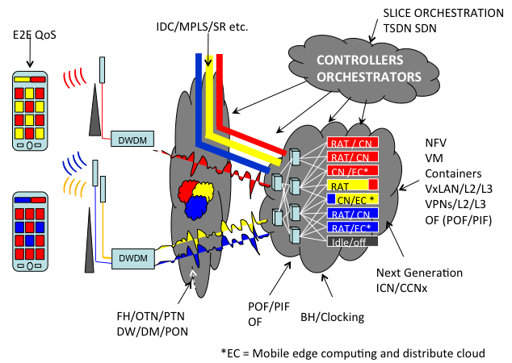
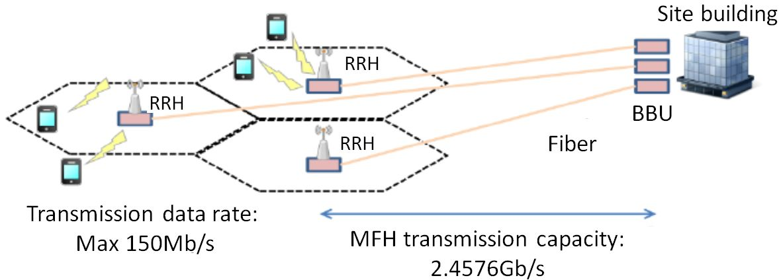
Output Document Structure: Executive Summary + Gaps + Supplemental info
A.17 OAM protocols | Priority: High
Description: OAM protocols are not standardized in some parts of IMT networks such as the front haul network. Standard OAM protocols should be studied for fault management and performance management between network equipment that may be commonly used across the IMT-2020 network.
Related work:
A.18 End-to-end network management in a multi-domain environment | Priority: High
Description: Multiple network management protocols in different network domains make it difficult to support unified network operations over multiple network domains. A unified end-to-end network management should be considered to ensure compatibility and flexibility for the operation and management of an IMT-2020 network.
Related work: SG13
A.19 Mobility management for distributed flat network | Priority: High
Description: As the IMT-2020 core network is envisioned to be a flat distributed network, which is composed of the multiple distributed gateways to cope with traffic explosion and latency requirements of applications, mobility management should be studied aligning with those architectural changes.
Related work: 3GPP, SG13

Slide 28
ITU-T 5G wireline FG-IMT-2020 Phase II (2016)
Renewed end of 2015 for all of 2016 (Ashwood-Smith chair), Vice Chairs mostly same with substitution within NTT.
New Terms of Reference as follows:
Demonstrations or prototyping with other groups (e.g., with open source community);
Network softwarization and ICN;
Network architecture refinement;
Fixed mobile convergence;
Network slicing for front haul/back haul;
New traffic models and associated QoS and OAM aspects applicable to IMT-2020 architecture.
Slower pace - Four meetings in 2016 – First is March in Seoul.
Outputs A: Several draft recommendations close to final ready to be progressed by ITU in 2017.
Outputs B: Proof of concept of softwarization, possibly joint open source orchestrator.
Other suggestions welcome ... We can do quite a bit with this FG in 2016

Slide 29
Thank You

